Slide 1
Brain Tumor Detection from MRI Images

Slide 2
Contents
01.
Team
03.
Brain Tumor Detection
02.
Introduction
04.
UI Design
05.
Conclusion

Slide 3
Team
1.Vaishnavi Sarikonda
2.Vytla Mounica
3.Gaddam Thanmayee Reddy
4.Arnepalli Yasaswi

Slide 4
Introduction
Brain tumor is a collection of mass of abnormal cells growth of these cells in a restricted space such as brain is life threatening.
Brain tumors can be of two types cancerous (malignant) or non-cancerous (benign)
These can not be diagnosed early as they don’t show much noticeable symptoms.
The most promising method of detecting a brain tumor is MRI scans of the brain

Slide 5
Brain Tumor Detector
Our solution is to detect brain tumor using the data of MRI scans of other patients.
The model uses CNN algorithm to classify features of tumor and thereby recognise presence of tumor when shown an MRI scan.
This is helpful when the patient/Doctor requires a second opinion or when at unavailability of experts.

Slide 6
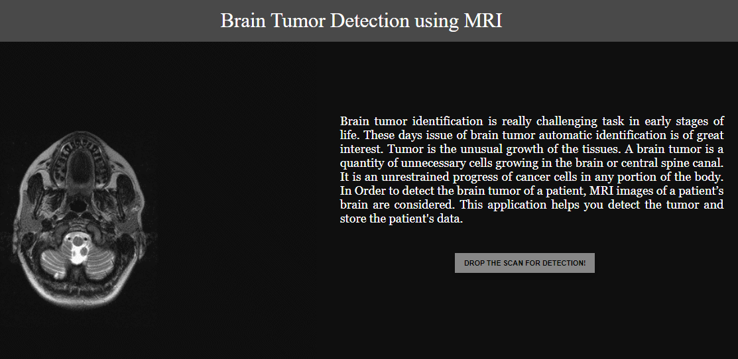
Front page of the web
application

Slide 7
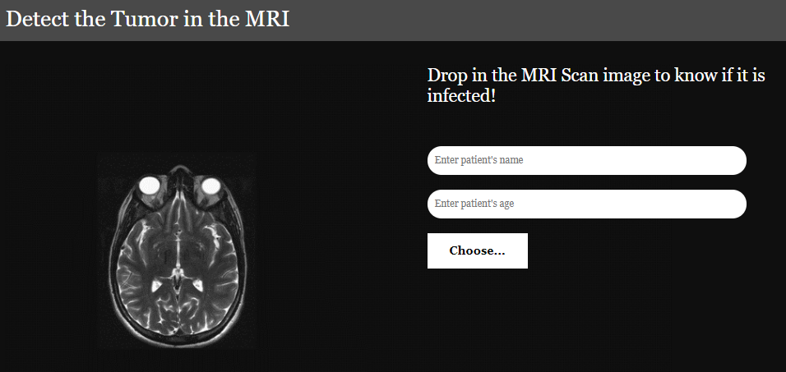
Clicking on “Drop The Scan for Detection” takes you to Patient Details and Tumor Detector section

Slide 8
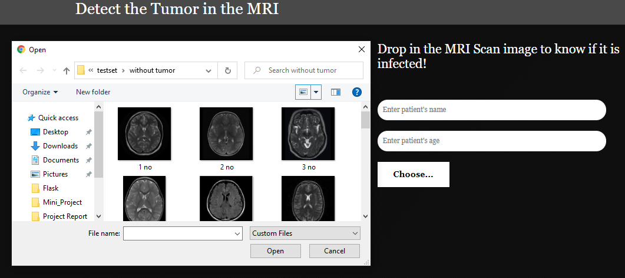
Click on upload to select MRI scan images

Slide 9
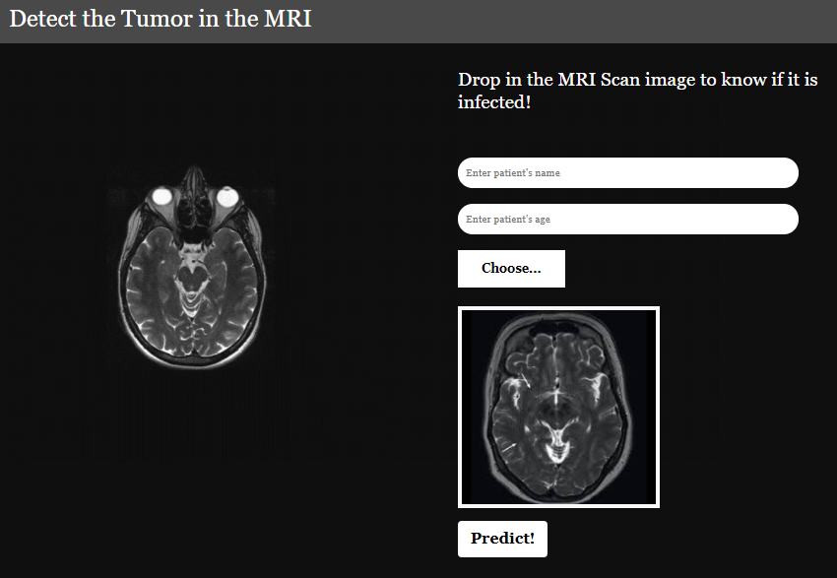
After uploading preview of selected file is displayed

Slide 10
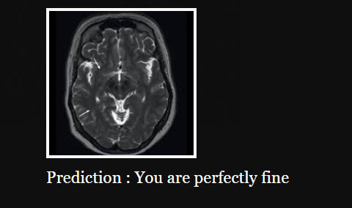
Clicking on Predict will give the result

Slide 11
Conclusion
Convolutional neural networks (CNNs) have accomplished astonishing achievements across a variety of domains, including medical research, and an increasing interest has emerged in radiology. Although deep learning has become a dominant method in a variety of complex tasks such as image classification and object detection, it is not a panacea. Being familiar with key concepts and advantages of CNN as well as limitations of deep learning is essential in order to leverage it in radiology research with the goal of improving radiologist performance and, eventually, patient will be taken care.

Slide 12

Thanks!

