Slide 1

FEVER DIAGNOSIS AND MEDICINE DATASET
An Exploratory Data Analysis of Patient Records
Presented by
Vaishnavi G M

Slide 2
Project Overview
This project analyzes a Fever Diagnosis and Medicine Dataset containing patient health records.
The dataset includes information about age, gender, BMI, symptoms, fever severity, previous medication, and recommended medication.
The analysis aims to understand patterns in fever symptoms and patient characteristics.
Data analysis techniques are used to clean, explore, and visualize the patient data.

Slide 3
Dataset Overview
Dataset collected from Kaggle
A quick look at the key details of the Fever Diagnosis and Medicine Dataset
Dataset
Fever Diagonosis and Medicine Dataset
Records
1,000
Patient Records
Variables
20
Columns
Main Information
Data types
Domain
Fever symptoms , patients,
characteristics, lifestyle,
health factors and medication
Numerical + Categorical
Healthcare
The dataset contains patient-level health information that can be explored to
Identify Patterns related to fever severity, symptoms and medication.

Slide 4
Data Preparation & Cleaning
The dataset was checked ,cleaned and structured for better analysis
01
Check missing values
Identified missing values and handled them.
02
Check Data types
Verified numerical and categorical columns using df.dtypes.
03
Handle missing Values
Filled missing categorical values using
the mode.
04
Create Derived Columnn
Created Age Group from the Age column
to categorize patients.
.

Slide 5
Exploratory Data Analysis
Understanding patient characteristics and fever-related patterns.
Fever severity
Relationships
Age & Temperature
Distribution of Normal,
Mild Fever and High Fever was analysed.
Groupby, Pivot Table and
Correlation were used to
Understand relationships
Between variables.
Patients were grouped
By Age and Temperature
to identify patterns.
Goal : Identify important patterns in patient health data.

Slide 6
Data Analysis
Key findings from the fever dataset
Univariate Analysis
Analyzed one variable at a time
Used value counts and summary statistics
Example: Age Group, Gender, Fever Severity, Temperature
Bivariate Analysis
Analyzed two variables together
Used groupby and comparisons
Example: Temperature vs Fever Severity, BMI vs Diet Type
Multivariate Analysis
Analyzed three or more variables together
Used correlation analysis
Example: Age, BMI, Temperature, Humidity, AQI and Heart Rate

Slide 7
Visualization
1.Correlation Heatmap
2. Fever Severity Distribution
3. Temperature Distribution
4. Age Group Distribution
5. Recommended Medicine Distribution
6. Temperature Category Distribution
7. Gender Distribution
8. Temperature by Fever Severity
9. Allergies vs Fever Severity
10. Temperature Distribution by Age Group
11. BMI Distribution by Diet Type
12. Heart Rate Distribution
13. Humidity vs Temperature
14. BMI Distribution by Age Group
15. AQI Distribution
16. Age vs BMI by Fever Severity

Slide 8
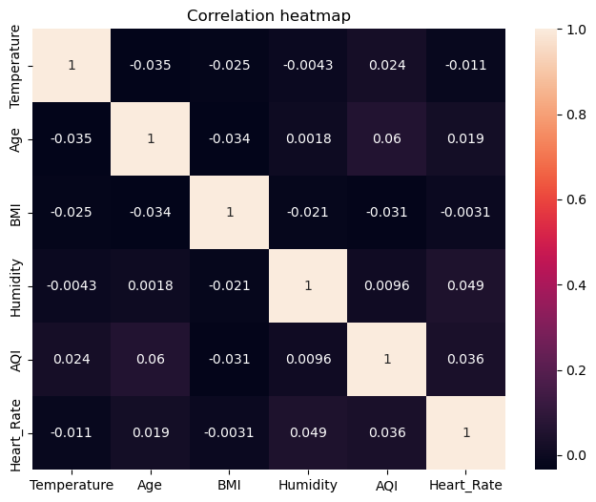
Correlation heatmap
The correlation analysis shows that the numerical variables have mostly weak relationships with each other. The highest positive correlation is between Age and AQI (0.060), while Humidity and Heart Rate also show a very weak positive correlation (0.049). Overall, no strong linear relationship is observed among the numerical variables.

Slide 9
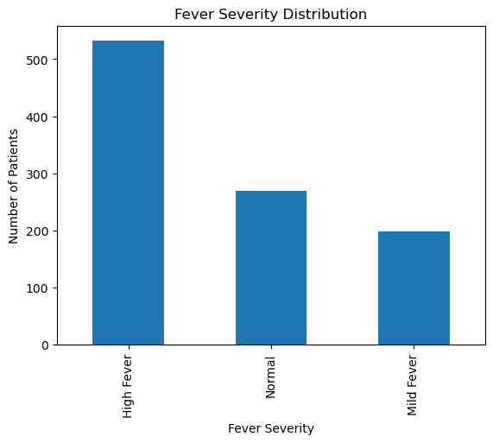
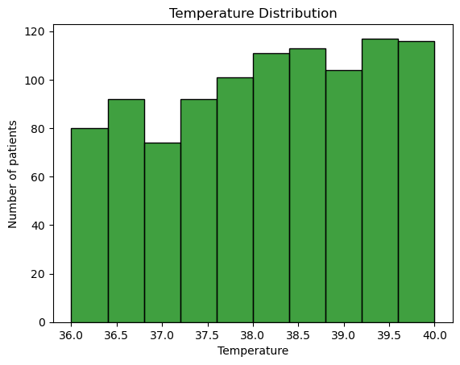
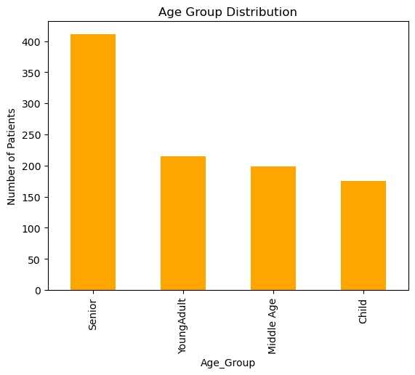
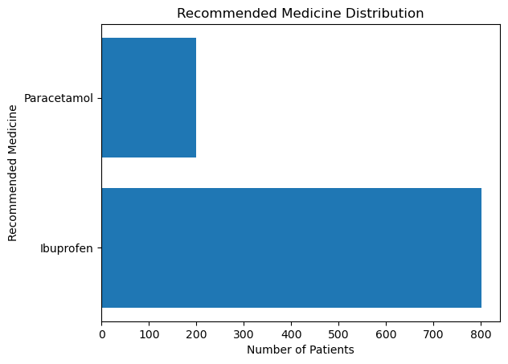
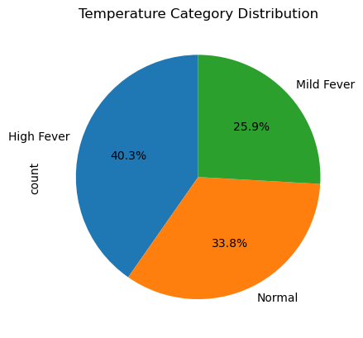
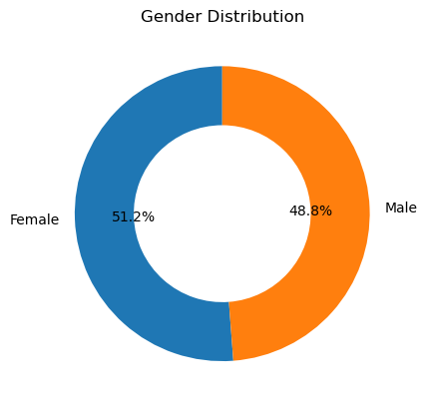

Slide 10
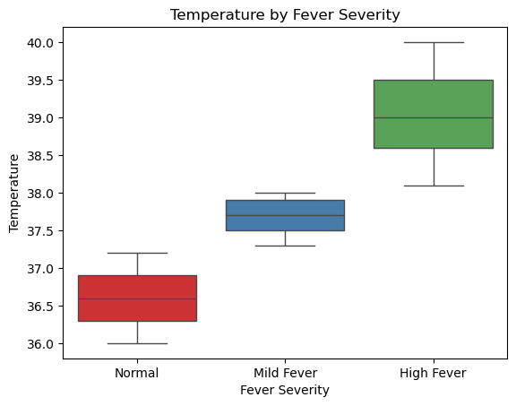
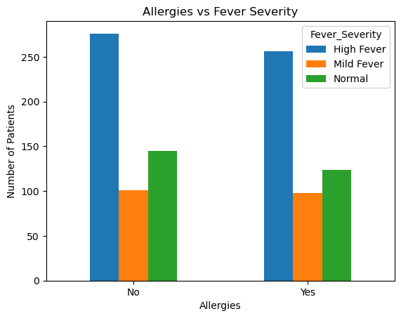
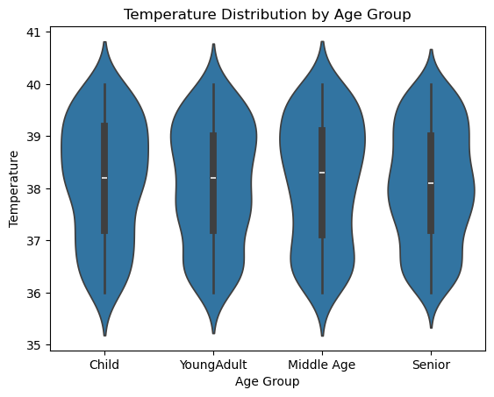
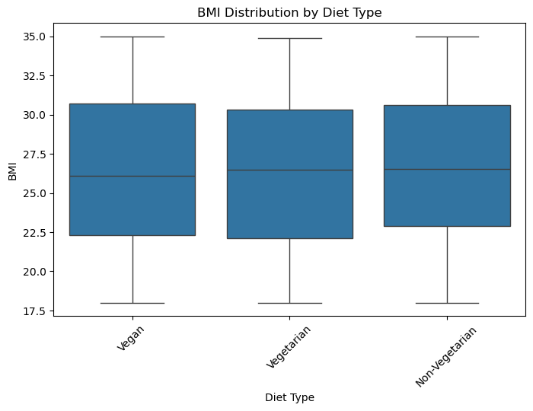
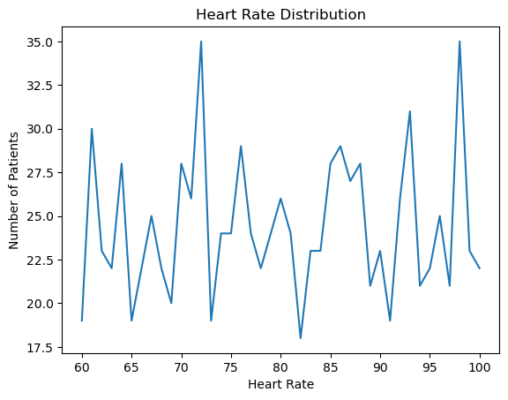
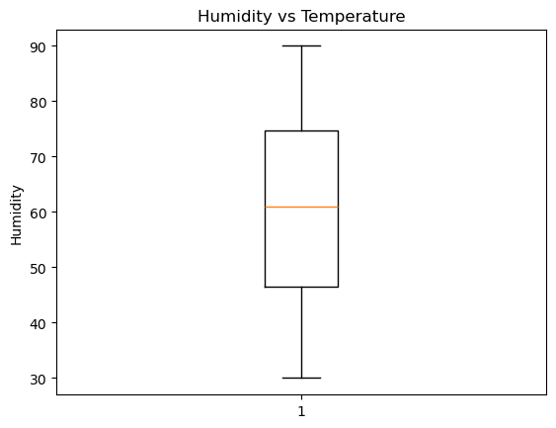

Slide 11
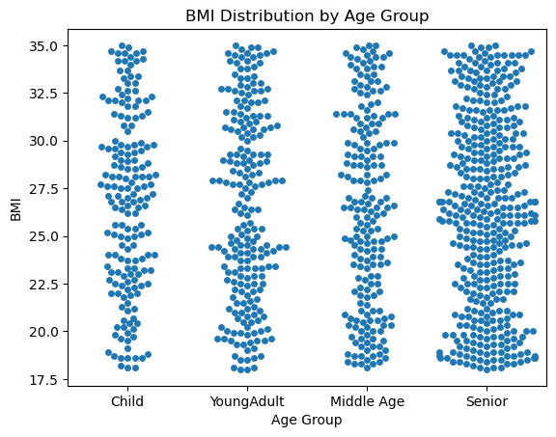
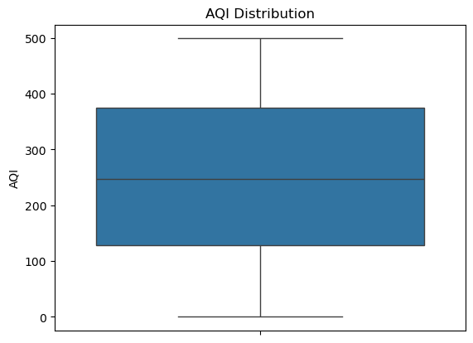
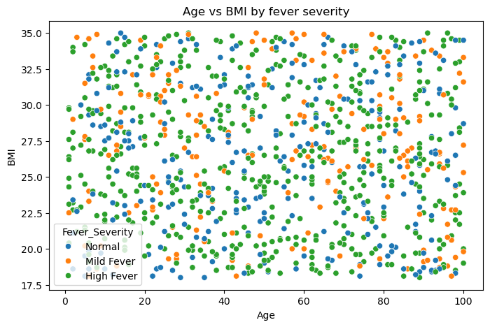

Slide 12
Key Findings
Senior age group had the highest number of patients.
High Fever had the lowest number of patients among fever severity categories.
High Fever was the most common temperature category.
Female patients were slightly higher than male patients.
Ibuprofen was the most frequently recommended medicine.
Most numerical variables showed weak correlations with each other.
Temperature showed differences across fever severity groups.

Slide 13
CONCLUSION
The analysis provided meaningful insights into the Fever Diagnosis and Medicine dataset. High Fever was the most common fever-severity category, and Ibuprofen was the most frequently recommended medicine. The analysis also explored patient characteristics, diet, allergies, BMI, heart rate, and environmental factors to identify important patterns and relationships. Overall, this project demonstrates how data analysis and visualization can transform healthcare data into meaningful and understandable insights.

Slide 14
THANK YOU

