Slide 1

KADIYALA VAISHNAVI AP22110010125 SRM UNIVERSITY AP 2022-2026
PORTFOLIO WEBSITE

Slide 2
PROJECT TITLE / PROJECT STATEMENT:
TITLE:
PORTFOLIO SITE CREATION USING HTML,CSS,JAVASCRICPT
STATEMENT:
In the past, when we applied for jobs, we had to carry hard copies of our resumes and all necessary documents.
Nowadays, we can create a portfolio website that includes all our essential details. Sharing this portfolio link is much more professional and convenient.

Slide 3
AGENDA:
Introduction to the Project:
This section introduces the project's background, objectives, and relevance, providing context for its development and implementation.
Project Components and Methodology:
It outlines the project's key features, functionalities, and the approach taken in its execution, highlighting the tools and methods used.
Project Idea and Innovation:
This part explains the core concept and innovative aspects of the project, showcasing its unique contributions to the field or problem it addresses

Slide 4
PROJECT OVERVIEW:
The goal of this project is to create an interactive portfolio website using HTML, CSS, and JavaScript. The portfolio site will showcase my skills, projects, and experience in an engaging manner.
Develop a responsive and mobile-friendly portfolio site with smooth scrolling and animations.
Incorporate personal branding elements and interactive project showcases to provide a unique and memorable user experience.

Slide 5
END USERS:
Potential Clients: Individuals or businesses seeking web development services. They visit developer portfolios to assess skills and previous work. For example, a small business owner looking for a website might check a developer's portfolio to see if their style matches the business needs.
Potential Employers: Companies evaluating a developer's capabilities for employment. They review portfolios to gauge skills and experience. For instance, a tech company may examine a developer's portfolio to determine if they have the necessary skills for a software development position.

Slide 6
SOLUTION AND VALUE PROPOSITION:
Responsive and mobile-friendly design using CSS.
Smooth scrolling and animations using JavaScript.
Interactive project showcases with details and live demos.
Engaging about me section with a personal touch.
Easy-to-navigate menu and intuitive user experience.

Slide 7
CUSTOMIZATION:
Designed a custom color scheme and branding elements.
Included personal touches and anecdotes in the content.
Incorporated my own illustrations and graphics.
Tailored the project showcases to highlight my specific strengths and achievements.

Slide 8
MODELING:
Table Concept: Portfolio site structured with a table-based layout for organized information presentation.
Flux Layout: Responsive and mobile-friendly design using a flux layout approach for adapting to various screen sizes.
Links and Documents: Include links to GitHub, LinkedIn, and relevant documents/resources.
Techniques Used: HTML for structure, CSS for styling, JavaScript for interactive features like smooth scrolling and animation.

Slide 9
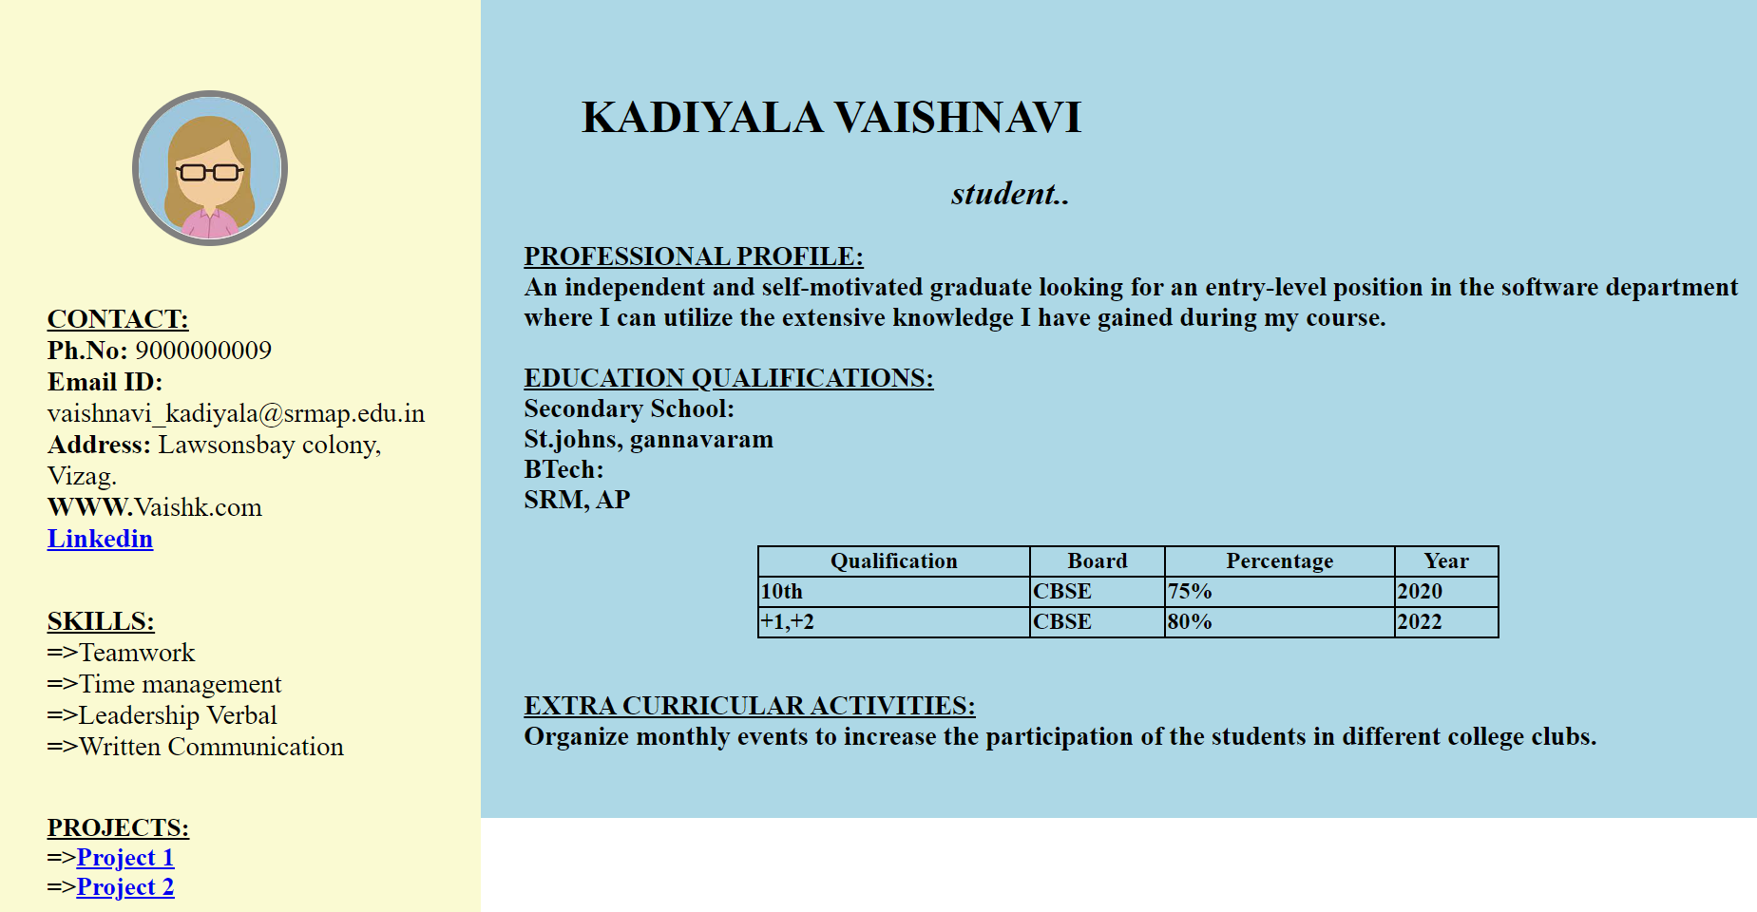
RESULTS AND LINKS:
RESULT :
GITHUB LINK :

