Slide 1
IBM Hack Challenge 2020
Optimized Warehouse Management of Perishable Goods for a Food Delivery Company

Slide 2
Team Name: DVMS
Team Members:
Deeksha Patkar
Vaishnavi Daber
Meghana Athanikar
Shreya Chauhan
Team Lead: Vaishnavi Daber
Contact: 7506478496 Email: 2017.vaishnavi.daber@ves.ac.in
Project Id: SPS_PRO_893
Application Id: SPS_CH_APL_20200006689

Slide 3
Contents
Basic Description
Technologies & Tools
Model Building
Data Visualization
UI Building
Difficulties Faced
Scope of Improvement
Conclusion

Slide 4
Basic Description
The warehouse management system of perishable goods for a food delivery company is an inventory management system. It uses demand forecasting to fetch results. Inventory management is the oversight of ordering, storing, and use of finished products for sale, as well as raw materials for the products.
For a food delivery company, both meals and ingredients for the meal are inventory. It often becomes necessary to ensure that there are sufficient raw materials from outside vendors to satisfy customer demands without any delays. While not having too much in hand that raw materials primarily the perishable ones spoil or go in waste.

Slide 5

Technologies & Tools
Model Building | UI Building
IBM Watson Studio- Machine Learning IBM Cloudant IBM Watson Assistant | IBM Node-Red Application
Algorithm

Slide 6
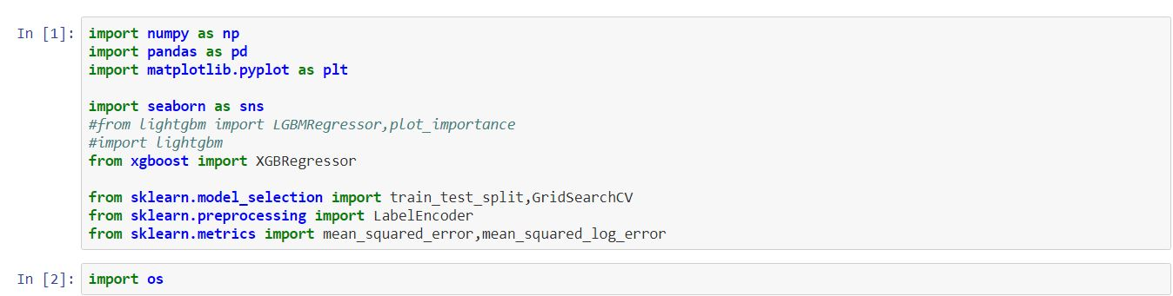
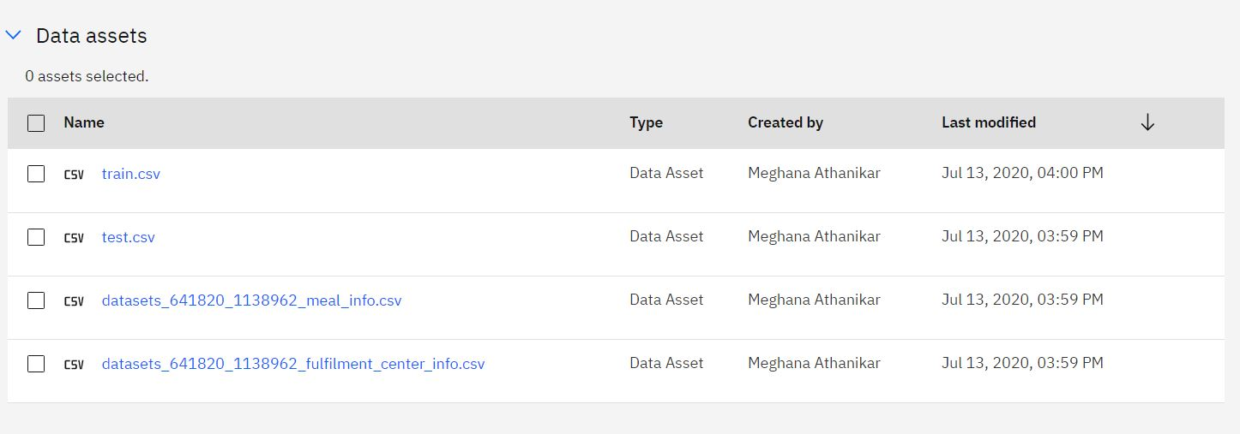
Import Datasets

Slide 7
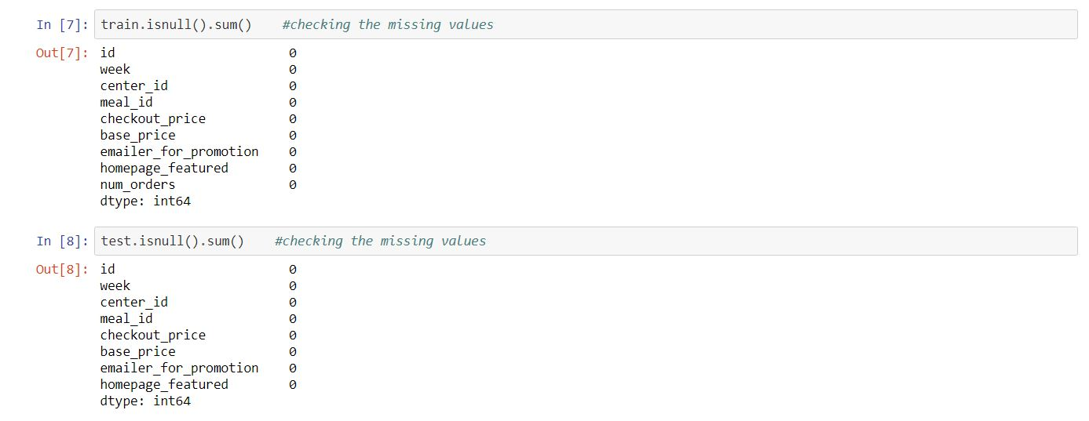
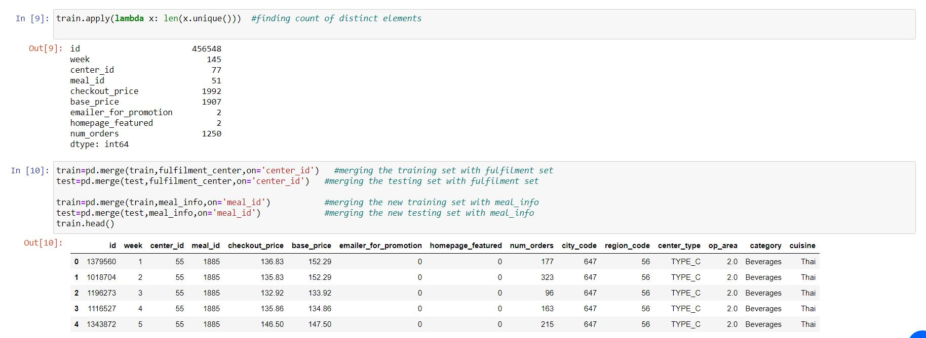
Check missing values
Merge Data

Slide 8
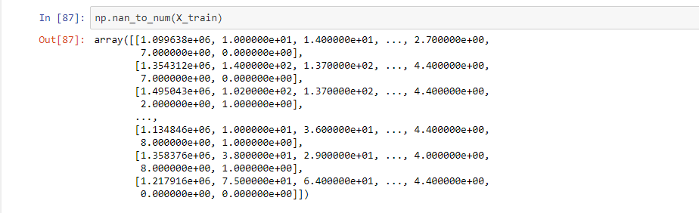
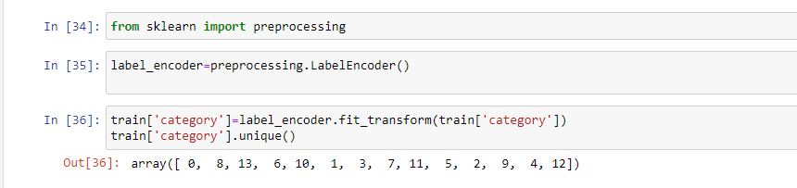
Converting the missing values
Label Encoding

Slide 9
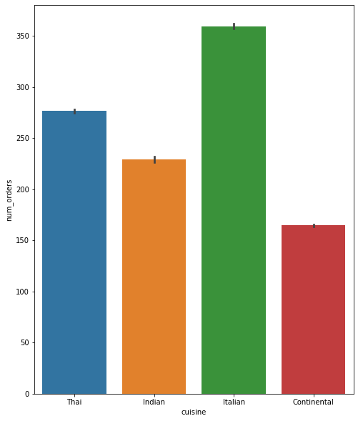
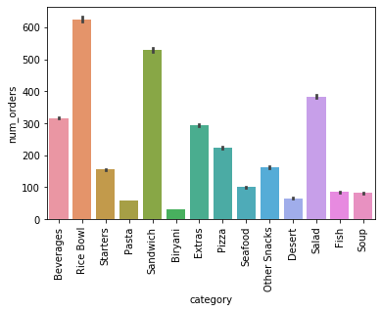
Data Visualization

Slide 10
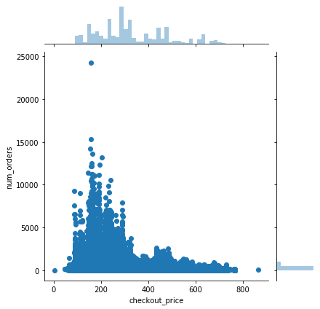
Checkout Price

Slide 11
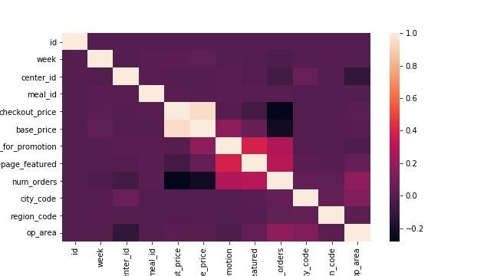
Correlation- Heat map

Slide 12
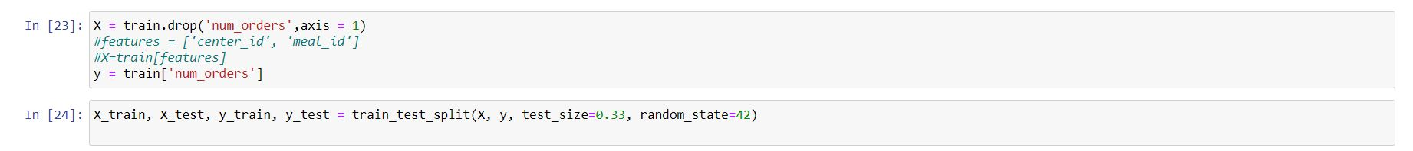
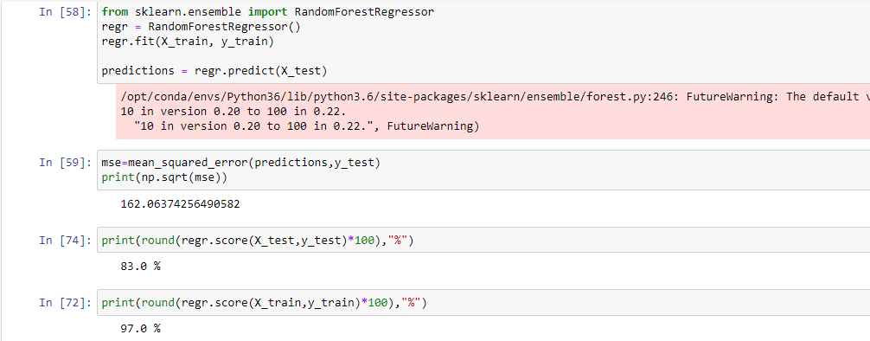
Split Data into Train and Test Model
Fit Model

Slide 13
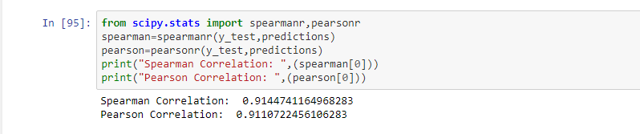
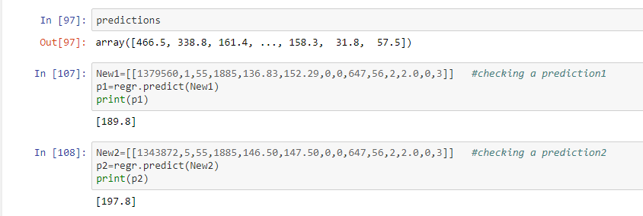
Spearmanr and Pearsonr Correlation
Checking the Predictions

Slide 14
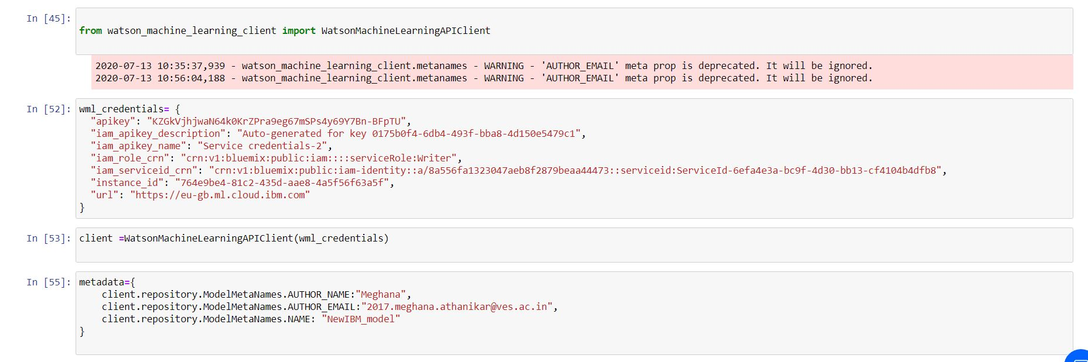
Deploy Model
Scoring endpoint

Slide 15
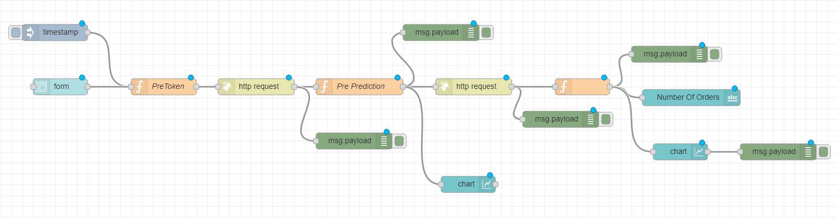
Machine Learning UI

Slide 16
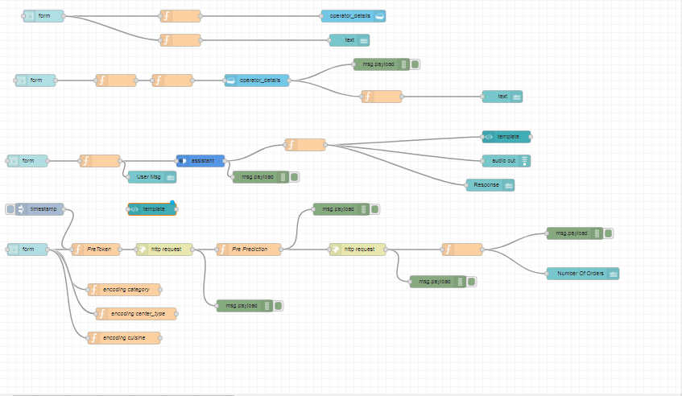
Form & Chatbot UI

Slide 17
Difficulties Faced:
New technologies
Couldn’t work with Lightgbm Model on IBM
Splitted data
Label Encoding
Null values

Slide 18
Scope of Improvement
The model can be improved by feature engineering
Fixing Outliers in Residual Plot
We can try to build models with different regression models and take their average.
More features like holidays, festivals,climate etc can be included
A better option than web can be an android application

Slide 19
Conclusion
Warehouse Management is important in food-processing and distribution industry because a large amount of products are typically stored. In this study, a prediction model composed of factor analysis and prediction tool is proposed. Through the random forest method, we are able to predict the forthcoming materials in warehouse. Through this study we have found that input/output of food, its frequency and the centre where it is located/to be delivered are the three major concerns.
This study summarized the above mention factors along with other factors(region id, meal id , prices etc) and calculated the no. of orders which would be required in upcoming weeks. Through this model, the best score of warehouse prediction model could be 0.92 . It is important for any food and distribution company to adopt this for inventory and food prediction.

Slide 20
THANK YOU

