Slide 1

Email Spam Detection Using Logistic Regression
Intro to Data Science (DSCI-6002-01)-Team 15
Professor: Dr. Ardiana Sula

Slide 2




Team - 15
Gnaneswari Vaddepalli
(Data Pipeline Developer)
Gude Venkata Naga Sandeep
(ETL Developer)
Vaishnavi Kukkala
(Team Lead & Data Analyst)
Abbina Vamsi Krishna
( Data Researcher & Engineer)

Slide 3
AGENDA
ABSTRACT
CHALLENGE
INTRODUCTION
FLOWCHART
LOGISTIC REGRESSION
METHODOLOGY
DATASET
CONCLUSION
LINKS
TOOLS

Slide 4
The project's primary objective is to build a spam filter. This spam filter's strength is in its capacity to decide probabilistically whether a given email is spam or not. We turn the attributes into numerical data so that we may perform a log regression on them.
Customers of this mail service are more satisfied because the mail program can provide a spam filter service to them thanks to this spam filter. The postal service's customer base is therefore expanded, which directly translates to increased revenue.
ABSTRACT

Slide 5
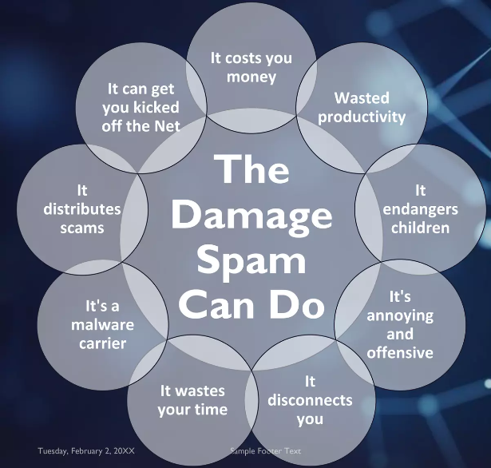
CHALLENGE
What is Spam?
Spam is Unsolicited email
Emails that involves sending identical or nearly identical messages to thousands (or millions) of recipients.

Slide 6


INTRODUCTION
Email transmissions are subject to extensive information collection. Postal providers have introduced spam detection to their inboxes in order to filter out the numerous incoming emails we receive everyday.
Here, We create spam filter to detect and prevent spam or unsolicited or unsolicited e-mail from entering a user's inbox. Spam filters work by recognizing and reporting messages that may be spam based on a variety of factors, including the sender's email address, message content, and the presence of suspicious attachments or links.
We use logistic regression method to categorizing techniques.

Slide 7
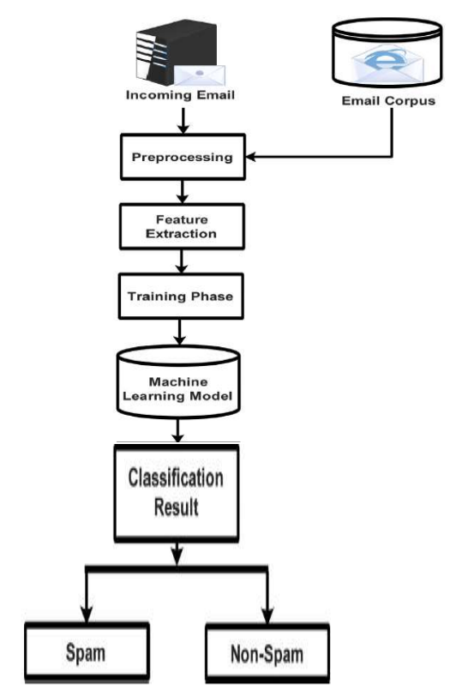
FlowcharT

Slide 8

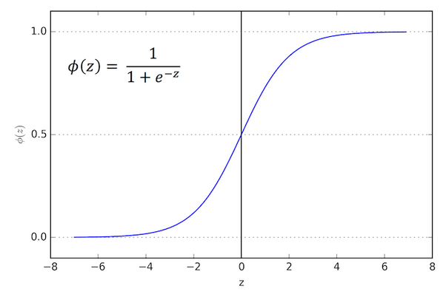
LOGISTIC
REGRESSION
The principal use of the supervised machine learning technique, logistic regression, is classification assignments where the objective is to estimate the likelihood that a given instance belongs to a particular class. Logistic Regression measures the relationship between the categorical dependent variable and one or more independent variables by estimating probabilities using a logistic function. The sigmoid function estimates the probability for the given class using the output of a linear regression function as input.
This statistical model (logit model) is often used in classification and predictive analysis. Based on a set of independent variables, logistic regression calculates the probability of an event such as voting or not voting.

Slide 9

MethodOLOGY
We have a total of 21 qualities at our disposal. To begin with, we applied one-shot encoding to convert categorical data into numerical data. The data set was then split into two parts: training and testing, split 80:20. A general linear model was then built using the stats. Model package in Python, convolved with the logit function, and trained on the training data set.
Training Dataset
Caterogical Data One-hot encoding Numerical Data
Testing Dataset

Slide 10

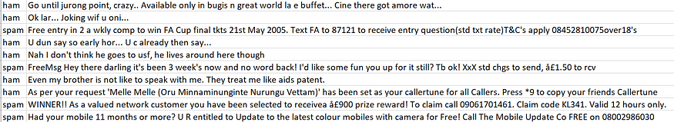
DATASET
We used the "Spam Detection Collection Dataset" from Kaggle.com. There are 5574 messages in the dataset that include the categories legitimate/Ham or spam. The collection contains 5574 messages, from which 4825 were valid communications and 747 are spam. The texts were gathered from a variety sources. The dataset is in the form of .csv(comma separated values) file. The dataset is then converted into dataframes with the help of panda library present in python. Below is the screenshot of the dataset used.

Slide 11




Tools

Slide 12

CONCLUSION
With this spam filter, mail software can provide spam filter service to postal service customers and satisfy customer needs. This increases the number of users of the postal service, which is directly related to more revenue.
Logistic regression is one of many algorithms that can be used to create spam filters. However, whether this is the "best" approach will depend on number of criteria, such as the size and quality of the data set, the characteristics used, and the specific constraints of the task.

Slide 13
LINKS
https://www.youtube.com/watch?v=Rve9WHPKg_o
https://github.com/Team-15-DS/email-spam-detection-using-logistic-regression

Slide 14

Thankyou

