Slide 1






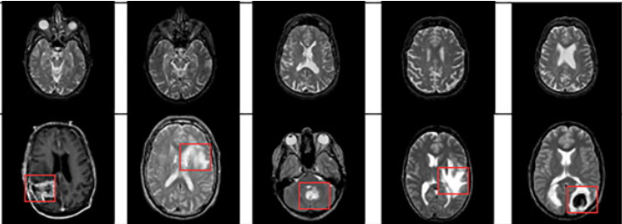
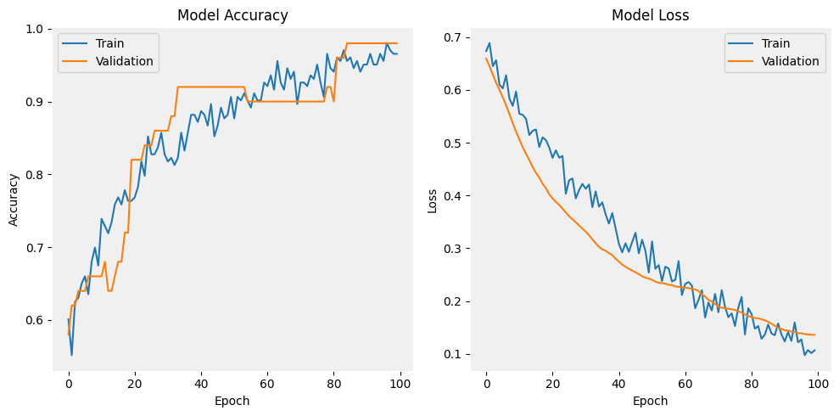

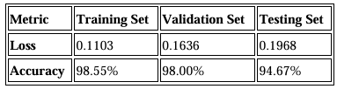
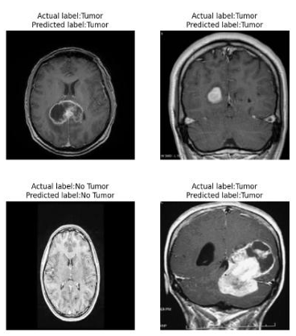
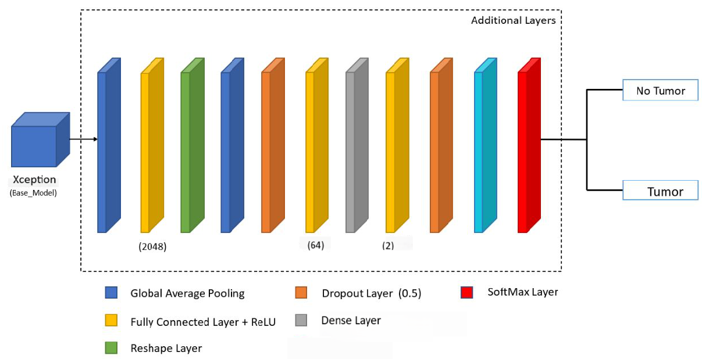
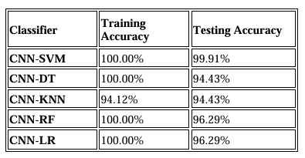
Brain Tumor classification and Detection by Integrating ML Classifiers with Xception model for Magnetic Resonance imaging Author –Vaishnavi Kukkala, Supervised by Prof. Khaled Sayed, PhD
Clinical Decision Support: Assists radiologists in accurately identifying brain tumors from MRI scans, reducing diagnostic errors and interpretation time. Acts as an AI-powered second opinion in low-resource or rural medical settings where expert radiologists may not be available.
Deployment in Lightweight Systems: The hybrid DL + ML model is computationally efficient, making it suitable for integration into portable diagnostic tools and hospital systems.
Brain tumors pose a serious threat to cognitive and neurological functions, making early and accurate detection crucial for patient survival.
MRI scans are the preferred imaging technique for brain tumors due to their high resolution and non-invasive nature.
Manual diagnosis is prone to human error and inconsistency, highlighting the need for reliable automated solutions.
Deep Learning (DL) models, especially Convolutional Neural Networks (CNNs), have revolutionized medical image analysis.
Xception, a state-of-the-art CNN architecture using depthwise separable convolutions, offers efficient and accurate feature extraction.
To improve generalization and interpretability, we combine deep features from Xception with traditional Machine Learning (ML) classifiers such as SVM, RF, KNN, LR and DT.
Our model was trained on MRI dataset and validated on a much larger independent test set to assess generalization capability.
Implementation: The Xception model was fine-tuned using TensorFlow/Keras with a learning rate of 1e-5, batch size of 16, and cross-entropy loss. The optimizer used was Adam, and early stopping with a learning rate scheduler helped prevent overfitting, dropout layers (rate = 0.5) provided regularization. Deep features were classified using ML models (SVM, RF, KNN, LR, DT), and the model was validated on a large independent dataset.
Advantages: Our hybrid DL + ML framework, generalizes well to unseen data, and performs competitively against multiple state-of-the-art models. It reduces training cost and overfitting by leveraging transfer learning. The combination of deep features with lightweight ML classifiers ensures both high accuracy and clinical applicability, especially in resource-constrained environments.
We propose a robust and accurate brain tumor detection framework combining the Xception model with machine learning classifiers which is a cost-efficient solution for real-world clinical applications.
The proposed system achieved a test accuracy of 98% with the deep learning model and 99.91% when combined with machine learning classifiers, demonstrating outstanding performance. To evaluate generalization, the model was tested on a completely independent dataset, where it achieved a strong accuracy of 94.67%, confirming its robustness across diverse data sources.
We utilized two publicly available brain MRI datasets from Kaggle. The training dataset contains 253 images labeled as "Tumor" or "No Tumor", while the testing independent dataset includes 3,060 images, offering a more diverse distribution for assessing model generalization.
Figure 3: Proposed Methodology
Images are of the size 224×224 pixels and normalized to a pixel range of [0–1].
Figure 4: Accuracy and Loss plots
Future Work:
One-hot encoding was applied to binary class labels. To improve model robustness, various data augmentation techniques such as rotation, flipping, zooming, shearing, and brightness adjustments were employed.
We will focus on expanding the dataset for rare tumor types and improving model interpretability using explainable AI. We are also aiming to make the system lightweight enough for real-time use in hospitals and clinics, so it can be seamlessly integrated into everyday medical workflows
Figure 1: Tumor and No Tumor images
[1] Seoyoung Yoon, Brain Tumor Classification Using a Hybrid Ensemble of Xception and Parallel Deep CNN Models, Informatics in Medicine Unlocked, 2025, 101629, ISSN 2352-9148, https://doi.org/10.1016/j.imu.2025.101629.
The core of our model is the Xception architecture, pretrained on ImageNet, known for its efficiency and fine-grained feature extraction using depthwise separable convolutions.
To further enhance performance and interpretability, we extracted deep features from the penultimate Xception layer and used them to train several machine learning classifiers: Support Vector Machine (SVM), Random Forest, k-Nearest Neighbors (KNN), Logistic Regression, and Decision Tree.
[2] Disci R, Gurcan F, Soylu A. Advanced Brain Tumor Classification in MR Images Using Transfer Learning and Pre-Trained Deep CNN Models. Cancers (Basel). 2025 Jan 2;17(1):121. doi: 10.3390/cancers17010121. PMID: 39796749; PMCID: PMC11719945.
We replaced the original classification layers with a custom head consisting of a global average pooling layer, a fully connected (Dense) layer with 64 neurons, a dropout layer to prevent overfitting, and a final Dense layer with softmax activation for binary classification.
.
[3] Rasheed, Z.; Ma, Y.-K.; Ullah, I.; Al-Khasawneh, M.; Almutairi, S.S.; Abohashrh, M. Integrating Convolutional Neural Networks with Attention Mechanisms for Magnetic Resonance Imaging-Based Classification of Brain Tumors. Bioengineering 2024, 11, 701. https://doi.org/10.3390/bioengineering11070701
[4] J. J. Philip, R. Rani and S. Kumar, "Brain Tumor Detection Using Xception Model," 2024 International Conference on Advances in Computing Research on Science Engineering and Technology (ACROSET), Indore, India, 2024, pp. 1-6, doi: 10.1109/ACROSET62108.2024.10743964.
Figure 2: Layered architecture of Proposed System
Loss Function and Optimization:
Cross-Entropy is used as the loss function for the CNN.
Adam Optimizer with a learning rate of 1e-5 ensures stable and efficient convergence.
Early stopping and learning rate scheduling are employed to avoid overfitting and optimize training.
Table 1: Comparative analysis of Performance Metrics
Figure 5: Sample Predictions

