Slide 1
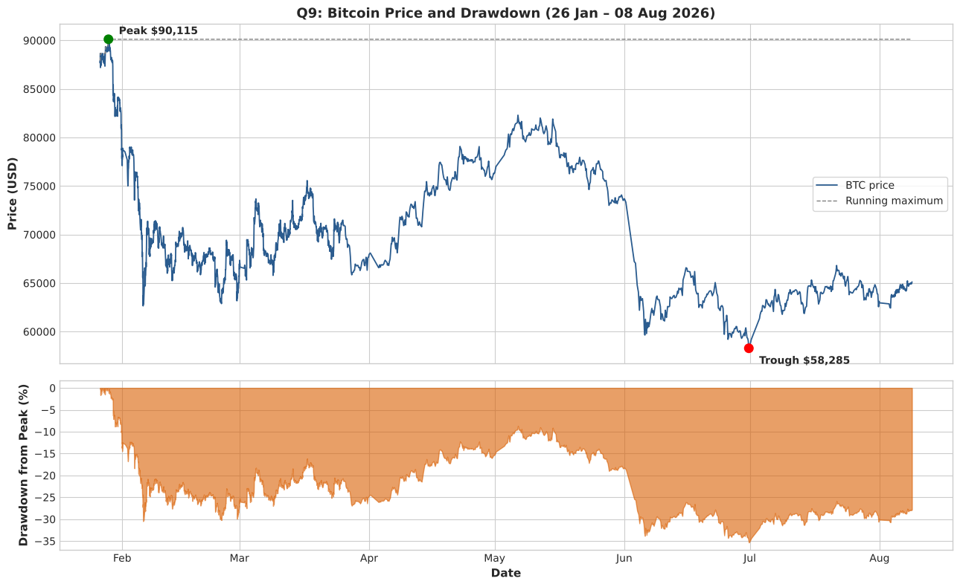
Cryptocurrency Market Behaviour
Statistical Analysis, Hypothesis Testing & Regression-Based Volume Prediction
23CSE351 – Foundations of Data Science · Case Study
[Student name] - BATTU HASINI (CB.SC.U4CSE24068)
GOPIREDDY SIRI (CB.SC.U4CSE24120)
VARNA P (CB.SC.U4CSE24156)
SABBELLA VAISHNAVI (CB.SC.U4CSE24363)
Bitcoin price and drawdown

Slide 2
Problem Statement & Objectives
The problem
1
Pre-process: verify columns, detect anomalies, build a daily panel
Crypto-assets trade 24×7 and their prices, volumes and market caps swing far more than traditional assets. Investors, exchanges and risk teams need evidence-based answers to:
2
Explore: summary statistics and visualisations
3
Answer 15 analysis questions with suitable methods and plots
How concentrated is the market?
Which assets are really volatile?
Do assets move together?
Is activity different at weekends?
How much should an asset trade, given its size and moves?
4
Test hypotheses, including A/B tests, with p-values and effect sizes
5
Build and evaluate a regression model for 24h trading volume
6
Summarise findings, limitations and future enhancements

Slide 3
Dataset Description
109,130
11
Column | Type | Meaning
timestamp | datetime | Time the snapshot was collected
name / symbol | categorical | Asset name and ticker (e.g. Bitcoin, btc)
price_usd | float | Price in USD, rounded to 2 decimals
vol_24h | float | Trading volume in USD, previous 24 hours
total_vol | float | Asset’s % share of combined 24h volume
chg_24h | float | % price change over 24 hours
chg_7d | float | % price change over 7 days
market_cap | float | Market capitalisation in USD
name_encoded, symbol_encoded | int | Label codes 0–70 (redundant, dropped)
records (market snapshots)
attributes (9 after cleaning)
71
2,573
distinct crypto-assets
snapshots, 26 Jan – 8 Aug 2026
One row: one snapshot of one asset at one moment
Source: cleaned_crypto.csv, top assets by market cap (add original URL)
Quality: no missing values or duplicates

Slide 4
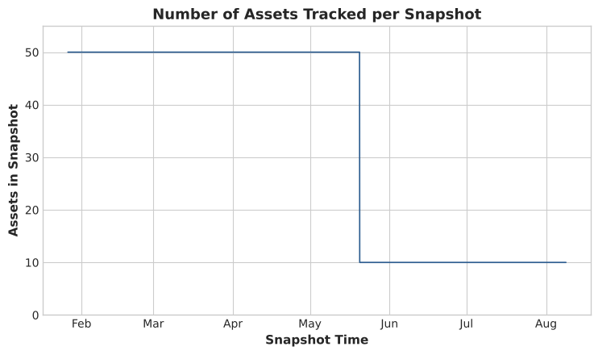
Data Cleaning & Preprocessing
Quality checks: 0 missing values, 0 duplicate rows, 0 duplicate (timestamp, asset) pairs
Type conversion: timestamp parsed to datetime; sorted by time and asset
total_vol verified: it is each asset’s % share of the snapshot’s 24h volume (sums to ≈100, r = 1.000)
Data reduction: dropped redundant encoded columns (11 → 9 columns)
Coverage regimes: 50 assets per snapshot until 20 May (2,085 snapshots), then 10 (488)
Decision: market-wide analysis uses the 50-asset period only
Collection regime change on 20 May 2026 (50 → 10 assets)
Feb–Mar: 859 and 733 snapshots; Apr–Aug: 106–174 per month

Slide 5
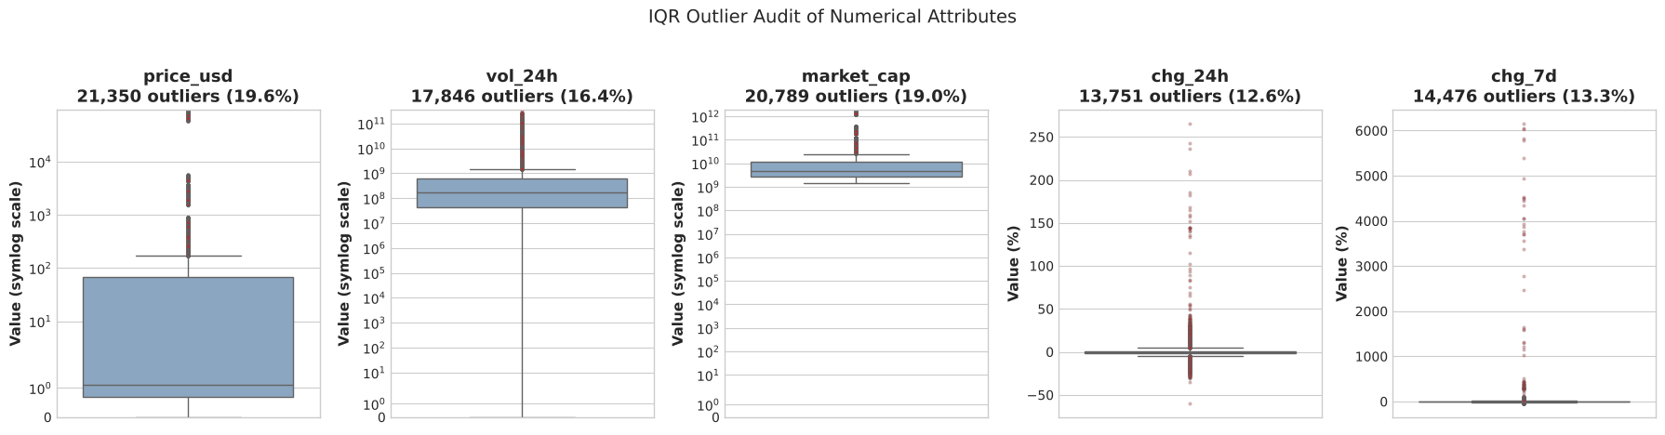
Anomalies, Feature Engineering & Daily Panel
Anomaly audit
Feature engineering
Daily panel
Prices of Shiba Inu, Pepe, HTX DAO round to $0: use chg_%, not price
BUIDL reports zero volume; RaveDAO (+6,154% in 7d) kept as genuine
IQR flags 12.6–19.6% of rows: heavy tails, no rows removed
asset_type: 17 Stable-value, 54 Volatile (price CV < 1%)
turnover_pct = volume ÷ market cap; log10 size and volume
24h
Rolling 24h rows overlap, so keep one end-of-day snapshot per day
6,150 asset-days; 5,400 in the 50-asset panel (108 days)
Bitcoin check: r = 0.994 with day-over-day change

Slide 6
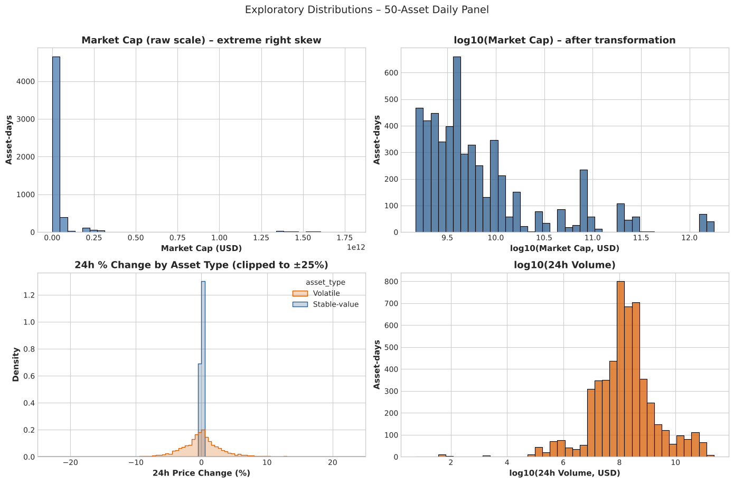
EDA: Summary Statistics & Distributions
What the statistics say
Raw market cap is extremely right-skewed; log10 makes it usable
Volume peaks near $100 m (10⁸) with a thin-trading tail
Stable tokens: 24h change SD 0.07%; volatile tokens 5.65%
Volatile excess kurtosis 350: crashes and spikes are common
Skewness 5.7–68.5, so medians and rank tests are used

Slide 7
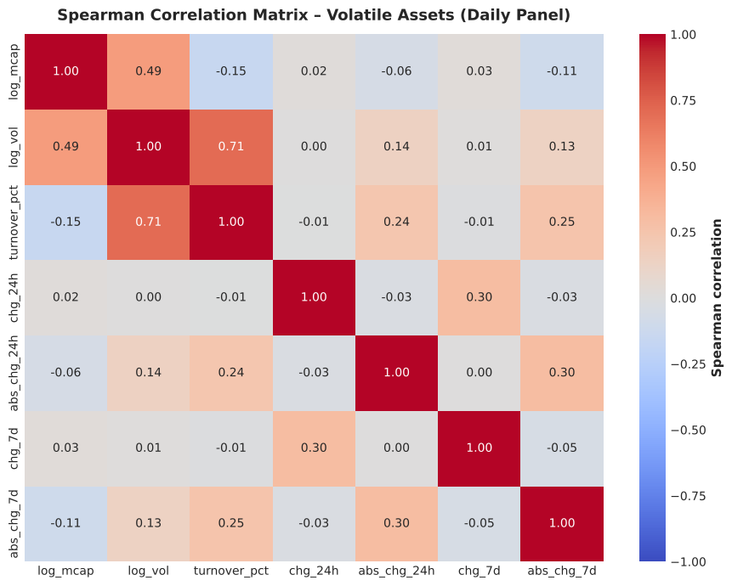
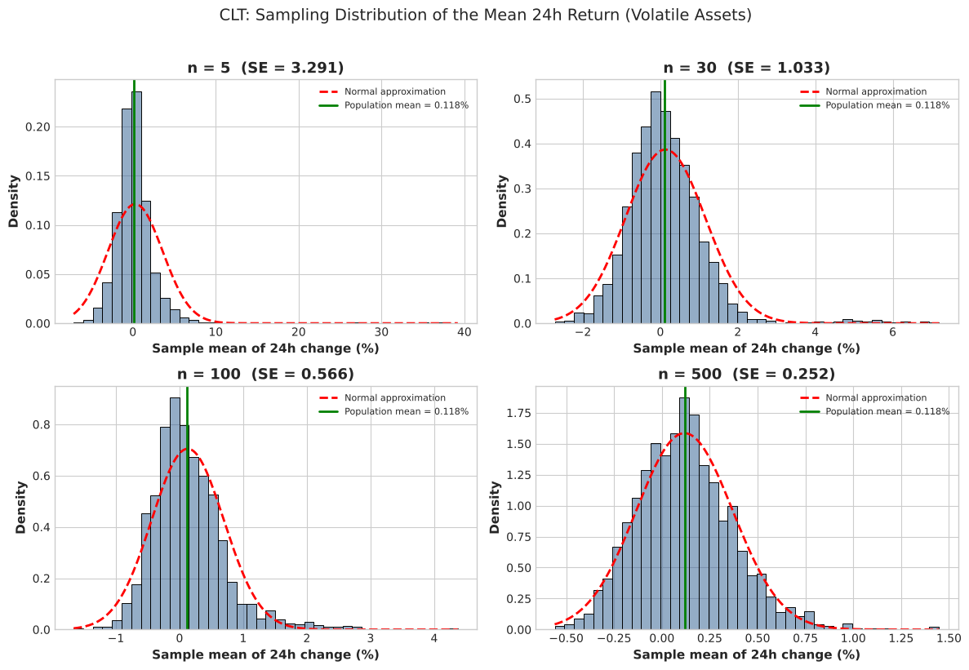
EDA: Correlations & Central Limit Theorem
Spearman correlation, volatile assets
CLT simulation of mean 24h return
Log volume rises with size (ρ = 0.49); turnover falls with size (ρ = −0.15)
Bigger moves, more trading (ρ = 0.24 with 24h change
Empirical SE ≈ σ/√n for n ≥ 30 (0.2517 vs 0.2525 at n = 500)
Heavy tails: skewness 1.87 at n = 30 falls to 0.53 at n = 500

Slide 8
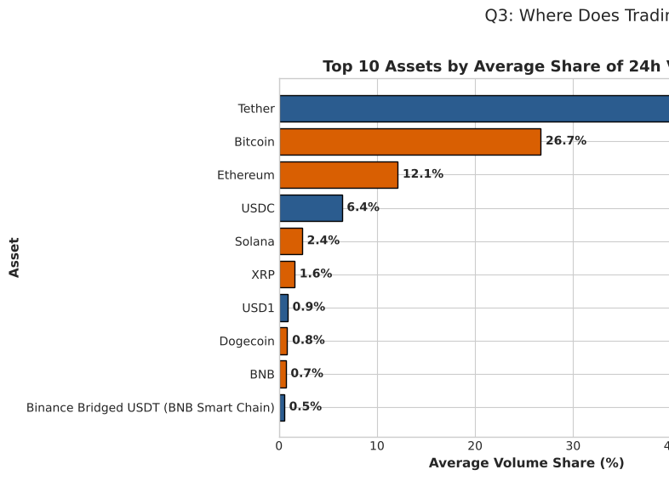
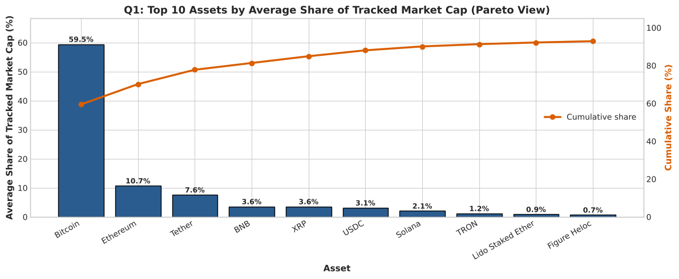
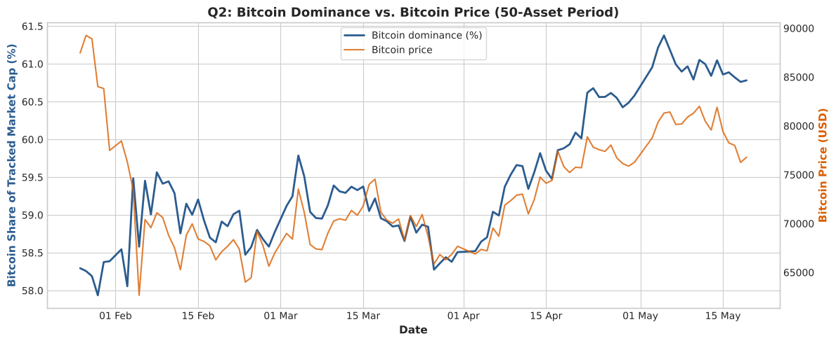
Q1–Q3 · Who holds the value, who trades it
Q1 · Concentration
Q2 · Bitcoin dominance
Q3 · Volume vs market cap
How concentrated is total market capitalisation among the tracked assets?
How did Bitcoin’s share of market cap evolve over time?
Is trading volume concentrated in the assets that dominate market cap?
Bitcoin averages 59.5% of tracked market cap; top 10 hold 92.9%
HHI ≈ 3,753, far above the 2,500 “highly concentrated” line
Dominance stayed in a 57.9–61.4% band, ending higher (58.3% → 60.8%)
ρ = 0.60 with BTC price (p ≈ 9×10⁻¹²): rallies were Bitcoin-led
Tether: 43.9% of volume but only 7.6% of market cap
Bitcoin: 59.5% of cap, just 26.7% of volume: held, not traded

Slide 9
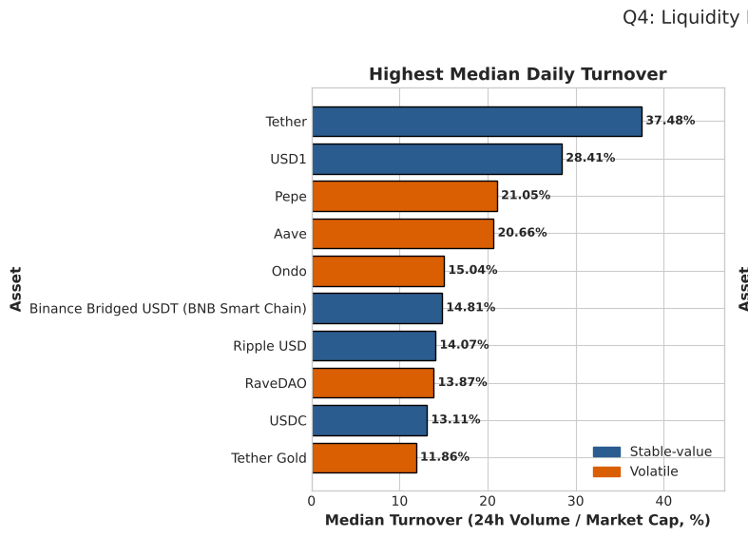
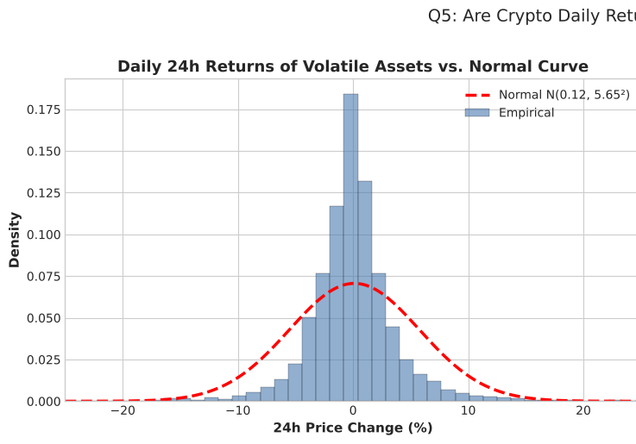
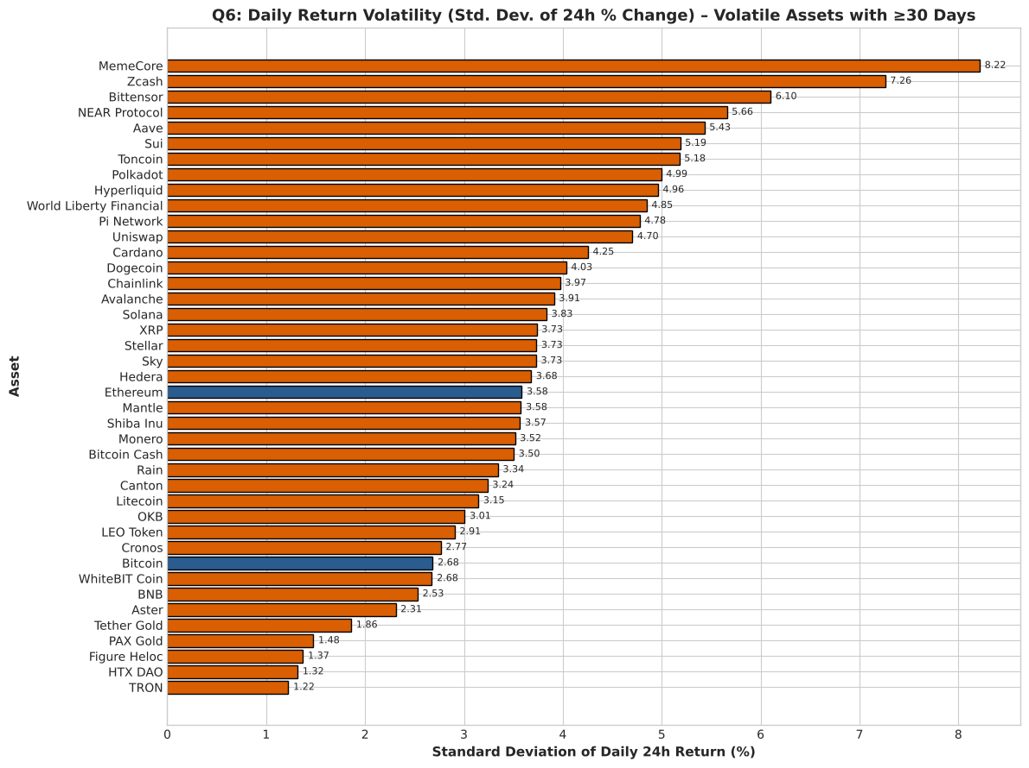
Q4–Q6 · Liquidity, return shape and volatility
Q4 · Liquidity
Q5 · Return distribution
Q6 · Volatility ranking
How liquid are assets relative to their size (turnover = volume ÷ market cap)?
What does the distribution of daily returns look like; is it normal?
Which assets are the most and least volatile?
Tether trades 37.5% of its value daily; USD1 28.4%, Pepe 21.1%
Yield tokens like Circle USYC barely trade (0.004%)
Excess kurtosis 350 (Bitcoin alone: 7.07): very fat tails
±3σ days occur 3.4× more often than a normal curve predicts
Most volatile: MemeCore 8.2% daily SD, Zcash 7.3%, Bittensor 6.1%
Least: TRON 1.2%; Bitcoin 2.7% (≈51% annualised)

Slide 10
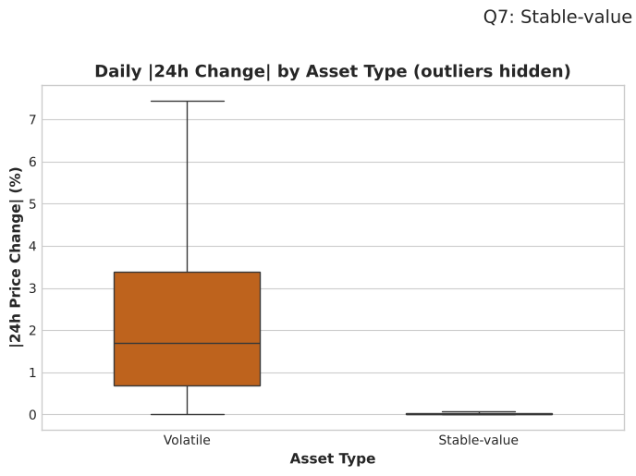
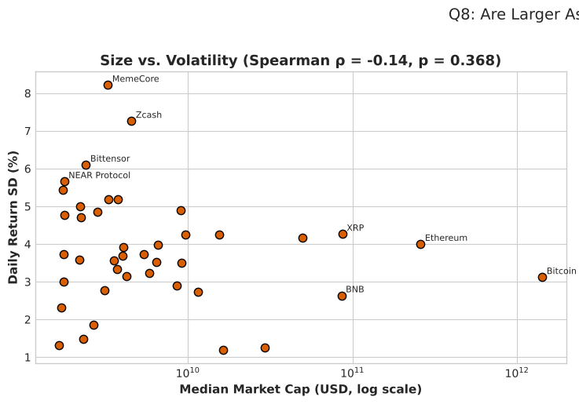
Q7–Q9 · Stable vs volatile, size and drawdown
Q7 · Stable vs volatile (A/B)
Q8 · Size vs risk
Q9 · Bitcoin drawdown
How different is the volatility of stable-value and volatile tokens?
Are larger assets less volatile than smaller ones?
How did Bitcoin’s price evolve and what was its worst drawdown?
Median 24h change
Groups never overlap: riskiest stable (0.28%) < calmest volatile (0.83%)
Spearman ρ = −0.14, p = 0.37: no significant link
Median SD by size quartile: 3.7%, 4.3%, 3.6%, 3.6%: size is not safety
$87,888 → $65,125 (−25.9%) from 26 Jan to 8 Aug
Max drawdown −35.3%: peak $90,115 (28 Jan) to trough $58,285 (30 Jun)

Slide 11
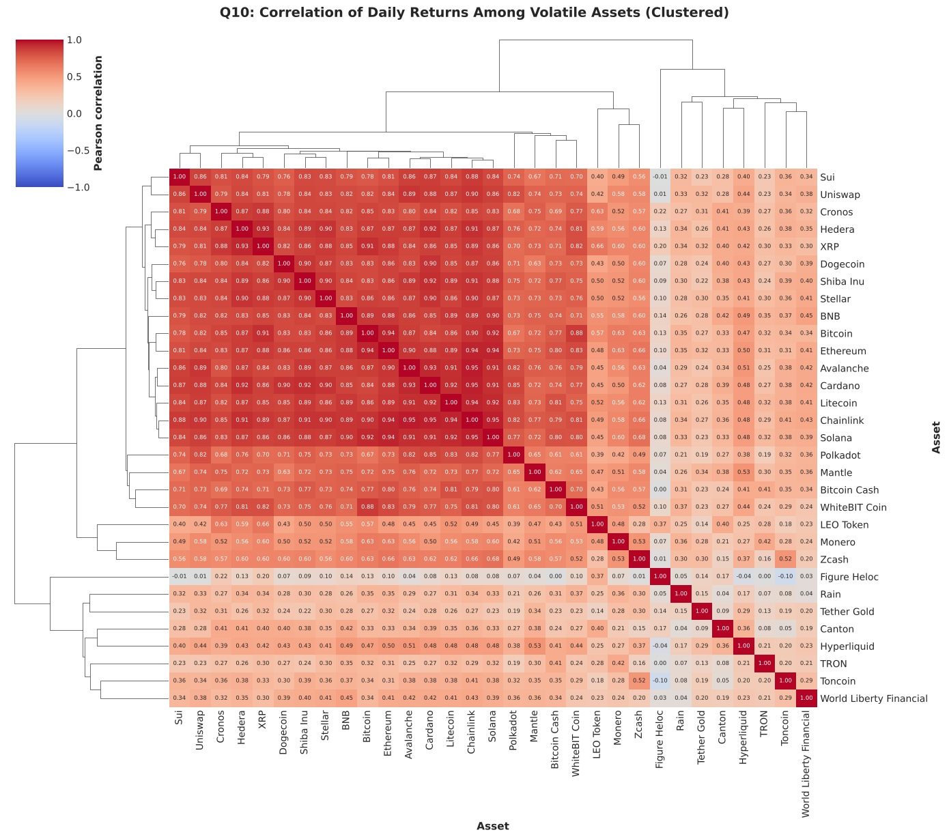
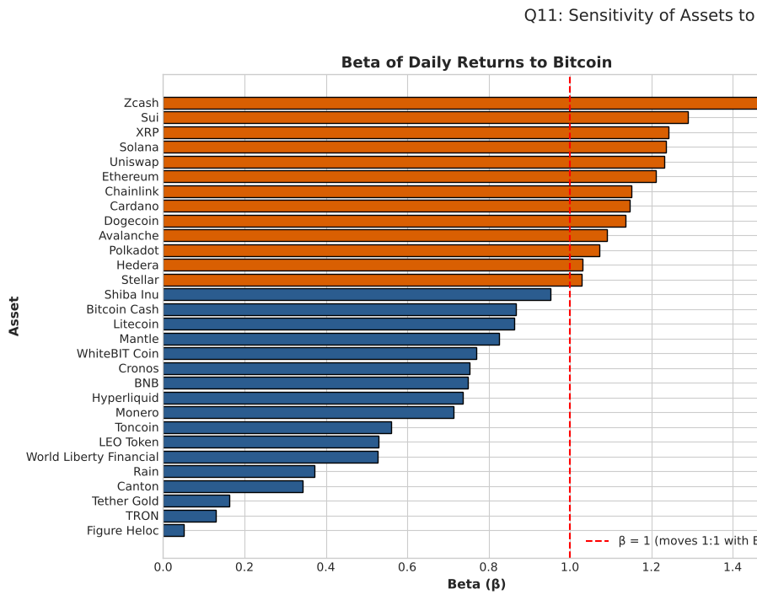
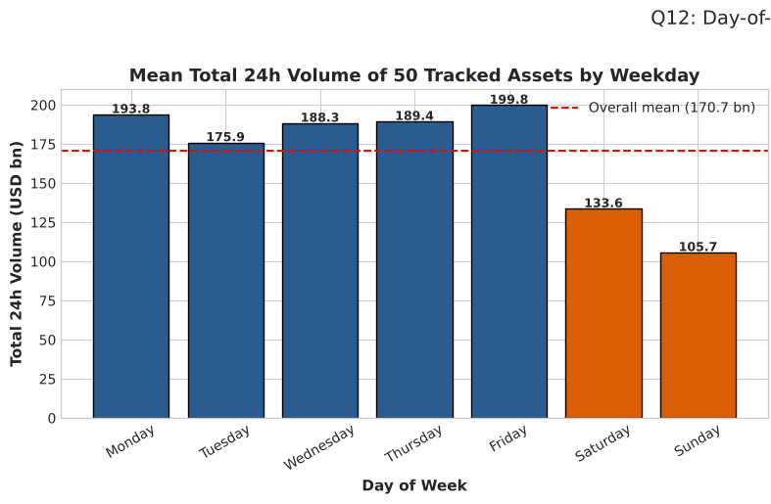
Q10–Q12 · Co-movement, beta and weekday patterns
Q10 · Co-movement
Q11 · Beta to Bitcoin
Q12 · Weekday effects
How strongly do the daily returns of major assets move together?
How sensitive is each major asset to Bitcoin’s moves?
Does market activity or Bitcoin’s return differ by day of the week?
Average pairwise correlation 0.54; 51% of pairs exceed 0.5
BTC–ETH r = 0.94; gold tokens and TRON diversify best
13 of 30 assets have β > 1; median β = 0.87, median R² = 0.64
ETH = −0.09 + 1.21 × BTC (R² = 0.89); Zcash highest β (1.47)
Volume: Sat $133.6 bn, Sun $105.7 bn vs $176–200 bn on weekdays
BTC mean return: Mon +1.02% vs Thu −1.40% (tested in Test 5)

Slide 12
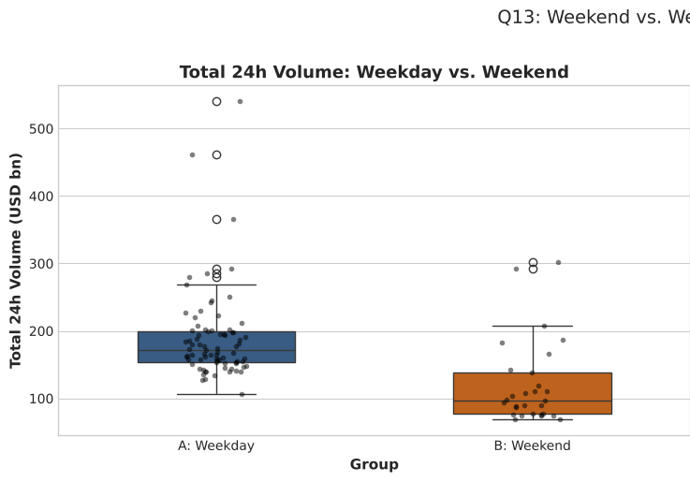
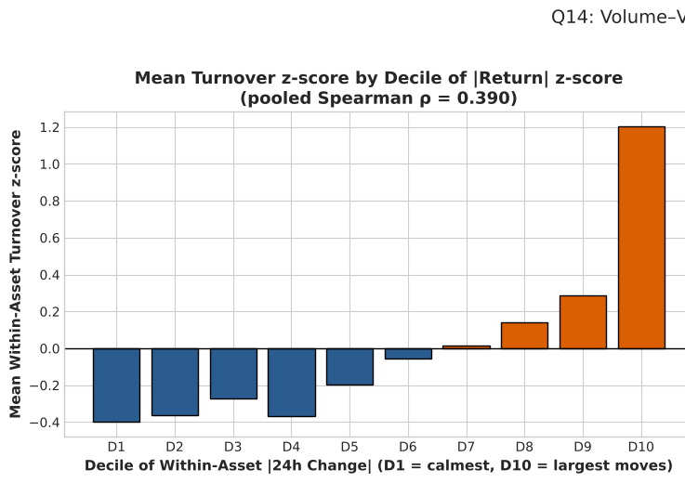
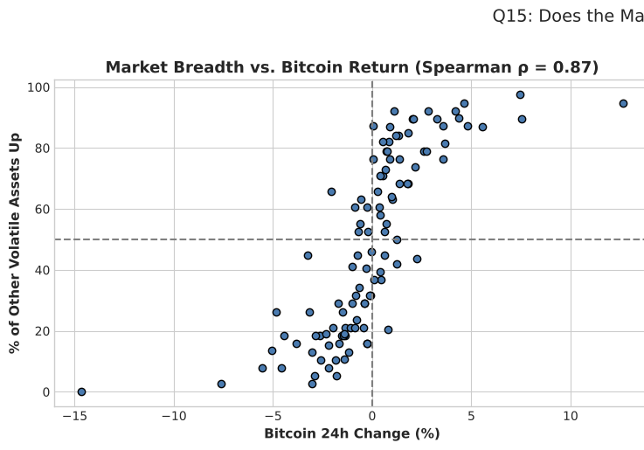
Q13–Q15 · Weekend volume, volume–volatility, breadth
Q13 · Weekend volume (A/B)
Q14 · Volume–volatility
Q15 · Market breadth
Is total market trading volume lower at weekends than on weekdays?
Is trading activity related to the size of price moves?
When Bitcoin moves, does the rest of the market move the same way?
Weekday mean $189.2 bn (n = 79) vs weekend $120.1 bn (n = 29)
36.5% lower on average, 43.7% lower at the median
Within-asset ρ = 0.39, p ≈ 4×10⁻¹⁵³ (4,216 asset-days)
Positive for 40 of 41 assets; biggest-move decile turnover z = +1.20
Breadth vs BTC return: ρ = 0.87 over 108 days
BTC up → 73% of other assets up; direction matches on 86% of days

Slide 13
Hypothesis Testing: Summary of 6 Tests (α = 0.05)
# | Question and null hypothesis (H0) | Test used | Statistic | p-value | Decision (effect size)
1 | A/B · Weekend vs weekday volume. H0: equal means | Null hypothesis + permutation | t = −5.03 | 0.00001 | Reject H0
2 | A/B · Volatile vs stable-value volatility. H0: same distribution | Null hypothesis | U = 918 | 3.2 × 10⁻¹⁰ | Reject H0
3 | BTC mean daily return = 0. H0: μ = 0 | One-sample t test | t = −0.61 | 0.542 | Fail to reject (d = −0.05)
4 | Day-of-week effect on BTC returns. H0: equal means | Null + Alternative hypothesis | H = 15.37 | 0.0175 | Reject H0 (Mon vs Thu only)
5 | Big-move days vs size tier. H0: independent | Chi-square independence | χ² = 22.55 | 1.3 × 10⁻⁵ | Reject H0 (V = 0.073, very weak)
6 | BTC |move| vs volume. H0: ρ = 0 | Null + Alternative hypothesis | ρ = 0.462 | 2.3 × 10⁻¹¹ | Reject H0 (moderate)
6 of 7 nulls rejected. Strongest practical results: the weekend volume drop, complete stable/volatile separation, fat-tailed returns and the volume–volatility link. Test 4 finds no reliable Bitcoin drift.

Slide 14
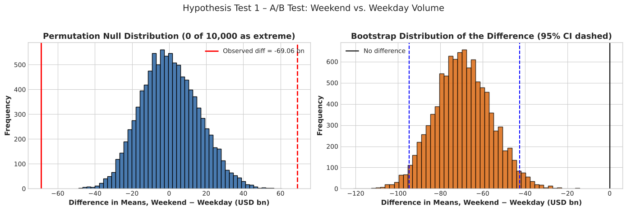
A/B Test 1: Weekend vs Weekday Trading Volume
Hypotheses and method
A = weekdays (control, n = 79); B = weekend days (treatment, n = 29)
H0: μ_weekend = μ_weekday vs H1: μ_weekend ≠ μ_weekday
A 10,000-shuffle permutation test agree
p = 0.001
−36.5%
d = −1.05
permutation p < 0.05
About −$69.1 bn per day; bootstrap 95% CI [−94.8, −42.5] bn
Cohen’s d: a large effect; weekends are the low-volume group
Reject H0: weekend volume is genuinely lower. Expect thinner order books.

Slide 15
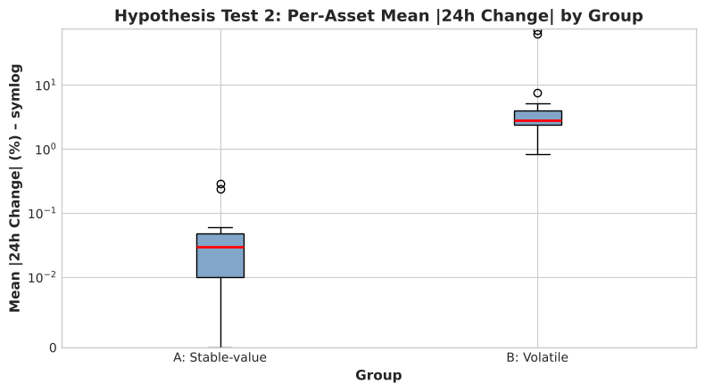
A/B Test 2: Stable-value vs Volatile Tokens
Hypotheses and method
A = stable-value tokens (17); B = volatile tokens (54); one value per asset
H0: same distribution of mean 24h change
Small, non-normal groups, so Mann-Whitney U instead of a t-test
Levene test on daily changes confirms unequal variances
p = 3.2×10⁻¹⁰
r = 1.00
5.65% vs 0.07%
Daily SD of 24h change; Levene W = 362.7, p ≈ 10⁻⁷⁸
Reject H0: volatile tokens are always more volatile; stable tokens act as near-cash.

Slide 16
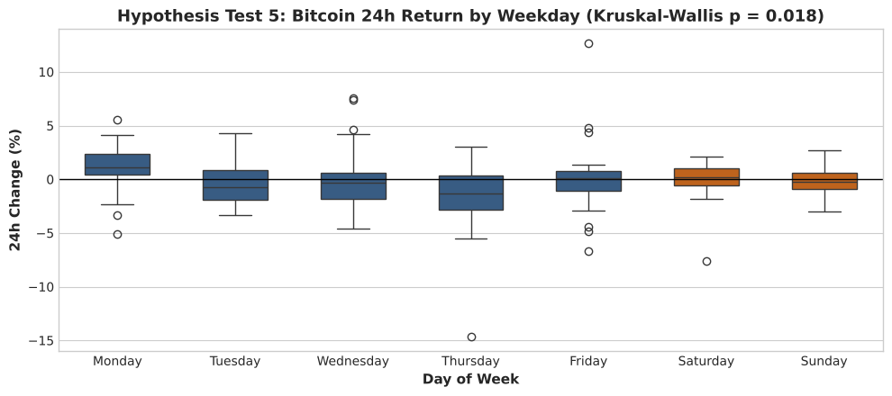
Hypothesis Tests 3–4: Normality, Drift and Weekday Effect
Test 3 · Bitcoin average daily return
Test 4 · Day-of-week effect (BTC)
H0: mean daily return μ = 0
H0: mean return is equal on all 7 weekdays
p = 0.542
t = −0.61 · Wilcoxon p = 0.552
Fail to reject H0; d = −0.045 (negligible)
95% CI [−0.51%, +0.27%] includes 0: no reliable drift despite −26%
p = 0.0175
Only Mon vs Thu survives Bonferroni (p = 0.033): weak, fragile

Slide 17
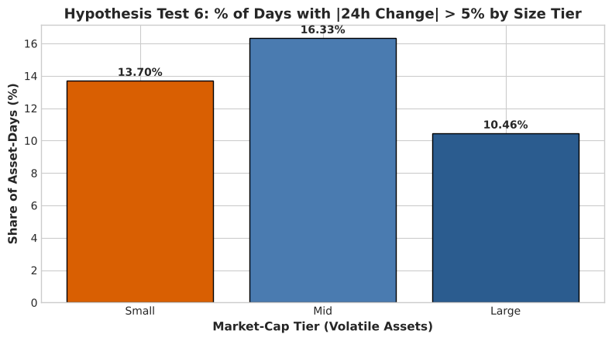
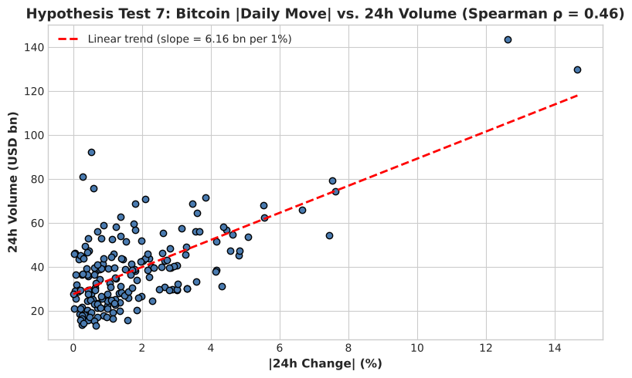
Hypothesis Tests 5–6: Big Moves and Volume–Volatility
Test 5 · Big-move days vs asset size (χ²)
Test 6 · Bitcoin |move| vs volume (Spearman)
H0: P(|24h move| > 5%) is independent of market-cap tier
H0: ρ = 0 vs H1: ρ > 0 (one-sided)
χ² = 22.55, df = 2, p = 1.3×10⁻⁵: reject H0
Cramér’s V = 0.073 (very weak): big-move days 13.7% small, 16.3% mid, 10.5% large
Non-monotonic, so size is only a weak risk signal
ρ = 0.462, p = 2.3×10⁻¹¹ (n = 183 days): reject H0
About +$6.2 bn of volume per extra 1% absolute move
Agrees with the cross-asset result in Q14 (ρ = 0.39)

Slide 18
ML Model: Multiple Linear Regression (OLS) + Random Forest
log10(Volume) = β0 + β1·log10(MarketCap) + β2·ln(1+|Δ24h|) + β3·ln(1+|Δ7d|) + β4·Stable + β5·Weekend + ε
Why regression
Why OLS
Why log scale
Data and split
Target is a continuous quantity: log10 of 24h volume
Estimates the volume an asset should trade
Large residuals flag abnormal activity
Interpretable coefficients with CIs and p-values
Log-log terms read as elasticities
Random Forest benchmarks a non-linear fit
Volume spans about 6 orders of magnitude
Log makes size vs volume near-linear
ln(1+Δ
50-asset daily panel: 5,300 rows
Train 26 Jan–25 Apr: 4,222 rows
Test 26 Apr–19 May: 1,078 rows, time-based

Slide 19
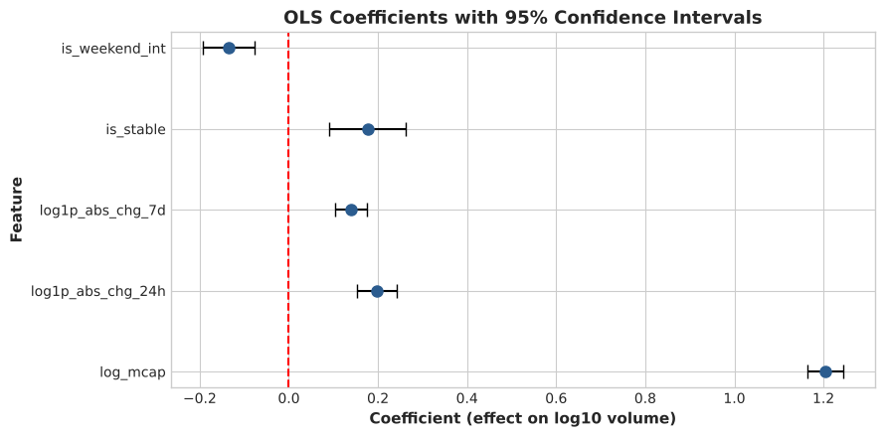
OLS Results: Coefficients and Interpretation
Feature | β | 95% CI | p-value | Interpretation
log10 market cap | 1.204 | [1.163, 1.244] | < 0.0001 | 1% larger market cap → about 1.2% more volume (elasticity)
ln(1+|24h move|) | 0.197 | [0.152, 0.242] | < 0.0001 | Doubling (1+|24h move|) → volume × 1.37
ln(1+|7d move|) | 0.140 | [0.105, 0.175] | < 0.0001 | Doubling (1+|7d move|) → volume × 1.25
Stable-value (dummy) | 0.177 | [0.090, 0.263] | 0.0001 | Volume × 1.50, offsetting near-zero moves
Weekend (dummy) | −0.136 | [−0.193, −0.078] | < 0.0001 | Volume × 0.73 (about 27% lower)
R² = 0.462, F = 724 (p ≈ 0); every coefficient significant
VIF max 1.94 (< 5): no multicollinearity
Size dominates; elasticity above 1 means bigger assets trade more than proportionally
Read the stable dummy together with the move terms

Slide 20
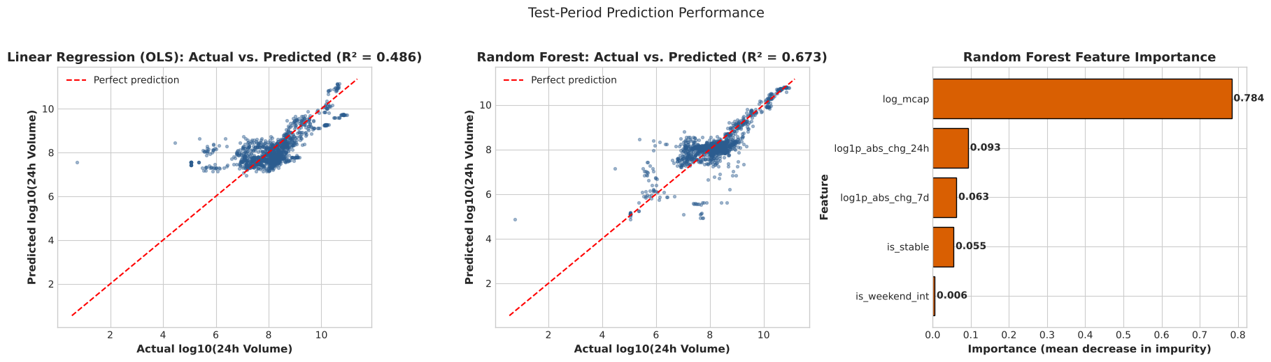
Model Evaluation: Metrics on the Held-out Period
Model | Test R² | RMSE (log10) | MAE (log10) | Median error factor | Train R²
Baseline (train mean) | −0.002 | 1.120 | 0.796 | 3.54× | —
Linear Regression (OLS) | 0.487 | 0.802 | 0.570 | 2.71× | 0.462
Random Forest | 0.673 | 0.639 | 0.428 | 1.93× | 0.849
OLS test R² 0.487 ≥ train 0.462: no overfitting; typical error about 2.7× the actual volume
Random Forest is more accurate (R² 0.673, error 1.9×) but overfits (train 0.849); size dominates importance (0.78)

Slide 21
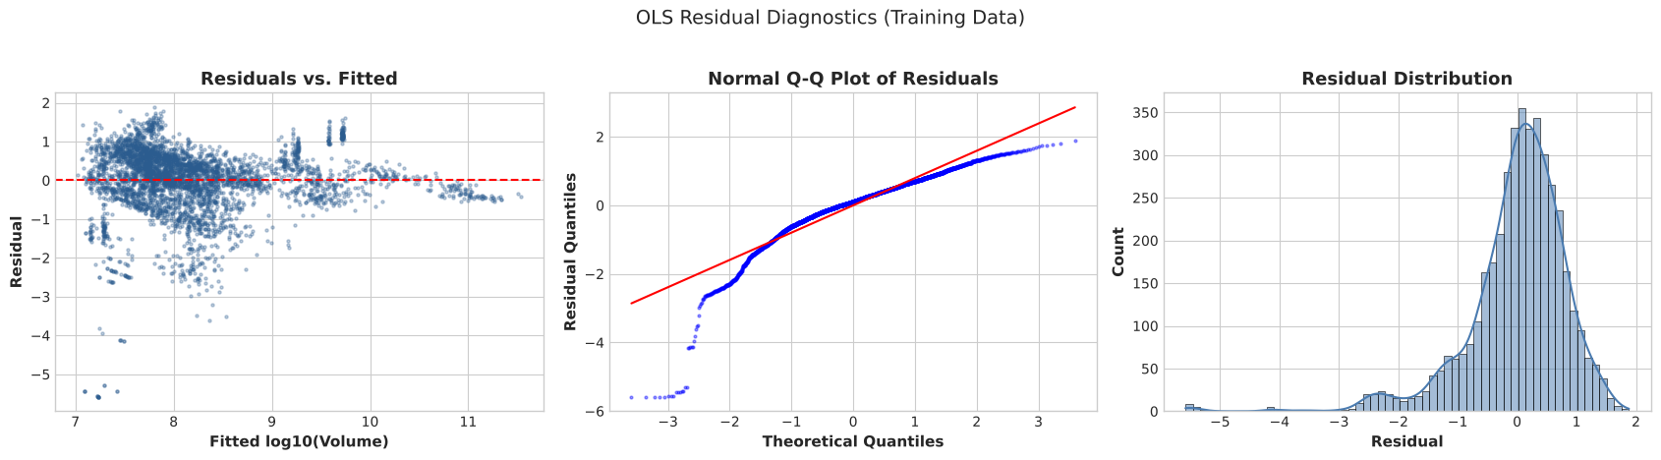
Residual Diagnostics & Generalisation to Unseen Assets
Residual diagnostics
GroupKFold by asset (5 folds)
Durbin-Watson 1.89: little autocorrelation
Residuals left-skewed (−1.82) and heteroscedastic, so p-values are approximate
Cause: trading stablecoins vs barely traded yield tokens
Model | Mean R² | Mean RMSE
Linear Regression | 0.220 | 0.850
Random Forest | −0.255 | 0.985
On unseen assets the Random Forest memorises asset identity; OLS transfers better.

Slide 22
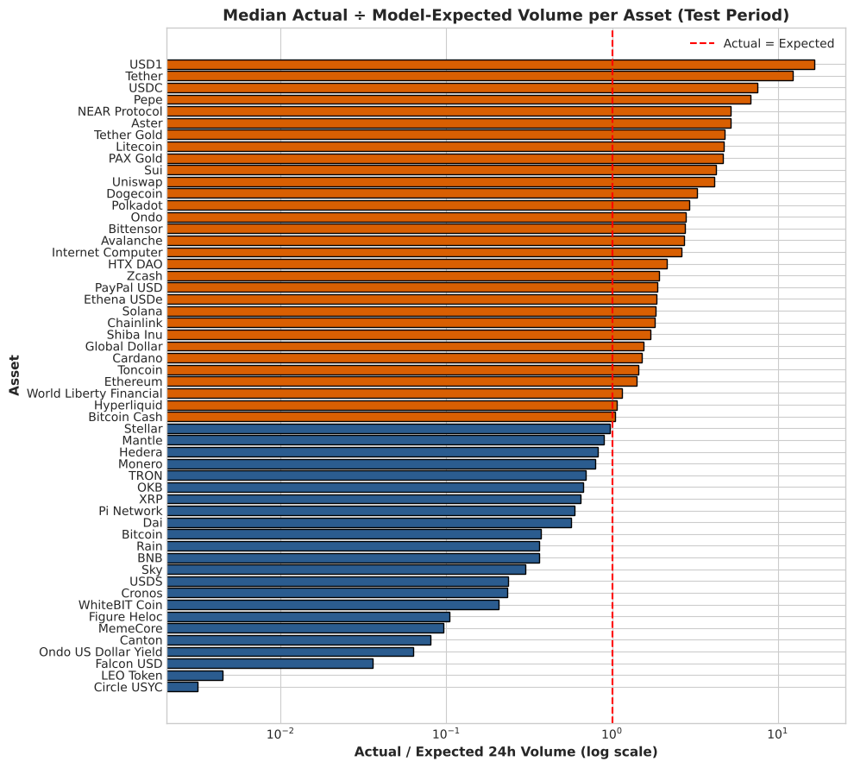
Using the Model: Actual vs Expected Volume
Interpretation of the results
Far above expectation: USD1 16.6×, Tether 12.3×, USDC 7.5×, Pepe 6.8×
Far below: Circle USYC 0.003×, LEO Token 0.005×, Falcon USD 0.04×
Meaning: trading stablecoins are the medium of exchange; yield and exchange tokens are held, not traded
Next step: add a token-category feature (stablecoin, yield, exchange, meme)
Choice: Random Forest for known assets; OLS for new assets and interpretation

Slide 23
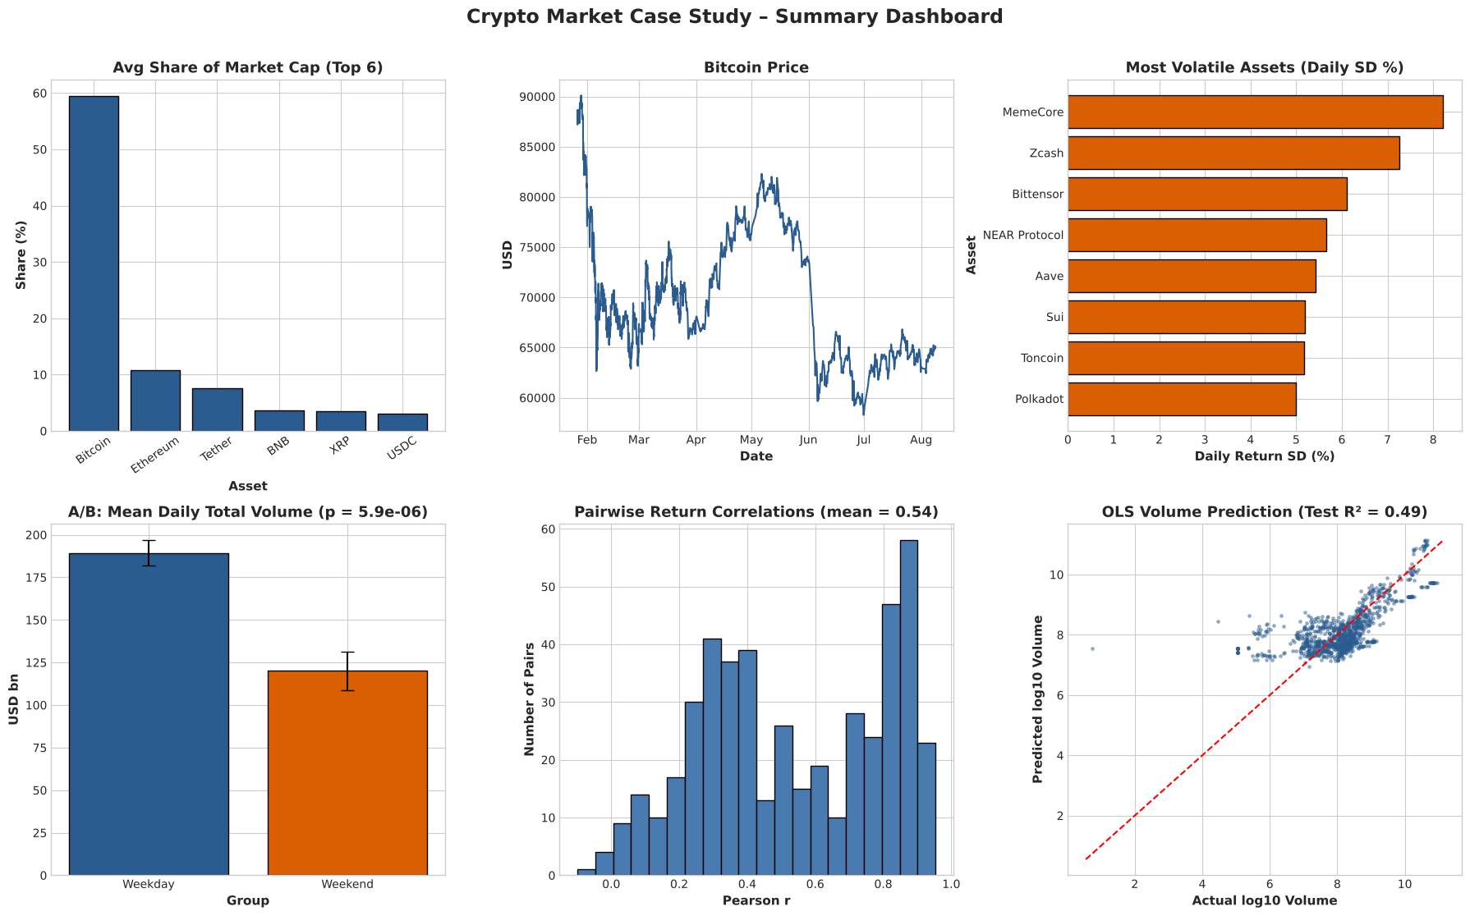
Python Visualisation Dashboard
Concentration, price path and volatility ranking
A/B result: weekend volume −36.5% (p = 5.9×10⁻⁶)
Return correlations and model fit (OLS test R² 0.49)

Slide 24
Key Findings & Interpretation
Extreme concentration: BTC 59.5% of cap, top 10 = 92.9%
Stablecoins dominate trading: Tether 43.9% of volume
1
2
Fat tails: >3σ days occur 3.4× more than normal theory
Stable vs volatile tokens are fully separated (r = 1.00)
3
4
Size is not safety: ρ = −0.14, p = 0.37
Herd behaviour: mean correlation 0.54; BTC direction matches 86% of days
5
6
Weekend volume 36.5% lower (p < 10⁻⁵, d = 1.05)
Bigger moves, more trading (ρ = 0.39; Bitcoin 0.46)
7
8
BTC −25.9%, max drawdown −35.3%, no reliable drift (p = 0.54)
Regression: size elasticity ≈ 1.2; OLS test R² 0.49, RF 0.67
9
10

Slide 25
Conclusion & Limitations
Conclusion
Limitations
The tracked crypto market behaves largely as one Bitcoin-driven system: value is concentrated in Bitcoin, most assets move with it, and diversifying across large tokens helps little.
Trading is concentrated in stablecoins, drops sharply at weekends and rises on volatile days. A simple log-log regression explains about half of daily volume variation and flags abnormal activity.
Short, uneven window: 6.5 months; 108 full-coverage days
Survivorship: only assets in the top 50 (later 10) appear
Prices rounded to 2 decimals hide sub-cent assets
Rolling 24h windows make daily figures approximate
Associations, not causes; results describe this period
Residuals skewed; no token-category feature; rough for new assets

Slide 26
Future Enhancements
1
Longer, evenly spaced history
Collect hourly or daily snapshots with full-precision prices
2
Token-category metadata
Stablecoin type, layer-1, exchange, meme and real-world assets as features
3
Time-series models
GARCH for volatility clustering; ARIMA or LSTM with lagged features for true forecasts
4
Better inference
Clustered standard errors or mixed-effects models for repeated assets
5
Interactive dashboard
Tableau or Power BI on top of the daily panel

Slide 27
References & Dataset Source
Dataset: cleaned_crypto.csv, time-stamped snapshots of the largest cryptocurrencies by market cap (add original source URL before submission)
pandas: https://pandas.pydata.org/docs/
SciPy statistics: https://docs.scipy.org/doc/scipy/reference/stats.html
statsmodels OLS: https://www.statsmodels.org/stable/regression.html
scikit-learn: https://scikit-learn.org/stable/user_guide.html (LinearRegression, RandomForestRegressor, GroupKFold)
Matplotlib and Seaborn: https://matplotlib.org/stable/ and https://seaborn.pydata.org/

