Slide 1
DATA VISUALISATION CASE STUDY
Data Science Job Market and Skills Demand Analytics
Source records
15,782 (14,838 salary records+944 job postings)
Unique Job Titles
153
Exploring salary trends, experience levels, job roles, and in-demand skills using Python, Plotly, and Tableau.
Indicators
2 datasets analyzed
Prepared by Sabbella Vaishnavi | Data Visualisation | 19 October 2026

Slide 2
Problem statement and objectives
Why a structured visual analysis is needed
Problem statement
Core question
The data science job market includes diverse job titles, experience levels, salary ranges, industries, and skill requirements. Analyzing these factors across separate datasets can be challenging because they differ in time period, structure, and salary format.
How can data visualization help us understand salary patterns, experience-level differences, and the skills demanded in data science job postings?
PROJECT OBJECTIVES
Assess the structure and quality of both datasets.
Analyze salary distributions and trends from 2020 - 2024.
Compare salaries across experience levels and job titles.
Identify frequently listed skills in 2025 job postings.
Build interactive visualizations and a Tableau dashboard.
Communicate limitations and demonstrate ethical visualization practices.
2

Slide 3
Dataset description
Dataset 1: Data Science Salaries 2024
14,838
11
2022 - 2024
records
original columns
Time coverage
Original fields
Data characteristics
work_year, experience_level, employment_type, job_title, salary, salary_currency, salary_in_usd, employee_residence, remote_ratio, company_location, company_size
Covers salary records from 2020–2024.
Contains 153 unique job titles.
Includes salary, experience, employment type, location, remote-work ratio, and company size.
Original dataset has no missing values.
Contains 5,711 exact duplicate rows.
3

Slide 4
Dataset description
Dataset 2: Data Science Job Postings 2025
944
13
2025
records
original columns
Time coverage
Original fields
Data characteristics
job_title, seniority_level, status, company, location, post_date, headquarter, industry, ownership, company_size, revenue, salary, skills
Contains job posting information for 2025.
Includes role, seniority, company, location, industry, salary, and required skills.
Has missing values in six fields: job_title (3), seniority_level (60), status (256), ownership (47), revenue (15), and location (2).
The salary field is text-formatted and may contain currency symbols; currency and pay period are not consistently established.
Useful for analyzing in-demand skills, job locations, seniority, and industry.
3

Slide 5
Data quality and preprocessing
Cleaning choices designed to preserve meaning
383
missing / non-numeric Value entries
0
Missing salary dataset values
Across the listed columns in 944 record
No missing values in the original 14,838-row dataset
5,711
exact duplicate rows
2
Datasets analyzed
Identified in the original salary dataset
14,838 salary records (2020–2024) and 944 job postings (2025)
Missing values in job postings were retained and handled according to the analysis requirements.
Exact duplicate salary records were identified and removed from the analytical copy.
Salary and job-posting datasets were analyzed separately because their time periods, structures, and salary formats differ.
4

Slide 6
Tools and visualization approach
Three visualization tools, with complementary roles
Python — Pandas, Matplotlib and Seaborn
Plotly
Tableau Public
Used to create interactive charts with hover details, allowing users to explore salary patterns across years and experience levels.
Used to build an interactive dashboard from the exported datasets, with filters and complementary views of job titles, seniority, industries, locations, company characteristics, and skills.
Used for data cleaning, descriptive statistics, salary distributions, boxplots, rankings, correlation analysis, and data-quality visualizations.
Workflow: inspect → clean → Analyze → visualize → interpret → communicate limitations.
5

Slide 7
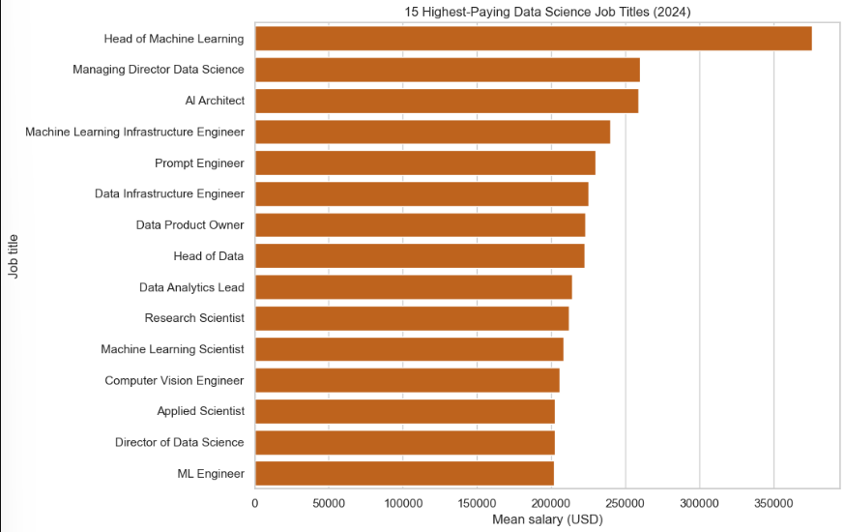
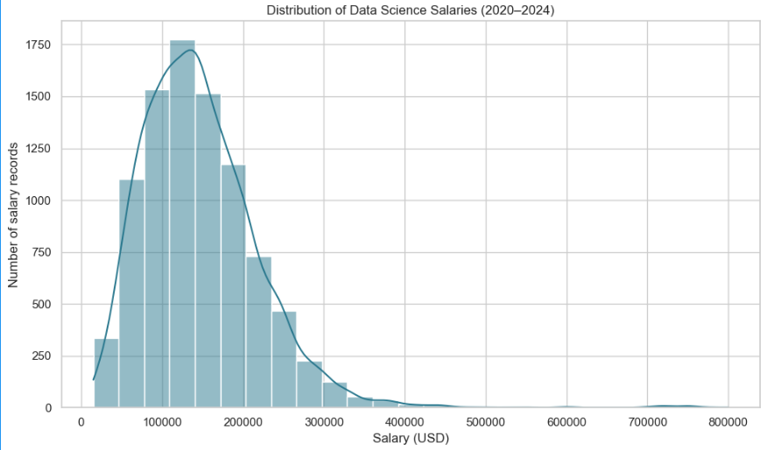
Exploratory analysis I
Distribution and area-level comparison
Salary Distribution
Highest-paying job titles
The salary histogram shows how salary records are distributed in USD, revealing the concentration of observations, spread, and potential extreme values.
A ranking of job titles by average salary in the latest available year highlights roles with high recorded average compensation.
Key interpretation:
Salary distributions may be skewed, and averages can be affected by unusually high or low observations.
Rankings describe the available records and do not guarantee what an individual will earn.
7

Slide 8
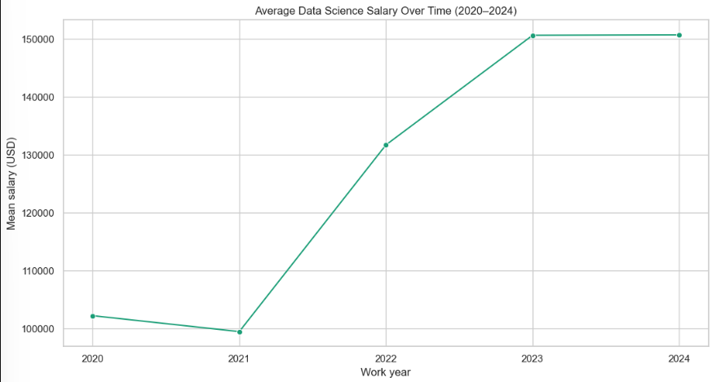
Exploratory analysis II
Salary trends over time
The salary dataset contains records from 2020 to 2024. Year-wise analysis compares average and median salaries across this period.
What to examine
Changes in average salary across years.
Differences between average and median salary.
Variation in the number of records per year.
Interpret carefully
The dataset contains different numbers of salary records in each year. Changes in the observed averages may reflect differences in job titles, experience levels, and record composition, rather than changes affecting every worker.
87

Slide 9
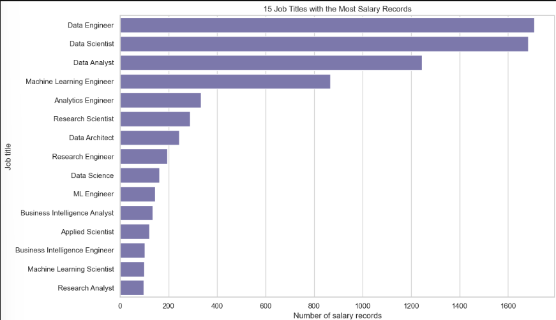
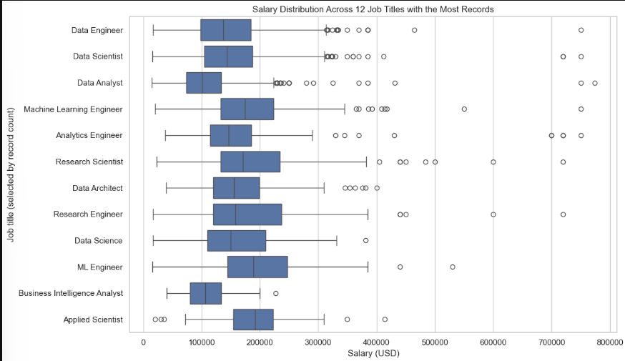
Exploratory analysis III
Experience-level comparison:
Salary records are grouped into Entry-level (EN), Mid-level (MI), Senior-level (SE), and Executive-level (EX) categories to compare salary distributions.
Salary distribution by year
Data availability
Boxplots summarize the median, spread, and potential outliers in salary records across 2020–2024.
A heatmap compares the percentage of available values in each column of the salary and job-postings datasets.
Key interpretation:
Missing data and outliers require careful interpretation. A missing value does not represent zero, and an outlier is not
automatically an error.
8

Slide 10
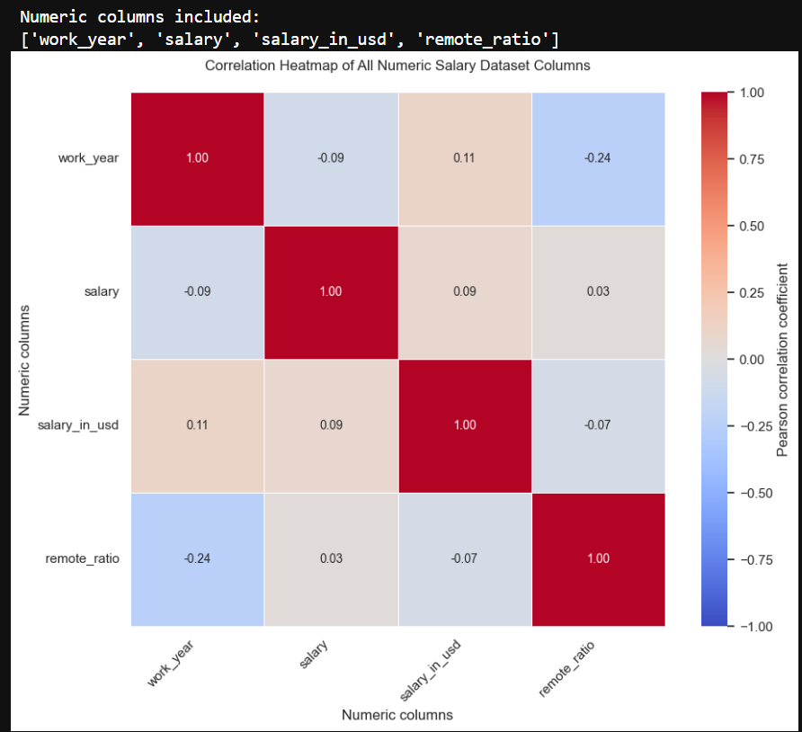
Exploratory analysis IV
Correlation heatmap: useful, but not causal evidence
What it helps reveal
Whether numeric variables move together.
The strength and direction of pairwise linear associations.
Potential relationships worth investigating further.
What it cannot prove
Correlation does not establish cause and effect. Salary, salary in USD, work year, and remote ratio have different meanings, and relationships can be affected by the composition of the dataset.
9

Slide 11
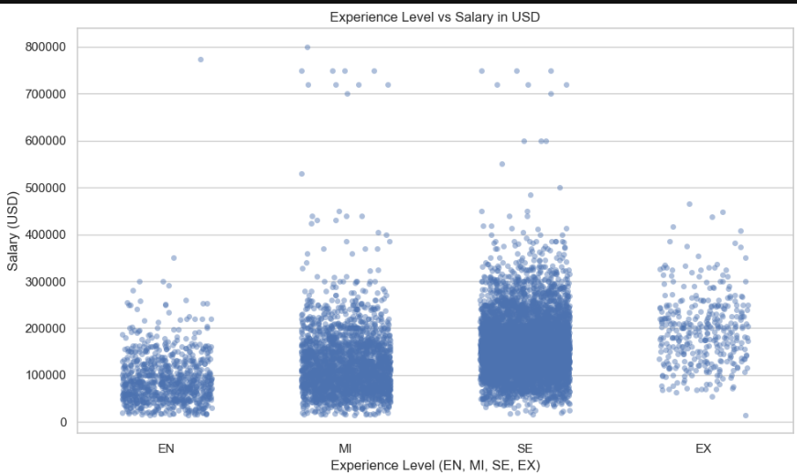
Supporting analysis: import dependency vs. undernourishment
Matched observations
Pearson correlation
Interpretation
Salary distribution varies by experience level; senior-level roles generally show higher salaries.
14,838 salary records
Not applicable to this analysis
10

Slide 12
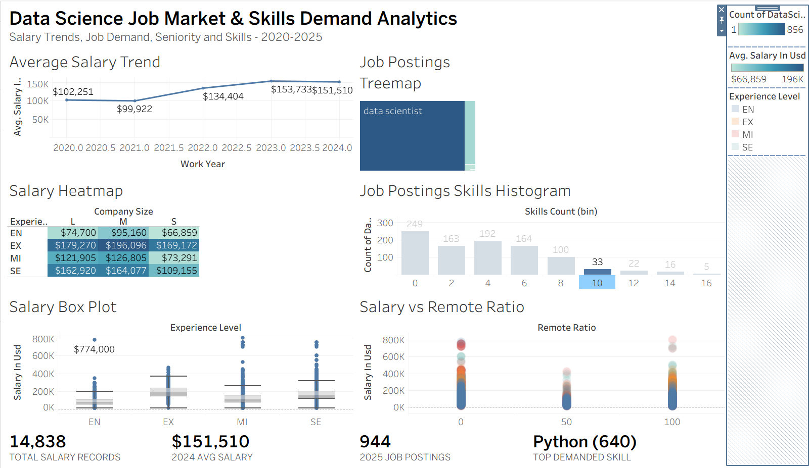
Interactive Tableau dashboard
Interpretation: Analyze salary trends and distributions using the 2020–2024 salary dataset, and explore skills demand using the 2025 job-postings dataset. Use the available filters to compare job titles, experience or seniority levels, industries, and locations. Interpret each chart according to its indicator, unit, time period, and selected filters.
11

Slide 13
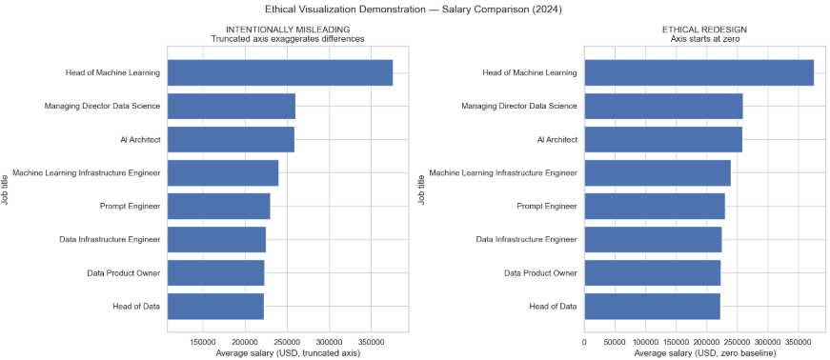
Misleading visualization and ethical redesign
The same values can tell a different story when the axis is distorted
Intentionally misleading
Truncated Y-axis exaggerates salary differences.
Missing labels and units can mislead viewers.
Ethical correction
Use an appropriate, consistent scale.
Label axes, salary units (USD), and years clearly.
Display relevant filters.
The data are unchanged; the visual framing is what changes.
12

Slide 14
Key findings
Evidence-led observations from the analysis
Dataset coverage
Temporal summary
Salary data from 2020–2024 and job postings from 2025.
Analyze salary trends across years to identify changes over time.
Country differences
Relationship analysis
Compare salaries across employee residence and company locations.
Explore relationships between salary, experience level, job title, and remote-work ratio.
13

Slide 15
Conclusion, limitations, and demonstration
What to communicate during the final presentation
Conclusion
Limitations
Recommendations
Analyzed data science salaries, job trends, and skills demand.
Explored salary patterns across years, countries, and experience levels.
Salary and job-posting datasets cover different time periods.
Missing values, duplicate records, and inconsistent salary formats may affect analysis.
Findings may not represent the entire job market.
Develop skills aligned with frequently requested job-posting skills.
Compare salaries by experience, location, and job title.
Update datasets regularly for more relevant insights.
LIVE DEMO CHECKLIST
• Open the Tableau workbook and explain each dashboard view.
• Change a filter and explain what changes in the dashboard.
• Explain missing values, threshold proxies, and multi-year periods.
• Compare the misleading chart with its zero-baseline correction.
14

