Slide 1
Acme Support
AI customer support
with human assistance
Vaishnavi Anand / Siya Munjal
Aastik Madaan / Gargi Gupta
Python / Streamlit / Azure AI Foundry / SQLite
01
Notes:
Introduce this as a working customer-support prototype. The focus is order questions and a human handoff inside the same conversation. No production adoption or performance claims are implied.
Project source: repo/README.md at commit 61e71f7. Repository: https://github.com/Vaishnavi120605/customer-support-ai-demo. September 2026.

Slide 2
The support problem
Customers need answers.
Some requests need a person.
Routine questions
Requests that need judgment
Order status, delivery dates, and store policies.
Refund exceptions, disputes, and explicit requests for human help.
02
Notes:
Describe the problem the project addresses rather than claiming measured improvements. Routine order questions can use stored order data. Exceptions need a specialist. Customers should retain their conversation context during that transition.
Project source: repo/README.md at commit 61e71f7. Repository: https://github.com/Vaishnavi120605/customer-support-ai-demo. September 2026.

Slide 3
The project at a glance
Customer chat
Support console
Customers enter order details, ask questions, and request a specialist.
Specialists view the transcript, send replies, and close tickets.
One saved conversation
Customer, AI, and human messages share a chronological history.
03
Notes:
The app has two Streamlit pages. Both use the same SQLite database. Foundry generates AI responses while the service layer supplies order context and manages the handoff. The support console does not need an Azure AI call to send human replies.
Project source: repo/ui/app.py; repo/support/console.py; repo/services/support_service.py at commit 61e71f7. Repository: https://github.com/Vaishnavi120605/customer-support-ai-demo. September 2026.

Slide 4
Application architecture
Interface
Streamlit customer chat and support console
Application
Python order lookup and conversation routing
AI service
Azure AI Foundry prompt agent
Persistence
SQLite orders, messages, tickets, and audit events
04
Notes:
Read these layers top to bottom. The customer UI invokes the service layer, which retrieves SQLite data and supplies grounded context to the Foundry runtime. The support UI writes replies through SQLite. Both pages poll for updates. These are component roles, not separate deployed microservices.
Project source: repo/ui/app.py; repo/services/support_service.py; repo/foundry/runtime.py; repo/support/console.py at commit 61e71f7. Repository: https://github.com/Vaishnavi120605/customer-support-ai-demo. September 2026.

Slide 5
Customer experience
CUSTOMER
“Where is my order?”
ACME AI
“Your order has shipped.
Here is the estimated delivery date.”
Order context stays with the conversation after a refresh.
05
Notes:
The wording on this slide is an illustrative demo conversation, not a transcript of a measured test. The interface aligns customer messages to the right and AI or human messages to the left. The application stores order context and message history for the conversation.
Project source: repo/ui/app.py; repo/services/chat_style.py at commit 61e71f7. Repository: https://github.com/Vaishnavi120605/customer-support-ai-demo. September 2026.

Slide 6
Human assistance
01
Customer requests a human
The app opens a ticket with the transcript and context.
02
Specialist takes the conversation
Human replies appear in the same customer chat.
03
Customer chooses what happens next
Continue with the specialist or switch back to AI.
04
Specialist resolves the ticket
The chat displays a closure notice and stops new messages.
06
Notes:
The customer explicitly asks for a human. The application creates or reuses a handoff ticket. Human mode keeps the AI silent for ordinary follow-up messages. The customer can switch back to AI. Resolving the conversation adds a closure message and disables further input.
Project source: repo/ui/app.py; repo/services/support_service.py; repo/support/console.py at commit 61e71f7. Repository: https://github.com/Vaishnavi120605/customer-support-ai-demo. September 2026.

Slide 7
The support workspace
Current customer first
Context beside the reply
The default view shows the latest active ticket.
The specialist sees history, order details, and the handoff reason.
Stable ticket selection
Visible resolution
Sending a reply keeps the same case selected.
Closing a ticket notifies the customer and closes the conversation.
07
Notes:
The default current-customer view selects the latest active ticket. It is a demo-focused inbox view, not a rule for deleting older tickets. Other filters keep history accessible. Sending a reply changes the ticket to waiting_customer and should preserve selection. Two-second polling updates both interfaces.
Project source: repo/support/console.py; repo/ui/app.py at commit 61e71f7. Repository: https://github.com/Vaishnavi120605/customer-support-ai-demo. September 2026.

Slide 8
Data and response boundaries
Stored order facts guide the answer
Lookup retrieves order status and delivery information from SQLite.
A supplied email must match the order’s customer.
When the app cannot verify an answer
Missing orders or AI service failures create a human handoff.
Azure identity handles access to the AI service.
08
Notes:
Order lookup checks the order number and, when supplied, the email. Email is optional in this demo and this is not full customer authentication. Azure identity authenticates the app to Foundry, not the customer to their order. The support role is a demo role. Production would need stronger access control.
Project source: repo/services/support_service.py; repo/foundry/runtime.py; repo/ui/app.py; repo/.gitignore at commit 61e71f7. Repository: https://github.com/Vaishnavi120605/customer-support-ai-demo. September 2026.

Slide 9
Live demonstration
Demo order
01
Ask: “Where is my order?”
CS-1001
02
Request human assistance
alex.morgan@example.com
03
Reply from the support console
04
Resolve and show the closure notice
09
Notes:
Use two browser tabs with both Streamlit processes running and a valid Azure login. CS-1001 is a seeded demo order. Ask where the order is, then ask for a human. In the console enter a specialist name, assign the ticket, and reply. After the customer follows up, send the next human reply. End by resolving and show the closure notice.
Project source: repo/database/seed.py; repo/ui/app.py; repo/support/console.py at commit 61e71f7. Repository: https://github.com/Vaishnavi120605/customer-support-ai-demo. September 2026.

Slide 10
Verification and improvements
5
Workflow checks
Reply saves to the conversation
Selection survives status changes
Refresh restores the selected case
Latest active ticket opens by default
offline quality checks passed
Validation covers demo behavior. Model accuracy and scale need separate evaluation.
10
Notes:
Five offline quality tests passed. These are contract checks for scenarios, instructions, and schema, not evidence of model accuracy. Streamlit AppTest checks exercised ticket selection after reply, rerun and refresh, and the current-ticket view. Previous project verification covered message ordering and resolution behavior. No benchmark of latency, cost, or concurrent-user performance is included.
Project source: repo/quality/tests/test_offline_quality.py; project verification runs for commits 383bf3c and 61e71f7 at commit 61e71f7. Repository: https://github.com/Vaishnavi120605/customer-support-ai-demo. September 2026.

Slide 11
Next development priorities
Identity and access
Team operations
Customer sign-in and authenticated support-agent roles.
Concurrent-agent assignment and a shared production database.
AI evaluation
Deployment
Measure factual accuracy and strengthen multi-turn context.
Hosted access, monitoring, backups, and usage controls.
11
Notes:
These are future improvements, not implemented capabilities. The current app is a local prototype with seeded data and a demo support role. A production service needs customer authentication, agent authorization, concurrent-agent queue handling, stronger AI history grounding, and deployment/operational controls.
Project source: repo/ui/app.py; repo/support/console.py; repo/foundry/runtime.py; repo/README.md at commit 61e71f7. Repository: https://github.com/Vaishnavi120605/customer-support-ai-demo. September 2026.

Slide 12
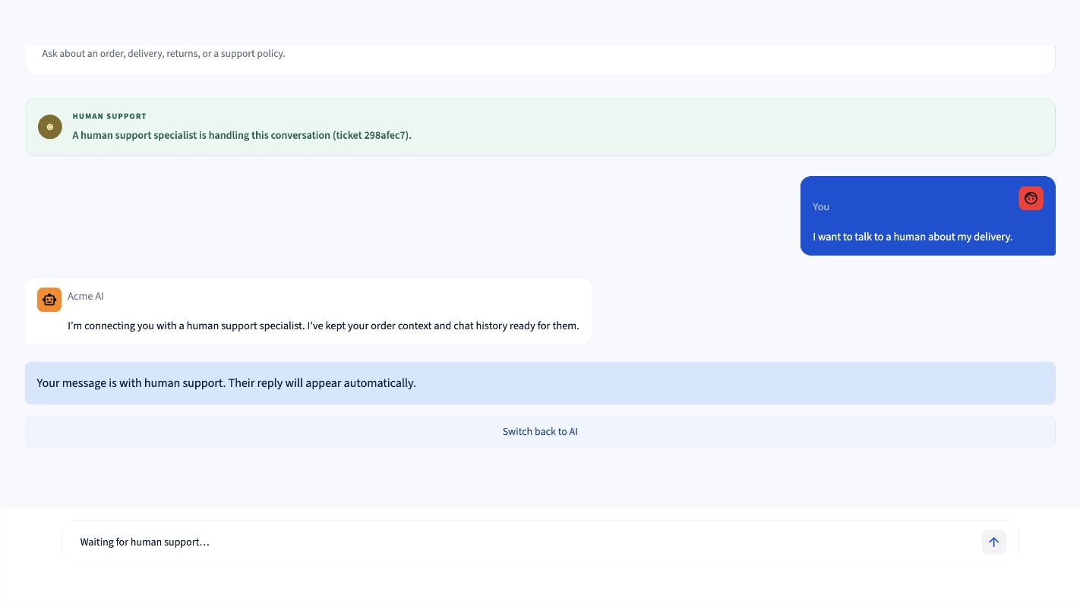
Customer handoff in the running prototype
Customer request on the right. AI acknowledgement and handoff status on the left.
12
Notes:
Actual application screenshot. Customer request on the right. AI acknowledgement and handoff status on the left.
Project source: /Users/vaishnavianand/Documents/Codex/2026-09-21/i-am-working-on-a-project/.presentation-build/customer-demo.png at commit 61e71f7. Repository: https://github.com/Vaishnavi120605/customer-support-ai-demo. September 2026.

Slide 13
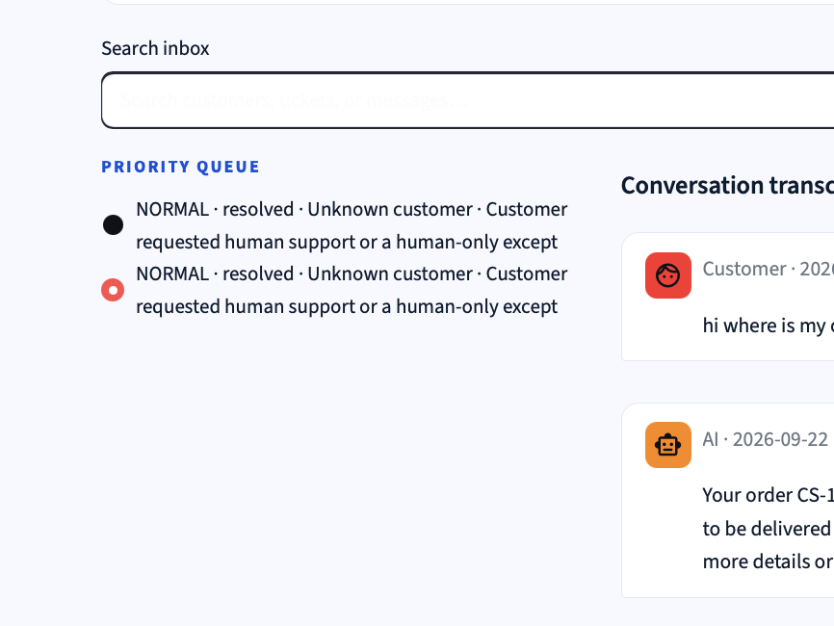
Support queue and conversation transcript
Earlier prototype screenshot: ticket selection beside the conversation transcript.
13
Notes:
Actual application screenshot. Earlier prototype screenshot: ticket selection beside the conversation transcript.
Project source: /var/folders/2n/1219sy8n0kxdgqcrx6194hb40000gn/T/codex-clipboard-f9135637-155b-4eae-ba56-916391314be3.png at commit 61e71f7. Repository: https://github.com/Vaishnavi120605/customer-support-ai-demo. September 2026.

Slide 14
Project takeaway
A complete support conversation
AI handles routine questions.
A specialist takes over when the customer needs help.
Questions & live demo
14
Notes:
The project demonstrates an AI-to-human support loop. The GitHub repository is public. The prototype runs locally and is not a hosted public application.
Project source: repo/README.md at commit 61e71f7. Repository: https://github.com/Vaishnavi120605/customer-support-ai-demo. September 2026.

