Slide 1

Business Problem:
Fraud can take place in various forms, and it affects the industry economically, although not in equal measure. The sectors that deal with it uses various techniques to overcome the fraudulent cases.
Objective
The objective of Warranty Claims is to Analysis the problem and Predicting whether the customer Claims is fraudulent or Genuine.
Predict whether a customer is going to claim or not, we have to decide using classification algorithm.

Slide 2
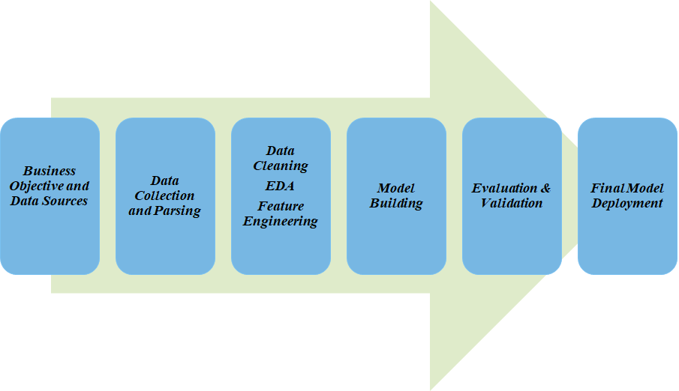
Project Architecture / Project Flow

Slide 3
Exploratory Data Analysis (EDA) and
Feature Engineering

Slide 4
Data set details
Data Set File: Claims.csv
Rows: 11917
Columns: 20
Datatype: 20 columns
NA’s are identified in the column:Claim_Value
Null Values: 333
Duplicate values: 11559
Some Column Details:
Region - Tot. no. of Regions = 8
State - Tot. no. of States = 22
City- Tot no. of City = 27
Product_type- Type of the product_Tv/Ac
AC_1001_Issue- 1001 is failure of Compressor in AC
AC_1002_Issue- 1002 is failure of Condenser Coil in AC
AC_1003_Issue- 1003 is failure of Evaporator Coil in AC
TV_2001_Issue- 2001 is failure of power supply in Tv
TV_2002_Issue- 2002 is failure of Inverter in Tv
TV_2003_Issue- 2003 is failure of Motherboard in Tv
Service_Centre- 7 Different service centers
Fraud- '1'- fradulent claim, '0' Genuin claim (‘1’ = 988, ‘0’ = 10929)

Slide 5
Exploratory Data Analysis (EDA)
Mean, Std. Dev
Count Mean Std. Dev.
AC_1001_Issue 358.0 0.332402 0.629446
AC_1002_Issue 358.0 0.329609 0.615182
AC_1003_Issue 358.0 0.203911 0.529559
TV_2001_Issue 358.0 0.377095 0.621943
TV_2002_Issue 358.0 0.452514 0.670910
TV_2003_Issue 358.0 0.268156 0.508353
Claim_Value 349.0 12159.69 12167.422
Service_Centre 358.0 12.812849 1.766844
Product_Age 358.0 201.843575 259.731564
Call_details 358.0 11.931844 11.559474
Fraud 358.0 0.097765 0.297413

Slide 6
EDA
Median
AC_1001_Issue 0.0
AC_1002_Issue 0.0
AC_1003_Issue 0.0
TV_2001_Issue 0.0
TV_2002_Issue 0.0
TV_2003_Issue 0.0
Claim_Value 7370.0
Service_Centre 13.0
Product_Age 60.0
Call_details 6.5
Fraud 0.0

Slide 7
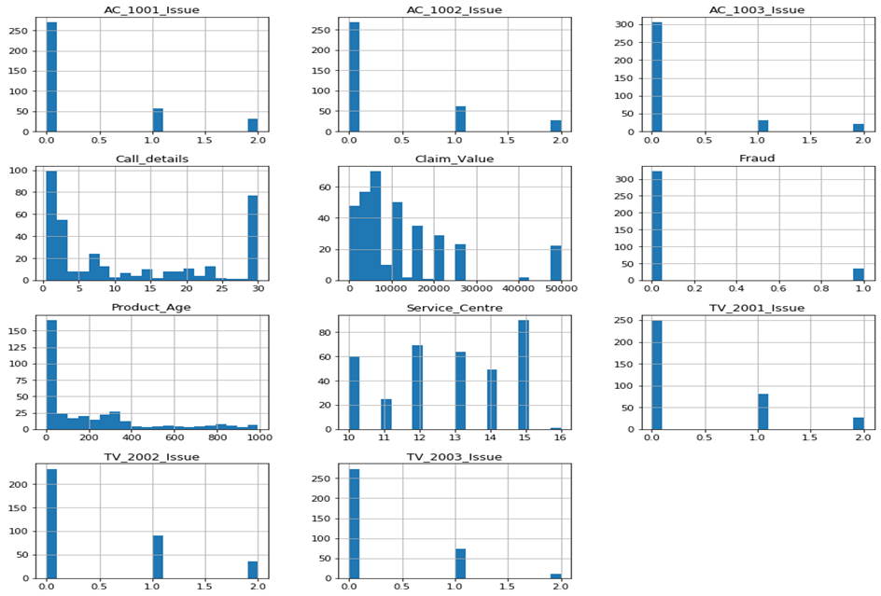
Histogram

Slide 8
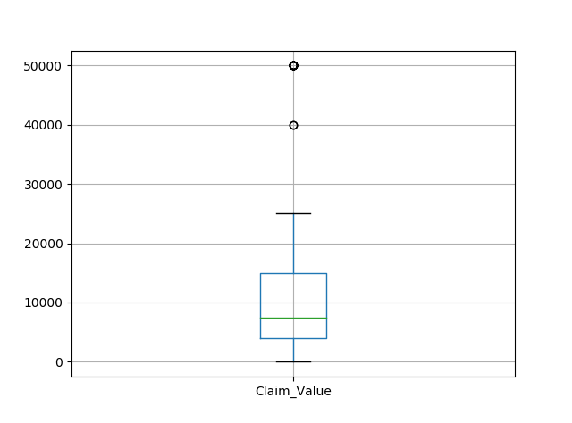
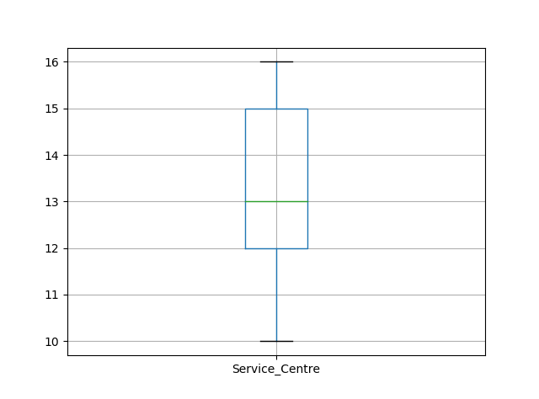
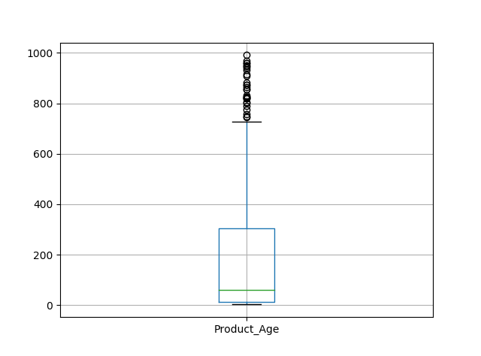
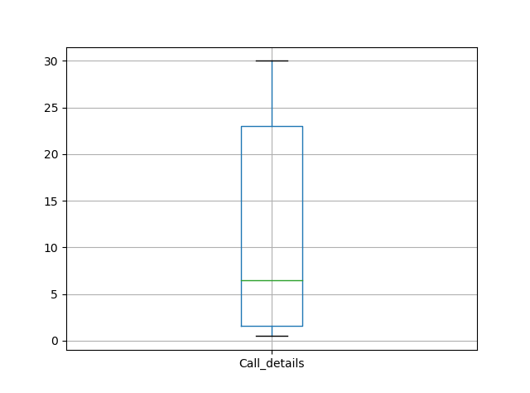
Boxplot

Slide 9
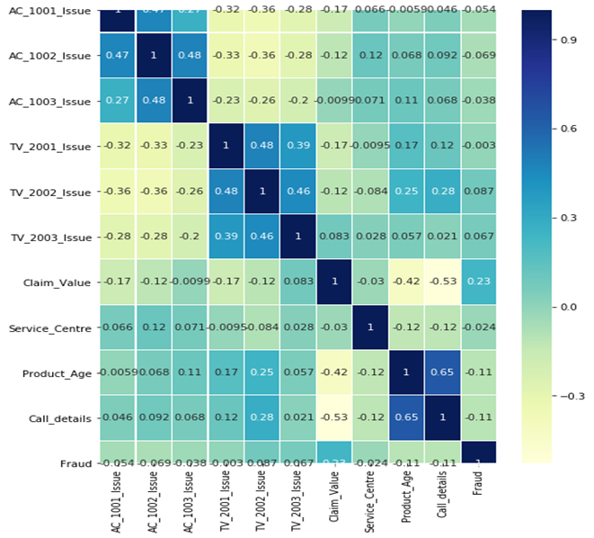
Heatmap- Correlation Matrix

Slide 10
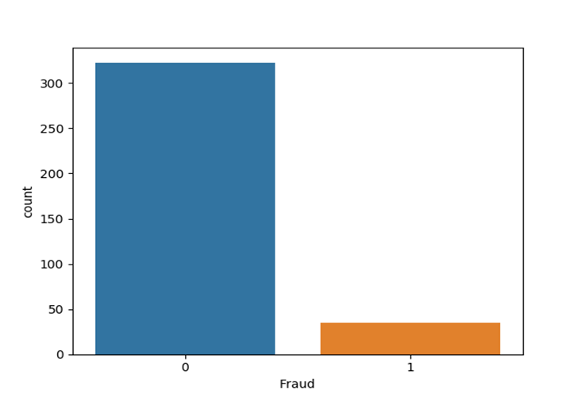
Count Plot
323
35

Slide 11
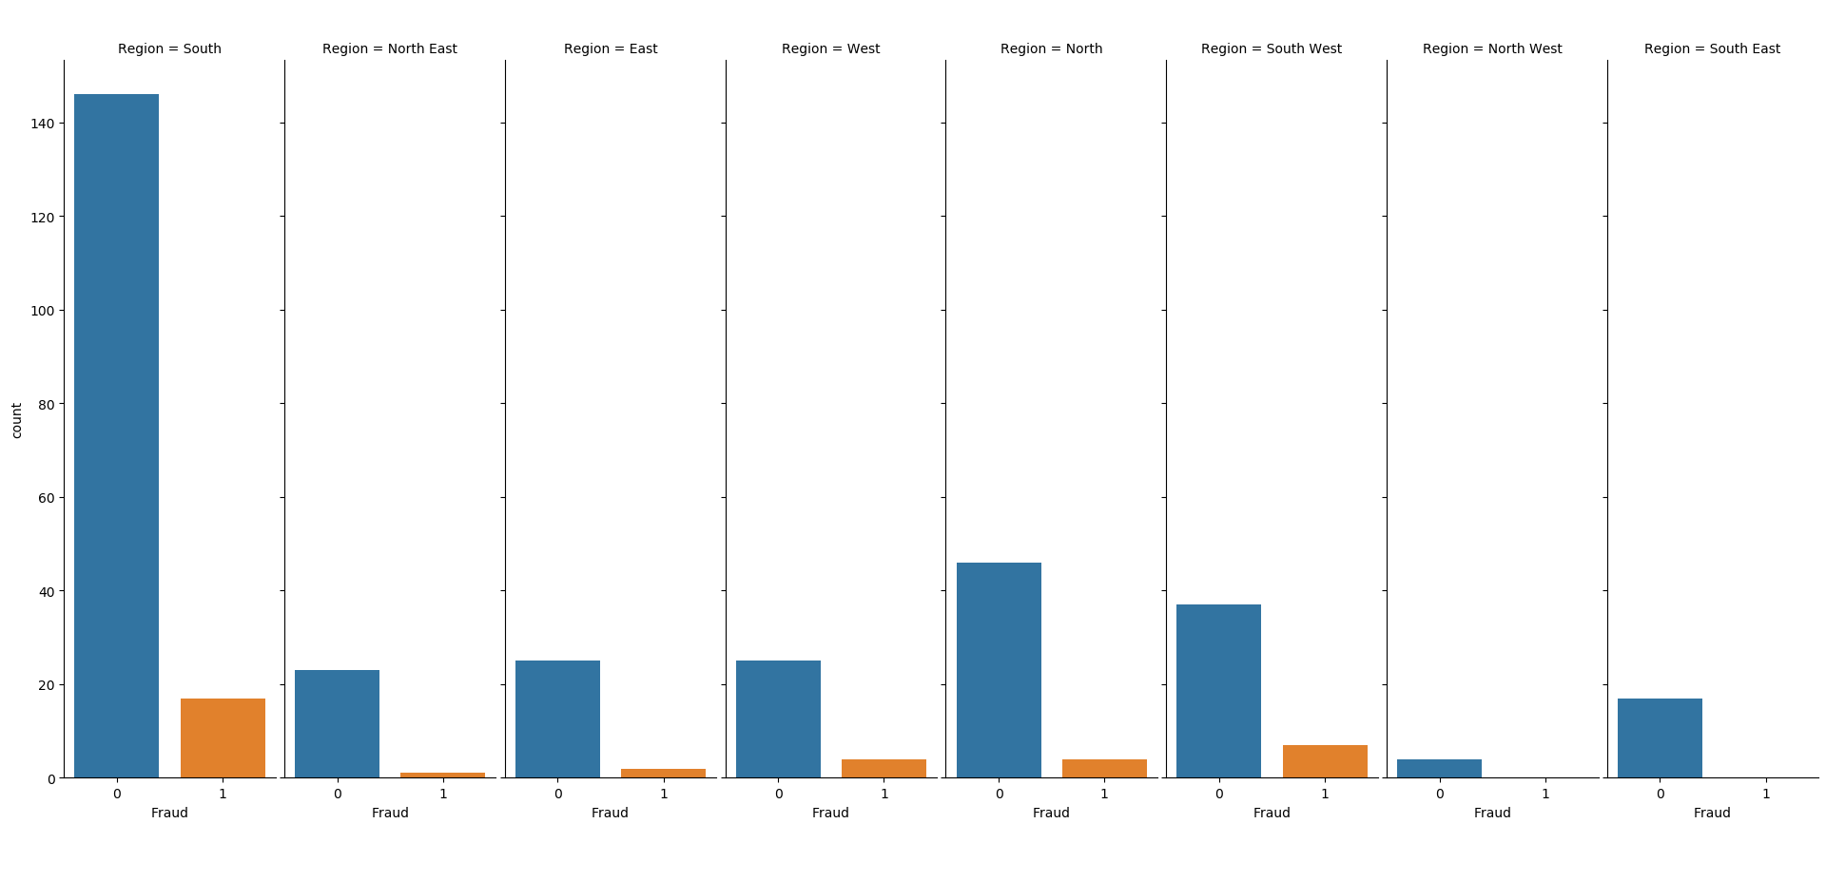
Factor Plot

Slide 12
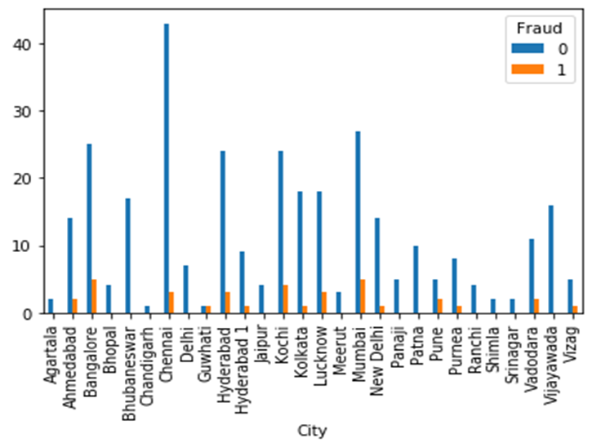
Cross Table Fraud vs City Plot

Slide 13
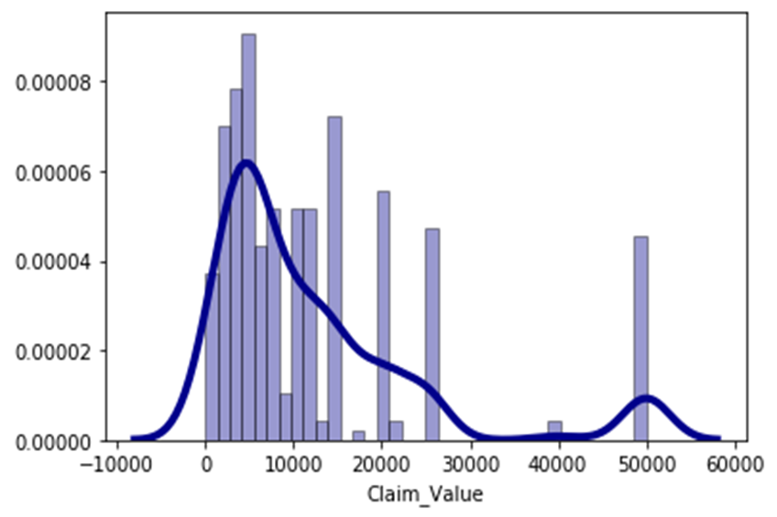
Density Plot

Slide 14
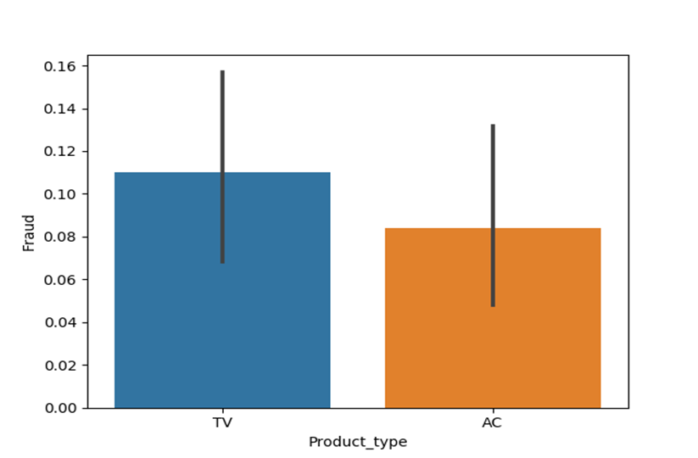
Bar Plot

Slide 15
Steps Taken before Model Building
Checked for Duplicate Values and Removed then performed further operation on remaining values.
By using Label Encoder to encode the labels with a value between 0 and n_classes-1.
Performed Median Imputation to fill NA values.
Performed Standardization - It transforms the data in such a manner that it has mean as 0 and standard deviation as 1. It arranges the data in normal distribution. It is more useful in classification than regression.
Performed Balancing operation to balance the count of output variable in proper ratio. Oversampling performed better than SMOTE and under sampling.
Performed Feature Selection using Tree Classifier.

Slide 16
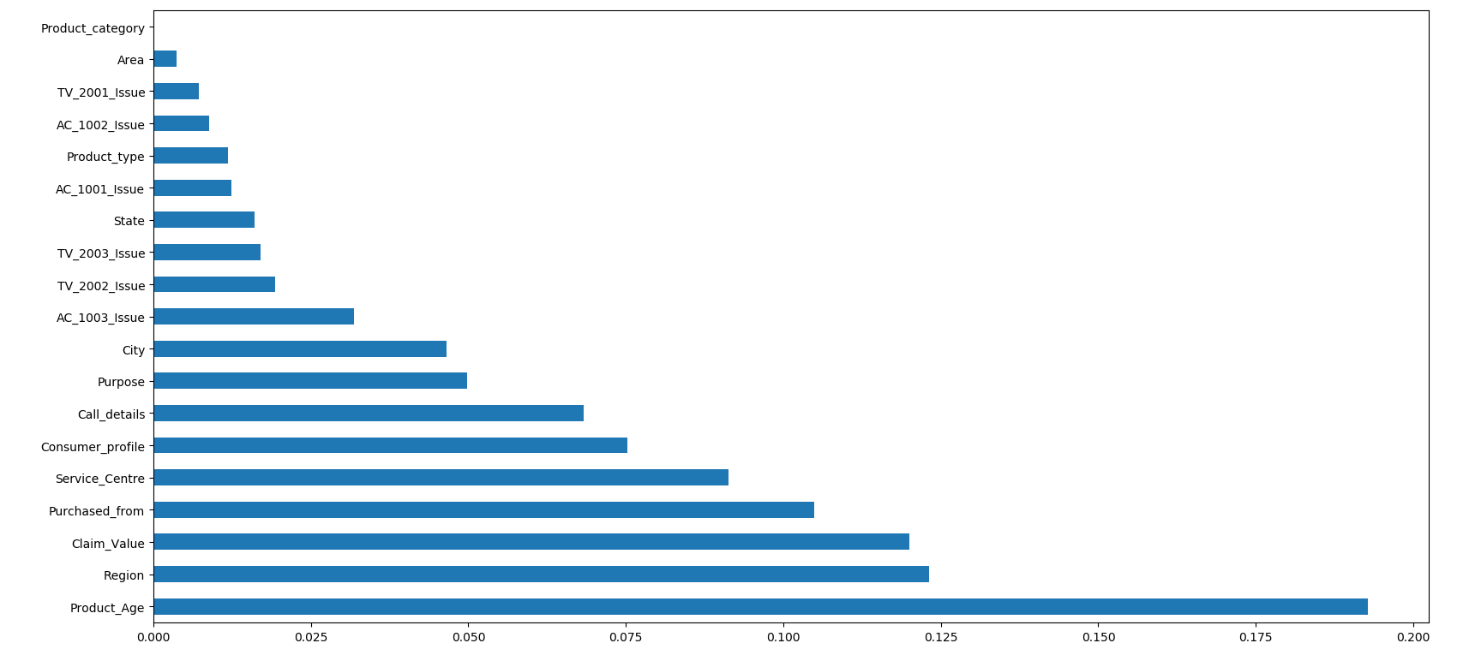
Feature Selection Graph

Slide 17
Model Building

Slide 18
Cross Validation for Model Selection
• Performed Cross validation technique before building the final model.
• We build various models and checked accuracy, like
Random Forest - 96.55%,
Adaboost classifier - 93.61%,
XGBClassifier - 94.11%,
Catboost - 95.39%,
MLP classifier - 94.88%,
Ridge Classifier - 77.78%.
• From all the models Random Forest gave Better result so we have selected Random Forest as Final Model and performed model evaluation.

Slide 19
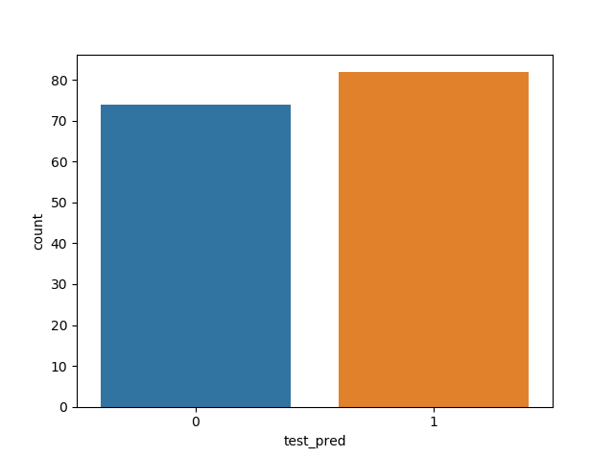
Final Model Results
Model generated the output for the claim test data(156 rows) set in which 74 transactions are genuine(0) claims and 82 transaction are fraudulent(1)
74
82

Slide 20
Final Model Evaluation
Train Data - 60%
Test Data - 40%.
Here, we got the train accuracy - 97.84% and the test accuracy is equal to 96.9%.
Also we evaluated model using,
Precision - 96.88%,
Recall - 96.51%,
F1_score - 96.70%.

Slide 21
Model Deployment using Flask

Slide 22
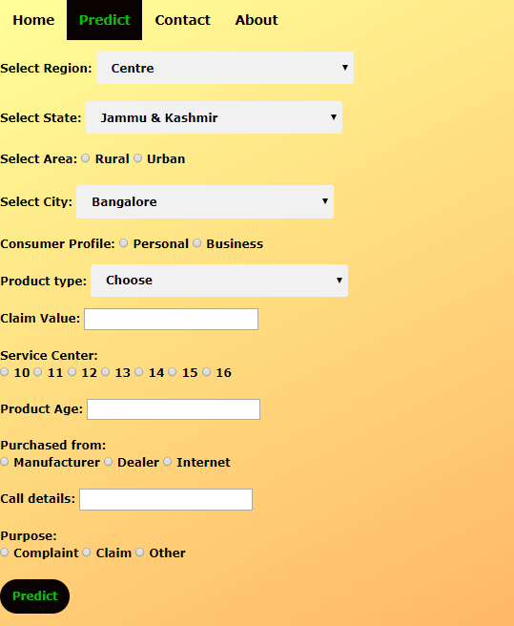

Slide 23
Challenges faced?
The Dataset is not well organised means regions, state variable not In proper manner so Data Cleansing is big task.
Faced issues in Output variable (Fraud), because ratio of 0 is much more than 1.
How did you overcome?
To overcome this problem we did Data Cleaning by arranging each state to their respective Regions According to Map of India, and secondly some States name is repeated so we converted them into one state names.
We used balancing Technique to overcome this balancing problem, we used Oversampling ,Under sampling and SMOTE Technique and we successfully balanced the data.

Slide 24


