Slide 1
Task 4: Power BI Dashboard
Power BI Financial Dashboard Summary

Slide 2
Dashboard Objective
Analyze sales and profit performance
Understand product profitability
Identify trends over months and years
Enable interactive filtering via slicers

Slide 3
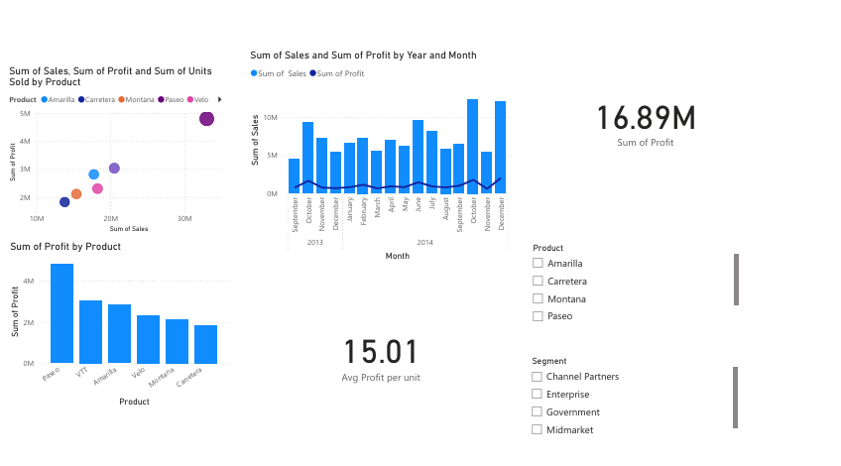
Full Dashboard Snapshot

Slide 4
1. Scatter Chart: Sales vs Profit vs Units
Shows relationship between sales, profit, and units sold
Each bubble represents a product (Paseo, Amarilla, Velo, etc.)
Larger bubbles = higher units sold
Paseo and Velo show strong performance
Helps identify products with high impact

Slide 5
2. Monthly Sales & Profit Trend (Bar + Line Chart)
Bar chart represents monthly sales
Line chart represents monthly profit
Clear seasonal variations visible
Peak sales observed in December
Useful for identifying performance cycles

Slide 6
3. Profit by Product (Bar Chart)
Displays total profit for each product
Paseo is the highest profit-generating product
Carretera shows the lowest profit
Supports decision making for inventory & marketing focus

Slide 7
4. KPI Cards: Total Profit & Avg Profit per Unit
Total Profit: 16.89M
Avg Profit per Unit: 15.01
Gives overall business performance at a glance
Helps stakeholders quickly assess profitability

Slide 8
5. Slicers: Product & Segment
Filters available for product and customer segment
Makes dashboard interactive and user-driven
Allows personalized insights for each category
Useful for targeted business analysis

Slide 9
6. Final Insights
Paseo is a strong performer in both sales and profit
December sees the highest monthly sales
Profit trends remain stable throughout the year
Product performance varies across categories
Interactive slicers enhance the decision-making process

Slide 10
Conclusion
The dashboard enables strategic decision-making using visual trends, KPIs, and product-wise comparison. Interactivity enhances exploration and clarity.

