Slide 1



Project SEE Presentation
December 2024
Dayananda Sagar College of Engineering, Bangalore, Karnataka Department of Electronics & Communication Engineering
Project Batch No. : IOT-5 Subject code : 21ECP76
Integrated Bus Tracking and Safety Management System
USN : 1DS21EC159 (Sec-C)
USN : 1DS21EC226(Sec-D)
USN : 1DS21EC196 (Sec-D)
USN :1DS21EC202 (Sec-D)
Name : Raghavendra Yaragatti
Name : Vaishnavi
Name : Shrinivas V A
Name : Shubhavani P D
Project Guide:
Dr. H V Manjunath
Professor

Slide 2
CONTENTS
Introduction
Problem Statement and Objective
Literature Survey
Block Diagram
Methodology and Tools
CIE1 Comments and Correction
Results and Discussion
Advantages and Applications
Outcome
References

Slide 3
INTRODUCTION
The advancement in technology has enabled the Development of intelligent transport systems that enhance the safety, efficiency, and reliability of public transportation.
The design of Bus Tracking and Safety management system that leverages an Arduino microcontroller integrated with various sensors to monitor key aspects of bus operation.
It includes the monitoring of Emission levels to ensure compliance with environmental standards, temperature to prevent overheating.
Tire pressure to prevent accidents caused by underinflation, Vehicle stability, and also detects accidents or significant impacts, triggering immediate alerts.
All data is transmitted to the Blynk IOT platform using a Wi-Fi module, where it is visualised in real time.
In case of an accident, the system sends instant alerts to designated user and also share its location.

Slide 4
PROBLEM STATEMENT
The increasing complexity of urban transportation systems has highlighted the need for enhanced monitoring and management of bus fleets to ensure safety, efficiency, and environmental compliance. Current systems often lack integrated solutions that can simultaneously monitor critical parameters such as emissions, temperature, vehicle stability, tire pressure, and accident detection in real-time.
To address these challenges, An IoT-based bus tracking and monitoring system that can provide real-time data and alerts, enabling fleet managers to maintain optimal bus performance, enhance passenger safety, and reduce environmental impact.

Slide 5
OBJECTIVES
Bus Safety Monitoring: Monitoring of Emission levels, Temperature, Tire pressure, Vehicle Stability and Accident detection and immediate alerting.
Real Time Location Tracking: To accurately track the bus’s location using GPS, facilitating effective route management and providing real time updates to fleet management.
Data Integration And Visualization: All sensor data is transmitted to Blynk IOT platform, where it is visualized in real time.
Enhanced Fleet Management: With a unified system that improves decision-making, enhances safety protocols.

Slide 6
LITERATURE SURVEY
Sr. No. | Title of the Paper | Author(s) & Year | Outcome | Limitations
1 | IoT-Based Bus Fleet Monitoring and Management System | Wang et al. (2021) | Improved fleet management through real-time data on vehicle performance and location. | High implementation cost and limited scalability for larger fleets.
2 | Real-Time Vehicle Emission Monitoring | Sawant et al. (2021) | Continuos emission monitoring ensures environmental compliance. | Requires frequent maintenance and calibration of sensors.
3 | Vehicle Accident Detection and Monitoring System | Singh et al. (2021) | Enhanced safety through immediate alerts in case of accidents | Limited accuracy in detecting low-impact accidents
4 | Real-Time Monitoring of Vehicle Tire Pressure | Yang et al. (2020) | Improved safety by alerting drivers to tire pressure deviations. | Sensor battery life issues and inaccuracies in harsh conditions.

Slide 7
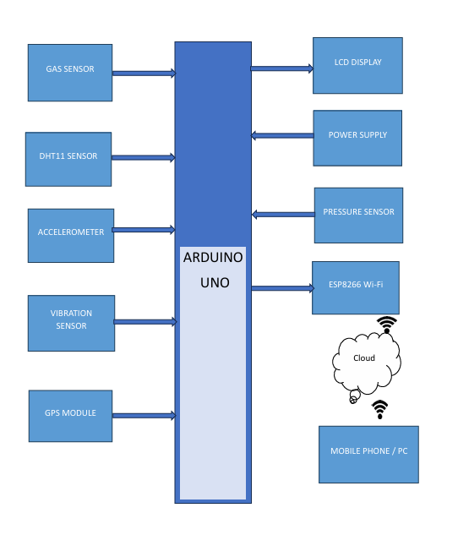
BLOCK DIAGRAM

Slide 8
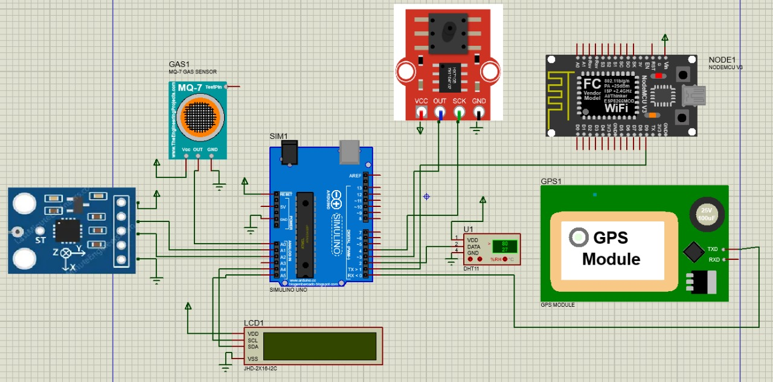
Circuit Diagram

Slide 9
Hardware & Software Tools
Hardware Tools
Arduino Uno
LCD Display
Gas Sensor
ESP8266 NodeMCU
GPS
Vibration Sensor
Accelerometer
Software Tools
Arduino IDE
Embedded C & C++
Blynk IOT

Slide 10
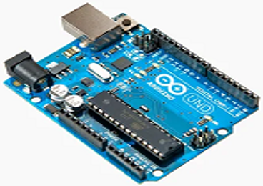
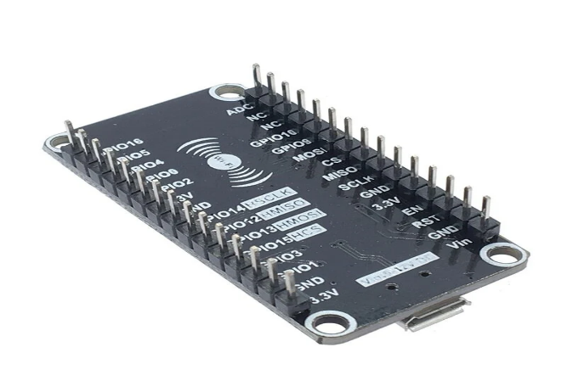
ARDUINO UNO
The Arduino Uno is an open-source microcontroller board based on microchip ATmega328P microcontroller.
14 Digital I/O pins(6-PWM o/p pins).
6 Analog input pins.
Clock speed-16Mhz, Operating Voltage-5v.
ESP8266 Wi-Fi Module
It is an affordable Wi-Fi microchip with an integrated TCP/IP stack
Microcontroller:
32-bit RISC CPU: Tensilica L106 running at 80 MHz (can be overclocked to 160 MHz)
Connectivity:
Wi-Fi: 2.4 GHz IEEE 802.11 b/g/n
Voltage: 3.0V to 3.6V
Interfaces: SPI, I²C, I²S, UART, PWM

Slide 11
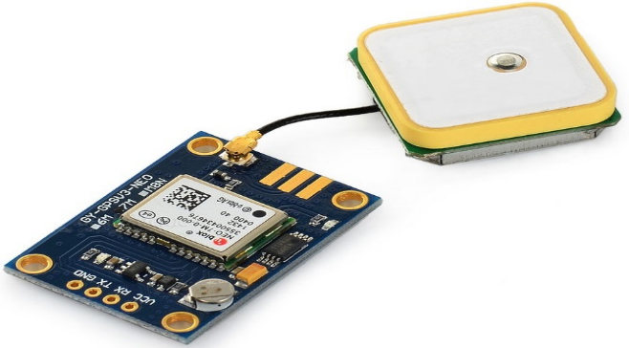
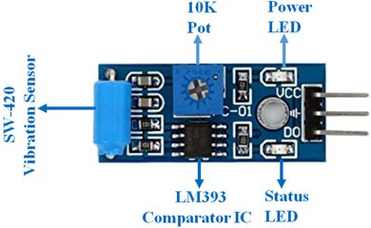
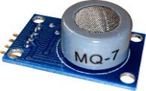
GPS Module
The NEO-6MV2 is the name of the GPS (Global Position System) module that is used in satellites for navigation.
Standalone GPS Receiver, Anti-jamming Technology, Maximum Navigation Update Rate: 5 Hz
Vibration Sensor
The vibration sensor module based on the vibration sensor SW-420 and Comparator LM393 is used to detect vibrations.
The threshold can adjust using an on-board potentiometer
Operating Voltage: 3.3V to 5V DC, Operating Current: 15mA.
MQ-7 Gas Sensor
They are used in gas detecting equipment for carbon monoxide(CO) in family and industry or car.
High sensitivity to carbon monoxide
Stable and long life
DEPT OF ECE, DSCE

Slide 12
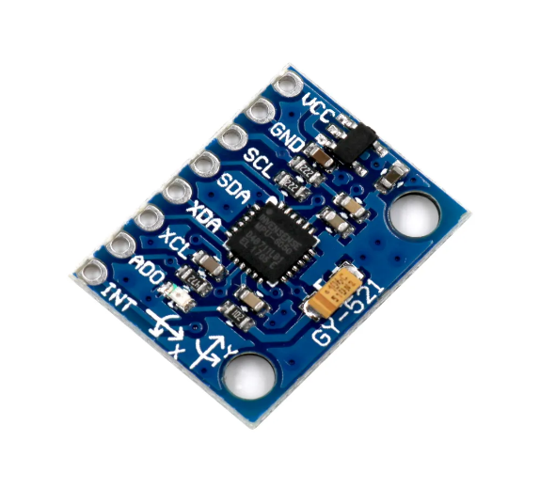
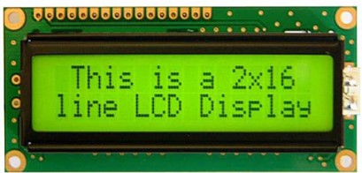
Accelerometer
The ADXL345 is a compact, low-power, full 3-axis MEMS accelerometer module.
The ADXL345 board has an on-board level shifter and 3.3V voltage regulator, which makes interacting with 5V microcontrollers like the Arduino easy.
Supports both SPI and I2C communication protocols.
LCD Display
16X2 LCD Display with I2C interface is an alphanumeric display that can show up to 32 characters on a single screen.
We can display more characters by scrolling the texts one by one.
Inter-integrated Circuit (in short I2C) is a two-wire short distance communication protocol.
A LCD Display 16x2means it can display 16 characters per line and there are 2 such lines. In this LCD each character is displayed in the 5×7 pixel matrix.
DEPT OF ECE, DSCE

Slide 13
The ranges of some parameters like Tyre pressure, inside temperature, and Accelerometer are,
Tyre Pressure: It also depends on type of bus, Load, Tyre size, Manufacture’s recommendations
In Normal Condition:
Front Tyres- Around 90-100 PSI(Pascals per square inches)
Rear Tyres(Dual Wheels)- Around 100-110 PSI
In Below Safe Range (Underinflation):
Front Tyres: Below 85 PSI
Rear Tyres: Below 95 PSI
Inside Temperature:
If outside temperature is 25 to 30°C, The inside temp. in bus is around 23 to 28 °C due to ventilation or AC system.
If bus is over-crowded, the inside temperature increases by 2 to 3 °C.
Accelerometer:
1g is the standard unit of acceleration used to describe the force of gravity on an object near the Earth's surface.
1g refers to the acceleration due to Earth's gravity, which is approximately 9.8 meters per second squared (m/s²)

Slide 14
Normal Conditions (Flat, Straight Road):
X-axis: 0g (no forward/backward acceleration)
Y-axis: 0g (no lateral movement)
Z-axis: 1g (normal gravitational pull)
Tilted Bus (Gradual Tilt or Swerve):
X-axis: Slight values like +0.2g to -0.2g (depending on forward/backward tilt)
Y-axis: Can show ±0.5g to ±1g depending on the angle of the tilt
Z-axis: May shift slightly, but around 1g unless the tilt is extreme
Accident (Rollover or Collision):
X-axis: Can spike to +2g or -2g or more, depending on the force and direction of impact.
Y-axis: In case of side impact or rollover, the reading can spike to ±3g or higher.
Z-axis: In extreme cases (rollover), it may show +2g, -2g, or larger oscillations as the bus rotates.

Slide 15
Arduino IDE:
The Arduino Integrated Development Environment (IDE) is a powerful and user-friendly platform designed for programming Arduino boards.
It provides a comprehensive environment for writing, compiling, and uploading code to Arduino hardware.
This software simplifies the process of interacting with microcontrollers, making it accessible to both beginners and advanced users.
The Arduino IDE supports various Arduino boards and compatible microcontrollers, enabling a wide range of applications from basic LED blinking to complex robotics projects.
Embedded C:
It is a specialized programming language extension of the C programming language, designed for use in embedded systems.
These systems are resource-constrained, with limited memory, processing power, and input/output capabilities.
DEPT OF ECE, DSCE

Slide 16
Embedded C retains the syntax and structure of standard C but includes additional features to handle hardware-specific tasks.
These features include direct access to hardware via memory-mapped registers, bit manipulation, and the ability to disable and enable interrupts.
These capabilities make Embedded C an ideal choice for programming microcontrollers and other embedded devices.
BLYNK IOT:
The core features of the Blynk IoT platform include a customizable mobile app, a cloud server, and an extensive library of pre-built widgets.
The mobile app allows users to create a virtual dashboard with widgets such as buttons, sliders, and gauges that interact with their hardware.
The cloud server ensures seamless communication between the mobile app and the IoT devices, handling data transmission and control commands.
Blynk supports a wide range of hardware platforms, making it highly versatile for different IoT projects.
DEPT OF ECE, DSCE

Slide 17
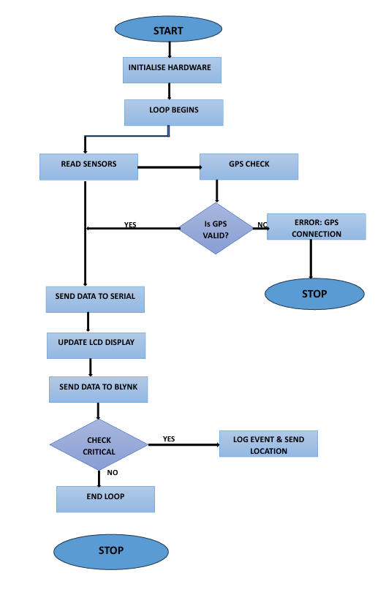
FLOW CHART

Slide 18
METHODOLOGY
The methodology involves several key stages, including System Design, Sensor Integration, Data Processing, and Real time Visualization.
System Design
The system is built around an Arduino microcontroller, which acts as the central hub for collecting and processing data from various sensors.
The initial design phase focuses on selecting and configuring the appropriate sensors, including those for measuring emissions, engine temperature, vehicle stability, tire pressure, and vibration, as well as a GPS module for real-time location tracking.
Sensor Integration
Each sensor is calibrated and tested to ensure its accuracy and compatibility with the Arduino system.
The emission sensor measures the level of pollutants emitted by the bus, while the temperature sensor monitors the engine's operating temperature. The accelerometer detects changes in vehicle stability, and the pressure sensor checks tire pressure.
Additionally, the vibration sensor is used to detect sudden impacts or accidents.
DEPT OF ECE, DSCE

Slide 19
Data Processing
Data from these sensors are continuously collected and processed by the Arduino
Then performs initial analysis and data fusion to provide a cohesive set of parameters reflecting the bus's operational status.
Real-Time Visualization
The processed data is then transmitted to an ESP8266 module, which handles the communication with the Blynk IoT platform.
The ESP8266 is responsible for sending real-time data to the cloud-based platform, where it is visualized and monitored through a user-friendly interface.
This step involves configuring the ESP8266 for reliable Wi-Fi communication and ensuring that data packets are transmitted accurately and promptly.
The Blynk platform provides a dashboard where users can view real-time data from all sensors, track the bus's location via GPS, and receive alerts or notifications in case of critical events such as high emissions, engine overheating, or accidents.
DEPT OF ECE, DSCE

Slide 20
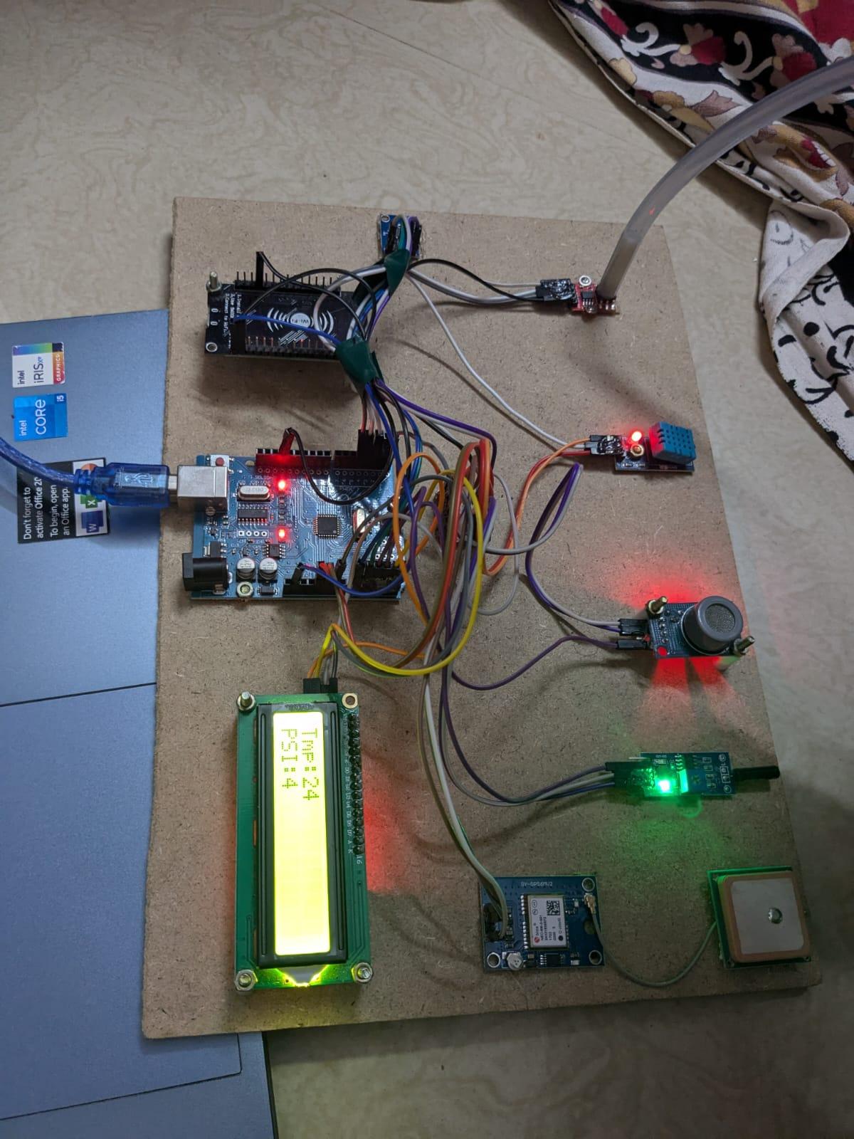
RESULTS AND DISCUSSIONS
DEPT OF ECE, DSCE

Slide 21
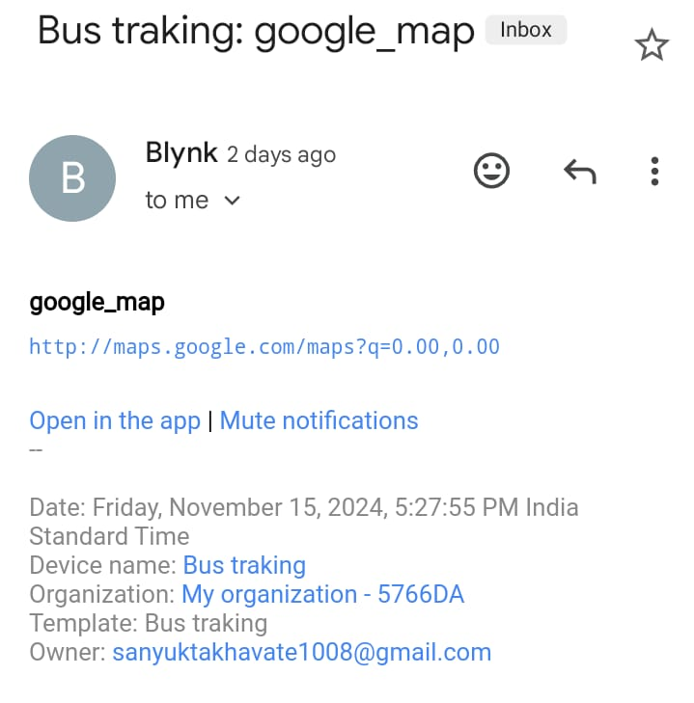
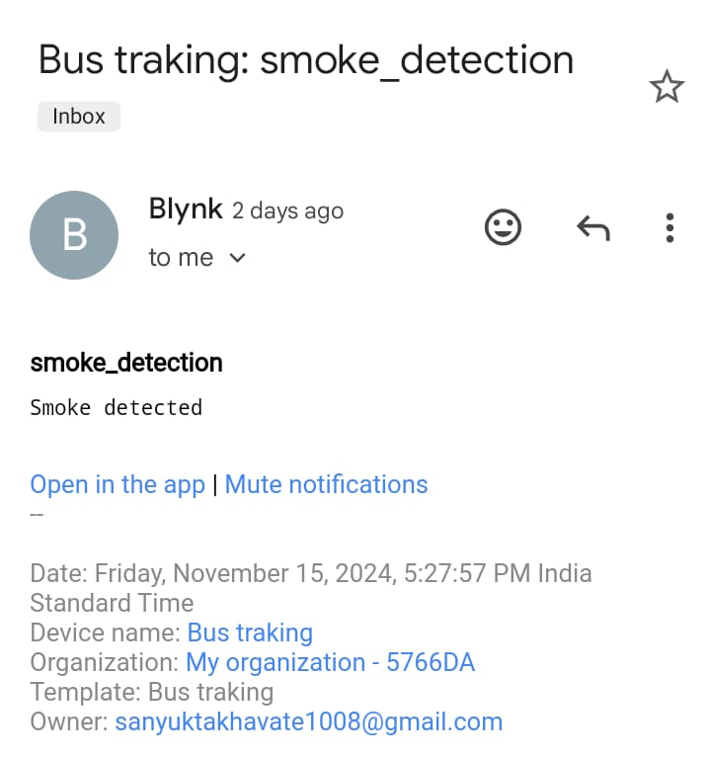
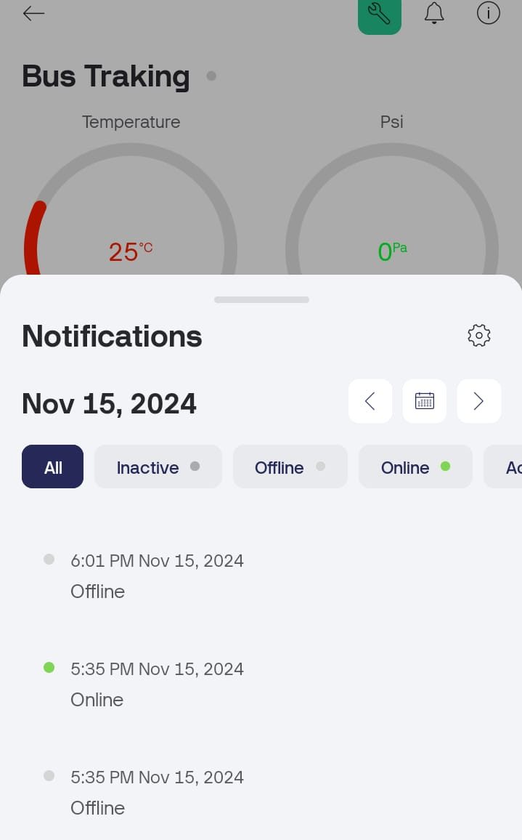
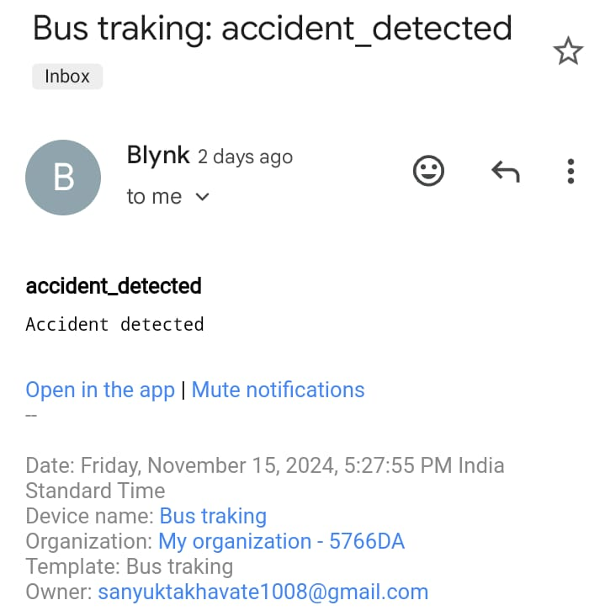
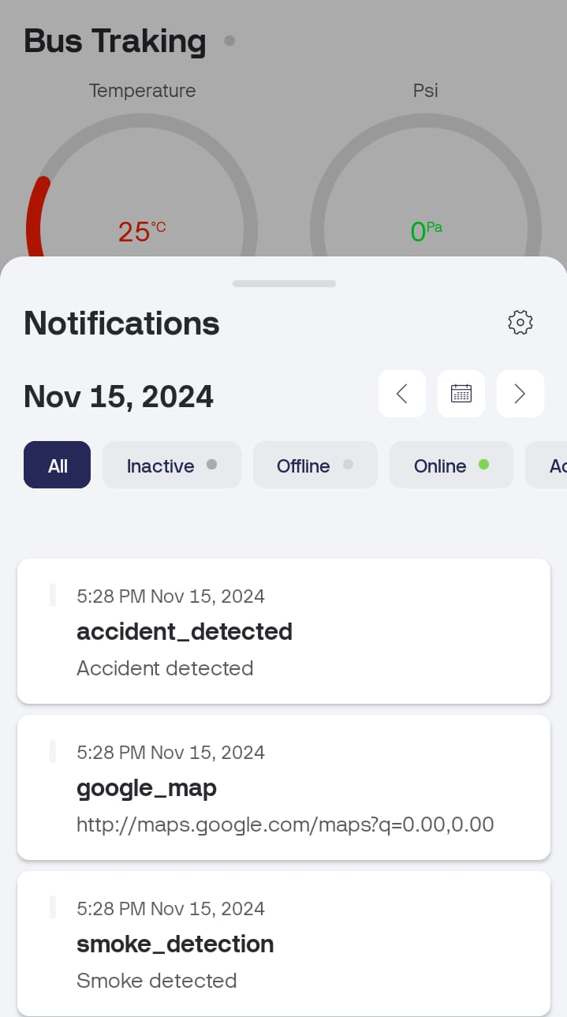
Notifications sent in Blynk IOT App
Notifications sent to Email
DEPT OF ECE, DSCE

Slide 22
APPLICATIONS
Some of the Applications are:
1. Fleet Management
2. Environmental Monitoring
3. Passenger Safety
4. Accident Response
DEPT OF ECE, DSCE

Slide 23
SUMMURY
The Bus Tracking and Monitoring System, utilizing IoT technology and various sensors, represents a significant advancement in the management of public transportation fleets.
By integrating real-time monitoring of emissions, temperature, vehicle stability, tire pressure, and accident detection, the system offers comprehensive oversight and proactive management capabilities.
The use of GPS tracking and data visualization through the Blynk IoT platform enhances operational efficiency, optimizes route planning, and facilitates timely maintenance interventions.
Overall, the system delivers a robust solution for modernizing bus fleet management, leading to improved service quality, reduced operational costs, and a safer, more efficient transportation network.
DEPT OF ECE, DSCE

Slide 24
REFERENCES
[1]. J. Park, S. J. Jung, and H. K. Kim, "Bus Tracking and Monitoring System Based on IoT," IEEE Access, vol. 8, pp. 14683-14691, 2020. doi: 10.1109/ACCESS.2020.2965904.
[2]. A. Shinde, M. M. Naik, P. Gadkari, and S. Deshmukh, "IoT-Based Smart Vehicle Monitoring System Using Sensors," IEEE Internet of Things Journal, vol. 7, no. 5, pp. 4153-4161, 2020. doi: 10.1109/JIOT.2020.2971817.
[3]. A. Roy, S. Kar, and P. K. Mandal, "IoT-Based Intelligent Vehicle Tracking and Monitoring System Using Raspberry Pi," in 2021 IEEE 8th Uttar Pradesh Section International Conference on Electrical, Electronics and Computer Engineering (UPCON), 2021, pp. 1-6. doi: 10.1109/UPCON52273.2021.9667614.
[4]. Y. Wang, L. Zhao, and Y. Zhang, "A Comprehensive IoT-based Bus Fleet Monitoring and Management System," in 2021 IEEE 6th International Conference on Signal and Image Processing (ICSIP), 2021, pp. 45-49. doi: 10.1109/ICSIP52628.2021.9688990.
[5]. M. El-Bendary, M. F. A. El-Soudani, and A. M. El-Shafee, "IoT-Based Vehicle Emission Monitoring and Control System," in 2020 International Conference on Innovative Trends in Communication and Computer Engineering (ITCE), 2020, pp. 109-113. doi: 10.1109/ITCE48509.2020.9047749.
DEPT OF ECE, DSCE

Slide 25
THANK YOU

