Slide 1
Research agent
IBM HACKATHON PROJECT
Presented By:
Student name:Vaishnavi Laxman Phad
College Name & Department : MIT Academy of Engineering Alandi – Computer Department

Slide 2
OUTLINE
Problem Statement
Technology used
Wow factor
End users
Result
Conclusion
Git-hub Link
Future scope
IBM Certifications

Slide 3
Problem Statement
An AI Agent for Smart Farming Advice, powered by RAG (Retrieval-Augmented Generation), supports small-scale farmers by delivering real-time, localized agricultural guidance. It retrieves trusted data on weather forecasts, soil conditions, crop recommendations, pest control measures, and current market prices from agricultural departments, meteorological sources, and agri tech platforms. Farmers can interact in their local language and ask questions like “What crop is best for this season?” or “What is today’s mandi rate for tomatoes?” The agent ensures timely, data-driven decisions that reduce risk, increase yield, and boost income. This AI-driven assistant bridges the knowledge gap and brings smart farming to the grassroots.
Proposed Solution:
To address the research overload and inefficiency in literature review, we propose building an AI-powered Research Agent using IBM Cloud Lite services and Granite-3.3-8b-Instruct (IBM’s optimized instruction-following LLM).
This intelligent assistant will help users—students, researchers, and academicians—by understanding their research goals and delivering context-aware summaries, suggestions, and citations via a conversational interface powered by IBM Watson Assistant.
By leveraging Retrieval-Augmented Generation (RAG) and Natural Language Processing (NLP), the agent will provide accurate, relevant, and up-to-date academic insights to streamline the research workflow.

Slide 4
Technology used
IBM cloud lite services
Natural Language Processing (NLP)
Retrieval Augmented Generation (RAG)
IBM Granite model

Slide 5
IBM cloud services used
IBM Cloud Watsonx AI Studio
IBM Cloud Watsonx AI runtime
IBM Cloud Service
IBM Cloud Storage Object
IBM Cloud Agent Lab
IBM Granite (via Watsonx.ai studio)

Slide 6
Wow factors
This intelligent assistant significantly reduces research time, improves the quality of literature reviews, supports early-stage researchers, and fosters interdisciplinary collaboration by making academic knowledge more accessible and actionable.
Unique features:
Weather Forecasts Provides real-time, location-based weather updates.
Soil Advice Recommends crops and fertilizers based on soil conditions.
Crop Recommendations Suggests best crops for the current season and region.
Pest & Disease Control Offers alerts and treatment tips for common crop issues.
Mandi Rates Shares daily market prices for fruits, vegetables, and grains.
Local Language Support Farmers can ask questions in their native language.

Slide 7
End users
Students – Especially undergraduate and postgraduate students who need help in literature reviews, project reports, or thesis writing.
Academic Researchers – Who require assistance in discovering relevant papers, identifying research gaps, and summarizing vast volumes of research.
Professors & Faculty – Looking to stay updated with the latest research in their fields and support students with up-to-date references.
Industry Professionals & R&D Teams – Who want to explore academic insights, technical advancements, and emerging trends for innovation and product development.
Data Scientists & Engineers – Who require datasets, technical papers, or algorithmic references for solving domain-specific problems.

Slide 8
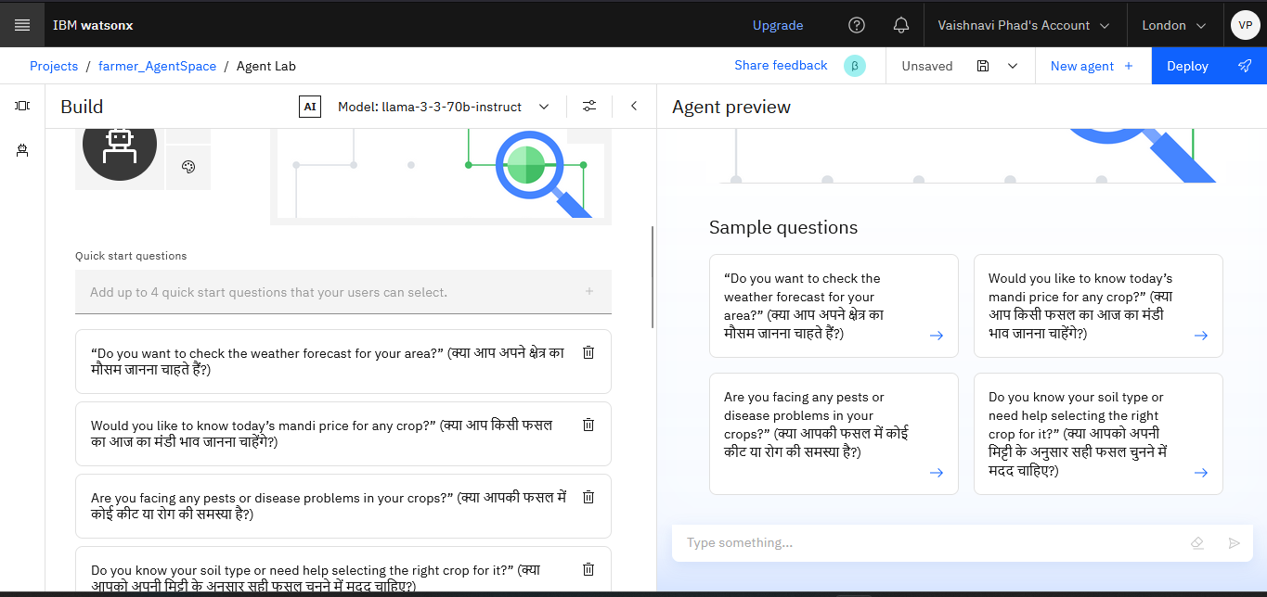
Setting up

Slide 9
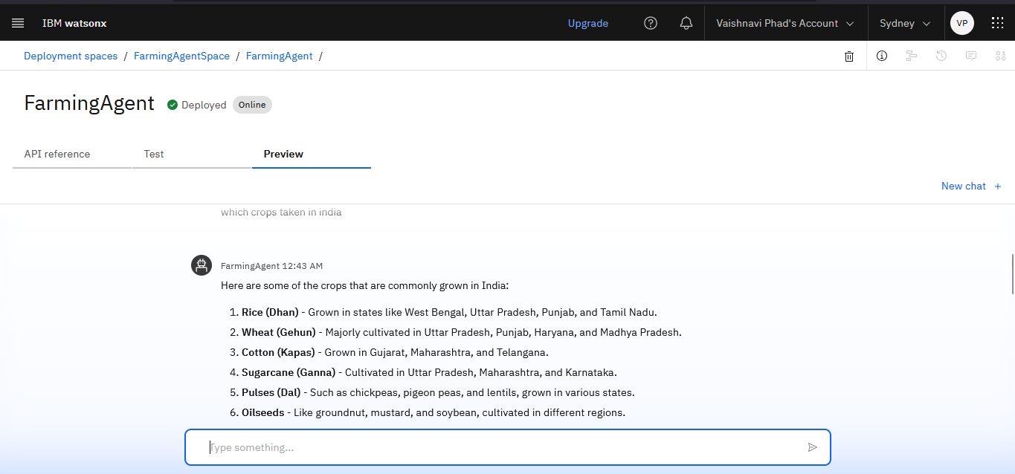
Agent Instruction

Slide 10
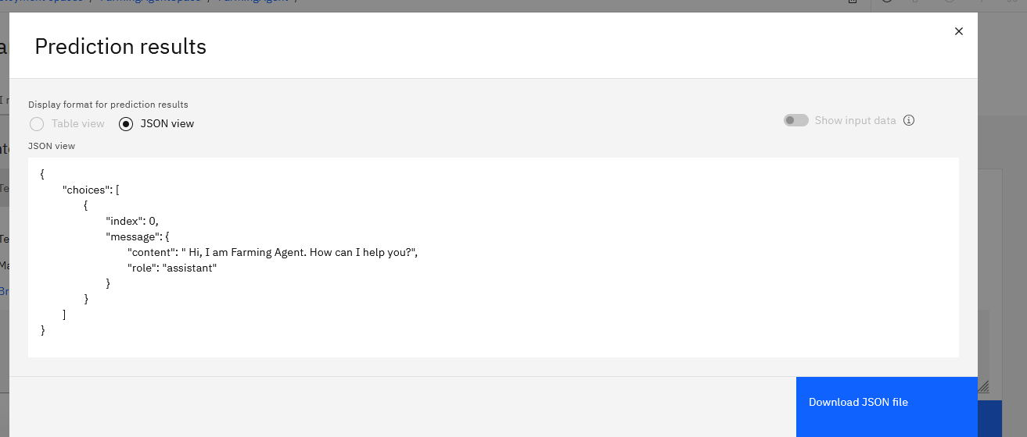
Add tools

Slide 11
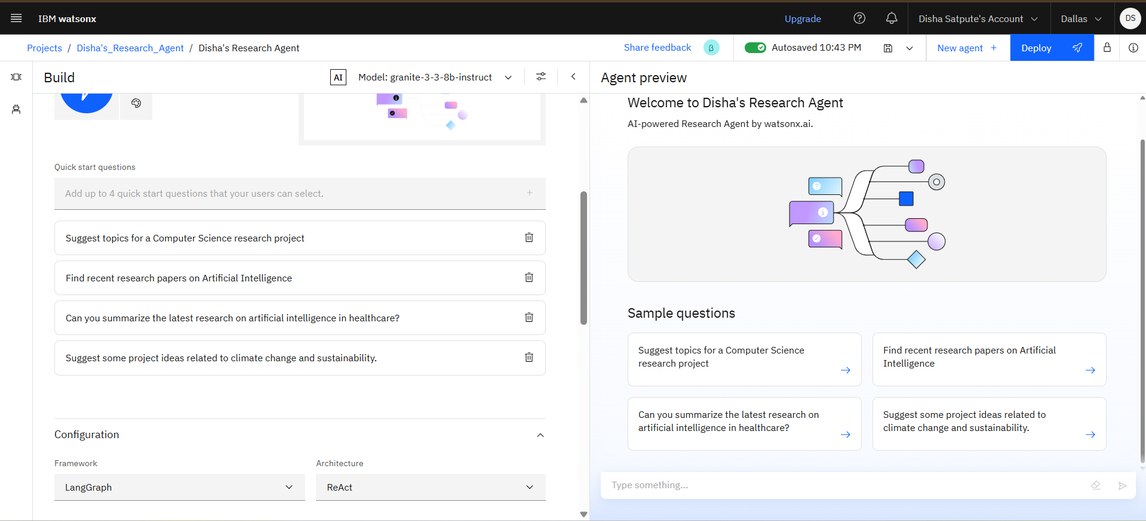
Quick start questions

Slide 12
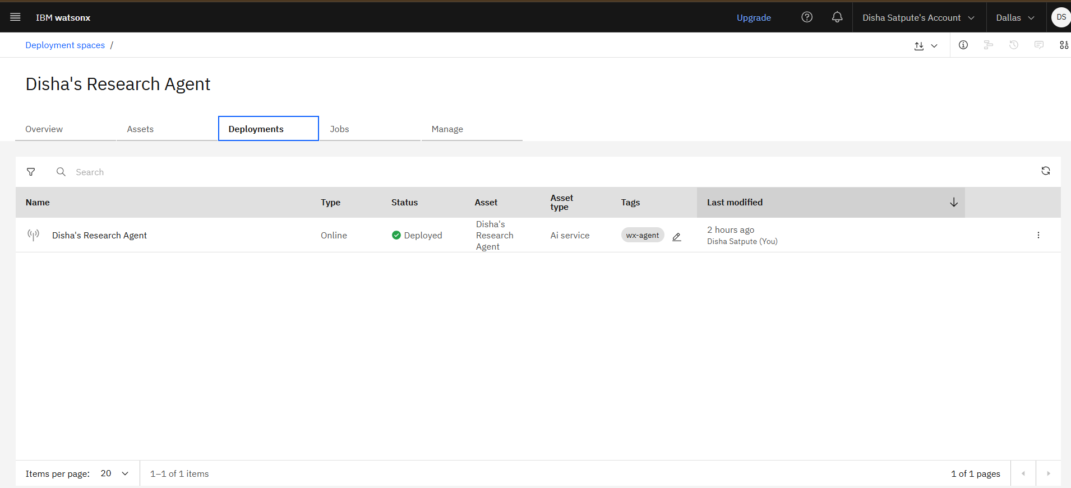
deployment

Slide 13
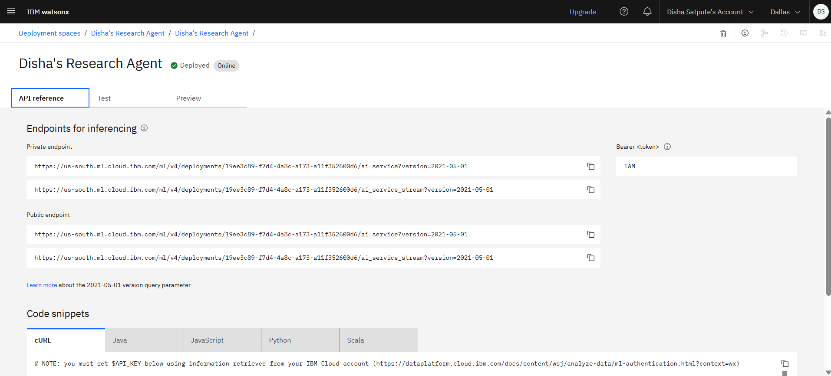
API references

Slide 14
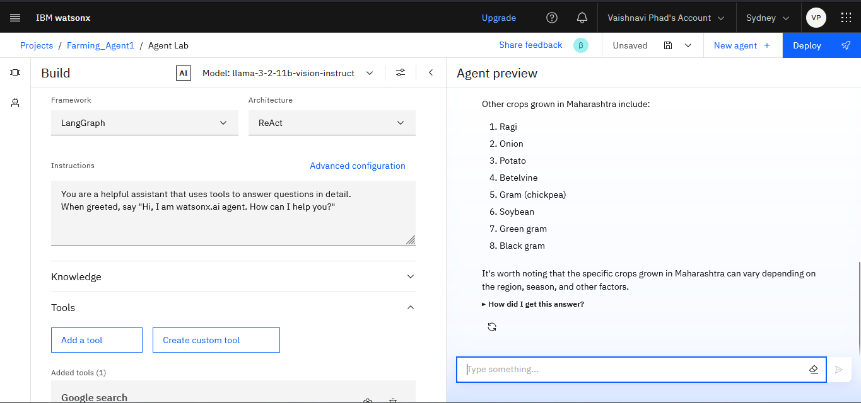
Preview

Slide 15
Conclusion
The AI-Powered Farming Agent is a smart, accessible, and reliable solution designed to empower small-scale farmers with real-time, data-driven agricultural guidance. By integrating Retrieval-Augmented Generation (RAG), IBM Granite LLM, and IBM Cloud Lite services, the agent bridges the information gap at the grassroots level. It supports informed decisions on crop planning, soil management, pest control, and market pricing—ultimately enhancing productivity, reducing risks, and increasing income. This innovation brings the power of AI directly to the fields, making smart farming a reality for every farmer.

Slide 16
GitHub Link
https://github.com/Vaishnavi1955/Farming_AgentProject

Slide 17
Future scope
Multilingual Research Support
Voice-Activated Research Assistant
Real-Time Collaboration Features
Research Gap and Novel Topic Identification
Integration with Publishing Platforms
AI-Assisted Paper Drafting

Slide 18
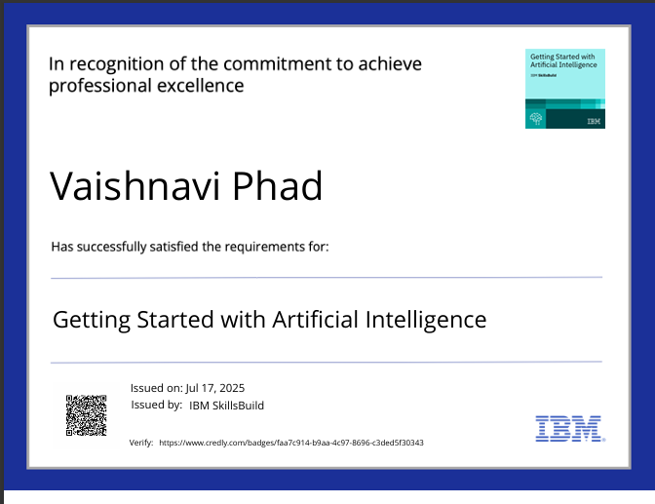
IBM Certifications

Slide 19
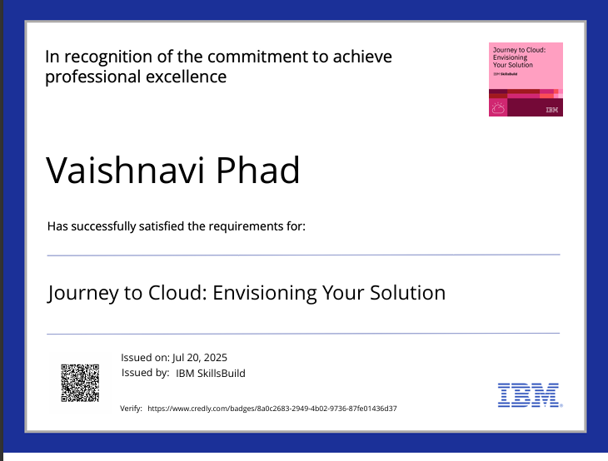
IBM Certifications

Slide 20
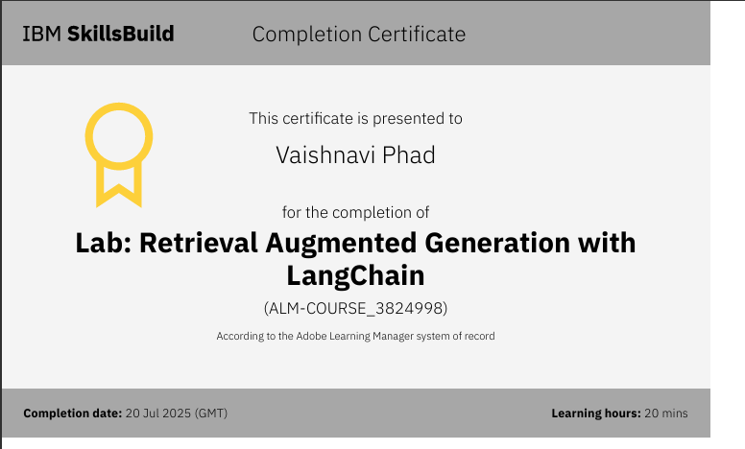
RAG LAB certificate

Slide 21
THANK YOU

