Slide 1
MODELFORGE
From a model file to standalone C++
C++17 | IR | CODE GENERATION
THE PROBLEM
WHY FIX IT?
A model can run, but the graph-to-code path stays hidden.
Fixing that gives us code we can verify, explain, and optimize.
1
2
3
4
5
MODEL
CHECK
IR
OPTIMIZE
C++
The idea is simple: make every compiler step visible.
Notes:
Source: ModelForge_Project.md, ModelForge\README.md. Visual reference: user-provided geometric navy and cyan theme image. Cover copy intentionally uses plain language for a viva-style explanation.

Slide 2
WHY MODELFORGE EXISTS
A small neural network is a good place to see compiler design in action.
Running a model is easy. Understanding how the graph becomes executable code is the interesting part.
What changes?
MODEL FILE
weights + operators
01
Runtime dependency
Small models often need a large runtime just to make a prediction.
ModelForge makes the middle visible.
02
Hidden transformation
The path from model graph to machine code is usually invisible.
STANDALONE C++
readable inference
03
Hard to verify
It is easy to say the output is correct. It is better to show why.
Payoff: inspect the code, test it locally, and explain why the answer is trustworthy.
Notes:
Source: ModelForge_Project.md sections 2-4, 6, 20. The wording is a plain-language restatement of the project motivation and scope.

Slide 3
THE DEMO MODEL: A SMALL IRIS CLASSIFIER
The first example is deliberately small, so every step can be explained.
What the network represents
iris_demo.mforge
4 input features
3 hidden values
3 class scores
model iris_classifier
input x float32 1,4
output y float32 1,3
node dense_1 Gemm
node activation_1 Relu
node dense_2 Gemm
node probabilities Softmax
4
3
3
Gemm + ReLU
Gemm + Softmax
dependency-free input
The input and output shapes stay simple: [1,4] in, [1,3] out.
The basic submission uses the .mforge manifest; real ONNX loading is an optional extension.
ModelForge | Compiler Design Laboratory
03 / 08
Notes:
Source: ModelForge\review_2_core_implementation\models\iris_demo.mforge; ModelForge\review_2_core_implementation\README.md; ModelForge_Project.md sections 5 and 15.

Slide 4
THE WORKFLOW, END TO END
Each stage has one job, and the output of one stage becomes the input to the next.
1
Load
2
Validate
3
Lower
4
Optimize
5
Generate
Read the model file
Check names, types, shapes
Build ModelForge IR
Remove work we do not need
Write model.cpp + model.h
Native build + inference
run the generated program
Compare the result
check the prediction
The final check answers the only question that really matters: did the generated program keep the model's meaning?
Notes:
Source: ModelForge\docs\architecture.md; ModelForge\review_2_core_implementation\src\README.md; ModelForge_Project.md sections 6-12 and 18.

Slide 5
WHAT HAPPENS INSIDE THE COMPILER
The custom IR keeps the file format separate from the generated C++.
Front end
Before optimization
Generated target
Loads the graph and checks whether it makes sense.
Gemm → Relu → Gemm → Softmax
std::vector<float> infer(
const std::vector<float>& input
) {
Tensor hidden = fused_gemm_relu(...);
Tensor scores = gemm(...);
return softmax(scores);
}
Middle end
Turns model operations into a compiler-owned language.
ModelForge IR
DENSE
FUSED_GEMM_RELU
DENSE → SOFTMAX
Back end
Prints ordinary C++ that can build on its own.
The IR is the translator: validation can reason about it, and code generation can consume it.
This separation is what lets the back end stay independent of ONNX-specific details.
Notes:
Source: ModelForge\review_2_core_implementation\src\README.md; ModelForge\docs\architecture.md; ModelForge_Project.md sections 7 and 9.

Slide 6
THE PART THAT FEELS MOST LIKE A COMPILER
Optimization changes the IR before the C++ is written.
7
5
01
Dead-node removal
optimize
Drops the unused activation in the demo.
IR instructions
before
IR instructions
after
02
GEMM + ReLU fusion
Keeps the activation inside one generated loop.
03
Constant folding
The demo removes one unreachable instruction and fuses one dense layer with its ReLU.
Available for constant-only work before runtime.
Net effect: less work to generate, same prediction to preserve.
Novelty
Compiler ideas applied to a tiny ML graph where the transformation stays readable.
06 / 08
Notes:
Source: ModelForge\review_2_core_implementation\IMPLEMENTATION_PROGRESS.md; ModelForge\review_3_final_integration\FINAL_STATUS.md; ModelForge_Project.md sections 8 and 20. The demo-specific numbers are 7 to 5, 1 dead instruction removed, and 1 fusion.

Slide 7
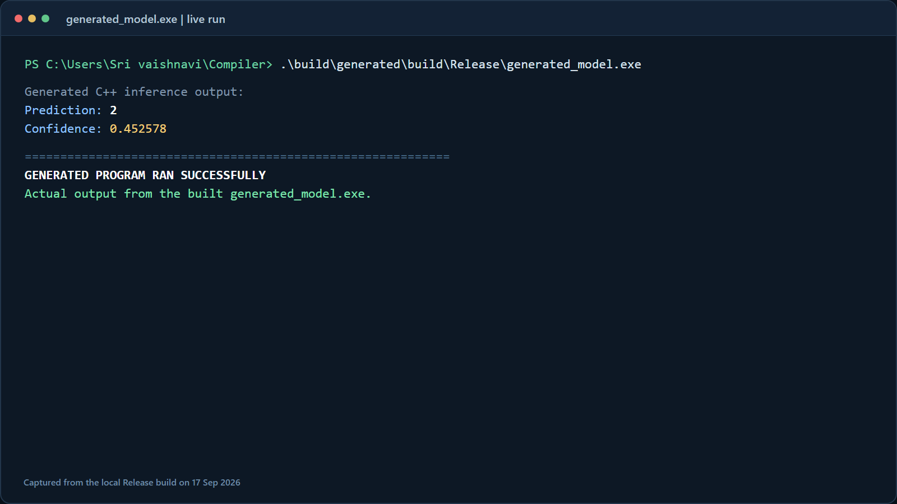
THE ACTUAL GENERATED OUTPUT
This is the output from the built generated_model.exe, using the Iris demo model.
What we actually got
2
Prediction
the generated program's class index
0.452578
Confidence
the value printed by the executable
1 / 1 passed
Tests
CTest validation result in this build
ACTUAL LOCAL RUN
Command: .\build\generated\build\Release\generated_model.exe
ModelForge | Compiler Design Laboratory
07 / 08
Notes:
Source: actual local run of C:\Users\Sri vaishnavi\Compiler\build\generated\build\Release\generated_model.exe on 17 Sep 2026; actual stdout: Prediction: 2, Confidence: 0.452578. Test result: ctest reported 1/1 passed. Screenshot asset: .codex-ppt-build\demo-output.png.

Slide 8
THE ONE-SENTENCE VIVA ANSWER
ModelForge treats the model like source code: it validates the graph, lowers it to its own IR, optimizes it, generates C++, and checks that the prediction stays the same.
CURRENT BOUNDARY
NEXT STEP
Dependency-free .mforge input
float32, rank-2 feed-forward models
Gemm, MatMul, Add, Relu, Sigmoid, Softmax
Connect the real ONNX path
then extend the operator set
with the same validation and IR structure
WHY THIS MATTERS
It connects language design, IR, optimization, and code generation in one testable example.
Worth doing because the model is small enough to understand, but rich enough to demonstrate a real compiler.
08 / 08
Notes:
Source: ModelForge\review_3_final_integration\FINAL_STATUS.md; ModelForge_Project.md sections 20, 23, 26, and 27. Final slide uses the project's own viva explanation in more conversational language. Visual reference: user-provided geometric navy and cyan theme image.

