Slide 1
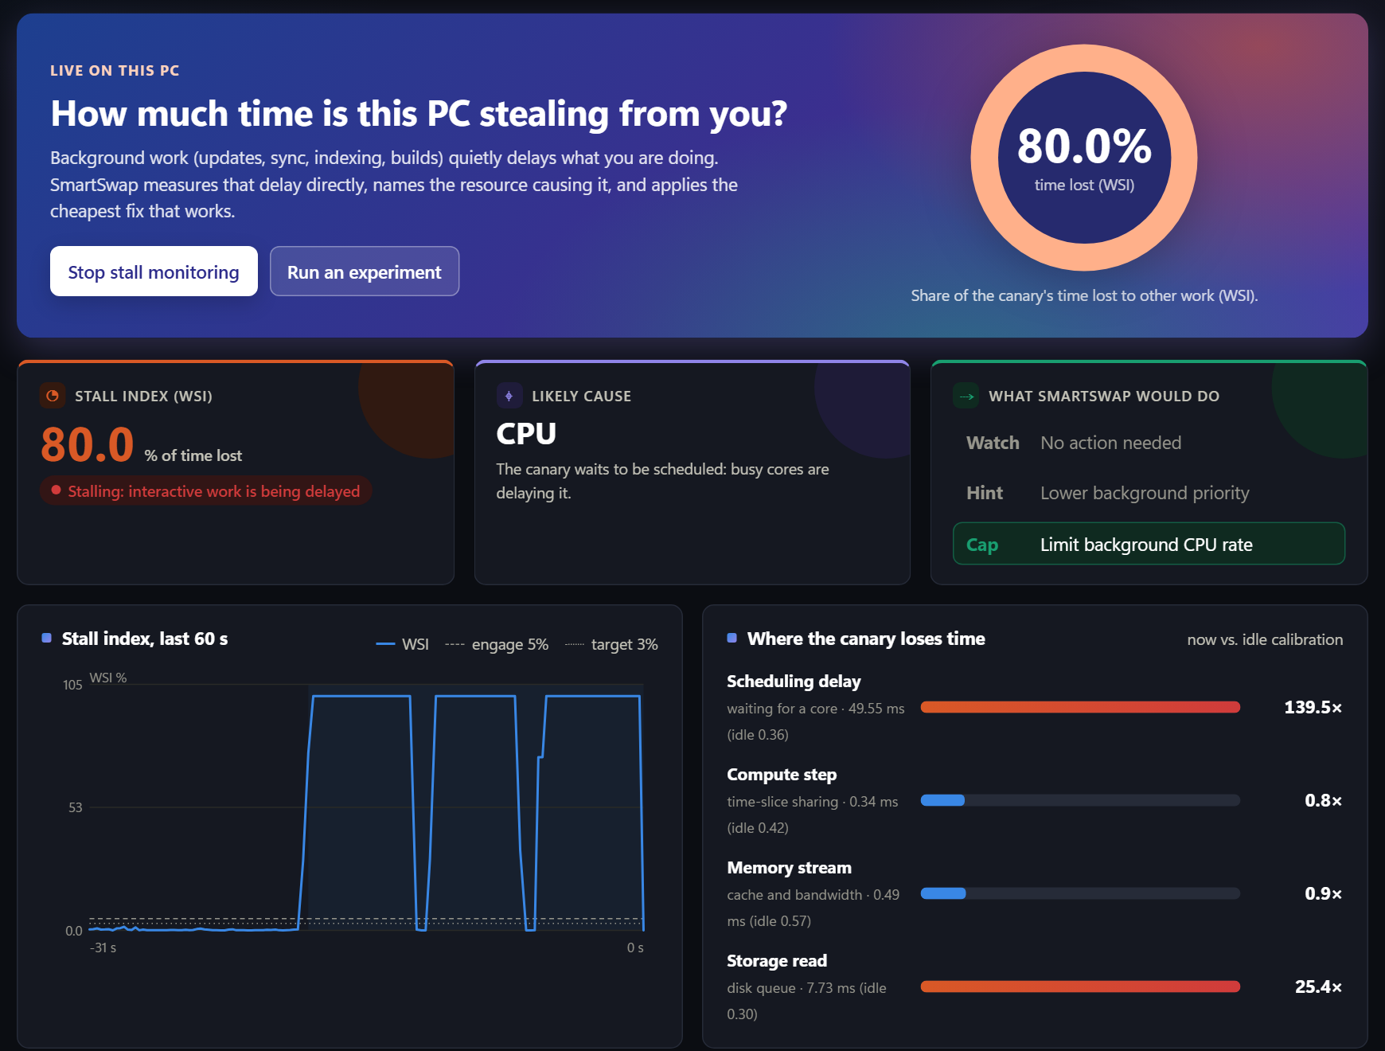
BCSE303P · OS LAB · PROJECT REVIEWS 1 & 2
SmartSwap
Measuring, and fixing, the time background work steals from the app you are using on stock Windows
No admin rights
user-mode only
Names the cause
CPU · memory · storage
Proves every fix
read back from Windows
The live dashboard during real CPU contention: 80% of the canary's time lost, cause named, cap stage reached.
Team: Name One (Reg. No.) · Name Two (Reg. No.) · Name Three (Reg. No.)
Guide: Prof. Name · School of Computer Science and Engineering, VIT
Notes:
Introduce the team and the one-line idea. SmartSwap answers a question Windows cannot answer today: how much time is background work stealing from the app I am using, which resource is responsible, and did the fix actually help. The screenshot is the real dashboard, captured while we injected CPU load.

Slide 2
01 · PROBLEM STATEMENT
Review 1
Task Manager shows how busy the PC is, not how much you are being slowed down
1
Background work never stops. Sync, search indexing, updates and builds run while you work. On our test laptop they used 3–4 cores without being asked.
8 of 16
CPU cores idle under memory-bandwidth load
2
Busy is the wrong signal. Memory-bandwidth contention can make an app several times slower while half the cores are idle. No Task Manager counter shows it.
yet
2.6× slower
interactive tail latency (p95 3.95 → 10.8 ms)
3
Today's fixes are blind. Priority tweaks and “optimizer” tools change settings without measuring whether the user actually benefits.
Problem statement Unprivileged software on Windows cannot measure how much time interactive work loses to background interference, tell which resource causes it, or verify that a mitigation helped.
Notes:
Problem statement (1 mark). Everyone has felt a laptop lag while OneDrive or Windows Update runs. Task Manager shows utilisation, which is not the same as harm. Our measured example: with memory-bandwidth load, half the cores are idle, yet the interactive task's tail latency is 2.6 times worse. Read the formal problem statement at the bottom.

Slide 3
02 · LITERATURE REVIEW
Review 1
Prior work measures stalls or controls interference, but not on an unprivileged desktop
Work | What it contributes | Why it does not solve our problem
Linux PSI (Weiner, 2018) | Kernel-reported share of time tasks stall on CPU, memory or I/O | Linux kernel only; Windows has no user-mode equivalent
Heracles (ISCA 2015), PARTIES (ASPLOS 2019) | Feedback controllers that co-locate latency-critical and batch jobs | Need server cache/bandwidth partitioning and privileged control
Caladan (OSDI 2020) | Reacts to interference within microseconds | Kernel-bypass runtime; the protected app must be rewritten
Bubble-Up, Bubble-Flux (MICRO 2011, ISCA 2013) | Synthetic probes measure how sensitive a job is to contention | Offline profiling for data-centre placement
Windows tools: Task Manager, priority, EcoQoS | Show utilisation; static deprioritisation | No harm measurement, no cause, no proof a change helped
Research gap No privilege-free way on Windows to measure interference harm, name its cause, and prove that a fix worked.
Notes:
Literature review (1 mark). Linux solved measurement with PSI in 2018. Data-centre systems like Heracles, PARTIES and Caladan control interference, but assume server hardware, root access, or modified applications. Bubble-Up inspired our canary idea. Windows tools show utilisation only. That leaves the gap in orange.

Slide 4
03 · PROJECT OBJECTIVES
Review 1
Five measurable objectives, all met in a 460-trial evaluation
O1
Measure interference harm from user mode, without admin rights
✓ Stall index tracks the real app's p95: ρ = 0.96
O2
Identify which resource is contended
✓ Cause named correctly in 86–99.6% of stalled periods
O3
Apply the cheapest effective fix automatically
✓ Tail latency cut by up to 94%
O4
Verify every action and every revert
✓ 1,575 / 1,575 actions · 322 / 322 reverts verified
O5
Evaluate rigorously, including the cost to background work
✓ Randomised blocks, exact Wilcoxon, Holm, bootstrap CIs
Notes:
Project objectives (1 mark). Each objective has a measurable target and we show the measured result next to it. 460 trials = 340 in the main study plus 120 in the hybrid-core study, with zero failed trials.

Slide 5
04 · NOVELTY & INNOVATION
Review 1
Four ideas that no Windows tool combines today
1
Windows Stall Index
2
Specificity-ordered attribution
A tiny canary times its own delays to estimate how much time interactive work is losing: a PSI-style signal Windows lacks.
Checks the most specific symptom first: CPU, then memory, then storage. The naive “biggest slowdown” rule blames storage for memory contention.
ρ = 0.96 with the real app's p95 · 1.2% false alarms
Cause correct in 86–99.6% of stalled periods
3
Least-cost, double-verified ladder
4
Hybrid-core steering
Priority first, CPU cap only if needed. Every action is read back from Windows and kept only if the stall really drops.
On P-core/E-core laptops, moves background work onto efficiency cores before throttling it.
Without the ladder: 4.8× worse p95
Memory contention: 27% lower p95 than the best static policy
Notes:
Novelty (3 marks), the most important slide. One: Windows has no user-mode stall metric like Linux PSI, so we built one and validated it against a separate app. Two: attribution ordered by how specific each symptom is; the naive rule gets memory contention wrong. Three: cheapest fix first, every action verified twice, and the ablation shows the ladder matters. Four: on hybrid CPUs we steer background work to E-cores before throttling, which beat static priority on memory contention with a 95% CI of 0.67 to 0.75.

Slide 6
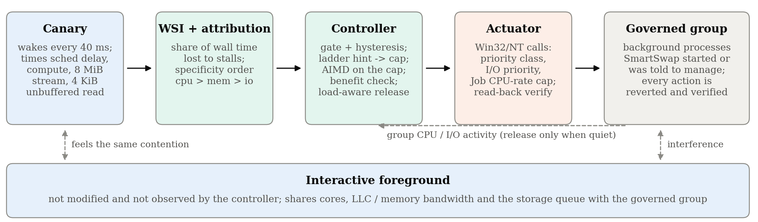
05 · SYSTEM DESIGN & ARCHITECTURE
Review 2
A closed control loop that runs every 200 ms, entirely in user mode
Sense
Canary wakes every 40 ms and times scheduling delay, compute, an 8 MiB memory copy and a 4 KiB unbuffered read.
Decide
WSI = share of time lost. Cause = first symptom above 2× idle. Ladder level chosen against a 3% target.
Act & prove
Priority, I/O priority, E-core affinity or Job CPU cap via Win32/NT; read back, check the benefit, revert when quiet.
Notes:
System design and architecture (1 mark). Walk left to right: the canary feels the contention, the WSI turns it into a percentage of time lost and names the cause, the controller picks the cheapest action, the actuator applies it through documented Windows APIs and reads it back. The dashed line: SmartSwap only releases a fix once the background group is actually quiet. The foreground app is never modified.

Slide 7
06 · MODULE IDENTIFICATION
Review 2
Six modules, each testable on its own
M1
✓ Complete
M2
✓ Complete
M3
✓ Complete
Canary & probes
WSI & attribution
Control ladder
probes.py
controller.py
controller.py
40 ms canary, foreground probe, CPU / memory / storage workloads
Stall index and specificity-ordered cause detection
Gating, hint → E-core steer → AIMD cap, benefit check, release
M4
✓ Complete
M5
✓ Complete
M6
✓ Complete
Verified actuator
Experiment engine
Analysis & dashboard
native.py
engine.py · run_study.py
analyze.py · app.py · frontend
Priority, I/O priority, affinity and Job CPU cap with read-back
Trials, randomised blocks, background-throughput accounting
Statistics, figures, live web UI and exports
Notes:
Module identification (1 mark). Six modules with clear boundaries: probes, measurement and attribution, the control ladder, the Windows actuator, the experiment engine, and analysis plus dashboard. The controller is pure logic with no Windows calls, so it is unit-tested and can be replayed offline.

Slide 8
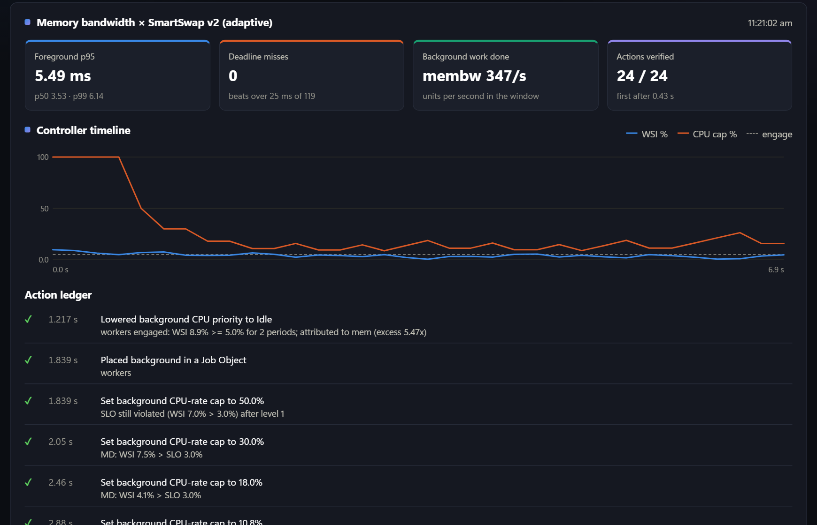
07 · MODULE COMPLETION
Review 2
All six modules are implemented, tested and verified on real hardware
6 / 6
modules complete
25
automated tests passing
460
trials run, 0 failed
1,575 / 1,575
actions verified by read-back
Also complete: live monitor page, CSV / JSON / HTML / PDF exports, emergency stop, and an IEEE-format paper draft.
Live trial from the dashboard: memory-bandwidth contention, p95 5.49 ms, 24 / 24 actions verified while AIMD tunes the cap.
Notes:
Module completion (4 marks). This screenshot is a real trial from our dashboard: the controller lowered priority, then capped the background CPU rate and tuned it up and down with AIMD; every one of the 24 actions has a green tick because Windows confirmed it. 25 automated tests pass (23 backend, 2 frontend). We ran 460 controlled trials with zero failures.

Slide 9
08 · RESULTS
Review 2
The stall index tracks what the user actually feels
ρ = 0.96
rank correlation between the canary's WSI and the separate app's p95 (50 trials)
AUC 0.965–1.000
detecting interference, with 1.2% false alarms on a quiet PC
92 · 86 · 99.6%
cause named correctly for CPU · memory · storage
Notes:
Results 1: the key validation. In observe-only trials SmartSwap measures but never acts, so this is a clean test: the canary's stall index rises in lock-step with the real foreground's tail latency, rank correlation 0.96. Used as a detector it almost never fires on a quiet machine (1.2%) and it names the right cause most of the time.

Slide 10
09 · RESULTS & NEXT STEPS
Review 2 → 3
Up to 94% lower tail latency, and E-core steering beats static priority on memory contention
What we report honestly
Static priority is a strong baseline; v2 matches it on CPU and mixed load.
Under memory contention, v2 without steering over-throttles: 56% of background work kept vs 92% for priority.
Steering is measured on one hybrid laptop (8 blocks); replication is next.
Review 3 plan
IEEE-format paper drafted (8 pages)
Replicate on a second Windows laptop
Add a real app (browser frame time)
Submit to an IEEE conference
Notes:
Results 2 and next steps. From the 120-trial hybrid study: SmartSwap and static priority both remove over 90% of tail latency under CPU and mixed contention. Under memory-bandwidth contention, adding E-core steering gives the best result, 27% lower p95 than static priority. We say clearly where we do not win. For Review 3: the IEEE paper is drafted; we will replicate on a second laptop, add a real application, and submit.

