Slide 1


NEXT GEN EMPLOYABILITY PROGRAM
CREATING A FUTURE-READY WORKFORCE
Student Name :
M.Sri Vaishnavi
Student ID :
STU672b0f8c034271730875276
College Name :
SR University

Slide 2
Music Player Website(Spotify clone)
CAPSTONE PROJECT SHOWCASE
Abstract | Problem Statement | Project Overview | Proposed Solution | Technology Used | Modelling & Results | Conclusion | Q&A

Slide 3
Abstract
1
User Authentication: The project includes a secure login page, home page, and registration page, providing seamless access to music content while ensuring robust authentication.
2
Easy Navigation and Registration: It simplifies user experience with intuitive navigation and an efficient registration process, allowing new users to quickly create accounts.
3
Modern Web Technologies: Built using up-to-date web development technologies, this project focuses on a balance of security, usability, and performance.
4
Scalable Foundation: This project serves as a foundational platform for future development, with potential for personalized music features and customization for a more tailored user experience.

Slide 4


Problem Statement
As the demand for personalized online music platforms continues to grow, there is a critical need for secure, user-centric systems that facilitate efficient user registration, authentication, and navigation. Many existing solutions are hindered by overly complex designs or inadequate security measures, which compromise the overall user experience. This project seeks to address these challenges by developing a robust web application that integrates essential features with a focus on security, operational efficiency, and an intuitive, seamless user interface.

Slide 5

Project Overview
The Music Website Project serves as a foundational web application aimed at managing user authentication and seamless navigation within a music platform. It consists of three core components:
Login Page: Ensures secure and efficient user access to their accounts through an optimized authentication process.
Registration Page: Enables new users to create accounts via a straightforward and validated sign-up form.
Home Page: Functions as the primary interface, allowing users to easily navigate and access music-related content.
This project emphasizes delivering a secure, intuitive, and user-centric experience, leveraging modern web development technologies to ensure both performance and functionality.

Slide 6
Proposed Solution
User Authentication: Implement a secure login system that ensures only authorized users can access the platform, safeguarding user data and maintaining secure access.
Efficient Registration: Design a streamlined, validated registration process that allows new users to quickly and easily create accounts with minimal friction.
Intuitive Navigation: Develop a well-structured home page that enables users to effortlessly browse and access music-related content, with the potential for future feature integration.
Scalable Design: Establish a foundational architecture that can be expanded to include advanced features, such as personalized playlists, music streaming capabilities, and user-specific preferences.
Focus on User Experience and Security: This solution prioritizes a seamless and enjoyable user experience while ensuring robust security protocols and operational functionality.

Slide 7
Technology used
Frontend :
HTML: For structuring the web pages.
CSS : For styling and enhancing the visual design of the website.
JavaScript : For adding interactivity and dynamic behavior to the website.
Backend :
Node.js : To handle server-side logic and API integration.
Express.js : For building a lightweight and efficient backend framework.
Database :
MongoDB: To store user credentials and other data securely.
Version Control :
Git/GitHub : For source code management and project collaboration. •
These technologies were selected to create a responsive, secure, and scalable application

Slide 8
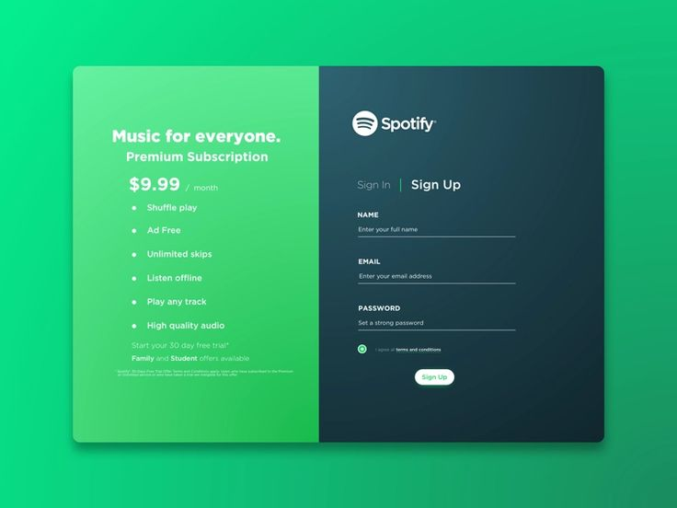
Modelling & Result
User Registration : The user fills out a registration form with necessary details like username, email, and password. Input validation ensures all fields are correctly filled, and passwords are securely hashed before storing them in the MongoDB database.

Slide 9
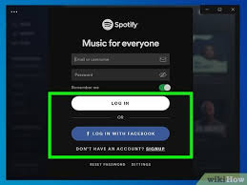
Modelling & Result
User Login : Registered users enter their credentials (username and password) on the login page. The system verifies the credentials against the stored data in the database, allowing access only for valid users

Slide 10
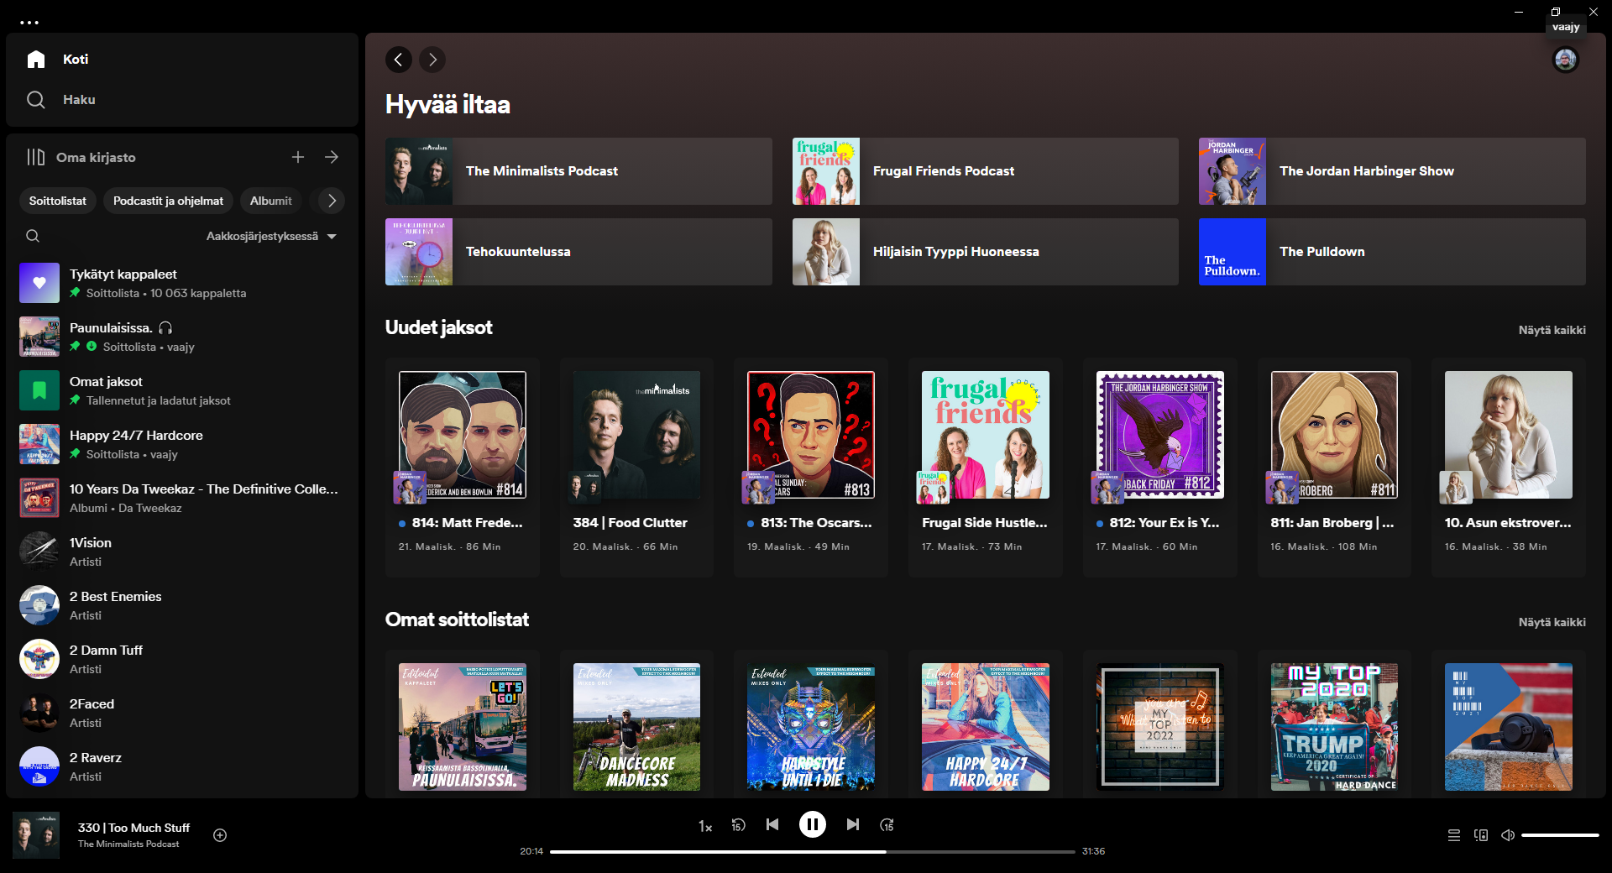
Modelling & Result
Access the Platform : Once logged in, users are directed to the home page, where they can explore the music-related content. The home page is designed to provide easy navigation, and the platform remains responsive across devices, ensuring a smooth experience

Slide 11

Conclusion
The Music Website Login Project successfully develops a secure and user-centric web application for managing user registration, authentication, and access to music-related content. Utilizing modern web technologies such as HTML, CSS, JavaScript, Node.js, and MongoDB, the project delivers a seamless user experience, emphasizing both security and functionality. The structured user flow, covering registration, login, and content access, ensures a reliable and efficient system, while the responsive design ensures compatibility across a wide range of devices. Preliminary testing has validated the platform’s functionality, and the architecture is designed to scale, enabling future enhancements such as music streaming and playlist management. This project lays a strong foundation for the development of more sophisticated music-related applications in the future.

Slide 12


Notes:
Thank You !!

