Slide 1

230670L: Introduction to Programming
T.Y. B TECH
Department of E&TC ENGINEERINGS
Alandi (D), Pune – 412105, INDIA
Project Title: Used Bike Prediction website
Team Members:
1) Shreya Kalaskar 202402060006
2) Vaishnavi Shinde 202402060016
Guide By : Dr. Rashmi Mahajan

Slide 2
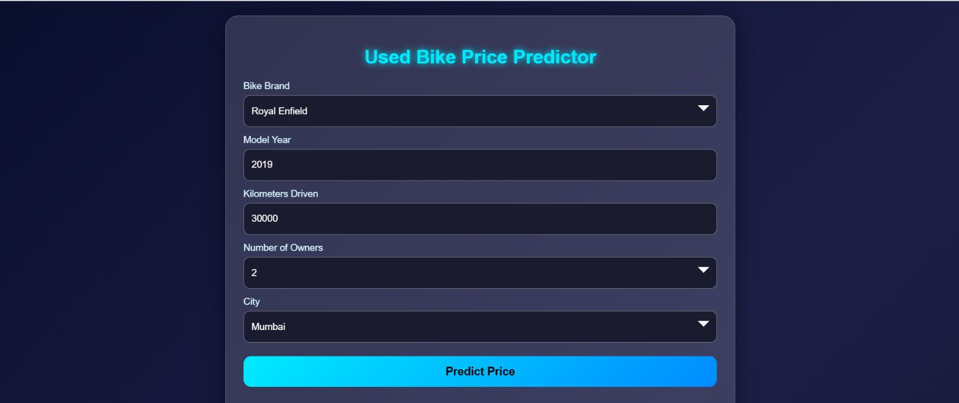
Introduction
The Used Bike Price Predictor is a web-based application designed to estimate the fair resale value of second-hand motorcycles. In the current market, buyers and sellers often struggle with inconsistent pricing due to negotiation, personal judgement, and lack of standard valuation. This system solves that problem by predicting the price based on real factors such as bike brand, model year, kilometers driven, number of owners, and city.
Using a rule-based pricing model implemented in JavaScript, the system provides instant price estimation along with a clear breakdown of how each factor influences the final value. The platform helps both buyers and sellers make informed decisions with transparency, fairness, and confidence.

Slide 3
Project Objectives
To develop a system that predicts the resale price of used motorcycles accurately and transparently.
To eliminate guesswork and negotiation-based pricing by using measurable real-world parameters.
To evaluate important factors such as brand, model year, kilometers driven, number of owners, and city demand.
To provide instant price estimation along with a clear breakdown of each factor’s impact.
To support buyers and sellers in making informed and fair resale decisions.
To build trust and transparency in the second-hand bike market

Slide 4
Key Features
User-friendly web interface for entering bike details easily
Instant price prediction without page reload
Rule-based pricing model simulating real market depreciation
Factor-wise breakdown showing age impact, kilometers impact, owner impact, brand value, and city premium
Useful buyer and seller tips to support decision-making
Suggestions of similar bikes for comparison
No backend required — complete client-side processing for fast performance
Compatible across mobile, laptop, and desktop browsers

Slide 5
Project Structure
User Interface Layer (HTML + CSS)
Provides the input form and visual layout for entering bike details and viewing results.
Logic Layer (JavaScript)
Handles input validation, applies the pricing formula, calculates the estimated price, and updates the output dynamically.
Pricing Model Module
Contains the rule-based depreciation and value-addition logic based on brand, year, kilometers, owners, and city.
Result Display Module
Shows the predicted price, factor-wise breakdown, buyer tips, seller tips, and similar bikes.
Deployment Layer (Static Hosting / GitHub Pages)
Hosts the complete application for public access without requiring a backend server.

Slide 6
Development Workflow
1. Planning Phase
Identified the need for a transparent bike price prediction system
Finalized core parameters: brand, year, kms, owners, city
Designed UI wireframes and user flow of the system
2. HTML & CSS Development
Built structured HTML form for input and result sections
Applied CSS with gradients and glassmorphism for modern look
Ensured responsive layout for mobile, tablet, and desktop
3. JavaScript Logic Implementation
Added validation for each input field
Developed rule-based pricing formula step-by-step
Automated dynamic rendering of price and breakdown
4. Debug & Optimize
Used browser DevTools to check calculation and UI behaviour
Improved performance of result updates and responsiveness
Fixed styling, layout, and dynamic content bugs
5. Deployment
Deployed the fully client-side app using GitHub Pages
Ensured smooth loading without server dependency
Tested accessibility and performance after deployment

Slide 7
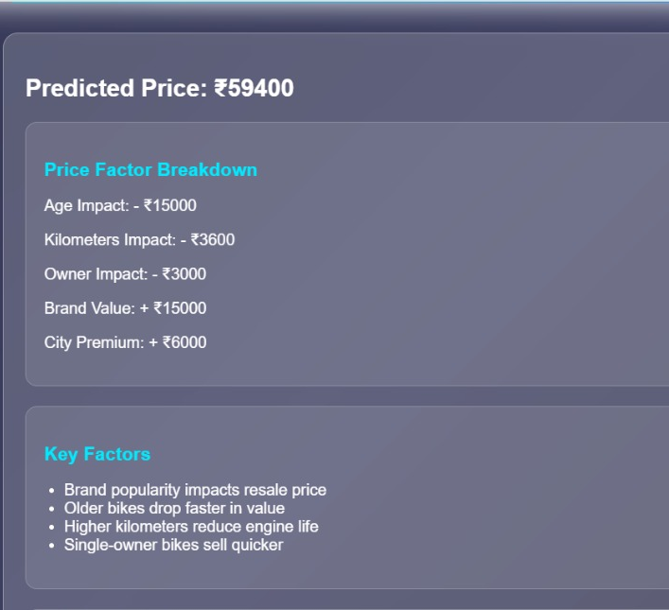
Project Screenshots

Slide 8
Challenges & Solutions
1. Accurate Price Prediction
Challenge: Difficult to estimate resale value without market dataset
Solution: Developed a rule-based pricing model using depreciation and brand/city value factors
2. Instant Dynamic Output
Challenge: Required to show results instantly without refreshing the page
Solution: Used JavaScript DOM manipulation for real-time result rendering
3. Input Validation
Challenge: Wrong or missing inputs caused incorrect calculations
Solution: Added validation checks and alert messages before performing prediction
4. Responsive UI
Challenge: Layout had to work perfectly on mobile, tablet, and desktop
Solution: Applied responsive CSS and tested across multiple screen sizes

Slide 9
Future Scope
Integration of machine learning models to improve price prediction accuracy using real market data
Addition of a backend database to store historical resale prices and user-listed bikes
Real-time price updates by scraping data from online bike selling platforms
User login system to allow buyers and sellers to save, compare, and track bike valuations
Expansion of the platform into a complete marketplace for buying and selling used bikes
Launch of a mobile application with notifications, multilingual support, and location-based services

Slide 10
Conclusion
The Used Bike Price Predictor successfully provides a fast and transparent method to estimate the resale value of second-hand motorcycles.
By evaluating key parameters such as brand, model year, kilometers driven, number of owners, and city, the system delivers realistic and reliable price predictions.
The instant output with factor-wise breakdown helps remove negotiation-based uncertainty and supports fair decision-making for both buyers and sellers.
Overall, the project demonstrates how front-end technologies can be used to solve real-world problems and bring confidence and clarity to the used bike market.

Slide 11

Thank You!!

