Slide 1

Understanding Genius
Genius is exceptional intellectual or creative power. It often involves novel insights and transformative impact.

Slide 2
01
Exceptional Ability
Genius often begins with a natural aptitude in a specific domain, setting the stage for extraordinary achievement and innovation.
The Nature of Genius
Explore the multifaceted nature of genius, encompassing innate talent, relentless dedication, and profound insight.
02
Creative Thinking
Geniuses demonstrate creative thinking, generating novel ideas that challenge existing paradigms and redefine understanding.

Slide 3
Identifying Genius Traits
01
02
03
High Intelligence
Intense Curiosity
Persistent Drive
Geniuses typically exhibit exceptional intellectual capacity, enabling them to grasp complex concepts and solve intricate problems effectively.
Driven by an insatiable thirst for knowledge, geniuses explore diverse subjects, seeking connections and patterns that others may overlook.
Geniuses maintain unwavering focus and determination, overcoming obstacles and setbacks to realize their vision and achieve their goals.

Slide 4
The Making of a Genius
01
02
03
Early Exposure
Deliberate Practice
Mentorship
Early exposure to stimulating environments and resources can ignite a child's passion and unlock their potential for greatness.
Focused training and dedicated effort are essential for honing skills and mastering expertise in a chosen field of endeavor.
Guidance from experienced mentors can provide invaluable insights, support, and encouragement along the path to achievement.

Slide 5
01
Encourage Exploration
Support exploration of diverse subjects and fields, fostering curiosity and interdisciplinary thinking in aspiring geniuses.
02
Provide Resources
Nurturing Genius Potential
Access to tools, materials, and mentorship opportunities can empower individuals to pursue their passions and develop their talents.
Creating an environment that fosters creativity, curiosity, and critical thinking is vital for unlocking genius potential.
03
Foster Resilience
Help individuals develop resilience and perseverance, enabling them to overcome challenges and setbacks on their journey.

Slide 6
01
Social Isolation
Geniuses may experience social isolation due to their unique perspectives, making it difficult to connect with peers and form meaningful relationships.
The Dark Side of Genius
Discuss the potential downsides, including social isolation, mental health challenges, and ethical dilemmas faced by geniuses.
02
Mental Health
Geniuses face higher rates of mental health issues like anxiety and depression, stemming from intense pressure and perfectionism.

Slide 7
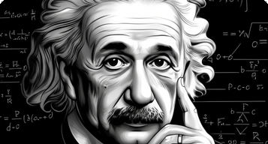
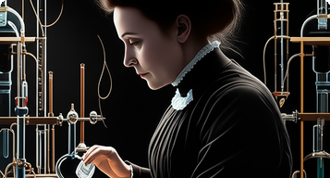
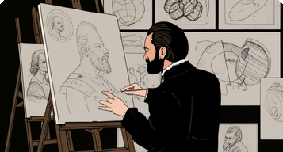
Examples of Genius Minds
Albert Einstein
Marie Curie
Leonardo da Vinci
Revolutionized physics with his theory of relativity, forever changing our understanding of space, time, and gravity.
Pioneered research on radioactivity and was the first woman to win a Nobel Prize, making groundbreaking contributions to science.
A true Renaissance man, excelling as a painter, sculptor, architect, scientist, inventor, and more, leaving an indelible mark.

Slide 8

Unlocking Your Inner Genius
Cultivate curiosity, embrace challenges, and never stop learning. Unlock your potential and transform your world.

