Slide 1
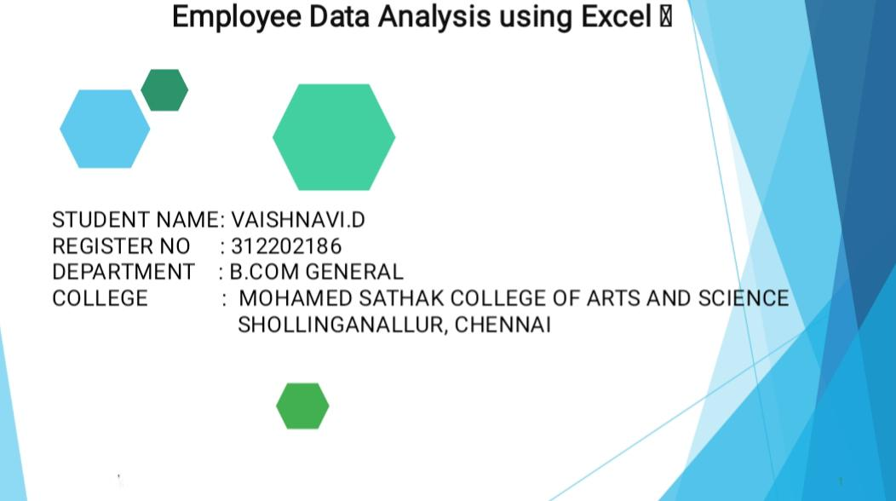
Page 1 of 12

Slide 2
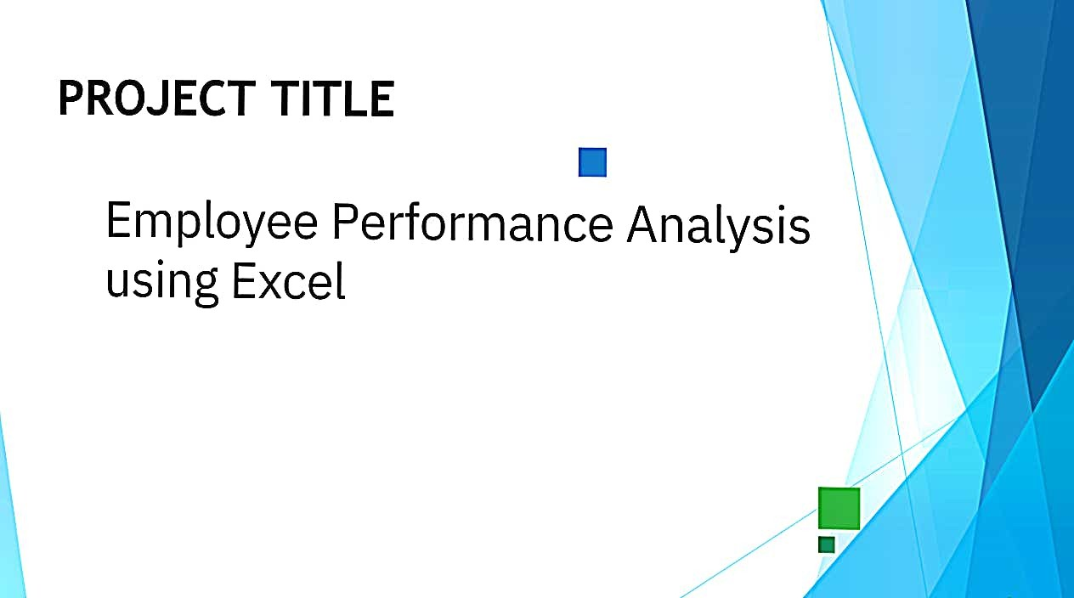
Page 2 of 12

Slide 3
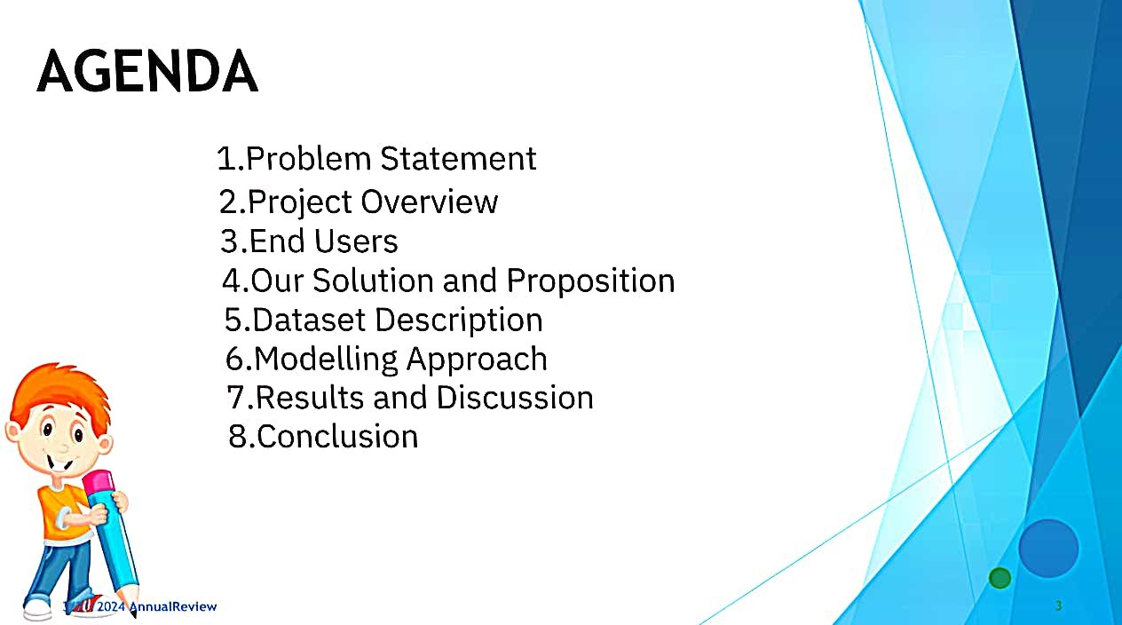
Page 3 of 12

Slide 4
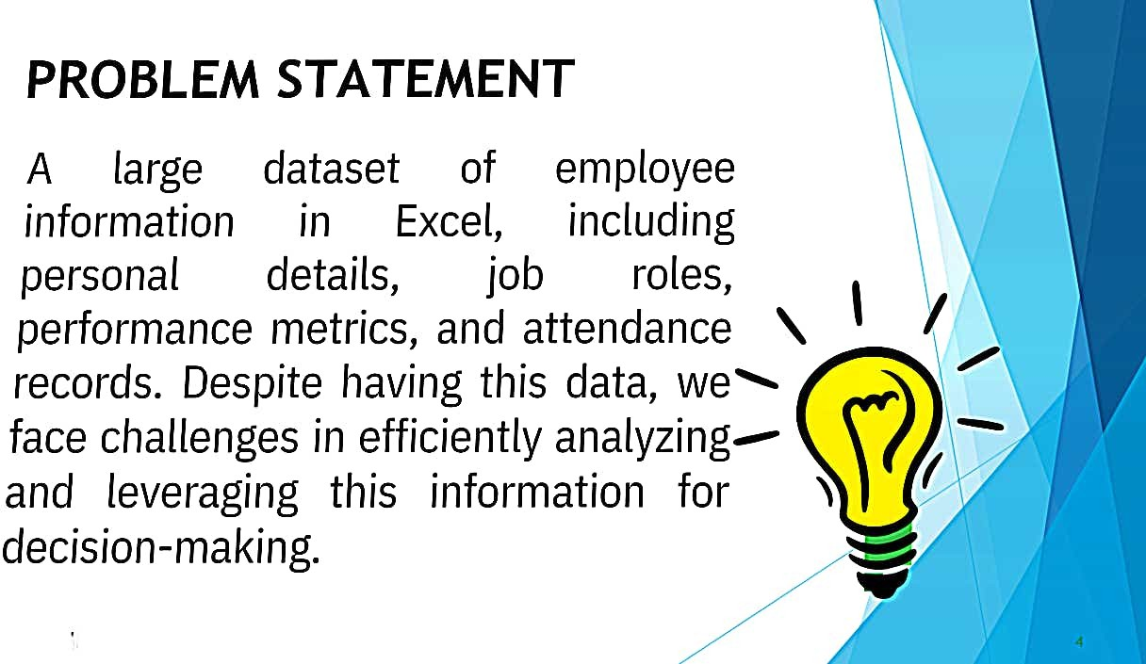
Page 4 of 12

Slide 5
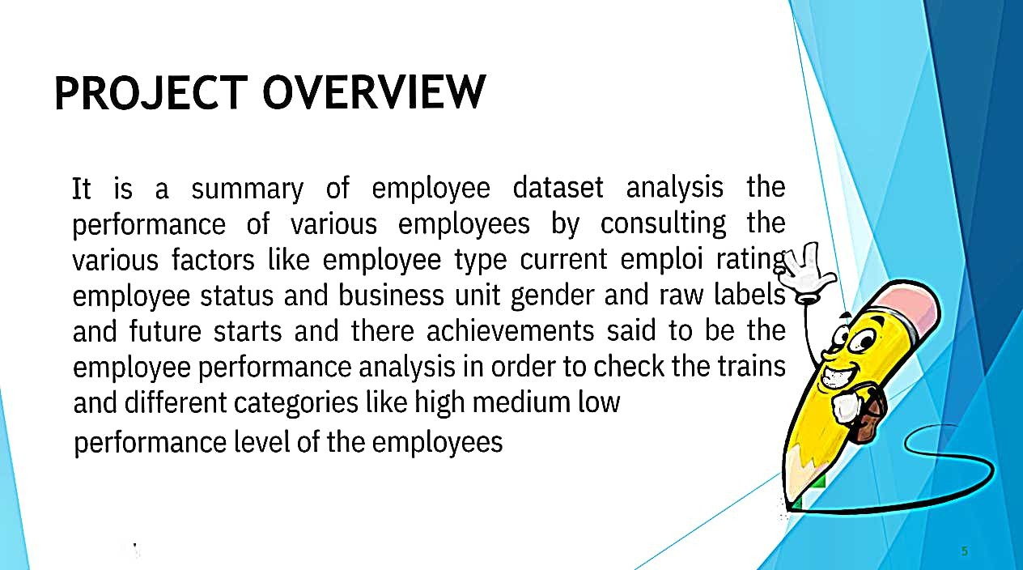
Page 5 of 12

Slide 6
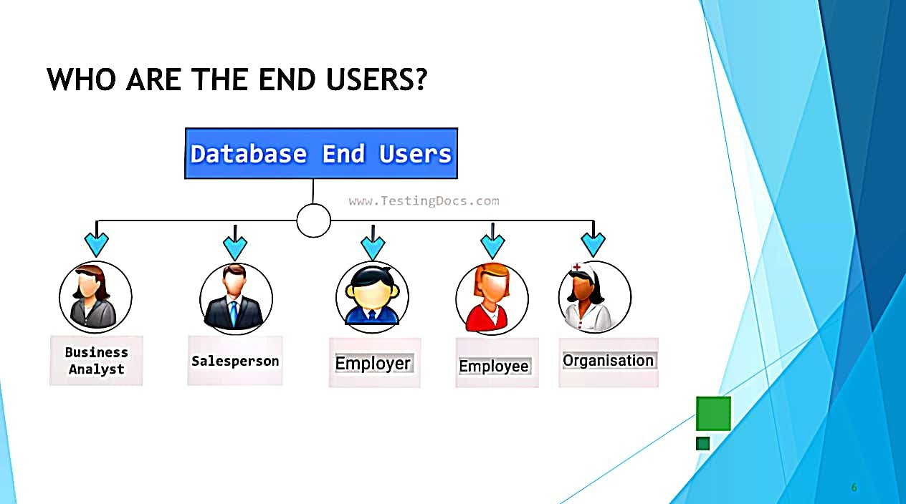
Page 6 of 12

Slide 7
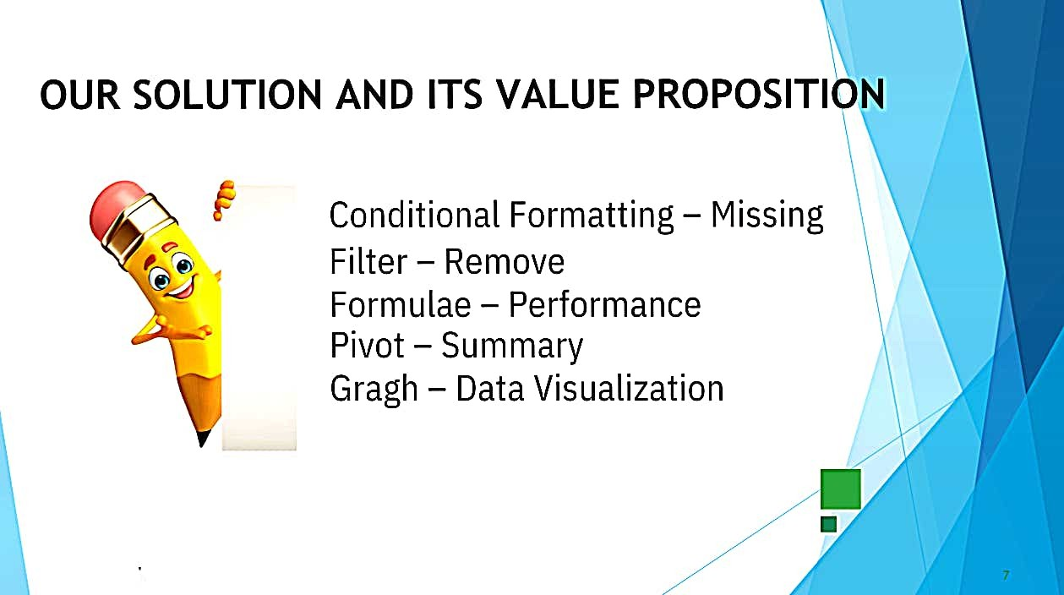
Page 7 of 12

Slide 8
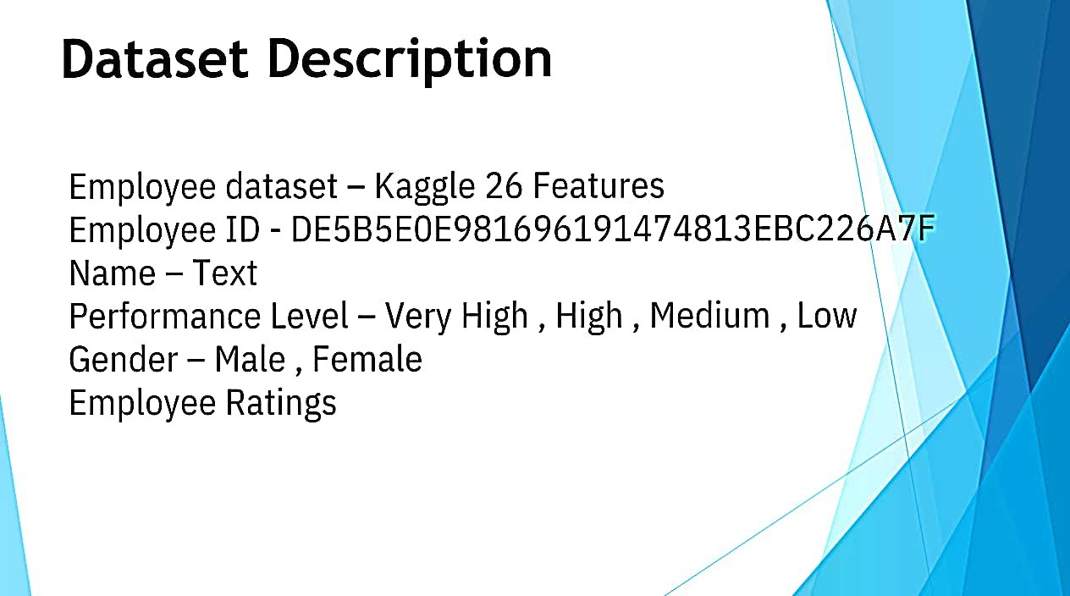
Page 8 of 12

Slide 9
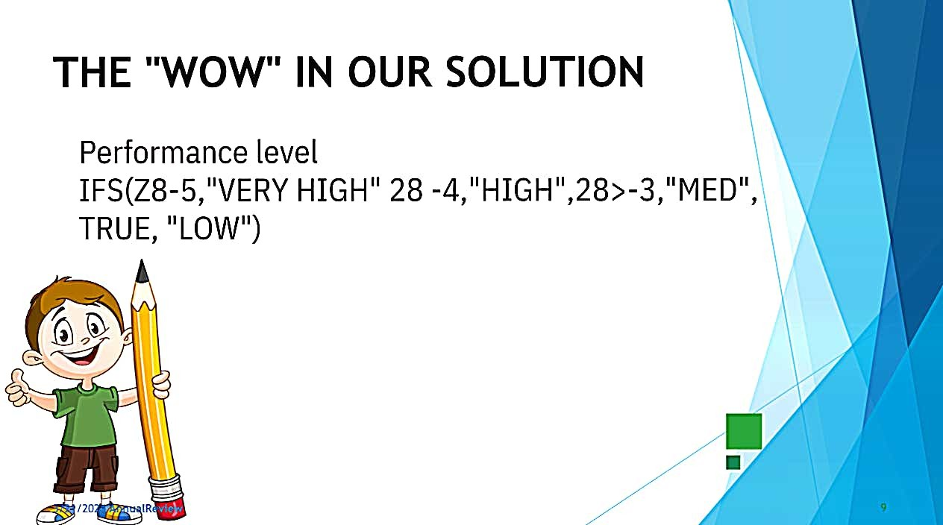
Page 9 of 12

Slide 10
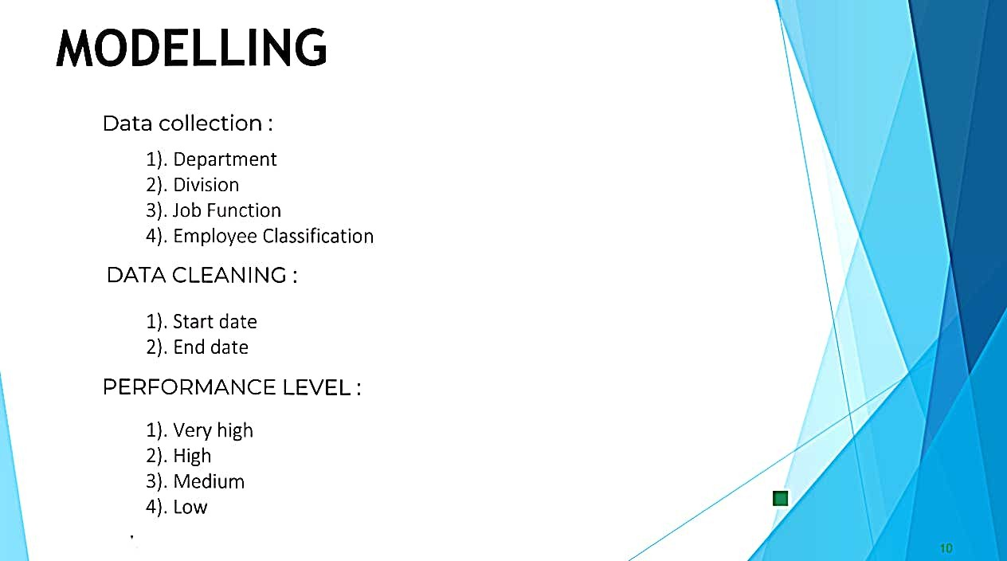
Page 10 of 12

Slide 11
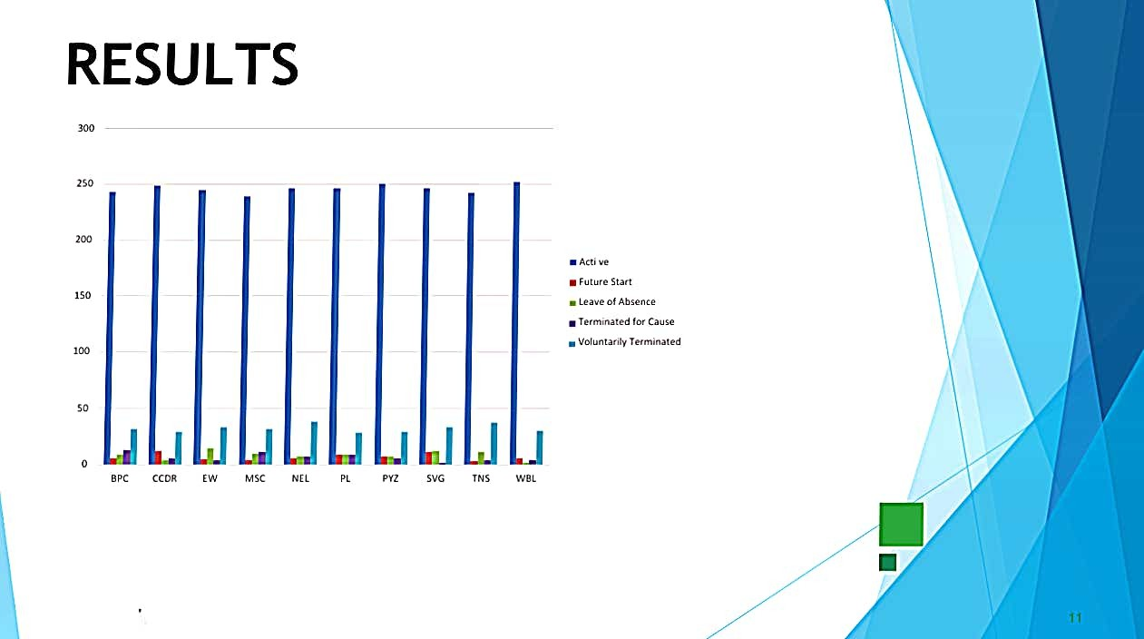
Page 11 of 12

Slide 12
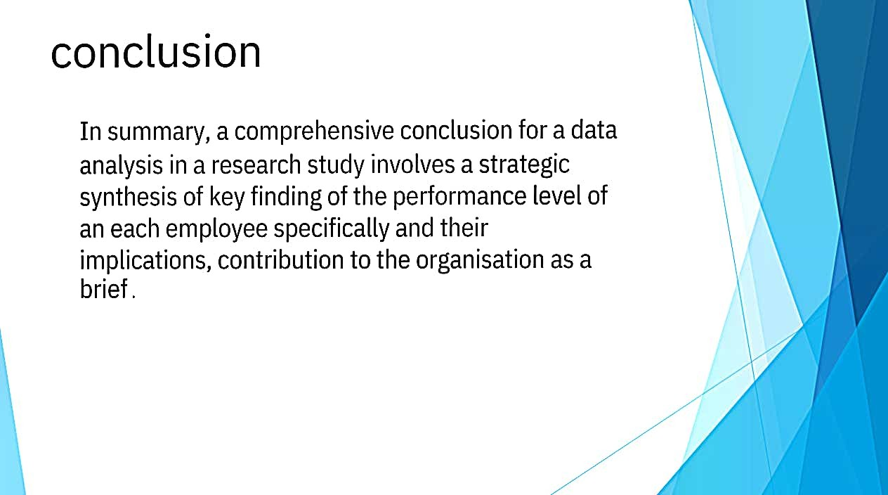
Page 12 of 12

