Slide 1
DATABASE MANAGEMENT SYSTEMS REVIEW-1 SUBMITTED BY: SUSHMITHA RAI(1BM15IS083) VAISHNAVI ARTHAM(1BM15IS088)

Slide 2
TITLE: TRAVEL AGENCY

Slide 3
AIM:
To provide efficient transport services to the customers using database systems.
To make work error free and more reliable.

Slide 4
ABSTRACT:
Travel agency is an online-booking web site. The website covers all the areas required for booking tickets, cancellation and payment. This project is developed to make the travelling process easier. The main module in this project are login and travel management.

Slide 5
PURPOSE:
To increase customer service.
Ensures the efficiency of booking the tickets.
Easier to handle than manual booking.
Payment can be done by various methods.

Slide 6
PROS AND CONS:
PROS:
Booking can be done easily.
Payment can be made easily and is secure.
Different means of transport is provided in one website.
CONS:
Manual labour is reduced.

Slide 7
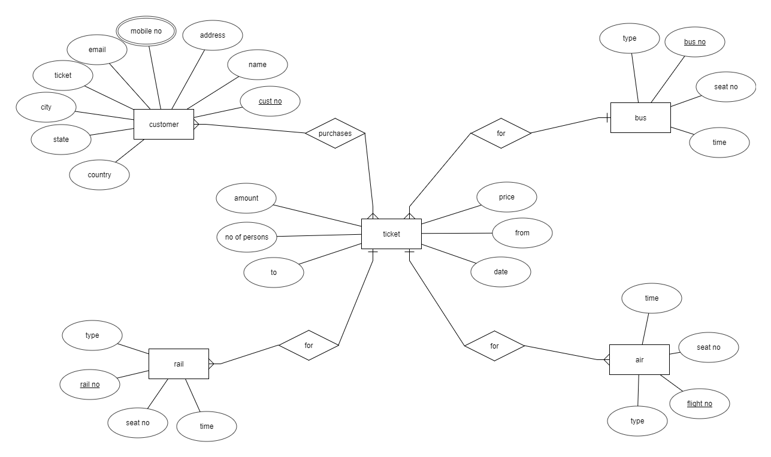
ER DIAGRAM:

Slide 8
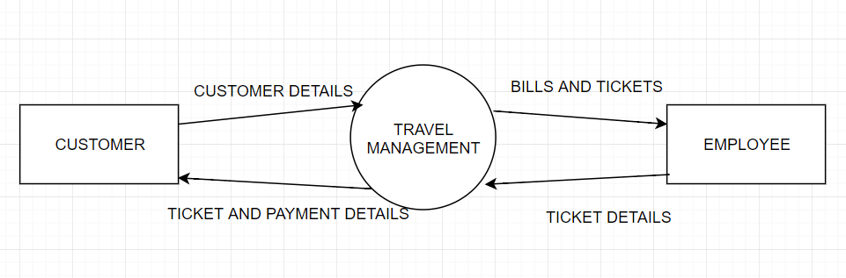
DATA FLOW:

Slide 9
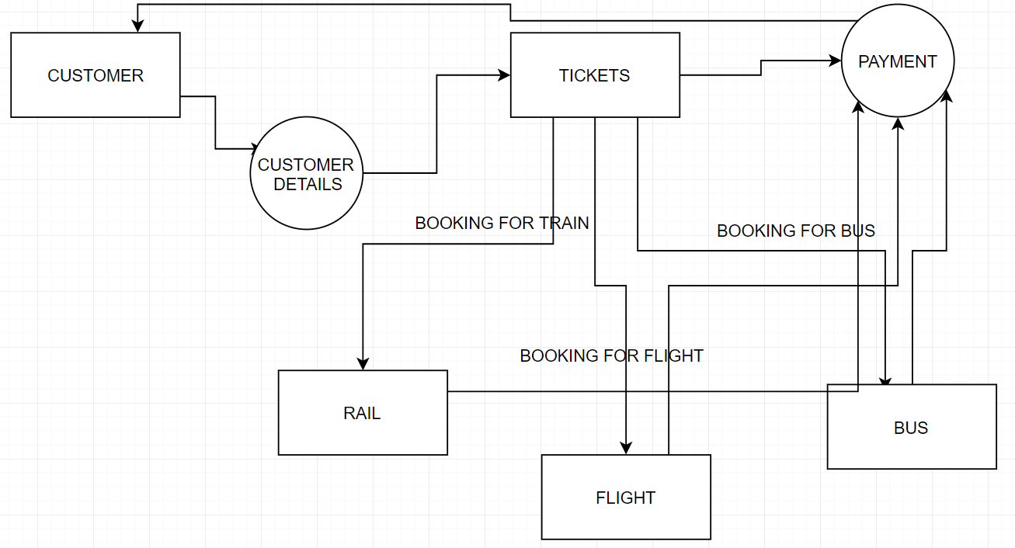

Slide 10
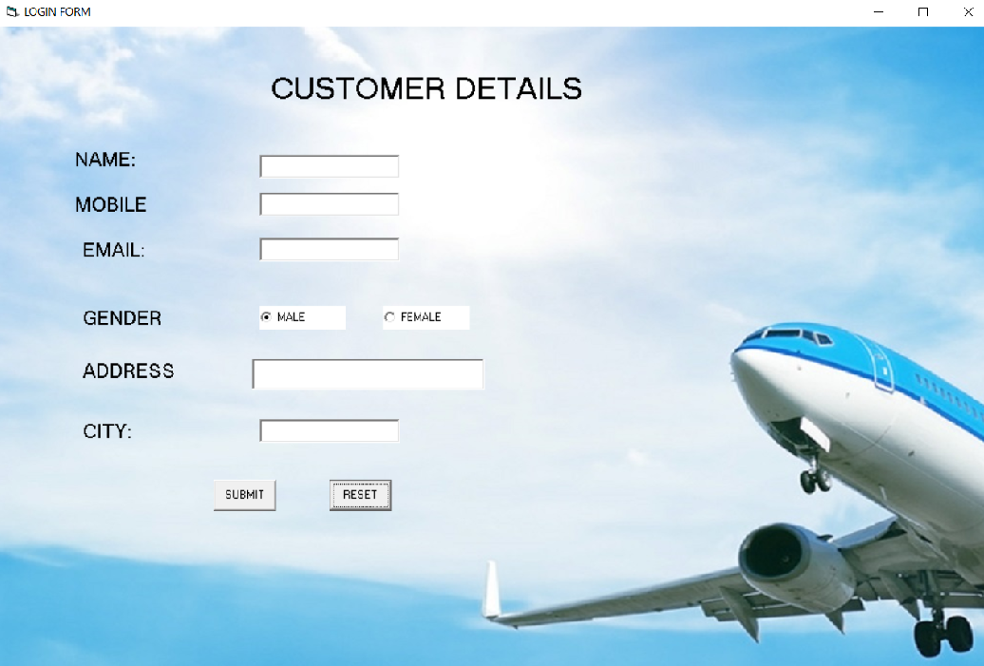
SNAPSHOTS

