Slide 1

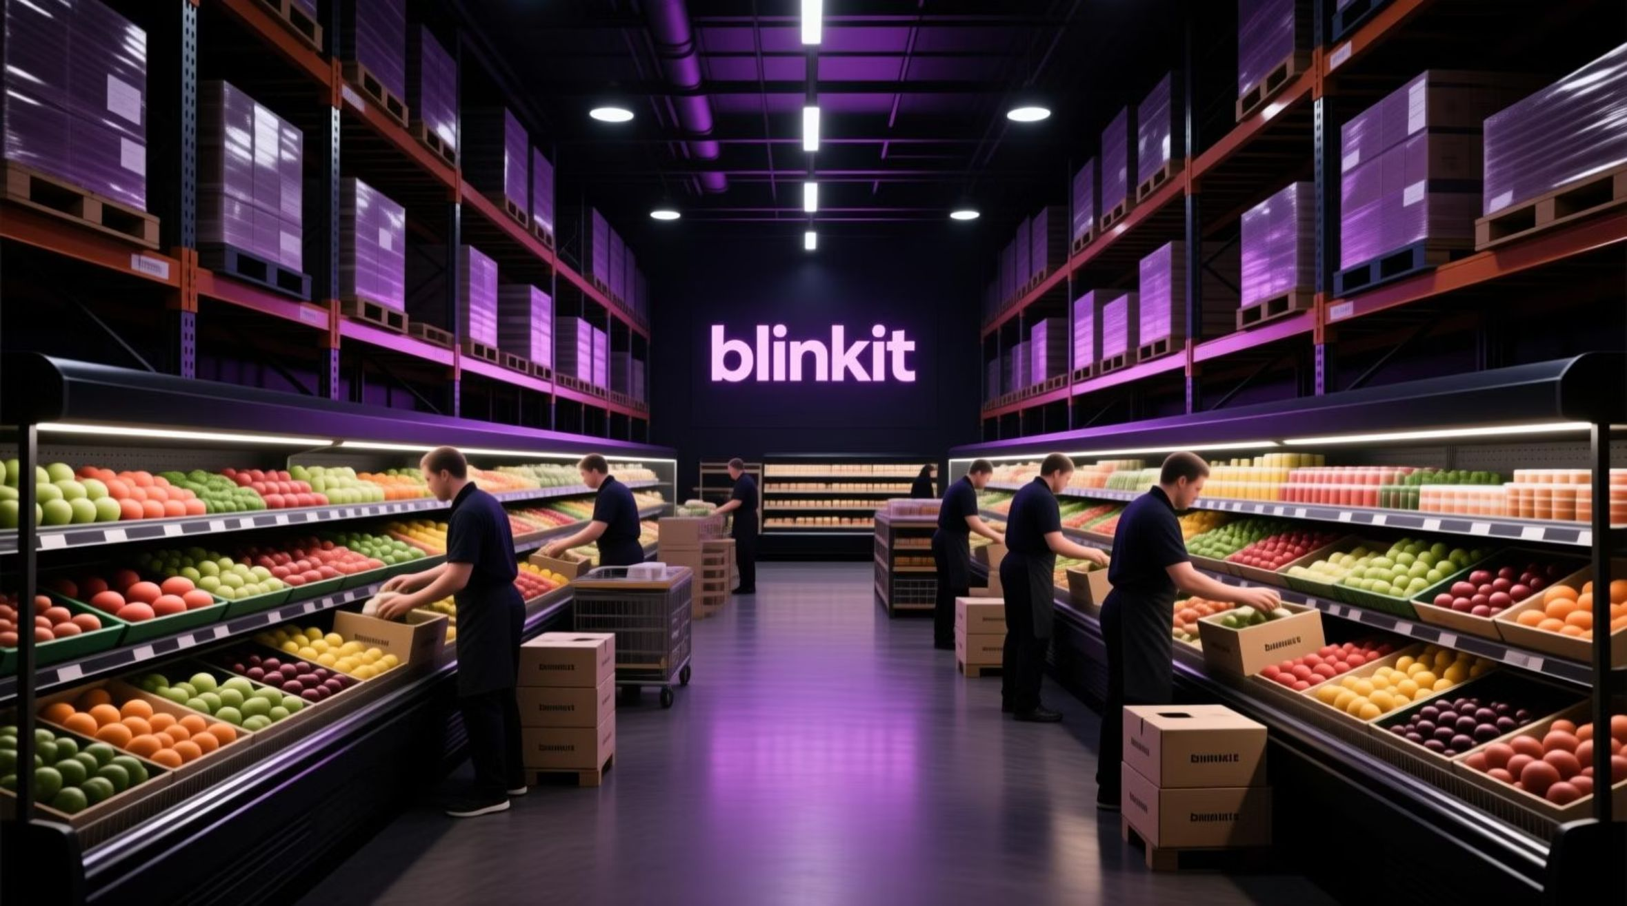
BLINKIT SALES STRATEGIC REVIEW: QX PERFORMANCE ANALYSIS
The 10-Minute Insight: Maximizing Hyper-Local Efficiency

Slide 2

Strategic KPI Overview
$1.20M
$141
Total Revenue
Average Order Value (AOV)
Strong baseline: Focus shifts from growth to profitability via optimized assortment.
High AOV suggests consumer reliance for bulk/essential items (groceries, produce), justifying high inventory investment.
Optimal Dark Store Profile
Medium-Sized Outlets in Tier 3 Locations
These sites are the highest revenue generators. Immediate action required to replicate the Medium/Tier 3 operational blueprint for all new expansions.

Slide 3
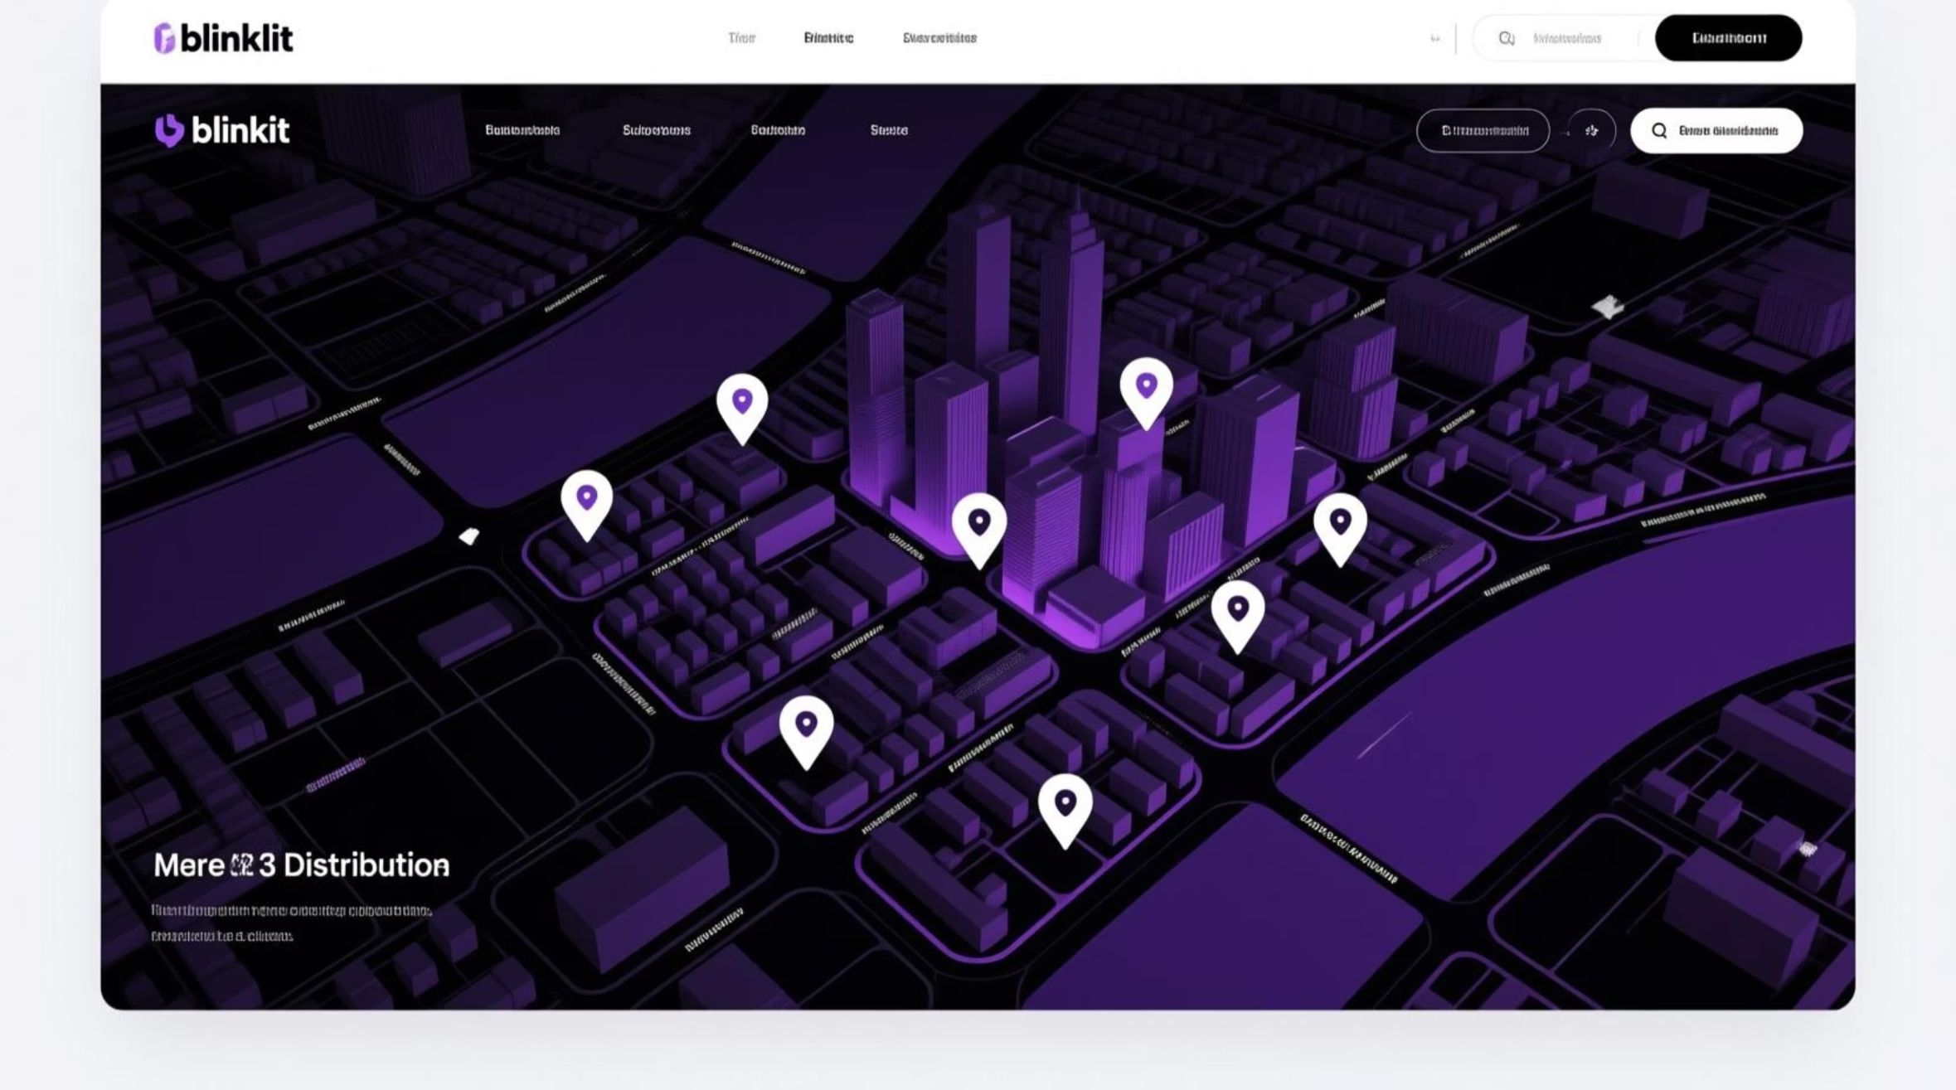
EXECUTIVE SUMMARY: GROWTH ACCELERATORS
The sales analysis reveals that Blinkit's performance is anchored by a highly effective hyper-local fulfillment network that caters to health-conscious, high-demand customers. The single greatest lever for immediate optimization is Dark Store Size and Location Tiering, which directly dictates revenue density.
The strategic imperative is to: Standardize the medium-sized, Tier 3 dark store model to capture maximum demand while rigorously stocking high-visibility, high-margin products like Fresh Produce and Low-Fat Consumables.

Slide 4
STRATEGIC INSIGHTS & DATA DEEP DIVE
1. Outlet Performance & Fulfillment Optimization
The analysis confirms a clear correlation between outlet characteristics and revenue generation. The Medium-Sized outlet model is the sweet spot, indicating the optimal balance between high inventory throughput and quick picker-to-delivery handoff time, which is critical for the 10-minute promise.
Area of Analysis
Key Finding
Strategic Recommendation (Action)
Outlet Size (Revenue Driver)
Medium-Sized outlets are the top revenue generators, while High-Sized outlets are the lowest.
Phase Out/Right-Size High-Sized Stores. High-sized stores likely suffer from inefficient picking routes and high rent. Convert capital from underperforming large stores into two or more high-efficiency Medium dark stores.
Geographic Tiering
Tier 3 locations demonstrate the strongest sales concentration, followed by Tier 2 and Tier 1.
Prioritize Tier 3 Expansion. Tier 3 is an 'untapped goldmine' with high sales potential. Allocate 60% of QX expansion budget to establishing the Medium-sized dark store blueprint in new Tier 3 suburbs.

Slide 5
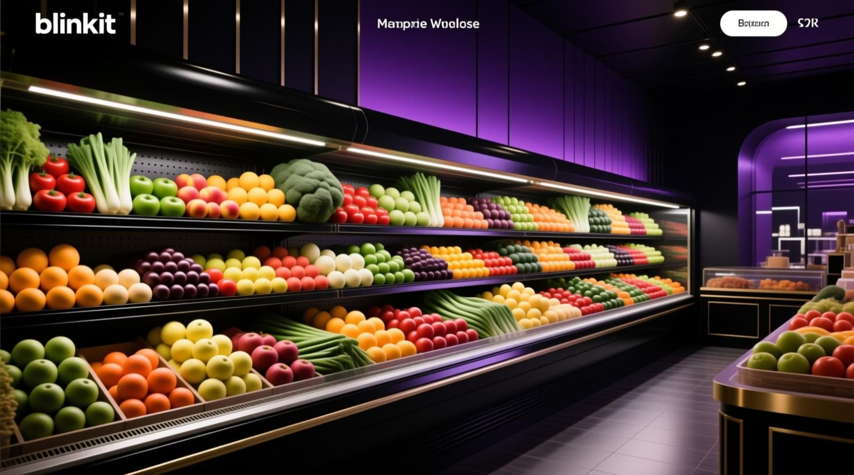
Assortment & Inventory Strategy
2. Product Stocking & Consumer Demand
Product stocking must reflect proven consumer demand, which skews towards immediate-consumption, low-fat grocery items.
Top-Selling Categories
Fat Content Preference
Inventory & Breadth
Key Finding:Fruits and Vegetables are the highest-selling item types, followed by Snack Foods.
Key Finding:Low Fat products generate the highest sales revenue ($776.32K), significantly outpacing Regular Fat products ($425.36K).
Key Finding:8,523 total items sold, averaging $141 per transaction.
Strategic Recommendation (Action):Maintain Strategic Breadth. The high item count supports the 'Last-Minute App' promise of solving various immediate needs. Utilize the Matrix Card visualization (Avg Rating, Avg Sales, Item Visibility) to cull bottom 5% of SKUs that have low rating/visibility but consume valuable dark store space.
Strategic Recommendation (Action):Elevate Freshness KPI. Because Fresh Produce drives max revenue, implement a rigorous, real-time quality control system for Fruits/Vegetables to protect the brand's 'Trust' metric. Dedicate 20% of dark store floor space to refrigerated produce.
Strategic Recommendation (Action):Negotiate Low-Fat Bulk Contracts. Use the sales data to secure better bulk pricing on Low-Fat variants across all relevant categories (Dairy, Packaged Goods). Re-allocate shelf space to increase SKU visibility for all Low-Fat items.

Slide 6
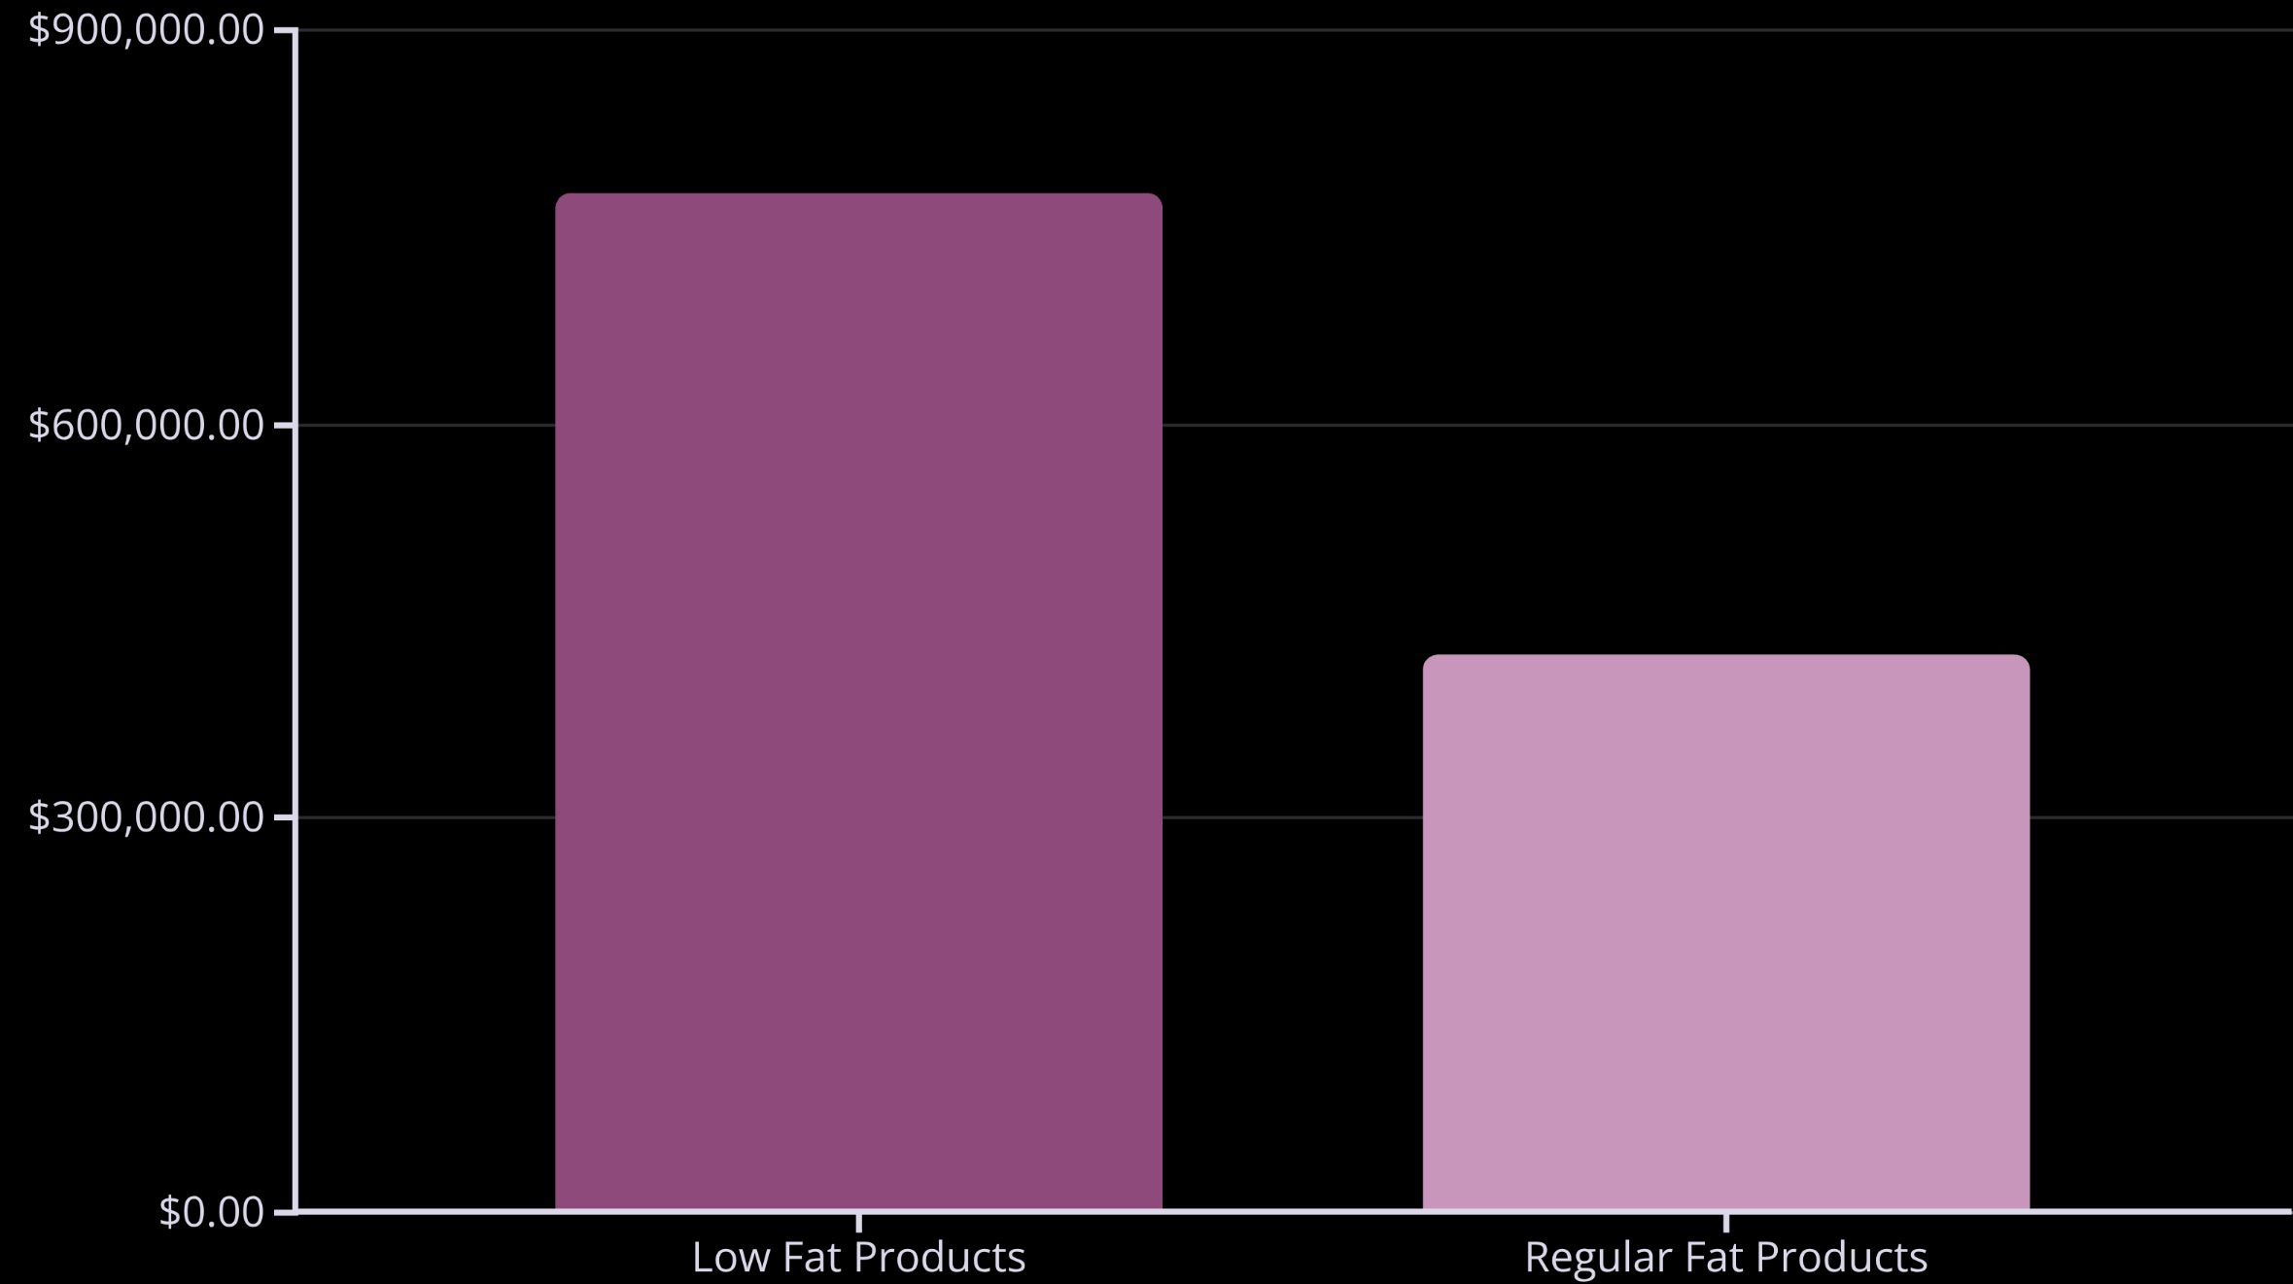
Revenue Performance by Category
The data clearly demonstrates consumer preference for healthier options, with Low Fat products generating nearly double the revenue of Regular Fat alternatives. This insight should drive both procurement strategy and shelf space allocation decisions across all dark store locations.

Slide 7

DAX CALCULATIONS: THE FOUNDATION
The insights are derived from robust DAX logic ensuring metric integrity:
KPI
DAX Formula (Semantic Layer)
Total Sales
SUM('BlinkIT Grocery Data'[Sales])
Average Sales
AVERAGE('BlinkIT Grocery Data'[Sales])
Items Sold
COUNTROWS('BlinkIT Grocery Data')
Revenue Density Index (RDI)
Custom Metric for Executive Use:[Total Sales] / [Outlet Square Footage]
These foundational metrics power all strategic recommendations and ensure data-driven decision making across the organization.

