Slide 1
Fake News Detection
CS-GY 6053 Foundations of Data Science
Final Project Presentation
PRESENTED BY
Dhanesh Baalaji Srinivasan
Vaishnavi Chellappa
Venkataramanan Venkateswaran

Slide 2
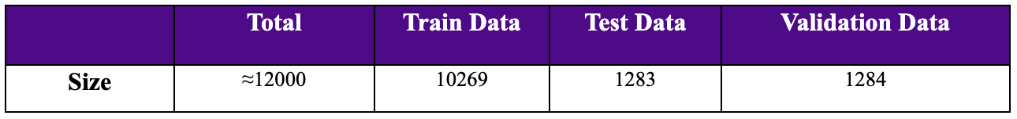
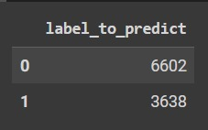
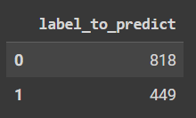
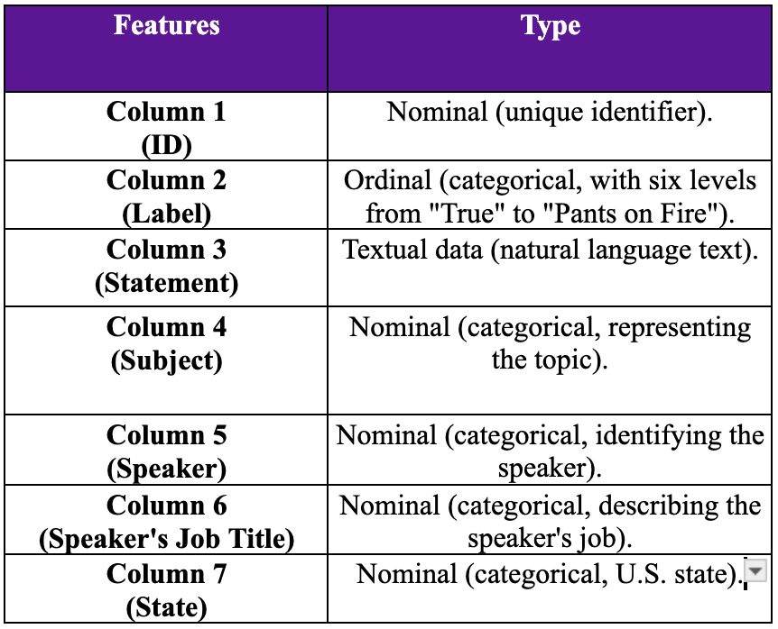
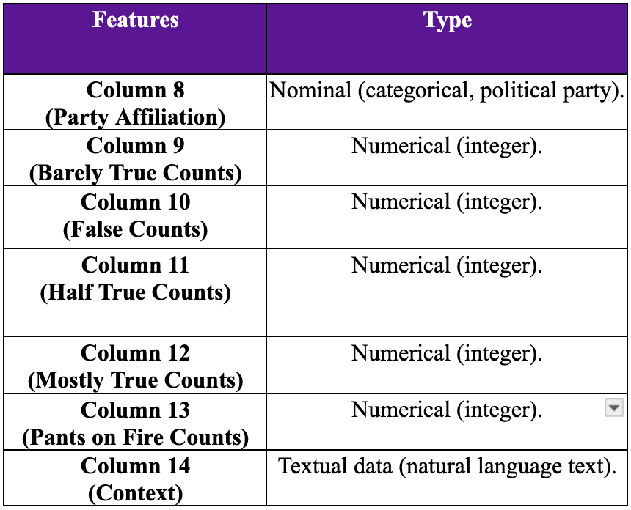
Background and Data
Background & Problem:
Our project aims to detect and analyze the accuracy of machine learning and deep learning models in identifying fake news, thereby enhancing our understanding of fake news classification.
Data Description:
Source: The LIAR dataset, introduced in a 2017 paper by William Yang Wang.
Features: Includes ID, Label (True, Mostly True, Half True, Barely True, False, Pants on Fire), Statement, Speaker, Job Title, State, Party Affiliation, and more.
Pre-processing: Assigning column names for the data present and reassignment of ‘true’ and ‘mostly-true’ class into 1 and the other labels as 0.
Training Data:
Testing Data:
Notes:
Data Description: - Particularly, when we focus on the label to predict, the data contains the labels as an ordinal with six levels, “True” to “Pants on Fire”. We convert the Ordinal to a categorical variable with two values “0” and “1” with which we build the classification models.

Slide 3
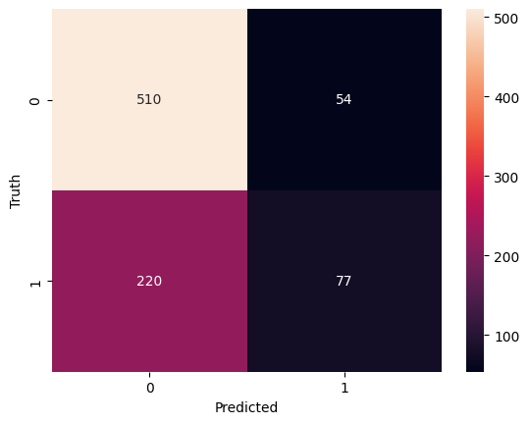
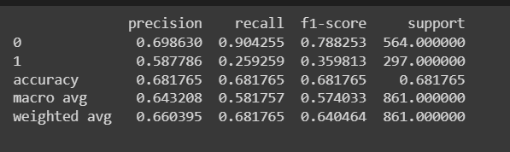
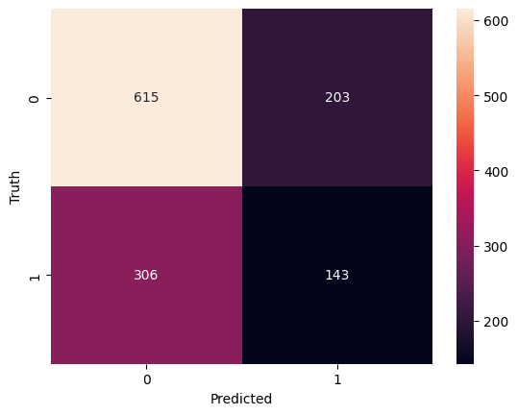
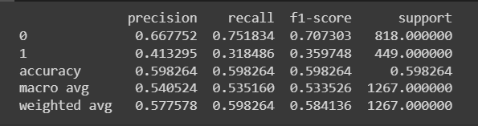
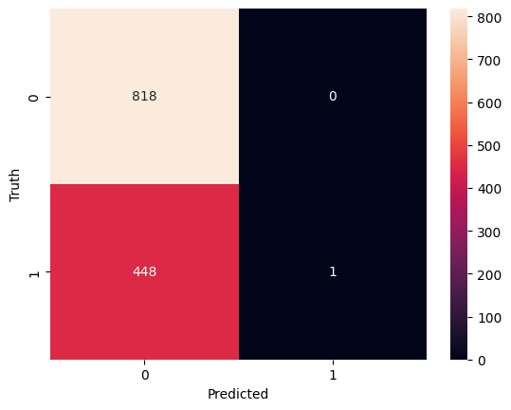
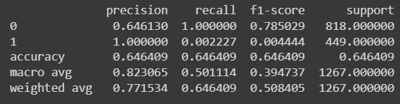
Model and Evaluation
Model Description:
Machine Learning: We used Support Vector Machines (SVM) and used the model in two ways: 1. We used the metadata information like subject, speaker_info and fit the model. 2. We discarded the metadata info and used only the news statement to predict the label. Deep Learning: We used BERT to capture complex patterns in text data and fit the model with just the news statement to predict the labels.
Evaluation Metrics:
Precision: It measures the proportion of correctly predicted positive instances out of all instances predicted as positive, focusing on the accuracy of positive predictions, crucial in scenarios where false positives are costly. Confusion Matrix: It provides a comprehensive breakdown of a model's predictions, detailing true positives, true negatives, false positives, and false negatives, offering a clearer insight into classification performance beyond simple accuracy metrics.
BERT Confusion Matrix: BERT Classification Report:
SVM (Initial) Confusion Matrix: SVM (Initial) Class Report:
SVM (Improved) Confusion Matrix: SVM (Improved) Class Report:

Slide 4
Assumptions, Limitations, and Next Steps
Assumptions & Limitations:
Reliability of the LIAR dataset which is sourced from credible fact-checking websites.
The SVM model was executed with extra variables like Speaker, Subject and Job Title and got an accuracy of around 60%. We then removed these variables and got a much higher accuracy. So the assumption made is that these variables are redundant and do not contribute to the final outcome.
Next Steps:
Implementing advanced regularization methods to mitigate overfitting in machine learning models.
Enhancing model versatility for broader datasets and real-world applicability to ensure robustness.
Long term goal: Aiming to create a real-time application for detecting fake news, impacting information consumption in society.

