Slide 1

Blockchain-Oriented Software Engineering: Smart Contracts Security
Vaishnavi Deshmukh (202111051) Research Guide: Dr. JayPrakash TL

Slide 2
Overview
Introduction
Motivation
Literature Survey
Proposed Objective
Future Work
Conclusion
References

Slide 3
Introduction
Blockchain is a decentralised ledger that stores all transactions, It is an immutable ledger technology.
Ethereum is a distributed (also decentralised) blockchain-based support technology such as Bitcoin.
Smart contracts, Solidity
Notes:
A blockchain is a distributed list of blocks, each of which is uniquely known by its cryptographic hash [20]. Each block contains a connection to the block preceding it, forming a chain of blocks. Each block is made up of a set of transactions. When a block is generated and applied to the blockchain, the transactions contained inside the block are permanent. This is to protect the transaction’s legitimacy and to avoid the occurrence of double spending.

Slide 4
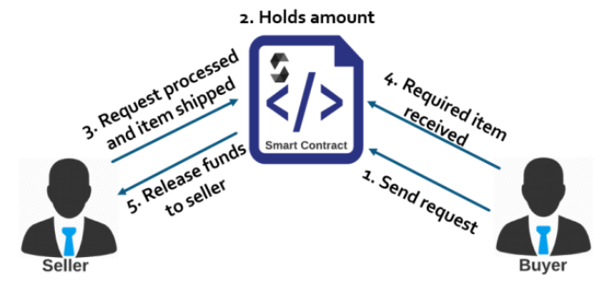
How Smart Contracts Work?
Image source-Praitheeshan, P., Pan, L., Yu, J., Liu, J., Doss, R. (2019). Security Analysis Methods on Ethereum Smart Contract Vulnerabilities: A Survey. arXiv. https://doi.org/10.48550/arXiv.1908.08605

Slide 5
Security Attacks On Smart Contracts
August 3rd, 2022, thousands of Solana (popular blockchain for speedy transactions) wallets were drained of nearly $ 8 million in total.
2nd of February 2022, the Wormhole Cross Chain Bridge Attack resulted in a loss of more than $320 million from Solana and Ethereum.
August 2021, one of the biggest cryptocurrency heists happened. Hackers stole $613 million worth of digital currency from a company named Poly Network.
2017, $150 million worth of ETH was stolen from an organization named Parity technologies
2016, The DAO Attack and many more.

Slide 6
Motivation
Smart contracts allow running contract code transparently for all parties, without the need for a centralized authority.
Smart contracts cannot be changed after deployment and hence the code needs to be verified for potential vulnerabilities.
However, smart contracts are far from being secure and attacks exploiting vulnerabilities that have led to losses valued in the millions.
Notes:
—Smart contracts belong to the most rapidly growing aspect of the world of cryptocurrencies. This phenomenon attracts great attention from researchers but also the business community, and the development brings daily a lot of novel applications

Slide 7
Literature survey
Luu et al. [2] use their suggested formal verification tool, Oyente, to analyse Ethereum smart-contract vulnerabilities without describing defensive strategies.
Dika [3] investigates smart contract security analysis tools and gives insights about their usefulness, accuracy, and consistency.
Atzei et al. [4] address key flaws and attacks in the context of typical programming concerns, and give the most referenced taxonomy of Ethereum smart contract vulnerabilities in three layers: Solidity, EVM, and Blockchain.
Notes:
This studies do not cover all aspects of Ethereum smartcontract security vulnerabilities, countermeasures, and tool support and may miss details about tools or defense mechanisms

Slide 8
Proposed Objective
A poorly coded smart contract can be hacked by someone sending certain instructions to it, so
Devised Countermeasures by analysing the vulnerabilities.
Tools Analysis is also done.
Notes:
There are various known real world smart contract attacks like The DAO Attack,PoWHcoin attack, Parity Wallet, Parity Library bug and many more.

Slide 9
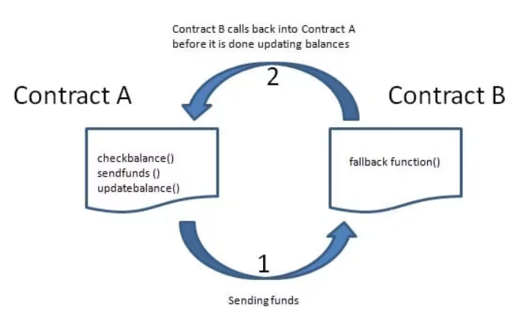
Re-entrancy Vulnerability-
Source: https://cryptomarketpool.com/reentrancy-attack-in-a-solidity-smart-contract/
Notes:
A reentrancy attack occurs when a function makes an external call to another untrusted contract.
the untrusted contract makes a recursive call back to the original function in an attempt to drain funds.

Slide 10
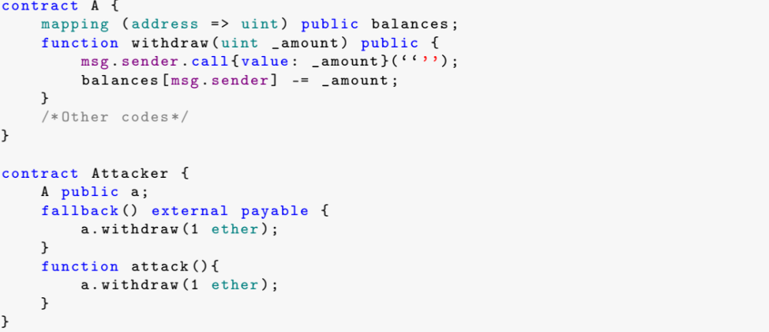

Slide 11
Countermeasure-
Restrain using call function whenever possible.
Add a “lock”, which is usually a state variable that shows the state of external calls and permits the external call only if the state is right.
Make all logic changes before the call function is executed.

Slide 12
Delegate Call to Insecure Contracts
The delegatecall reuses codes of the called contract and executes them in the caller’s context.
Risky to use delegatecall.
Notes:
Delegatecall is a special function in Solidity. It is the same as the call function with one major difference. The delegatecall re-uses codes of the called contract and executes them in the caller’s context.

Slide 13
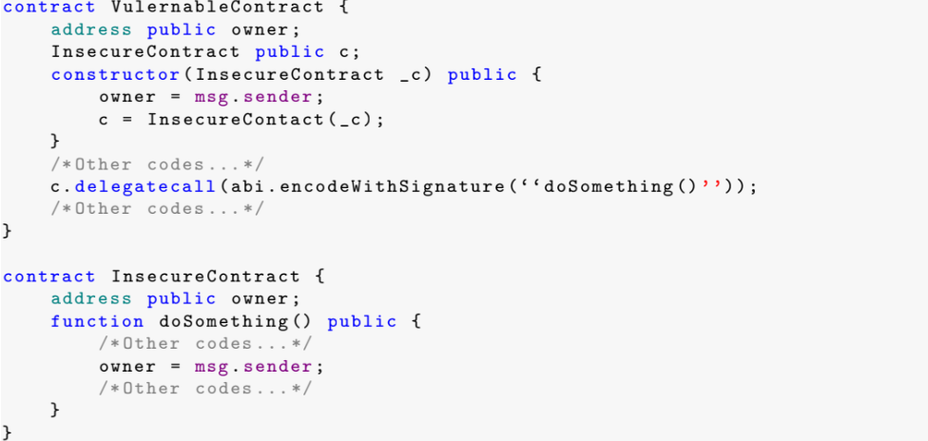

Slide 14
Countermeasure-
The library keyword for implementing library contracts, ensures the library contract is stateless and non-self-destructible.
when using DELEGATECALL pay careful attention to the possible calling context of both the library contract and the calling contract, and whenever possible, build state-less libraries.
Notes:
https://blog.sigmaprime.io/solidity-security.html

Slide 15
Arithmetic Issues
Due to the lack of floating point support, smart contracts generally represent values as integers.
In Solidity, the integer type has a limited range.
Variables values may exceed the upper or lower constraint during arithmetic operations
Notes:
https://icommunity.io/en/5-key-vulnerabilities-of-smart-contracts/

Slide 16
Countermeasure-
Use or build mathematical libraries which replace the standard math operators; addition, subtraction and multiplication.
Safe Math Library is a reference or library to use to avoid under/overflow vulnerabilities.

Slide 17
Self destruct
Self destruct procedure allows you to delete certain contracts from the blocks and can still be part of the historical blocks in the blockchain.
Results in Ether loss.

Slide 18
Countermeasure-
Avoid an unexpected self destruct call, try the best practice of using caution when making external calls.
Avoid being dependent on exact values of the balance of the contract because it can be artificially manipulated. If applying logic based on this.balance, ensure to account for unexpected balances.

Slide 19
Freezing Ether
A contract in a freezing Ether condition can only receive Ether but cannot send it out.
Also referred to as frozen money or greedy contract.
Notes:
https://news.bitcoin.com/defi-attacker-siphons-570000-from-curve-finance-crypto-exchange-fixedfloat-freezes-112-ethereum/

Slide 20
Countermeasure-
Avoid this situation at the smart-contract designing phase.

Slide 21
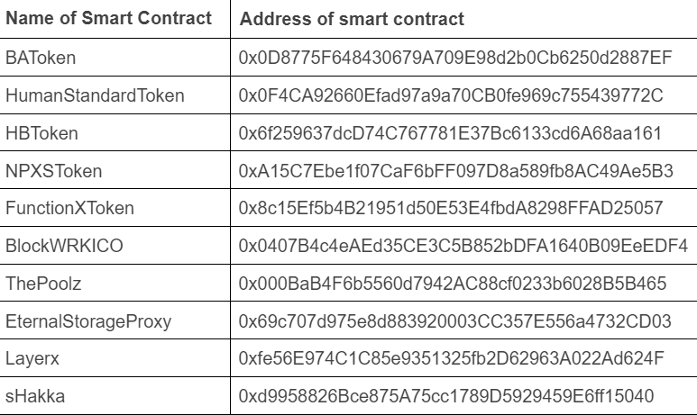
What I’ve done
Resource-https://etherscan.io/

Slide 22
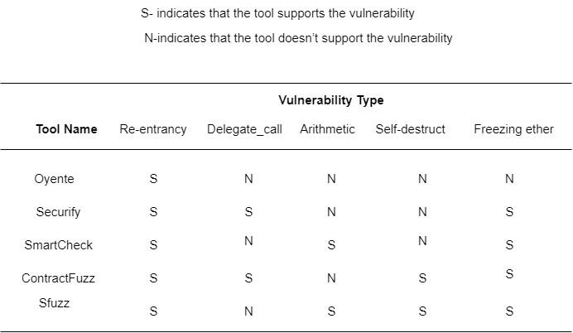
Analysis Of Various Tools
Tools-https://github.com/enzymefinance/oyente
https://github.com/eth-sri/securify2
https://github.com/smartdec/smartcheck
https://github.com/gongbell/ContractFuzzer
https://github.com/duytai/sFuzz

Slide 23
Conclusion
There are several Vulnerabilities present in smart contracts in real world which can be found by using various tools but no specific tool can detect all.
Manual Testing is required.
We need better methods and a combined tool.
Notes:
Smart contracts are becoming more and more complex in their structure to achieve complex functionality, and the variety of smart contract vulnerabilities is increasing, and the rules defined by experts based on vulnerabilities cannot keep up with the speed of smart contract vulnerability updates

Slide 24
Future Work
There are various tools present for finding vulnerabilities but no standard real world dataset based on Ethereum smart contracts labelled with vulnerabilities.
The aim is to pave the way for a disciplined, testable and verifiable smart contract software development.
Studying vulnerabilities related to blockchain platforms other than Ethereum such as Hyperledger Fabric, Hyperledger Sawtooth, EOS, Tezos, Solana, Corda,NEO, and Cardano.

Slide 25
References
[1]Praitheeshan, P., Pan, L., Yu, J., Liu, J., Doss, R. (2019). Security Analysis Methods on Ethereum Smart Contract Vulnerabilities: A Survey. arXiv. https://doi.org/10.48550/arXiv.1908.08605
[2]Luu, L.; Chu, D.H.; Olickel, H.; Saxena, P.; Hobor, A. Making Smart Contracts Smarter. In Proceedings of the 2016 ACM SIGSAC Conference on Computer and Communications Security (CCS’16), Vienna, Austria, 24–28 October 2016; Association for Computing Machinery: New York, NY, USA, 2016; pp. 254–269. [CrossRef]
[3]Dika, A. Ethereum Smart Contracts: Security Vulnerabilities and Security Tools. Master’s Thesis, Norwegian University of Science and Technology, Trondheim, Norway, December 2017
[4]Atzei, N.; Bartoletti, M.; Cimoli, T. A survey of attacks on ethereum smart contracts (sok). In Proceedings of the International Conference on Principles of Security and Trust, Uppsala, Sweden, 24–25 April 2017; Springer: Berlin/Heidelberg, Germany, 2017; pp. 164–186.
[5]G. Wood, “Ethereum: A secure decentralised generalised transaction ledger,” Ethereum project yellow paper, vol. 151, pp. 1–32, 2014.

Slide 26
Thank You

