Slide 1

A Static Analysis Approach For Ethereum Smart Contracts
Vaishnavi Deshmukh (202111051) Research Guide: Dr. JayPrakash TL

Slide 2
Overview
Introduction
Architecture
System Requirements
Dataset statistics
Methodology
Conclusion and Future work
References

Slide 3
Introduction
Our approach for reducing future attacks, we have come up with a modular static analysis approach that uses symbolic execution to detect traces leading to vulnerabilities.
Interaction can be done through the command line interface(CLI). It supports five modules that are identified as DASP 10 vulnerabilities-
Reentrancy
Arithmetic
Unchecked low level calls
Front running
Time manipulation

Slide 4
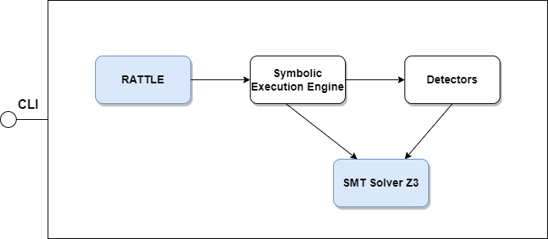
Architecture

Slide 5

If byte code is provided then-
1.The bytecode will be delivered to the Rattle module.
2. In the Rattle module it will elevate the bytecode to an intermediate representation (IR) and instructions will be converted to Single Static Assignment (SSA)form.
3.The CFG will be constructed by the following command.

Slide 6
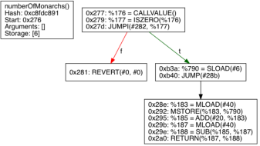
4. Function arguments, memory locations, and storage locations are recovered. this artifact will be passed to the next module which is Symbolic Execution Engine.
5. The Symbolic Execution Engine is in charge of iterating across CFG and generating traces.
Notes:
A trace is a possible execution route that comprises information such as the register, memory, storage, revalue, depth hit, constraints to follow this path, the context in which it is run, and if the transaction was reverted, interrupted, destroyed, or hit an invalid instruction. When it encounters a conditional JUMP.

Slide 7
6.SMT Solver Z3 module generates symbolic variables and symbolic expressions.The Symbolic Execution Engine traces will be supplied to the Detectors module.
7.This module is responsible for detecting a certain type of vulnerability.
Notes:
This module also consults SMT Solver Z3 to see whether or not certain restrictions are feasible.

Slide 8
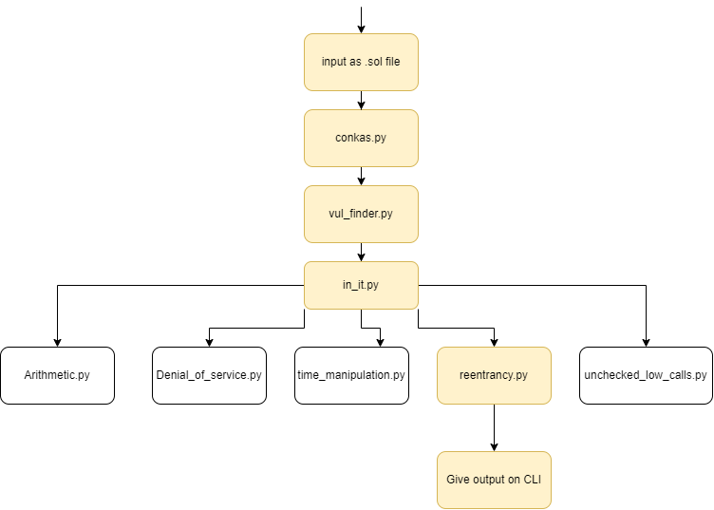
If source code is provided as an input-

Slide 9
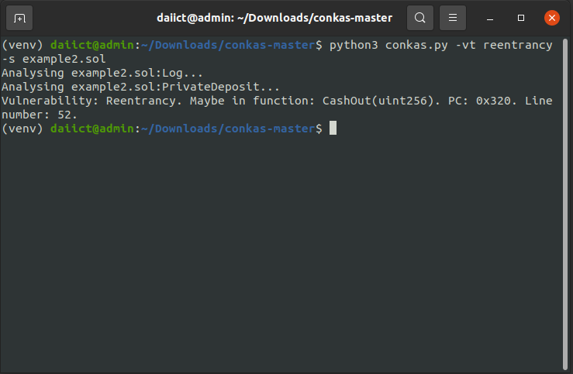
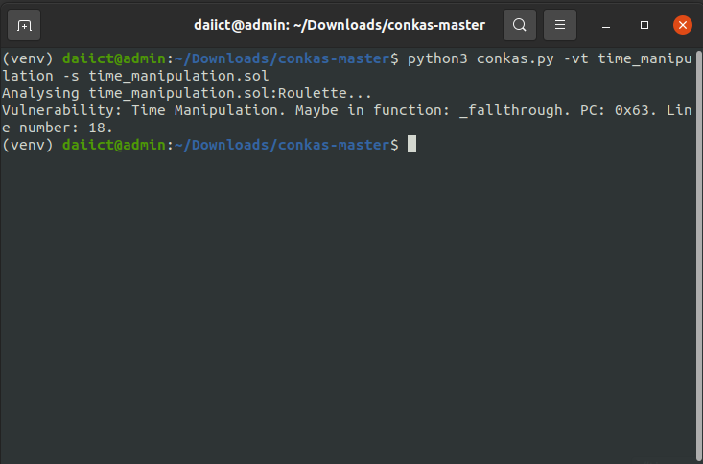

Slide 10

Easy to add new modules-
1.To add an entry to the object inside the file init .py inside vuln finder folder, being the key the name of the module and the value the function to be called. This function needs to follow the signature as shown in Listing below.
Notes:
.This function receives the traces generated by the Symbolic Execution Engine and a boolean that when it is true it means that the module should find all vulnerabilities and not to stop when it finds one. As a return value, the function should return a list of Vulnerability instances.

Slide 11

Easy to add new EVM instructions-
To add new EVM instructions the object to add the function responsible to symbolically execute is in file init .py at sym exec/instruction folder. The function signature can be seen in Listing below.
Notes:
2.The first argument is an instance of SSAInstruction and the second argument is an instance of State and can return a list of instances of type SSA BasicBlock.

Slide 12
System Requirements
Python3 is used for Implementation and the following modules-
pyevmasm
cbor2
z3-solver
pycryptodome
py-solc-x
solidity parser
Notes:
pyevmasm-a Python package that provides a set of tools for working with the Ethereum Virtual Machine (EVM). It allows you to disassemble, assemble, and analyze EVM bytecode.
cbor2-a Python implementation of the Concise Binary Object Representation (CBOR) data format. CBOR is a binary format for encoding data that is designed to be compact and efficient
z3-solver-a Python package that provides an interface to the Z3 theorem prover. Z3 is an open-source theorem prover that is designed for automated reasoning about software and hardware systems.
pycryptodome- Python package that provides cryptographic functions and algorithms. It is a fork of the PyCrypto package and provides improved performance and security.
py-solc-x-a Python package that provides an interface to the Solidity compiler. It allows you to compile Solidity source code to EVM bytecode.
solidity parser- Python package that provides a parser for Solidity source code. It allows you to generate an Abstract Syntax Tree (AST) of a Solidity program, which can be used for further analysis and transformation.

Slide 13
Dataset Statistics
Analysis with SmartBugs sb_curated[7]dataset as the vulnerabilities were manually annotated.
According to the sb curated dataset [7] contains 69 contracts and 115 tagged vulnerabilities, However while manually going through the contracts, found that 124 vulnerabilities in total are detected(this number may arise).
we considered 124 vulnerabilities for the estimation of tools.

Slide 14
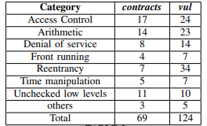
Categories of vulnerabilities available in the dataset sb_curated. For each category, the number of contracts available within that category, and the count of vulnerabilities found.

Slide 15
Methodology
Execution of 9 tools along with our approach with the sb_curated dataset.
Extraction of vulnerabilities that were detected by the tools into a JSON file.
We mapped the detected vulnerabilities to a category of vulnerabilities.

Slide 16
Results
True positive rate- when a tool indicates the correct vulnerability category and the line number where the vulnerability occurs in the source code.
We analysed the tool with two criterions-
1.Tools must indicate the correct vulnerability category and line number in the source code(here the execution time was set to 30 minutes for each tool).
2.Tools must indicate the correct vulnerability category and line number in the source code with no time limit(till complete execution).

Slide 17
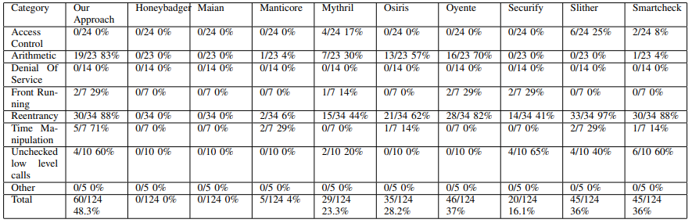

Slide 18
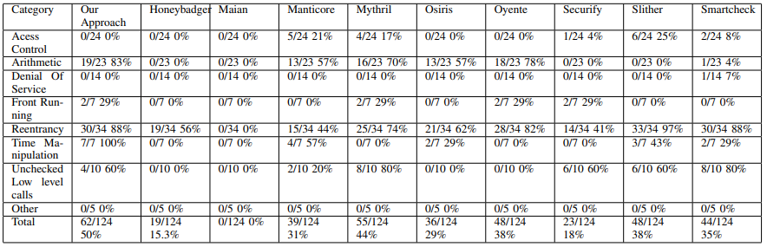

Slide 19
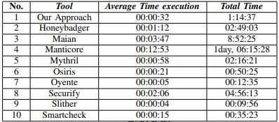
Performance- The performance of the tools is a point to be into account because if a tool lingers a lot to analyze a contract the user will be unsatisfied.
Considered following observations while calculating-
1. Average execution is time per contract. It considers the execution of the tool on a contract, including compilation, analysis, and parsing of the results average. The average execution time does not reflect the complete picture of the performance of a tool.
2.Total execution time used by each tool.

Slide 20
Conclusion and Future work
Our approach is able to detect on an average 48% of vulnerabilities.
If our approach with Mythril is chosen and it yields 51% in this choice.
For future work, improving the symbolic execution engine can be done.
Add the possibility to use different strategies in path exploration, improve the arithmetic module, add more modules to detect more vulnerability categories, add newer EVM instructions when they emerge, and eliminate the limitations of Rattle.

Slide 21
References
[1] Praitheeshan, P., Pan, L., Yu, J., Liu, J., Doss, R. (2019). Security Analysis Methods on Ethereum Smart Contract Vulnerabilities: A Survey. arXiv. https://doi.org/10.48550/arXiv.1908.08605
[2] Phil Daian. 2016. Analysis of the DAO exploit. http://hackingdistributed.com/ 2016/06/18/analysis-of-the-dao-exploit
[3] R. Stortz. Rattle - an ethereum evm binary analysis framework. In reCON Montreal Conference, https: //www.trailofbits.com/presentations/rattle/, 2018. (Accessed on 17/09/2020).
[4] S. Nakamoto. Bitcoin: A peer-to-peer electronic cash system. https://bitcoin.org/bitcoin.pdf, 2008. (Accessed on 15/09/2020)
[5] G. Wood, “Ethereum: A secure decentralised generalised transaction ledger,” Ethereum project yellow paper, vol. 151, pp. 1–32, 2014.
[6] D. P´erez and B. Livshits. Smart contract vulnerabilities: Does anyone care? CoRR, abs/1902.06710, 02 2019.
[7] J. F. Ferreira, P. Cruz, T. Durieux, and R. Abreu. Smartbugs: A framework to analyze solidity smart contracts. CoRR, abs/2007.04771, 2020

