Slide 1

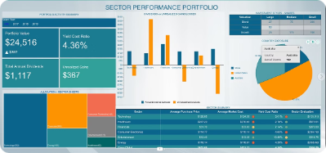

Introduction to Stock Market Prediction
Stock market prediction is the attempt to predict the future movements of stock prices. This is a complex task due to the many factors that influence stock prices.
by Sonal Mhatre
SM

Slide 2

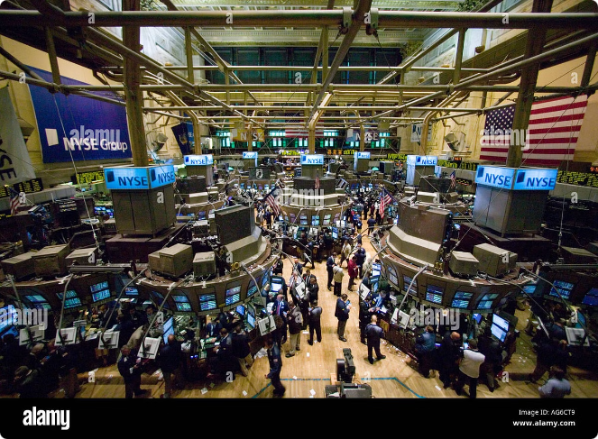
Understanding Stock Market Fundamentals
Supply and Demand
The basic principle that drives stock prices. When demand for a stock is higher than supply, the price rises, and vice versa.
Company Performance
Earnings, revenue, and other financial metrics impact a company's value and influence investor sentiment, affecting stock prices.
Economic Indicators
Factors like inflation, interest rates, and unemployment can affect market sentiment and impact stock prices.
Investor Sentiment
The overall mood of investors, driven by news, events, and expectations, can significantly influence stock prices.

Slide 3


Data Collection and Preprocessing
1
Data Sources
Financial news websites, stock exchanges, and government databases provide a wealth of data on stock prices, company financials, and market indicators.
2
Data Cleaning
Removing duplicates, handling missing values, and correcting inconsistencies ensures data accuracy and reliability for analysis.
3
Feature Extraction
Identifying relevant features from raw data, such as price history, company fundamentals, and market indicators, for model training.

Slide 4


Feature Engineering
1
Technical Indicators
Moving averages, relative strength index (RSI), and other technical indicators derived from price data can provide insights into price trends.
2
Fundamental Ratios
Financial ratios like price-to-earnings (P/E) ratio, debt-to-equity ratio, and return on equity (ROE) reflect a company's financial health.
3
Sentiment Analysis
Analyzing news articles, social media posts, and other text data to gauge investor sentiment and its impact on stock prices.
4
Time Series Features
Extracting features from past price data, such as seasonality, trends, and volatility, can aid in predicting future price movements.

Slide 5
Machine Learning Algorithms for Prediction
Regression Models
Classification Models
Time Series Models
Linear regression, support vector regression (SVR), and neural networks are commonly used to predict continuous stock prices.
ARIMA, LSTM, and other time series models are specifically designed to analyze and predict time-dependent data, such as stock prices.
Logistic regression, decision trees, and random forests can predict categorical outcomes like "buy," "sell," or "hold."

Slide 6

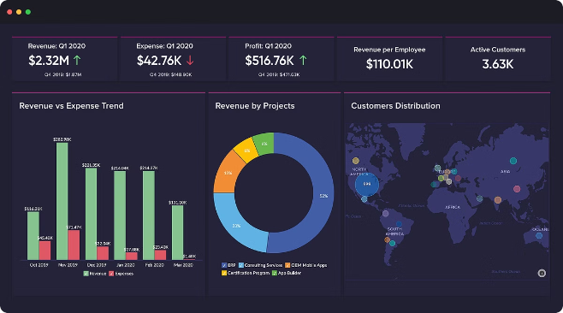
Model Evaluation and Optimization
Metric
Description
Accuracy
The percentage of correct predictions made by the model.
Precision
The percentage of positive predictions that are actually correct.
Recall
The percentage of actual positive cases that are correctly predicted.
F1-score
A harmonic mean of precision and recall, providing a balanced measure of model performance.

Slide 7





Practical Applications and Use Cases
Algorithmic Trading
Automated trading systems use prediction models to execute trades based on real-time market data.
Investment Portfolio Management
Models can help investors identify undervalued stocks and make informed decisions about asset allocation.
Risk Management
Predictive models can assess market volatility and help investors manage risk by identifying potential downturns.

Slide 8






Conclusion and Future Outlook
Advancements in Machine Learning
Continued research and development of new algorithms and techniques will lead to more accurate and sophisticated prediction models.
Big Data Analytics
The availability of vast amounts of data from various sources will enhance model training and improve prediction accuracy.
Artificial Intelligence (AI)
AI-powered systems will play a crucial role in analyzing complex market dynamics and generating more accurate predictions.
Global Market Integration
Predicting stock movements in a globally interconnected market will require sophisticated models that account for cross-border influences.

