Slide 1
Sales Dashboard using Tableau
Data Analyst Internship – Task 4
Vaishnavi H | 25/09/25 | Tool: Tableau Public

Slide 2
Objective & Dataset
Objective:
- To design an interactive dashboard that provides stakeholders with insights on sales, profit, and growth.
Dataset: - Superstore Dataset (Kaggle) - Fields: Order Date, Sales, Profit, Category, Region, Product, State

Slide 3
KPIs Defined
Key Metrics:
Total Sales
Total Profit
Profit Margin (%)
Sales Growth (YoY/Monthly Trend)

Slide 4
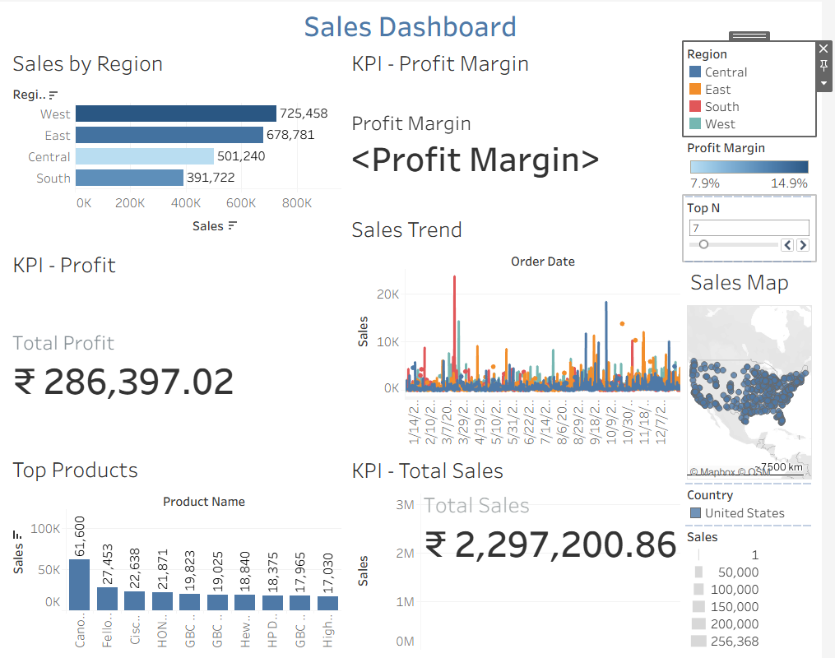
Dashboard Overview

Slide 5
Highlights:
KPI Cards (Top)
Sales Trend (Line Chart)
Sales by Region/Category (Bar Chart)
Map (left side)
Top Products (Bottom)

Slide 6
Insights from Dashboard
West Region contributed ~35% of total sales.
Technology category had the highest profit margin.
Office Supplies showed the lowest profitability.
Q4 sales were consistently higher – seasonal demand observed.

Slide 7
Conclusion
Conclusion:
Dashboard helps stakeholders track performance, growth, and problem areas at a glance.

