Slide 1

TATYASAHEB KORE INSTITUTE OF ENGINEERING AND TECHNOLOGY WARANANAGAR
Department Of Computer Science And Engineering
Academic Year 2025-26
Presentation on ,
“AI BASED LANDSLIDE DETECTION AND PREDICTION SYSTEM”
Presented by ,
Name | Roll No.
Vaishnavi Babaso Hirave | 48
Akanksha Nivas Hujare | 50
Diksha Rajendra Karande | 52
Pallavi Shrimant Gavade | 70

Slide 2
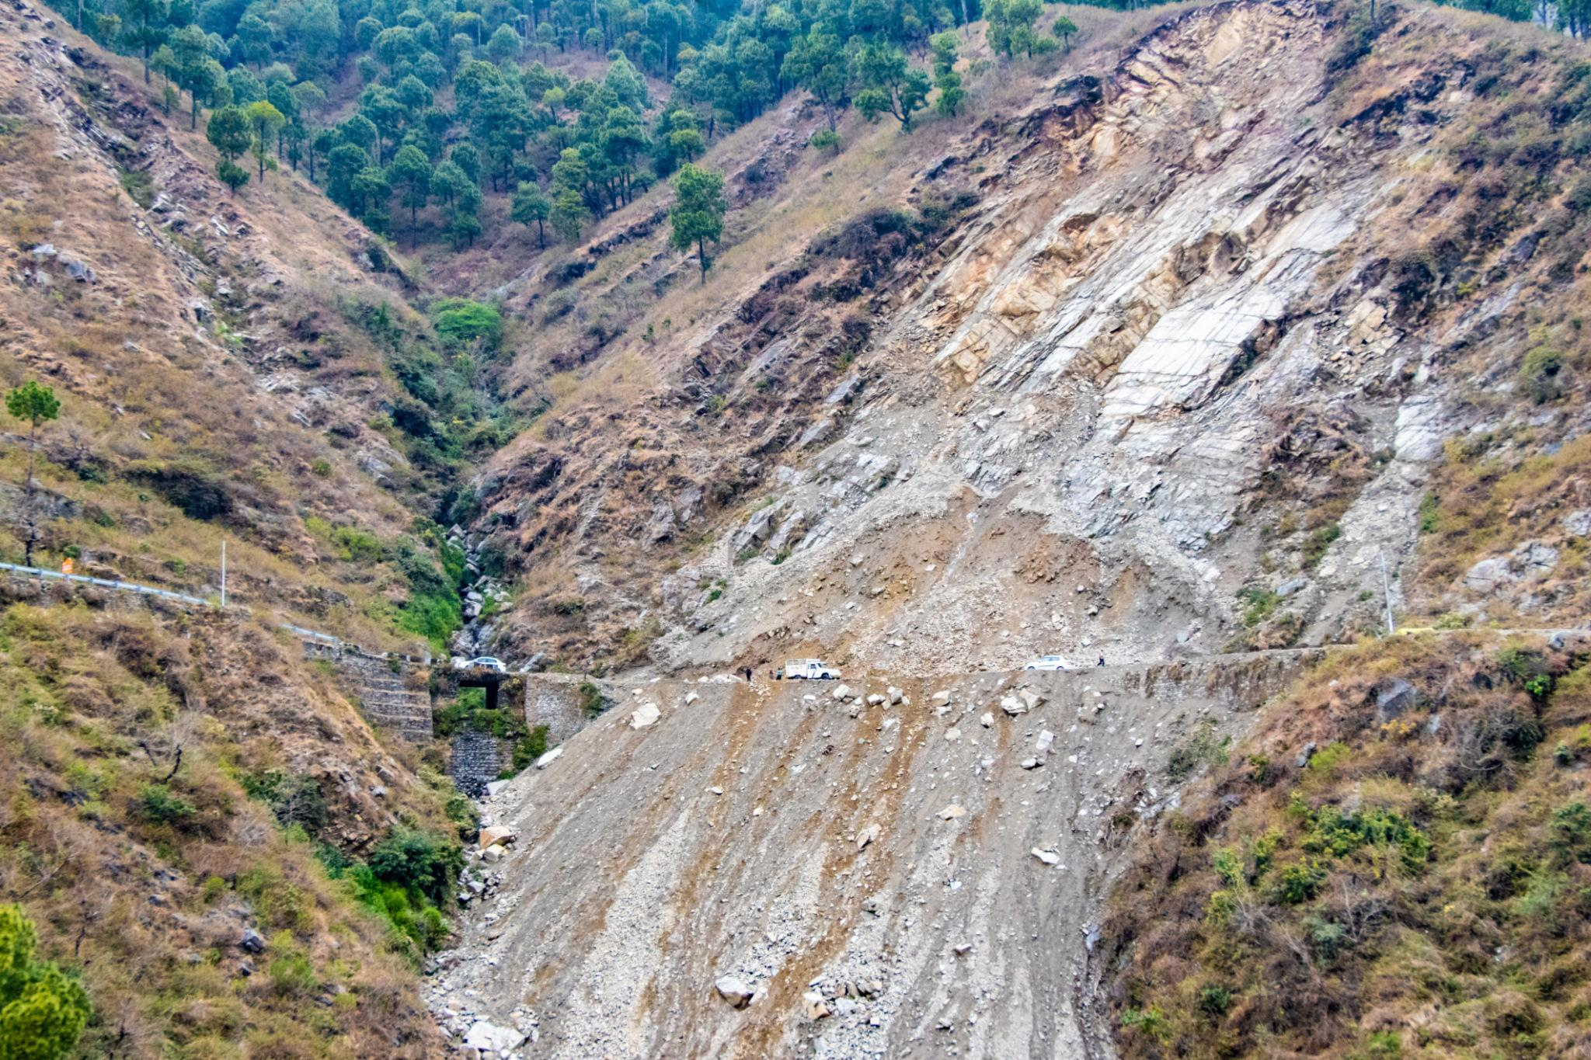
Introduction
Landslides are one of the most dangerous natural disasters, causing severe damage to life and infrastructure.
Early detection is difficult due to unpredictable environmental conditions.
Traditional monitoring methods are slow and require manual observation.
With the advancement of Artificial Intelligence, automated detection systems can improve accuracy and response time.
This project uses deep learning techniques to detect and highlight landslide-prone areas from images.

Slide 3
Literature Review
Author & Year | Paper Title | Contribution | Limitations
Omid Ghorbanzadeh et al., 2019 | Landslide Detection Using Deep Learning and Object-Based Image Analysis | Combines deep learning with object-based image analysis for accurate landslide mapping | High computational complexity and requires expert tuning
Hamed Shahabi et al., 2021 | Unsupervised Deep Learning for Landslide Detection from Remote Sensing Images | Introduces unsupervised deep learning to detect landslides without labeled data | Lower accuracy compared to supervised models (MDPI)
S. Qin et al., 2021 | Landslide Detection from Open Satellite Imagery Using Distant Domain Transfer Learning | Uses transfer learning + attention mechanism to improve detection with small datasets | Needs pre-trained models and complex architecture (ResearchGate)
Zan Wang et al., 2024 | Delimitation of Landslide Areas in Optical Remote Sensing Images via Deep Transfer Learning | Compares U-Net and Mask R-CNN for landslide segmentation across regions | Performance varies with dataset size and terrain diversity (ris.utwente.nl)

Slide 4
Problem Statement
Landslides cause severe damage to life and property, but early detection is challenging due to unpredictable conditions and reliance on manual methods. Existing systems are slow, less accurate, and lack real-time analysis, creating a need for an automated and intelligent detection system.

Slide 5
Objectives
To develop an AI-based system for landslide detection
To classify images as landslide or non-landslide
To build a user-friendly web interface for image upload
To store user data and prediction results in a database
To improve detection accuracy using deep learning models

Slide 6
Motivation
Landslides cause severe damage to life, property, and environment
Early detection is difficult using traditional methods
Existing systems lack automation and real-time analysis
Need for faster and more accurate prediction systems
Advancement in AI and deep learning enables smart detection
To develop a system that provides early warnings and improves safety

Slide 7
Existing System
Existing landslide detection methods mainly rely on manual observation, geological surveys, and traditional GIS-based analysis. These approaches require significant human effort, are time-consuming, and often fail to provide real-time results. Some systems use satellite data, but they depend on high-quality images and complex processing techniques. Overall, current systems lack automation, speed, and precise region detection, making them less effective in critical situations.

Slide 8
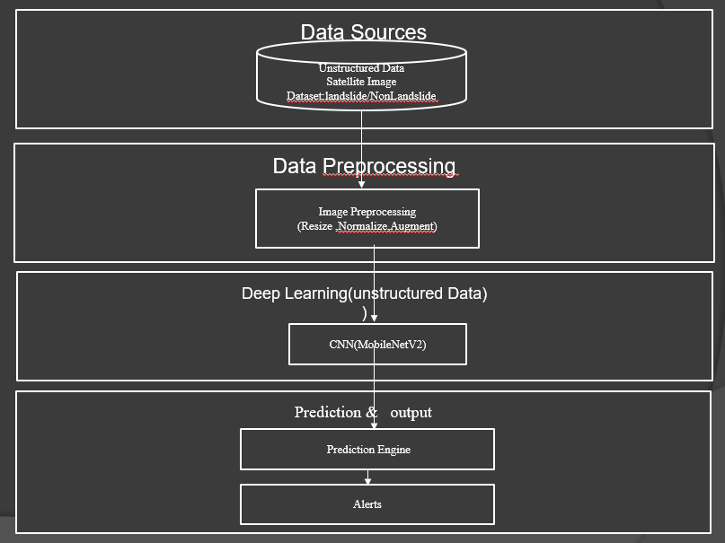
Block Diagram Of System
Fig. 1: Block Diagram Of System.

Slide 9
Block Diagram Explanation
This diagram represents the workflow of the landslide detection system. It starts with collecting unstructured data such as satellite images and landslide datasets. The data is then preprocessed using techniques like resizing, normalization, and augmentation to improve model performance. Next, a deep learning model (MobileNetV2 CNN) is used to analyze the images and extract features. Finally, the system generates predictions indicating landslide presence and provides outputs such as alerts and results.

Slide 10
Modules of the System
User Module Handles user registration, login, and authentication.
Image Upload Module Allows users to upload landslide or terrain images for analysis.
Data Preprocessing Module Performs image resizing, normalization, and augmentation.
Deep Learning Module Uses MobileNetV2 for classification and UNet for segmentation.
Prediction Module Generates results (Landslide / Non-Landslide) and confidence score.
Database Module Stores user data, uploaded images, and prediction results.
Alert Module Generates alerts if a landslide is detected.

Slide 11
Dataset :
Bijie Landslide Dataset
A remote sensing dataset used for landslide detection
Developed by Wuhan University, China
Key Features
770 landslide images and 2003 non-landslide images
High-resolution satellite images (~0.8 m)
Includes RGB images, segmentation masks,
DEM & annotations
Dataset Link
🔗 https://gpcv.whu.edu.cn/data/Bijie_pages.html

Slide 12
Methodology
Collect landslide and non-landslide image datasets
Preprocess images (resize, normalize, augment)
Train deep learning model (MobileNetV2) for classification
Apply UNet model for region-based segmentation
Integrate trained models into Flask web application
Accept user input (image upload) and process it
Generate prediction and highlight affected areas
Store results in database and display output

Slide 13
Algorithm Used
Convolutional Neural Network (CNN) Used for image classification.
MobileNetV2 Applied for efficient and accurate landslide classification using transfer learning.
UNet Algorithm Used for image segmentation to highlight landslide-affected regions.
Image Preprocessing Techniques Includes resizing, normalization, and augmentation for better model performance.

Slide 14
Project Scope
In Scope
✔ Analyze satellite images and environmental data ✔ Predict landslide-prone areas using AI models ✔ Generate alerts for potential landslides ✔ Use Python and open-source tools
Out of Scope
✘ Real-time sensor data or IoT integration ✘ Field monitoring or rescue operations ✘ Government policy or infrastructure planning

Slide 15
Requirement Specification
Software Requirements
Hardware Requirements
Category | Requirement
Operating System | Windows / Linux / macOS
Programming Language | Python
Framework | Flask
Frontend | HTML, CSS, JavaScript
Machine Learning Libraries | TensorFlow / Keras
Image Processing | OpenCV, PIL
Database | MySQL
Category | Requirement
Processor | Intel i5 or higher
RAM | Minimum 8 GB
Storage | 256 GB or higher

Slide 16
Feasibility Study
Technical Feasibility
Uses Python and open-source
Libraries like TensorFlow,Keras.
No need for special hardware
Free cloud platforms can be used.
Schedule Feasibility
Clear stages: data collection → modeling→prediction.
Can be completed within the academic timeframe.
Economic Feasibility
Software and data are free or low-cost.
No extra equipment needed.
Reduces disaster losses — cost-effective for users.
Operational Feasibility
Easy to use for authorities and
researchers.
Provides alerts.
Can be deployed as web or mobile application.

Slide 17
Requirement Engineering
Functional Requirements
✔ Collect and preprocess satellite images (resize, normalize) ✔ Detect landslides using Deep Learning (MobileNetV2 CNN model) ✔ Classify images as Landslide or Non-landslide ✔ Display prediction results with confidence score ✔ Generate alerts when landslide is detected
Non-Functional Requirements
✔ Performance: Achieves ~94% accuracy in prediction ✔ Usability: Simple and user-friendly interface ✔ Reliability: Provides consistent results for different image conditions ✔ Security: Access restricted to authorized users ✔ Scalability: Can handle larger datasets in future

Slide 18
Software Requirement Specification (SRS)
Purpose
The purpose of this system is to develop an AI-based solution for detecting and predicting landslides using satellite imagery, terrain, and rainfall data. The system aims to provide early warnings to reduce damage and improve safety.
Scope
The system focuses on automated analysis of image and environmental data to detect landslides and generate timely alerts for authorities and communities. It does not include detailed risk mapping, real-time field monitoring, or rescue operations, but serves as an early warning support system.
Constraints
Limited availability of labeled datasets
High computational requirements for model training
Dependence on availability and quality of satellite data

Slide 19
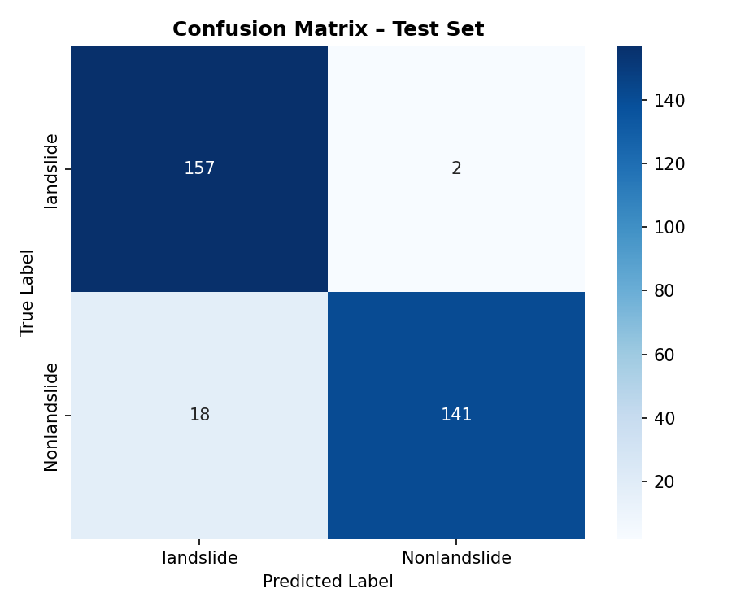
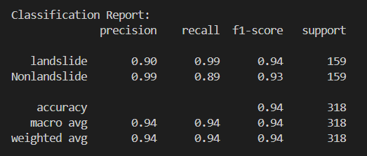
Results :
Fig.2:Classification Report
Shows model performance using precision, recall, and F1-score for both classes.
Achieves 94% overall accuracy, indicating strong and balanced classification.
Fig.3:Confusion Matrix
Displays correct and incorrect predictions, with high correct classification (157 & 141).
Very few misclassifications, proving the model is highly reliable and accurate.

Slide 20
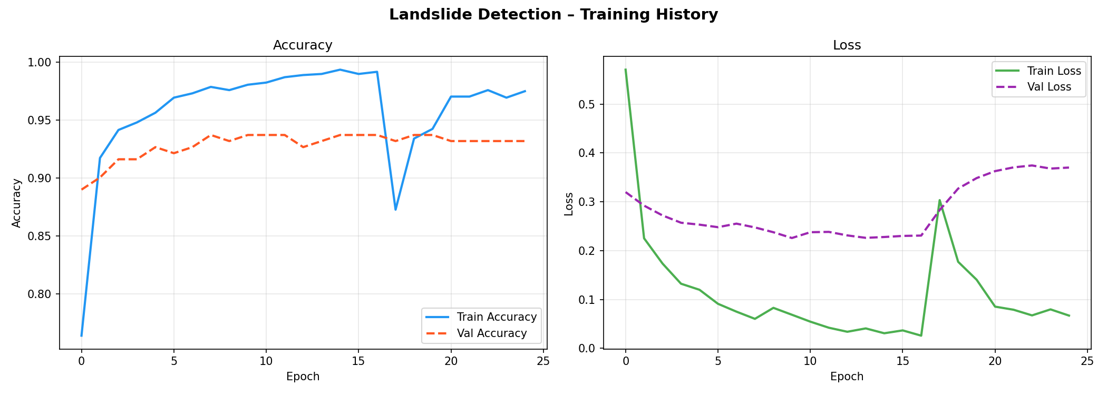
Fig.4:Training History (Accuracy & Loss Graph)
Training accuracy increases steadily while validation accuracy remains stable, showing good learning behavior.
Loss graph indicates low training loss.

Slide 21


MODULS Screenshot
Fig. 5:Home Page of the system
Fig. 6: User Login Interface

Slide 22
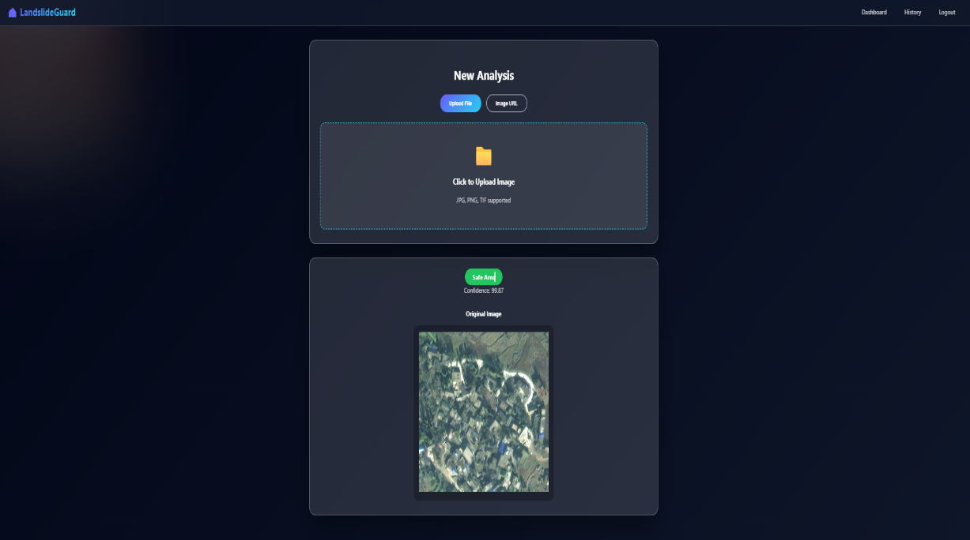
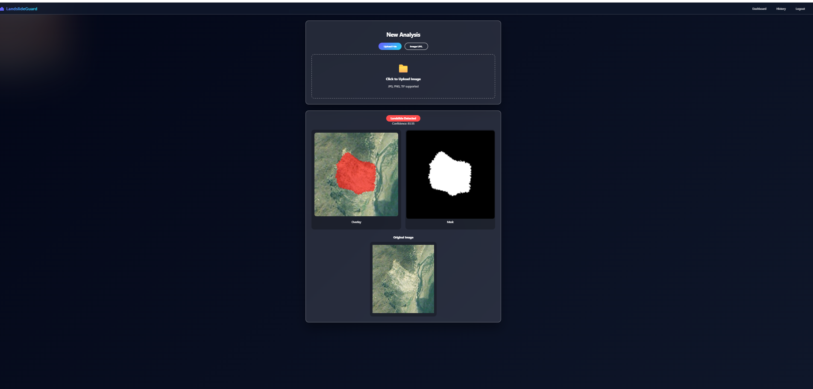
Fig. 7: Image Analysis Page

Slide 23

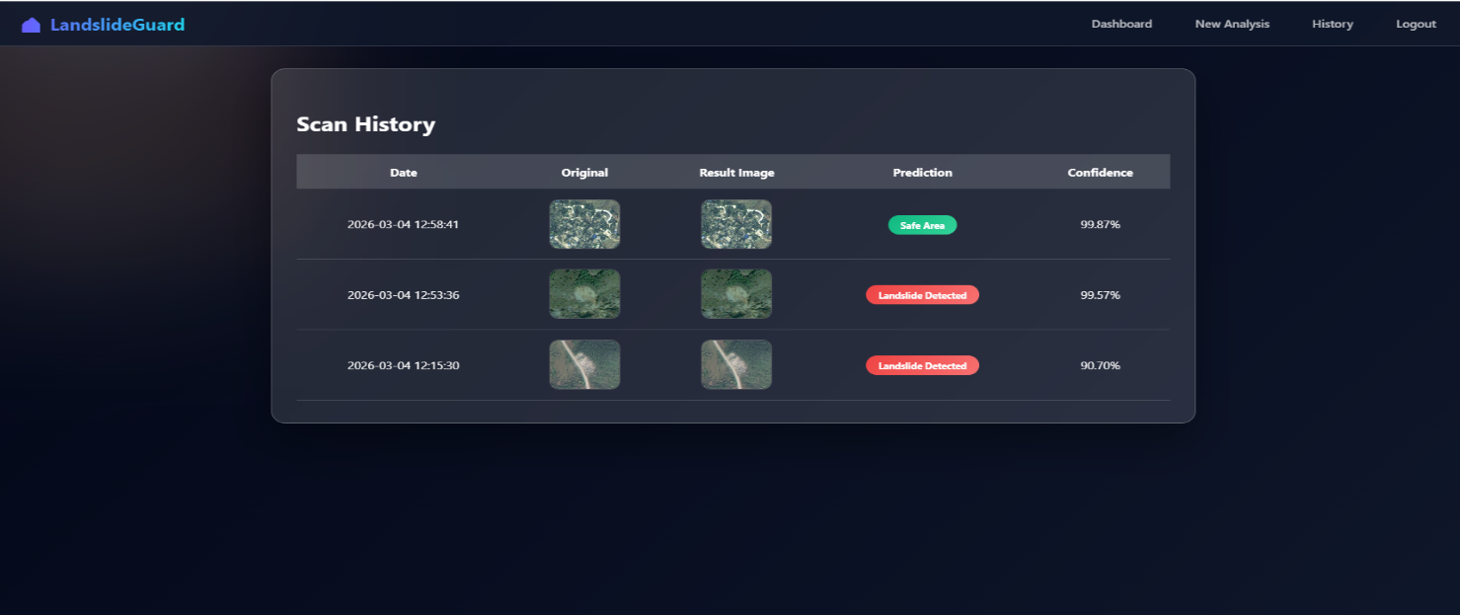
Fig. 8: User Dashboard
Fig. 9: Prediction History Page

Slide 24
Conclusion
This project presents an AI-based system for landslide detection using deep learning techniques. It successfully classifies images as landslide or non-landslide and highlights affected regions using segmentation. The system is integrated into a user-friendly web application that provides quick predictions and alerts. It can support early detection and help reduce the impact of natural disasters. Overall, the project demonstrates the effective use of AI in disaster management.

Slide 25
References
Research Papers
O. Ghorbanzadeh et al., “Landslide Detection Using Deep Learning and Object-Based Image Analysis,” Remote Sensing, 2019. https://www.researchgate.net/publication/357969745_Landslide_detection_using_deep_learning_and_object-based_image_analysis
H. Shahabi et al., “Unsupervised Deep Learning for Landslide Detection from Remote Sensing Images,” Remote Sensing, 2021. https://www.mdpi.com/2072-4292/13/22/4698
S. Qin et al., “Landslide Detection from Open Satellite Imagery Using Distant Domain Transfer Learning,” Remote Sensing, 2021. https://www.mdpi.com/2072-4292/13/17/3383
Z. Wang et al., “Delimitation of Landslide Areas in Optical Remote Sensing Images Across Regions via Deep Transfer Learning,” 2024. https://ris.utwente.nl/ws/portalfiles/portal/492888704/Delimitation_of_Landslide_Areas_in_Optical_Remote_Sensing_Images_Across_Regions_via_Deep_Transfer_Learning.pdf
Web References
https://earthdata.nasa.gov
https://www.geeksforgeeks.org/machine-learning/
Book References
Remote Sensing and GIS for Natural Hazards Assessment – J. van Westen
Data Mining: Concepts and Techniques – Jiawei Han & Micheline Kamber

