Slide 1

Stock price prediction using machine learning algorithms
- Vaishanavi Kale

Slide 2

Introduction
Stock market
Motivation
Aim

Slide 3
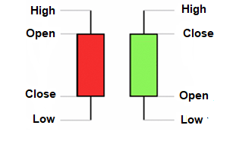
Candlestick
Bullish candlestick
Bearish candlestick
Candlestick reversal patterns

Slide 4
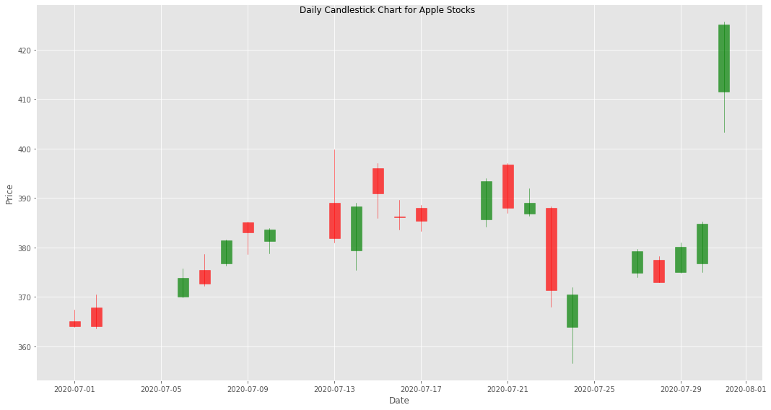
Candlestick Chart

Slide 5
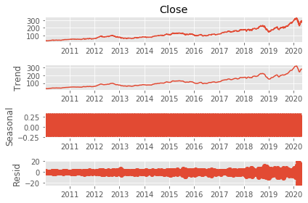
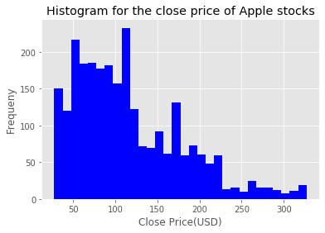
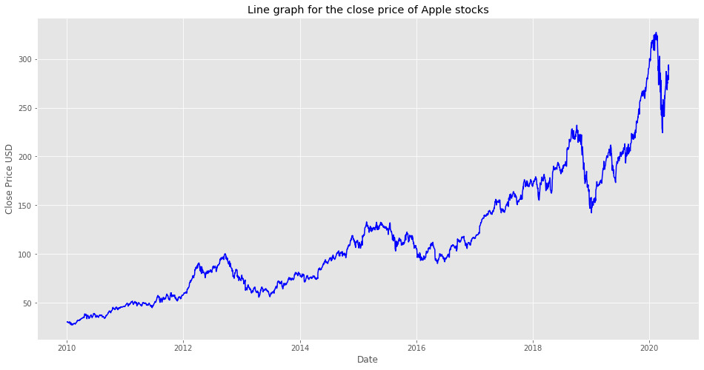
Exploratory Data Analysis

Slide 6
Machine Learning Algorithms
Linear Regression
Support Vector Machine
K-nearest Neighbours
Decision Tree

Slide 7
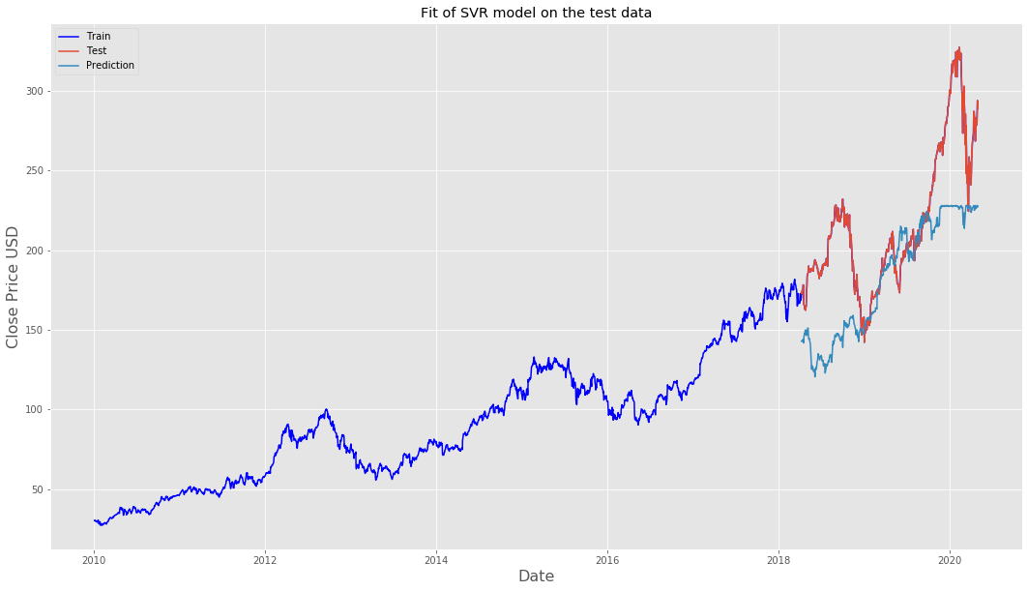
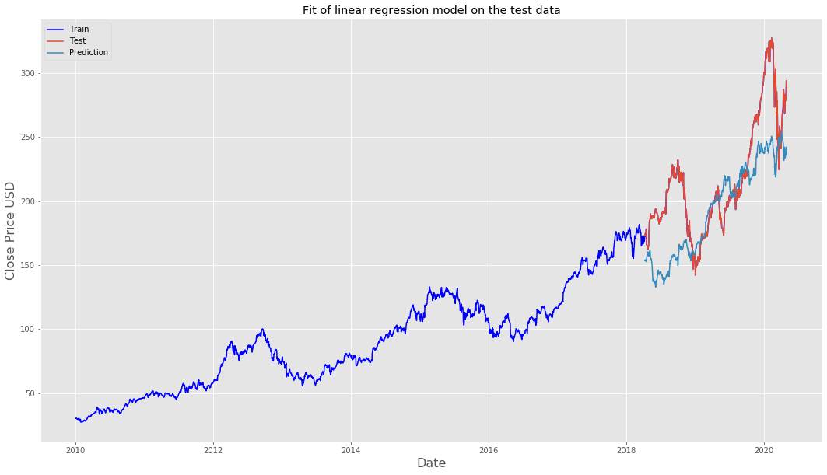
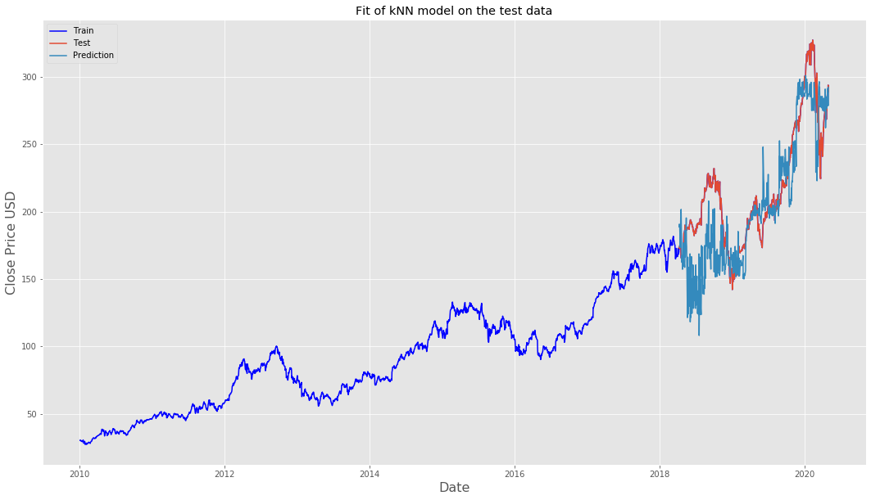
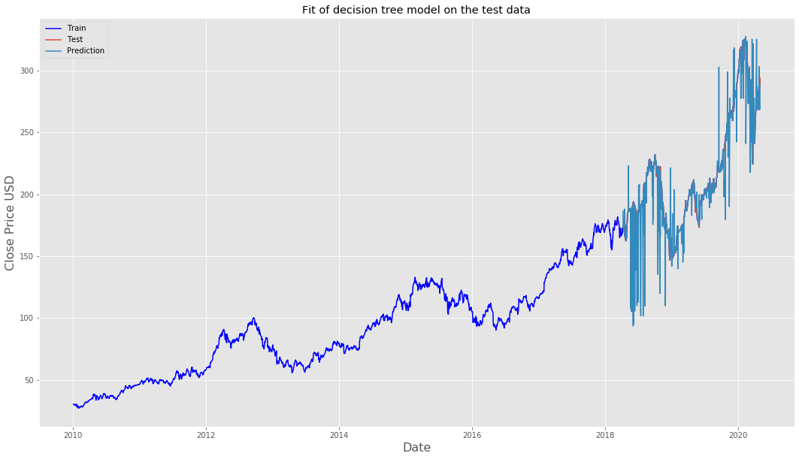
SVM
Linear Regression
KNN
Decision Tree

Slide 8
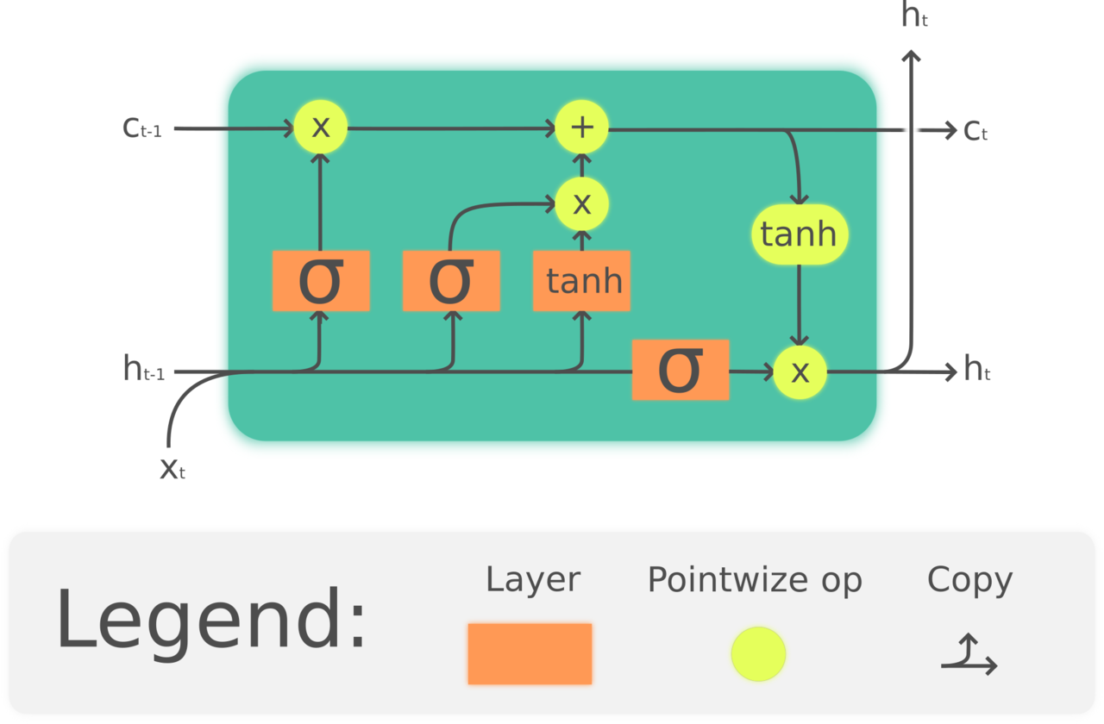
LSTM
Long Short Term Memory
Inputs of LSTM unit:
X_{t} is the input of the current unit
h_{t-1} is the output from the previous unit
C_{t-1} is memory of the previous unit
Outputs of LSTM unit:
C_{t} is the memory of the current unit.
h_{t} represents the output of the previous unit
Forget Gate, Input Gate and Output Gate
Activation Functions :
sigmoid
tanh

Slide 9
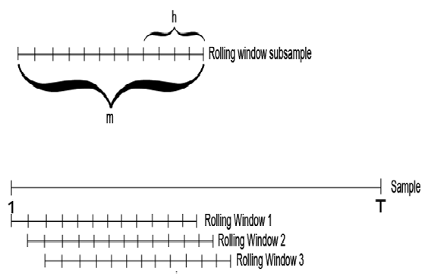
Train and Test Split
Training Set (70 %)
Test Set (30 %)
Rolling window (m) =60 days
Forecast horizon (h) = 1 day

Slide 10
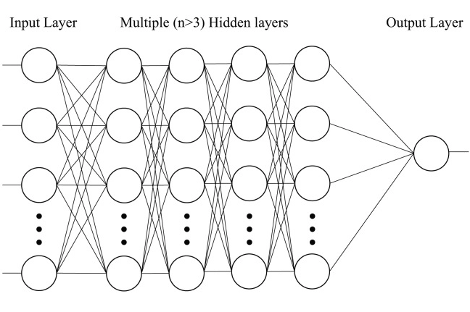
LSTM Modelling
Input Layer
Sequential Model
Hidden Layers
Dropout Layers
Dense Layer
Model Compilation
Training Model
Output Layer

Slide 11
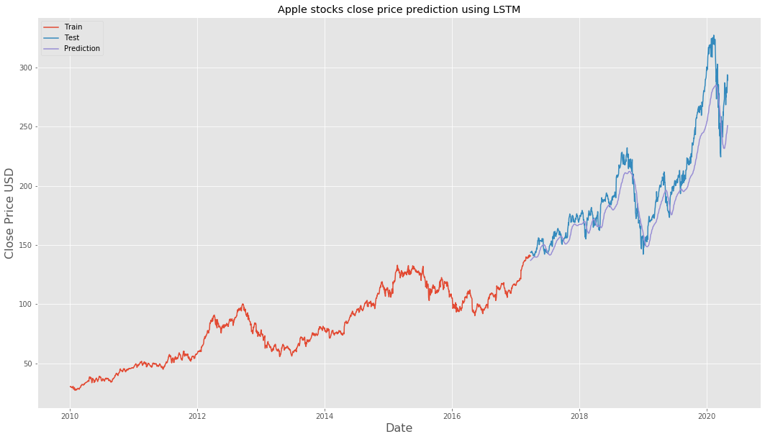
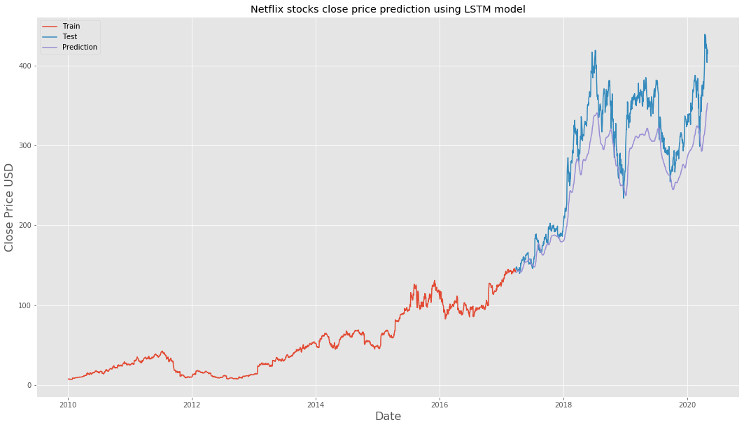
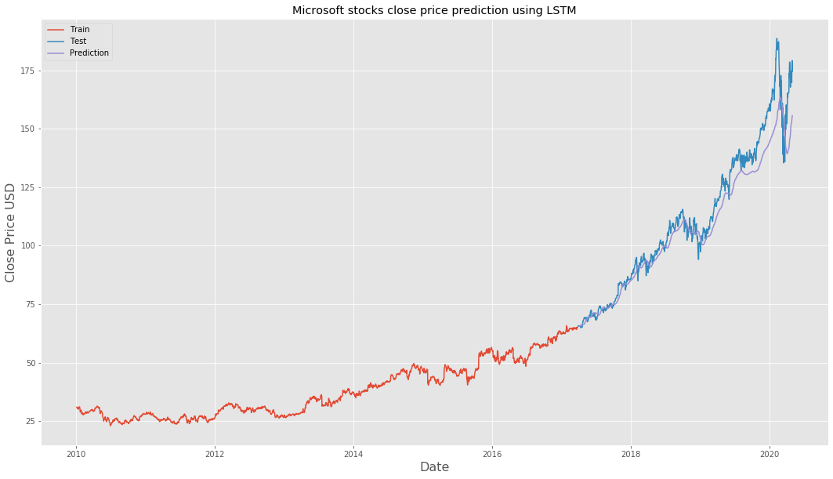
LSTM Results
Apple
Netflix
Microsoft

Slide 12
Thank You

