Slide 1
Customer Retention Case Study Presentation
Presented By Vaishnavi K

Slide 2
Introduction
What is Customer Retention and do we really need it?
“Customer retention refers to company’s ability to turn customers into repeat buyers and prevent them from switching to a competitor”
In other words customer retention means – “To maintain the existing customers”
This happens only if there exists a positive relation between the company and the customer.

Slide 3
What are the benefits of Customer Retention ?
Retained customers tend to buy other services from same company.
Retained customers are known to be less price/cost sensitive
The probability of selling to an existing customer is 60-70%
The probability of selling to new prospect is 5-20%
Declined migration rates
It’s more expensive to acquire a new customer than to retain an old one.

Slide 4
Tips for Succeeding at Customer Retention
Find out what customers want & what causes them to stay or leave ?
Proactively collect and promote customer feedback.
Analyze customer feedback to gain valuable insights and ensure the right people hear it.
Take action and Measure the results
Actively measure and monitor your customers’ loyalty and engagement
Keep asking, listening analyzing and improving

Slide 5
Problem Statement
Customer satisfaction has emerged as one of the most important factors that guarantee the success of online store; it has been posited as a key stimulant of purchase or repurchase intentions and customer loyalty.
A comprehensive review of the literature, theories and models have been carried out to propose the models for customer activation and customer retention.
Five major factors that contributed to the success of an e-commerce store have been identified as: service quality, system quality, information quality, trust and net benefit.
The research furthermore investigated the factors that influence the online customers repeat purchase intention.
The combination of both utilitarian value and hedonistic values are needed to affect the repeat purchase intention (loyalty) positively.
The data is collected from the Indian online shoppers. Results indicate the e-retail success factors, which are very much critical for customer satisfaction.

Slide 6
EXPLORATORY DATA ANALYSIS [E.D.A]
While checking for null values I found no null values present in my Dataset.
By the info() function, we found that there are no missing data present in the given dataset.

Slide 7
Visualization
What is Data Visualization? Data visualization is defined as a graphical representation that contains the information and the data.
Benefits of Good Data Visualization? Data visualization is another technique of visual art that grabs our interest and keeps our main focus on the message captured with the help of eyes.
Different Types of Analysis for Data Visualization are Univariate Analysis: In the univariate analysis, we will be using a single feature to analyze almost all of its properties. Bivariate Analysis: When we compare the data between exactly 2 features then it is known as bivariate analysis. Multivariate Analysis: In the multivariate analysis, we will be comparing more than 2 variables.

Slide 8
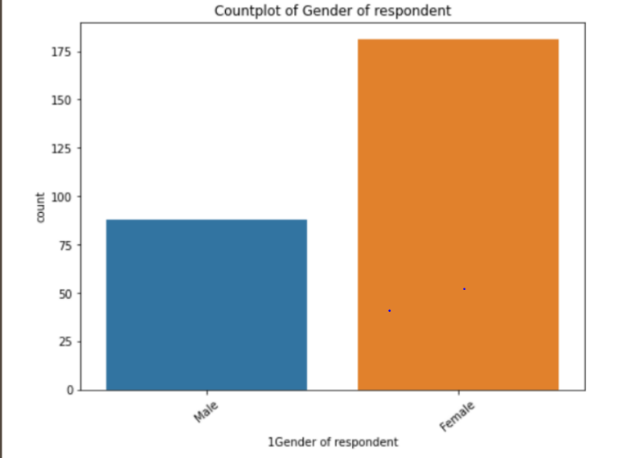
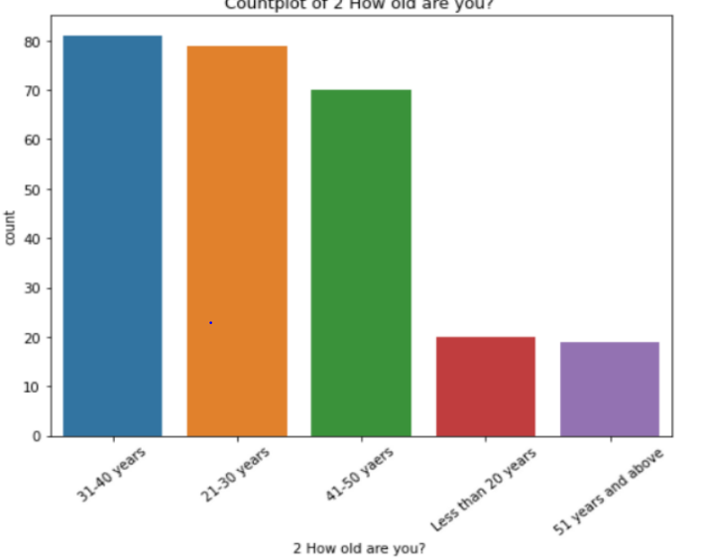

Slide 9
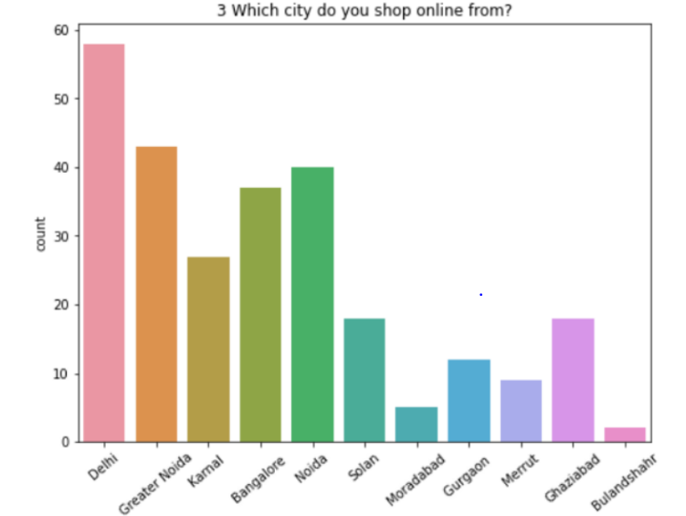
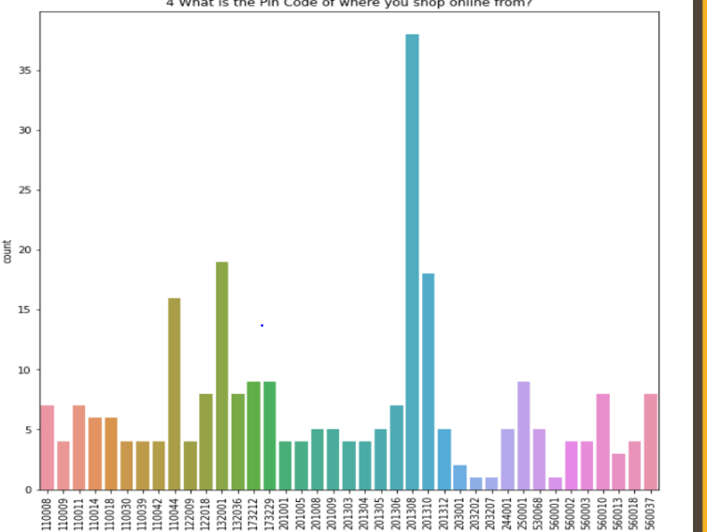

Slide 10
After Multiple Bar Plots I have observed that:
181 customers were female & 88 were male.
81 are from the age group ranging from 31-40 years.
58 placed orders from Delhi & 38 placed orders from the pincode 201308
Other information also was observed like how many customers use mobile internet while shopping online or which search engine do they widely use etc…
These Visualization graphs help us analyse our given data and categorize them accordingly.
After which, we will be able to build a model that fits best and give the accurate result.

Slide 11


