Slide 1

Retail Sales Prediction
Vaishnavi Mane

Slide 2

Importance of Retail Sale Prediction: 1.Inventory Management 2.Operational Efficiency 3.Cost Reduction Goal: Building a predictive model to forecast weekly sales across multiple retail stores using available data.

Slide 3
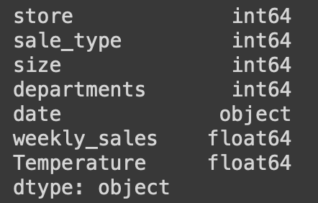
Data Overview: Historical sales data across 45 stores, including store characteristics, sales type, and external factors like temperature

Slide 4

Methodology:
Data preprocessing steps: Merging datasets, Understanding data, Visualizing relations and outliers.
Evaluated multiple regression models: Linear Regression, Decision Tree, Random Forest, Gradient Boosting
Model selection process based on performance metrics (MAE, RMSE) on training and validation sets and hyper tunning of model to improve performance.
Adding new features to improve sales prediction further

Slide 5
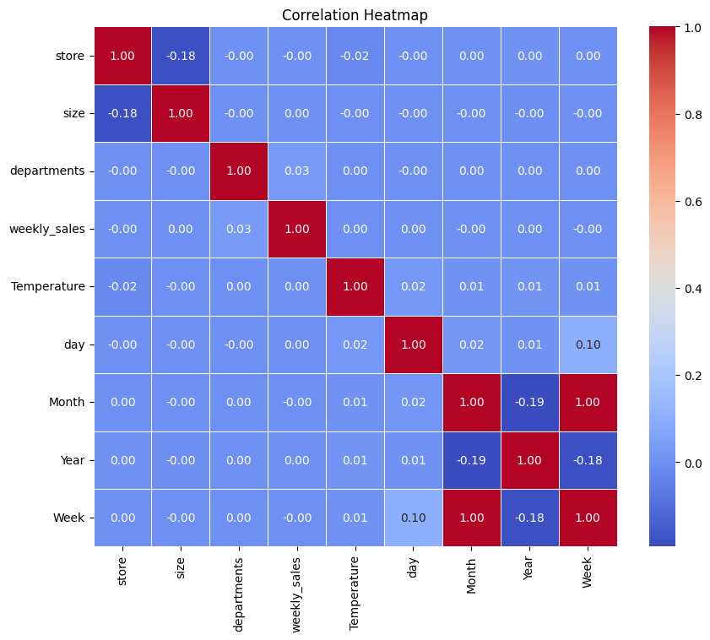
Key Challenges
Limited correlation between available features and target variable (weekly sales)
Computational limitations for extensive hyperparameter tuning

Slide 6
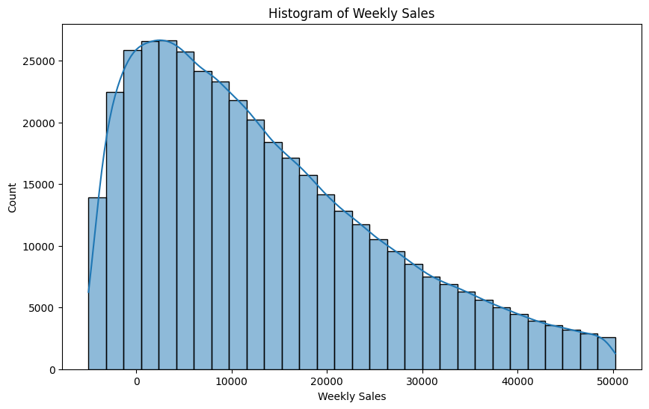
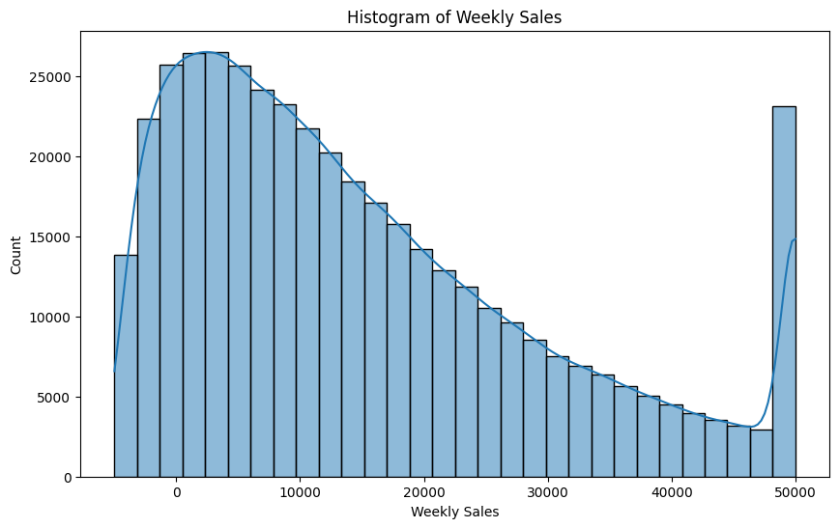
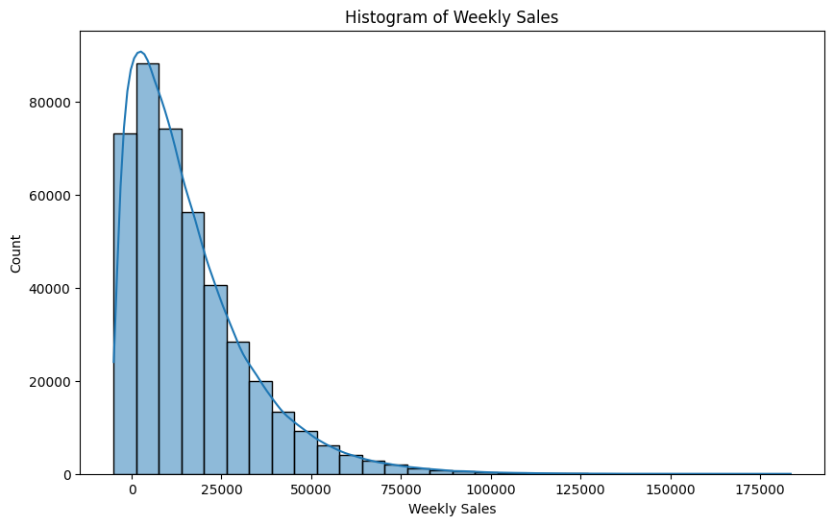
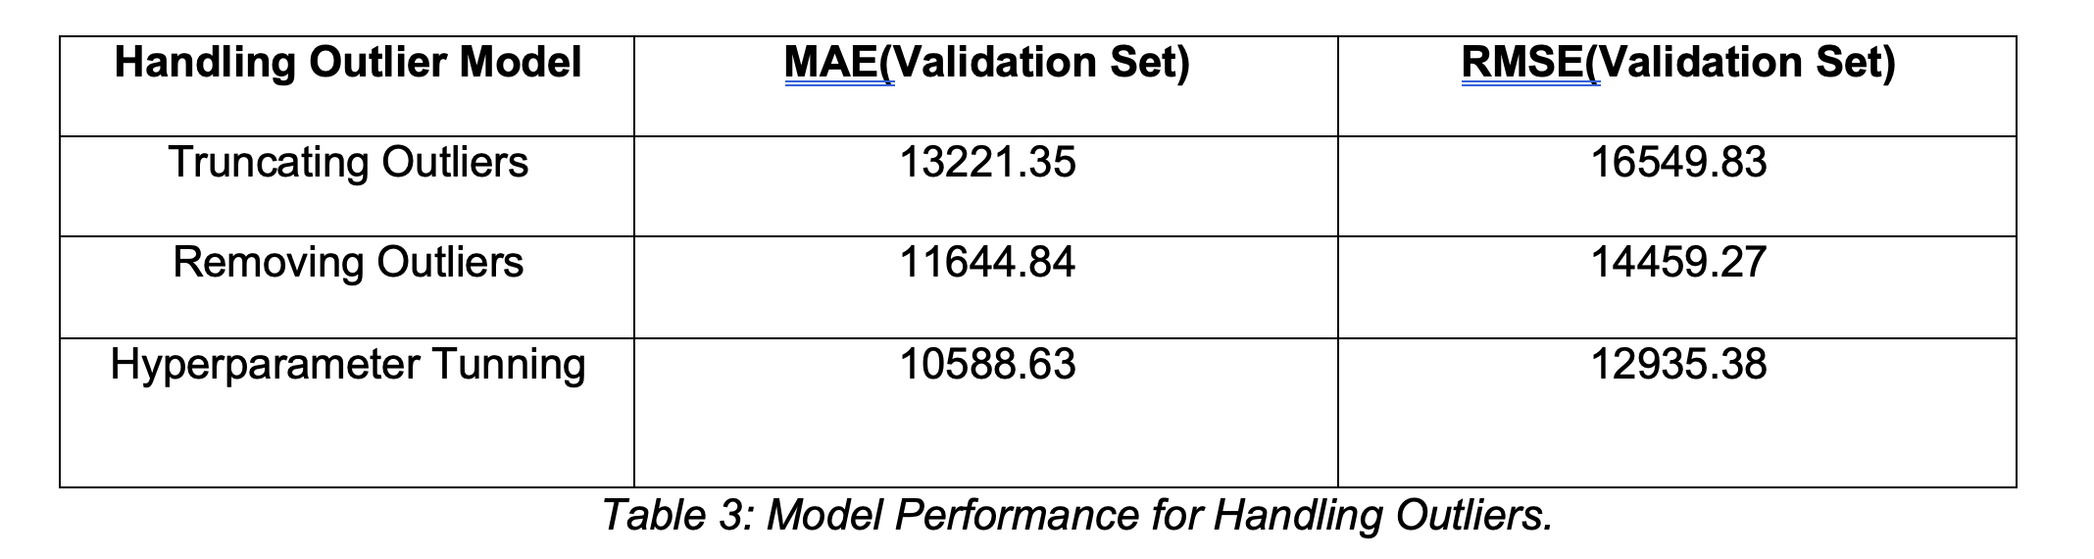
Handling Outlier and Hyperparameter Tunning
Outliers in the weekly sales variable were addressed using two approaches:
Truncating Outliers
2. Removing Outliers
Removing Outliers
Truncating Outliers
Outliers

Slide 7
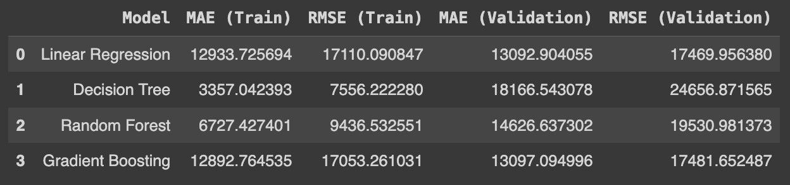
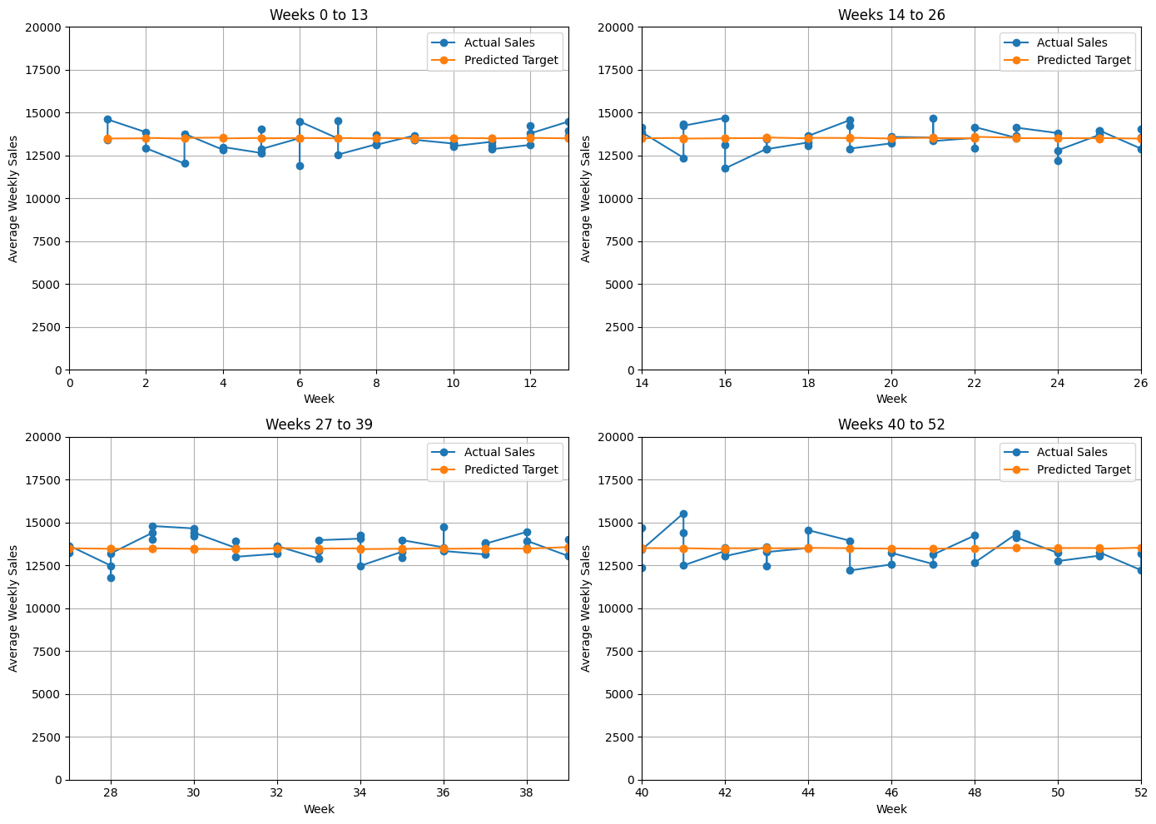
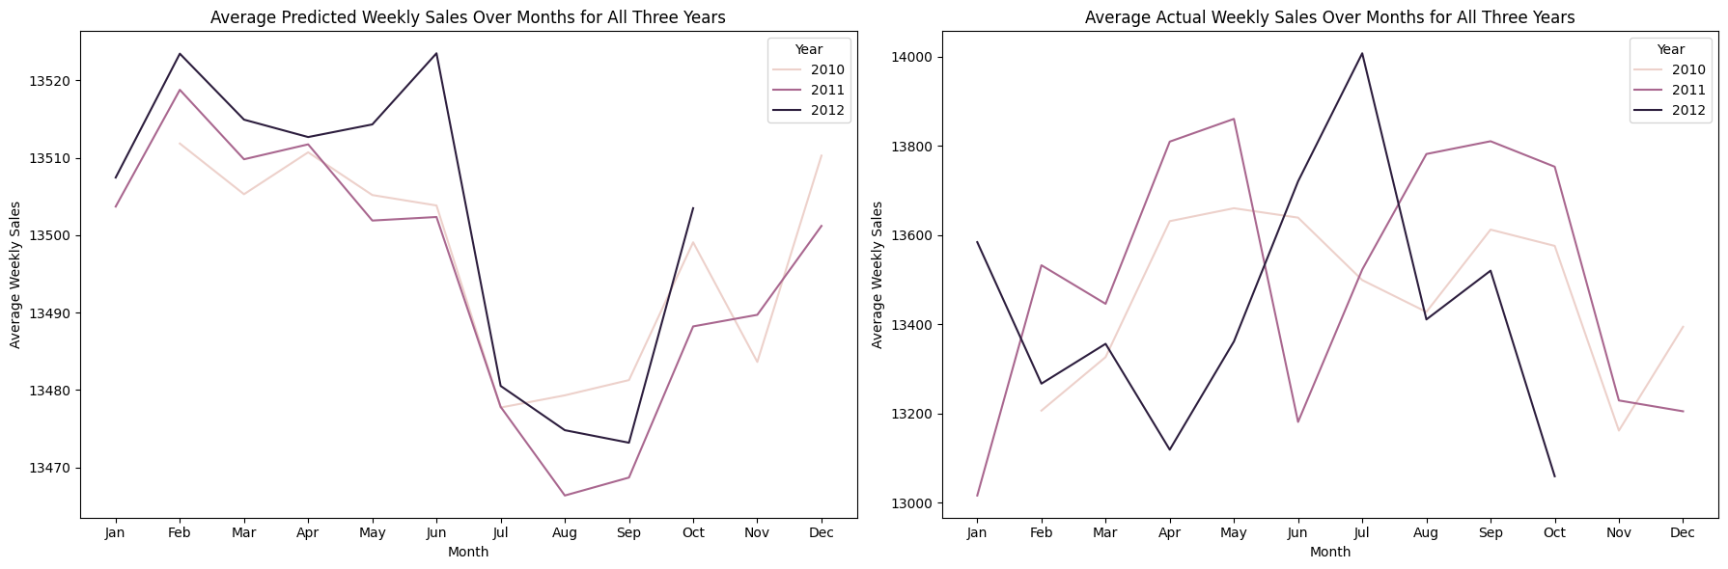
Findings and Insights:
Random Forest Regression model performed best on the validation set
Visualizations comparing predicted and actual sales over weeks shows slight deviation after hyper-tunning of model.
As seen in below graph there is no similar patterns observed in predicted sales and actual sales, hence observations can not be relied on to take actions.

Slide 8

Business Implications:
Accurate sales forecasting enables better inventory management and resource allocation
Identify sales patterns, trends, and anomalies to make informed business decisions
Potential cost savings and increased profitability through optimized operations

Slide 9

Lessons Learned:
Importance of feature engineering and domain expertise for improving model performance.
Importance of data quality over data size.
Continuous model evaluation and refinement for better accuracy.
Collaboration with business experts for deeper insights and strategic decision-making.
Future Considerations:
Explore additional data sources and relevant features
Implement advanced techniques like ensemble models or deep learning
Regular model updates to account for changing market conditions and consumer behavior

Slide 10

Thank You

