Slide 1




SIP
PRESENTATION
Internship / Course
Vaishnavi Somnath Nehare Computer Engineering

Slide 2

INDEX
Introduction
Image of Certificate
Collage of no. of hours per course
Learnings from the Internship
Problem Statement and Output
Plan for future use of learned things
References

Slide 3


Introduction
This presentation highlights my journey through the "TATA’S Data Visualization: Empowering Business Insights" internship program. The program equipped me with valuable skills in data visualization, analysis, and communication, empowering me to drive informed decision-making in a business setting.
And also I am complete the Infosys Cyber Security Course.

Slide 4


Certificates

Slide 5

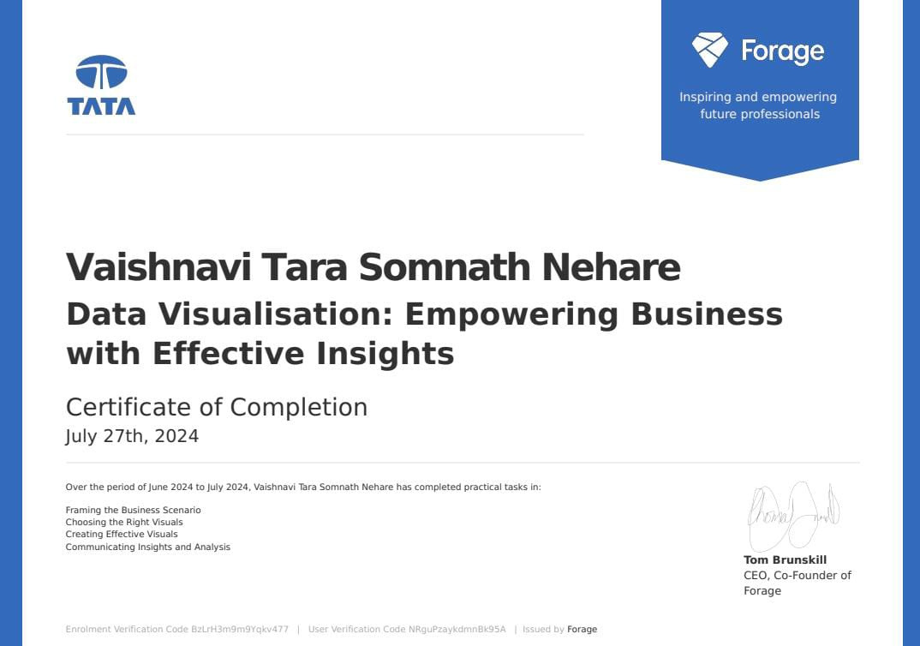


Slide 6
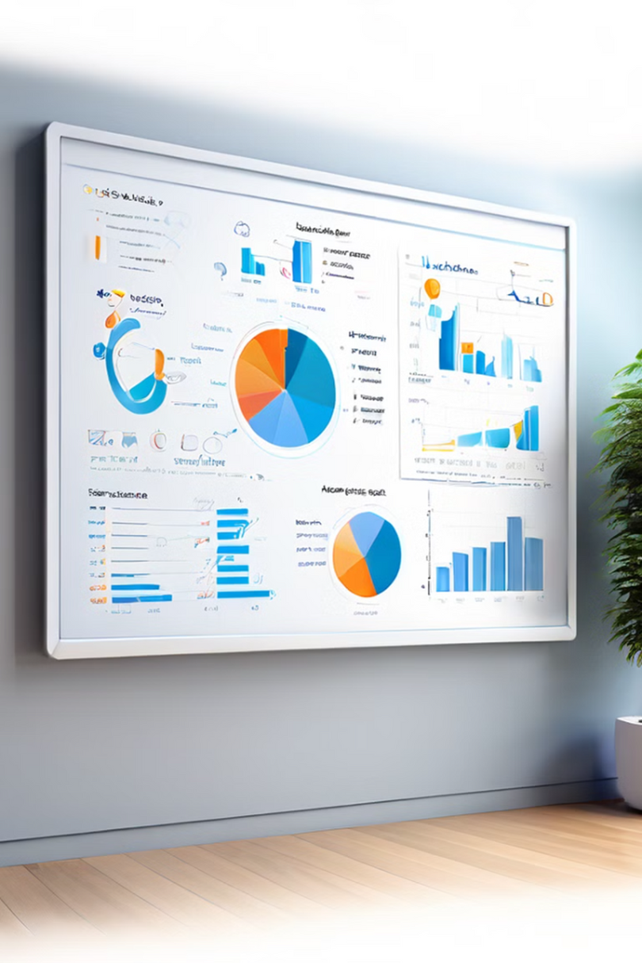

Learnings from the Internship : -
Framing the Business Scenario
This task involved understanding the context of a business problem and identifying the key data points required to effectively analyze the situation.
Choosing the Right Visuals
This task focused on selecting the appropriate data visualization techniques based on the nature of the nature of the data and the insights to be conveyed.
Creating Effective Visuals
This task required creating visually appealing and insightful data visualizations using tools like Tableau and Power Bl, ensuring clarity and accuracy.
Communicating Insights and Analysis
This task involved effectively communicating the findings of the data analysis through clear and concise presentations, highlighting key takeaways and recommendations.

Slide 7


Analysis & Presentation
I gained expertise in analyzing and interpreting data, presenting findings in a clear and concise manner to communicate insights effectively
Skills
Analytics & Insights
Learning from the Internship
I learned to extract valuable insights from data, identifying trends, patterns, and anomalies to inform decision-making
Visual Basics
I learned to extract valuable insights from data, identifying trends, patterns, and anomalies to inform decision-making

Slide 8

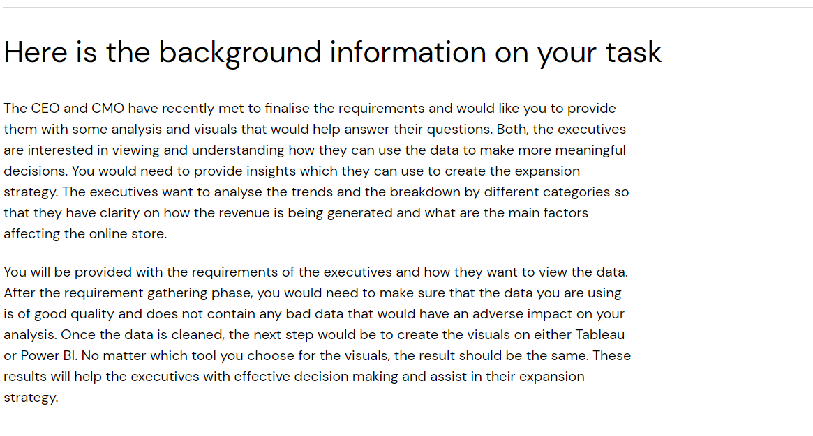
Problem Statement
Create the visuals around the questions the CEO and CMO requested

Slide 9
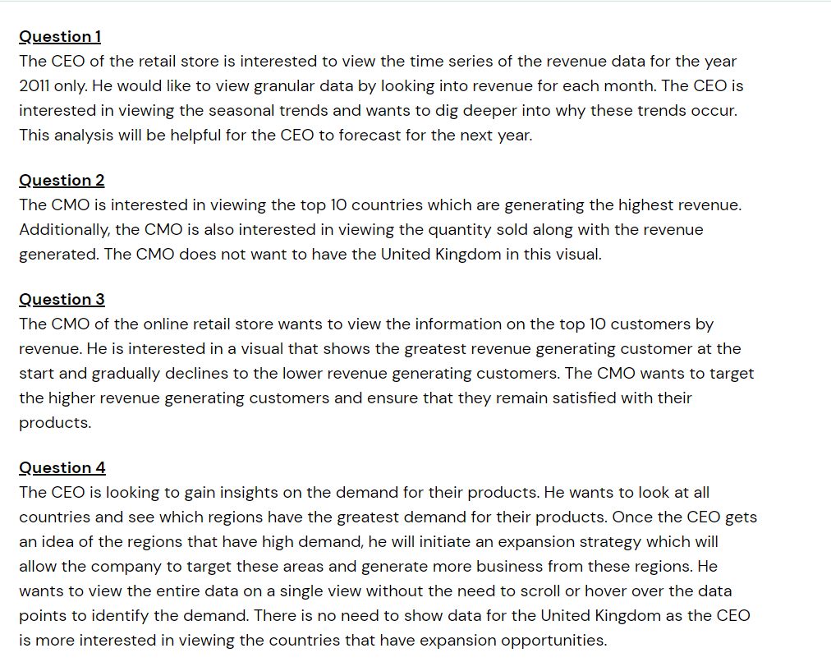

Slide 10
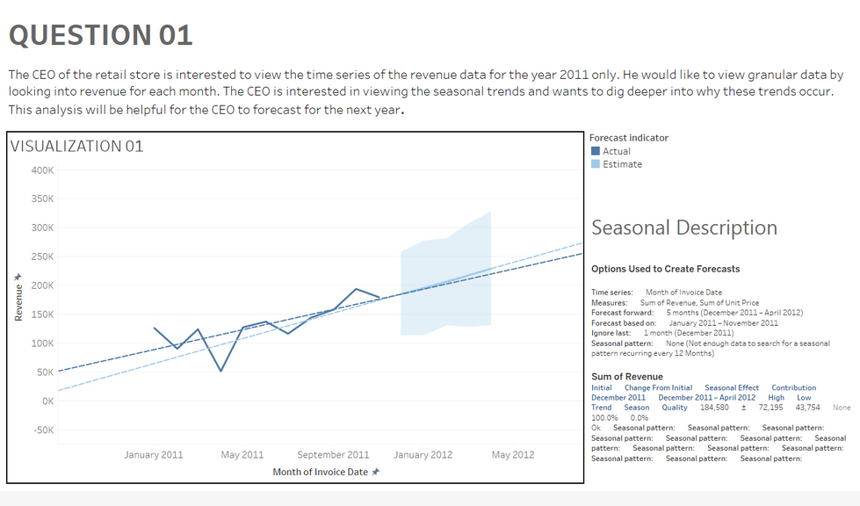
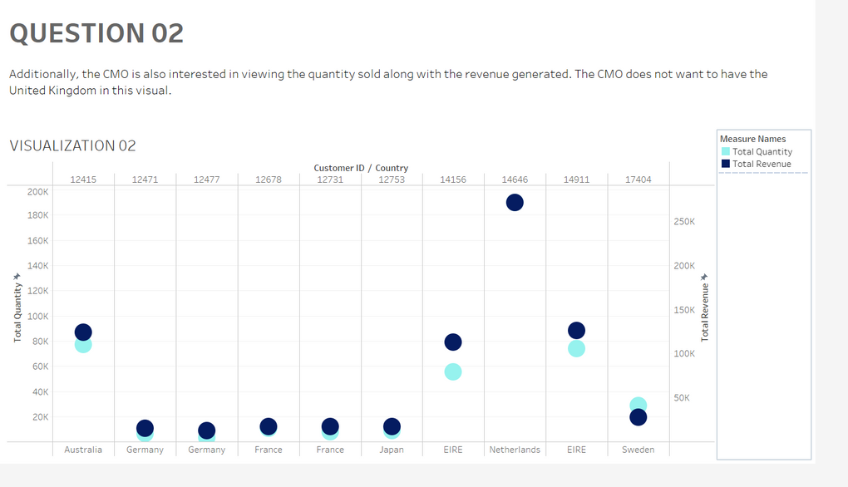
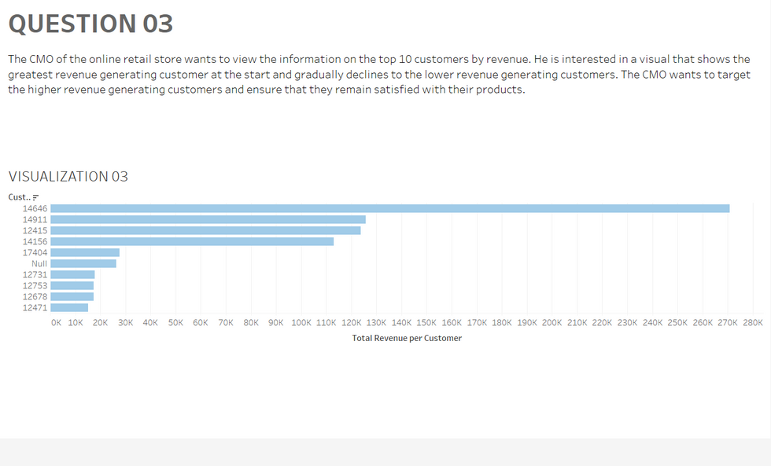
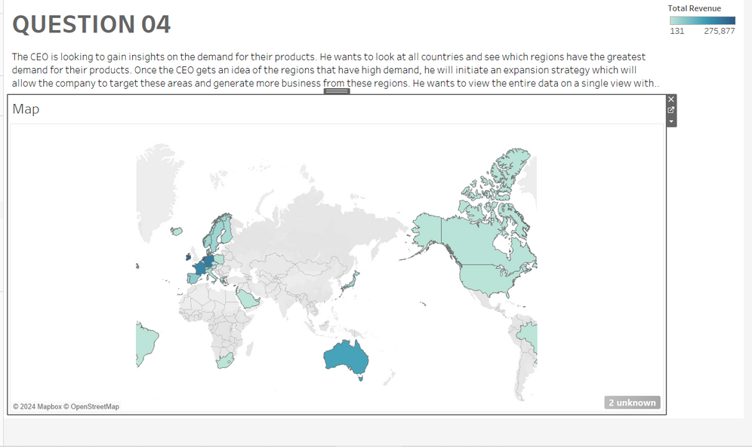

Slide 11
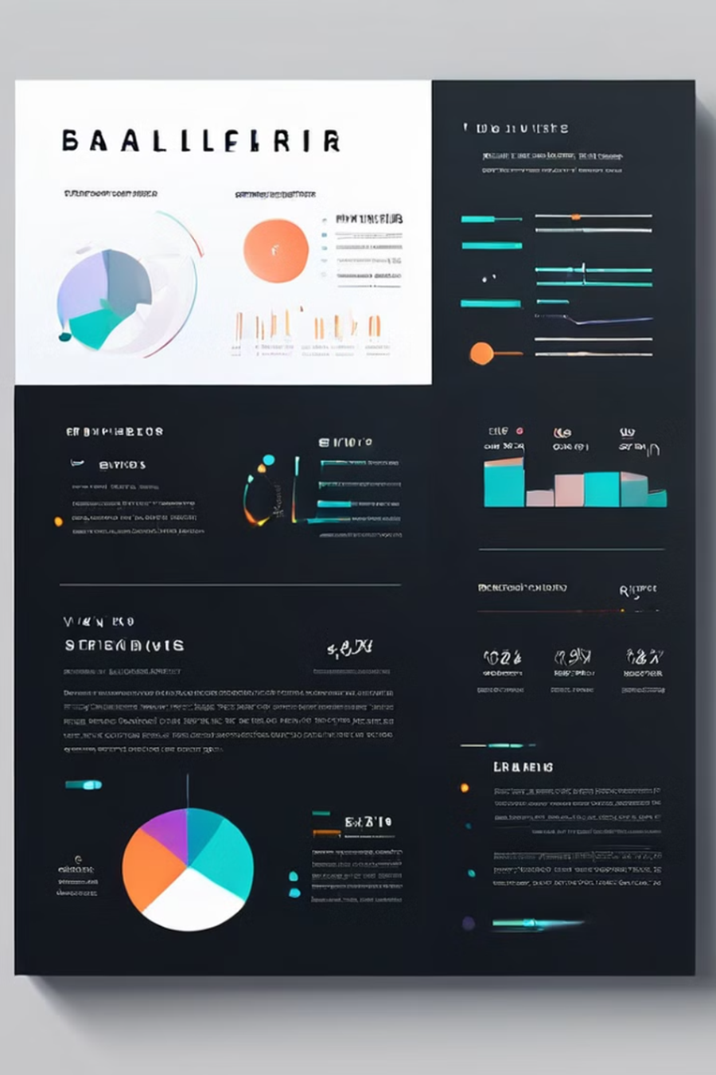
Plan for future use of learned things...
I recently participated in Tata's job simulation on the Forage platform, and it was incredibly useful to understand what it might be like to participate on a consulting team at Tata.
I worked on a project to help a retail client review their revenue data to prepare for the future. I created data visuals, practiced using Tableau and PowerBI to represent information, and built my presentation skills in a real-world context.
Doing this program confirmed that I really enjoy working on strategic problems for clients and I'm excited to apply these skills on a consulting team at a company like Tata.
Olivia Wilson
Aaron Loeb

Slide 12

Plan for future use of learned things...
Tata Data Visualization:
I participated in a job simulation on the Forage platform, immersing myself in a realistic scenario involving data visualization for a retail client.
Presenting to Client Senior Leadership
I prepared questions for a meeting with client senior leadership, ensuring I could effectively communicate my analysis and recommendations.
Effective Decision-Making
My visualizations helped executives make data-driven decisions, contributing to the client's success.
Data Visualization for Revenue Analysis
I created data visualizations to analyze revenue data, identifying key trends and patterns, and preparing insights for informed decision-making.
.

Slide 13

References
I am always looking for ways to expand my knowledge and expertise in data visualization and related fields. I am particularly interested in exploring advanced data visualization techniques, data storytelling, and the ethical implications of data usage. The TATA Data Visualization Internship provided valuable resources and learning materials.

Slide 14

THANKING
YOU !!

