Slide 1
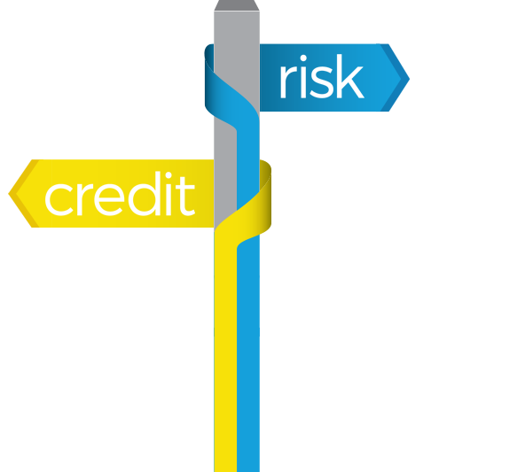
Home Credit Default Risk
Group-2 project work

Slide 2
Group2
Team Members:
1. Aakanksha Chauhan
2. Aziz Isamedinov
3. Vaishnavi Poondi Chinnappa Narayanan
4. Jacob Radey

Slide 3
INTRODUCTION
Many people struggle to get loans due to insufficient or non-existent credit histories and are often taken advantage of by untrustworthy people.
For a safe and positive loan experience Home Credit makes use of alternative data including telco and transaction details in order to predict client’s repayment capabilities.
Doing so will ensure that clients capable of repayment are not rejected and that loans are given with a principal, maturity, and repayment calendar that will empower their clients to be successful.
Results will be evaluated based on area under the ROC curve.

Slide 4
PROBLEM STATEMENT
Building a model to predict how capable each applicant is of repaying a loan, so that loan sanctioning is done only for the applicants who are likely to repay the loan.
Mapping to a Machine Learning Problem: Since we have two classes in the target label, we will pose this problem as a Binary classification problem.

Slide 5
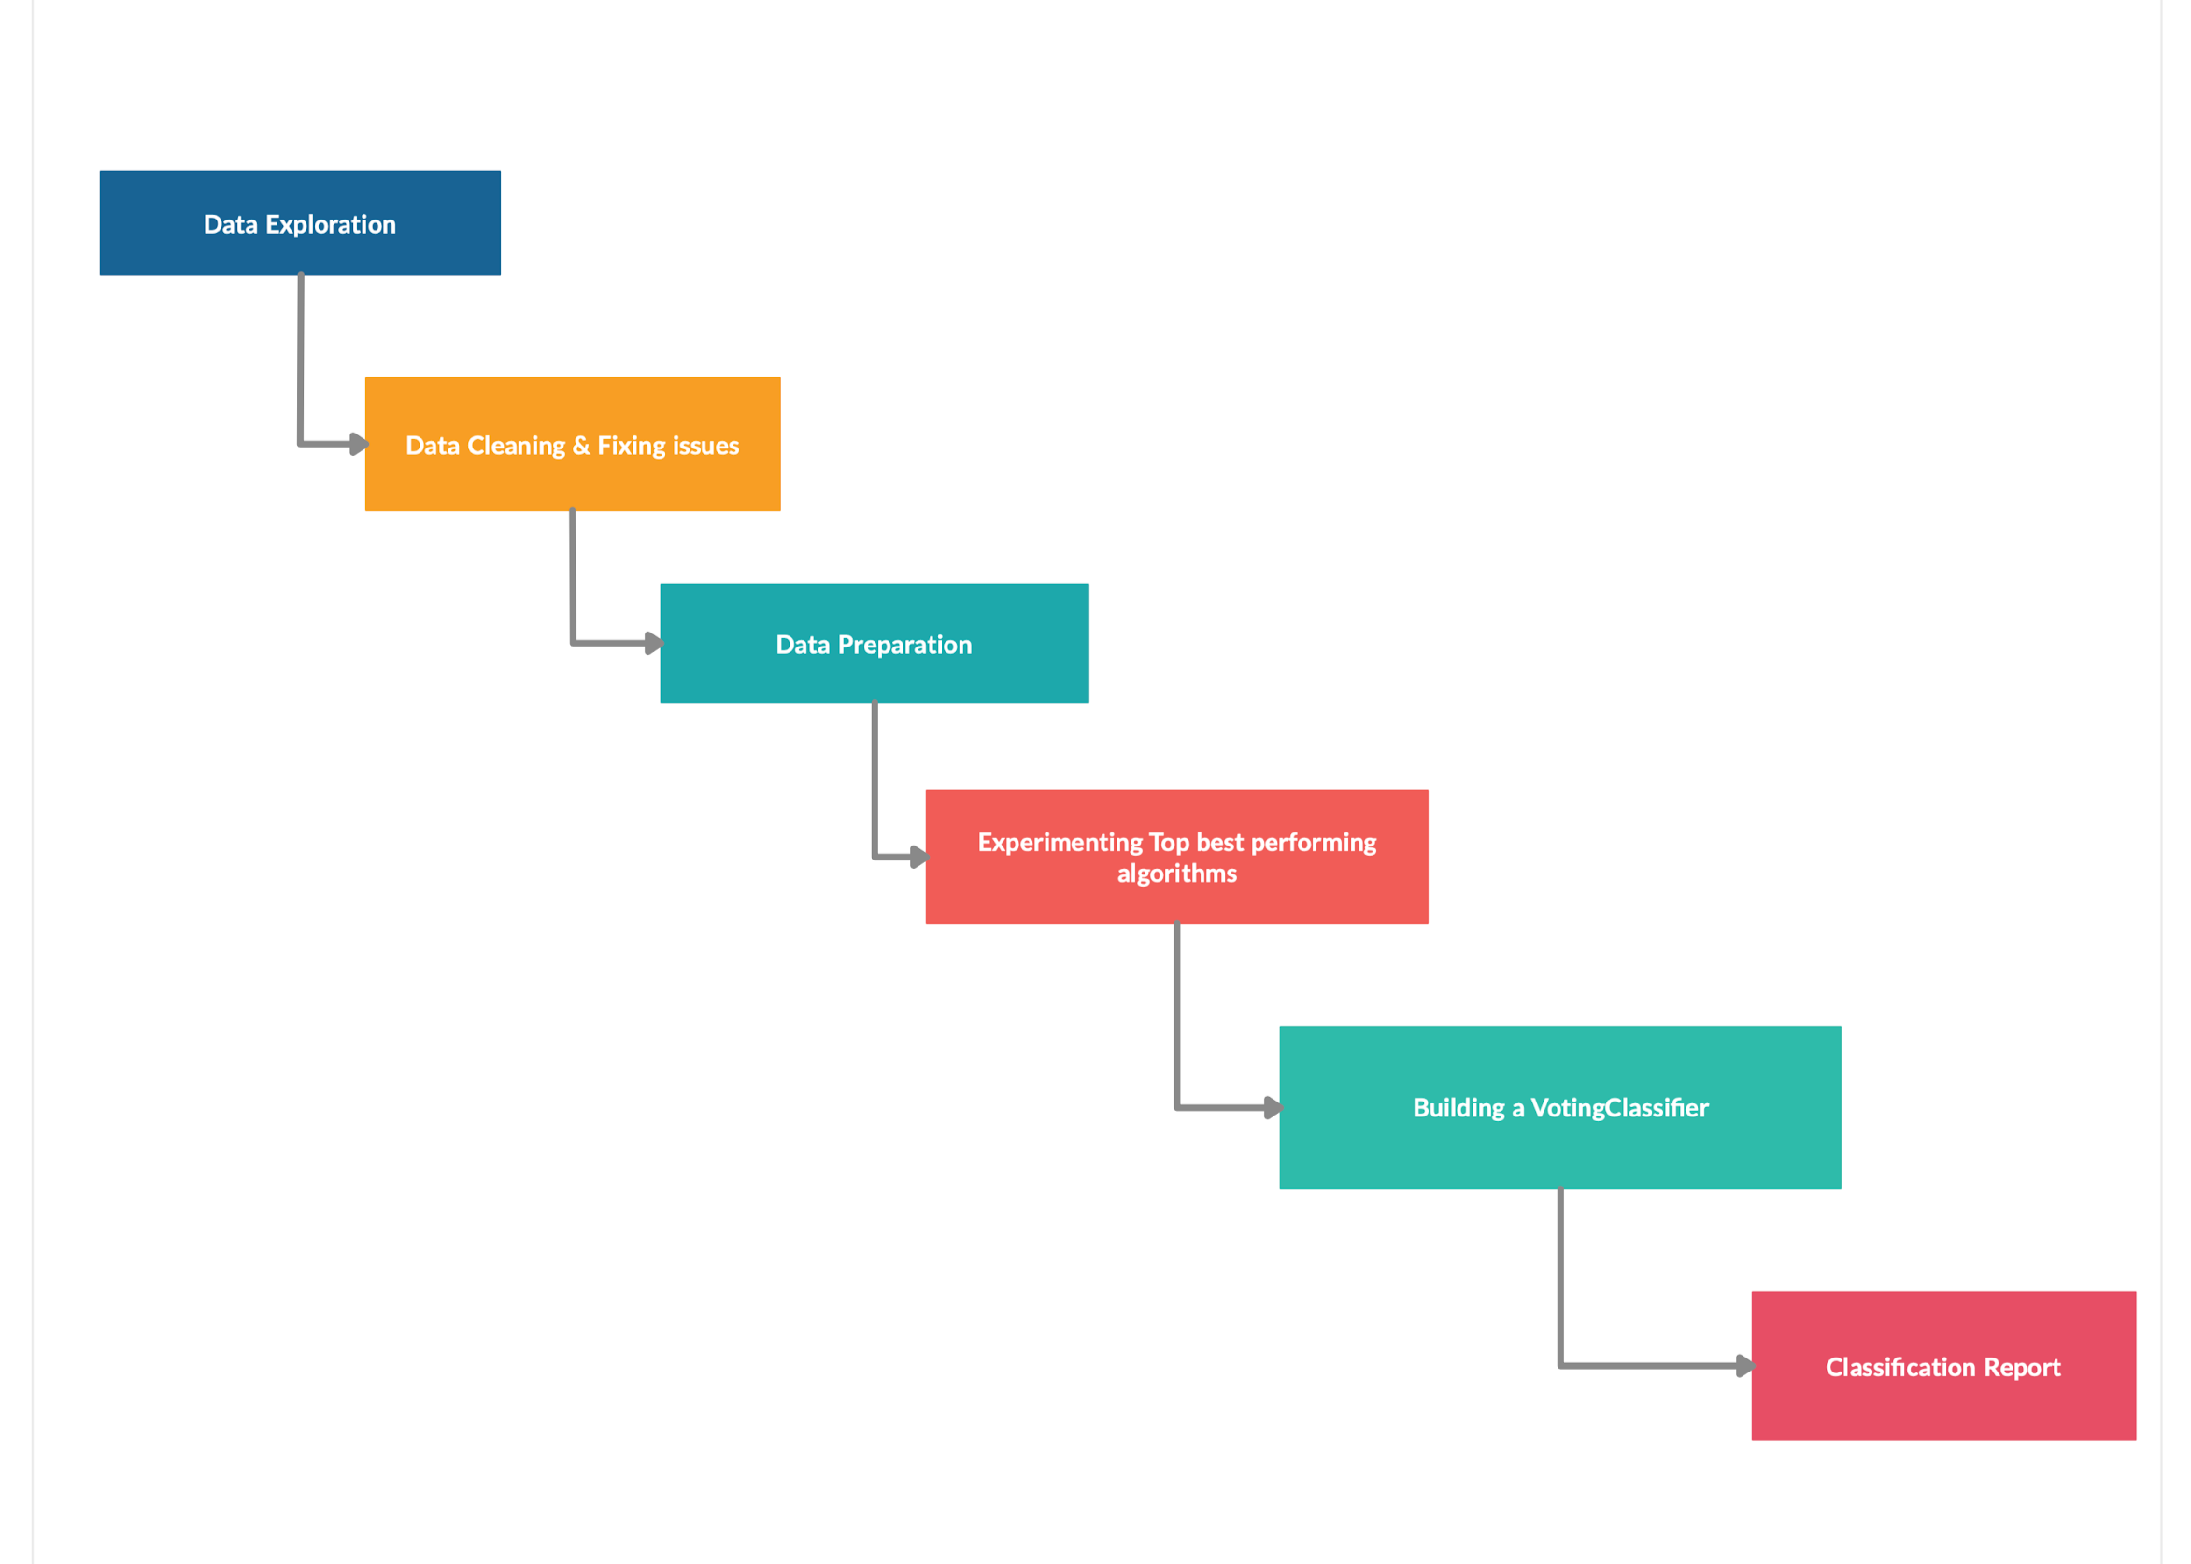
Work Process

Slide 6
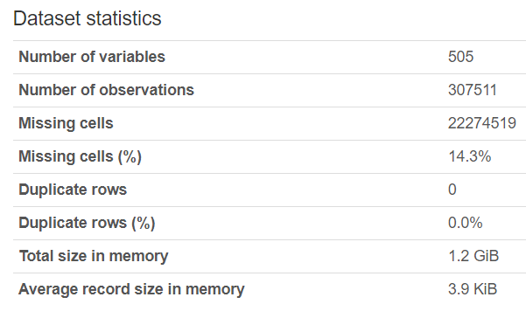

Data Overview
Data Source
The data is provided by Home Credit, a service dedicated to provided lines of credit (loans) to the unbanked population. It was collected from Kaggle.https://www.kaggle.com/c/home-credit-default-risk/data
Data Description
There are mainly seven tables among which Application (train and test) is the master table.
1. Application_train /test: Basic data with the borrower information,
with the TARGET variable (customer repaid loan or not)
2. Bureau: Data on previous loans in other credit institutions.
3. Bureau_balance: Monthly data on previous loans by bureau.
4. Previous_application: Previous applications for loans in Home Credit
5. Cash_balance: Monthly data on loans in Home Credit with cash and loans for purchases of goods.
6. Credit_card_balance: Monthly credit card balance data in Home Credit
7. Installments_payment: Billing history of previous loans in Home Credit
Joined Tables Profile:

Slide 7

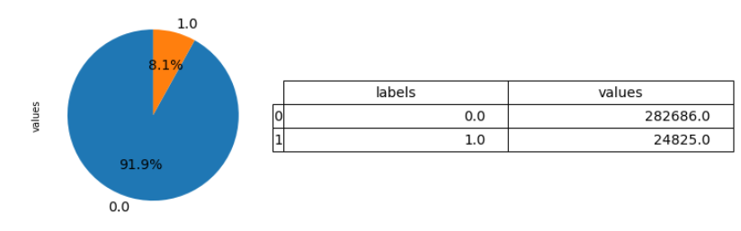
Data Analysis
Data Exploration:
1. Missing values - 100 variables had missing values more than 15%.
2. Duplicate rows - Customers had duplicate applications, with multiple accounts & credits.
3. Many attributes: 122 variables in application table. Total 505 variables in joined table.
4. Missing key features: missing counts in features
5. Outliers - approximately 5% of the dataset came with outliers.
6. Imbalanced Class - 8.1% values for TARGET category 1, and 91.9% for category 0.
Data Cleaning:
Removed columns with missing values exceeding more than 15% .
The duplicate rows were automatically eliminated by grouping the applications ids.
Duplicate accounts were aggregated by averaging method.
Missing values were imputed with the most frequent values
Outliers exceeding 2xStandardDev were removed
Feature Engineering:
New features were created as per our estimate of impact of default-rate. ie. number inquiry counts, ect
Categorical values were converted to dummy variables.
Imbalanced classes were balanced using “Upsampling” method.
Feature Selection:
Handled using Feature Selection method BorutaPy which uses RandomForest as an estimator. Out of 505, only 95 top ranking features were selected

Slide 8
Methodology:
Logistic Regression
Algorithm used for binary classification. This Machine Learning classification algorithm is used to predict the probability of a categorical dependent variable.
LightGBM
Light GBM is a fast, distributed, high-performance gradient boosting framework based on decision tree algorithm, used for ranking, classification and many other machine learning tasks.
Random Forest
Ensemble learning method for classification

Slide 9
Logistic Regression
Easy to implement and efficient to train
Helps in Maximum likelihood estimation when used as a performance baseline
Highly Interpretable
Random Forest
Overcomes Overfitting issues
Reduces variance and improves accuracy
Works well with Categorical Variables

Slide 10
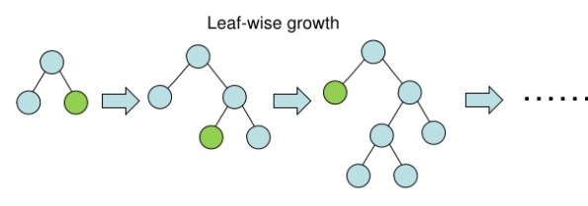
Light GBM (A Gradient Boosting Framework)
Better Efficiency and accuracy
Faster training speed
Helps eliminate feature redundancy

Slide 11
Evaluation Metrics
-Area Under Curve (AUC): An ROC curve is the most commonly used way to visualize the performance of a binary classifier, and AUC is (arguably) the best way to summarize its performance in a single number.
-Confusion Matrix: To get an overview of complete predictions.

Slide 12
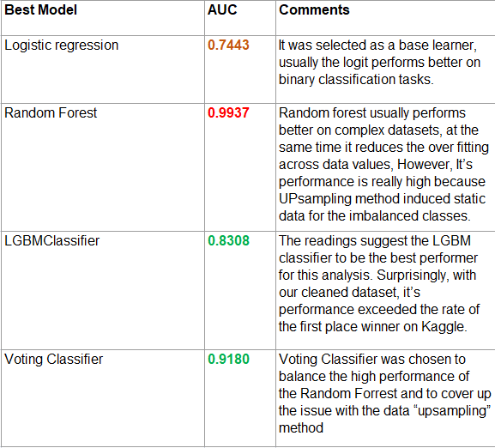
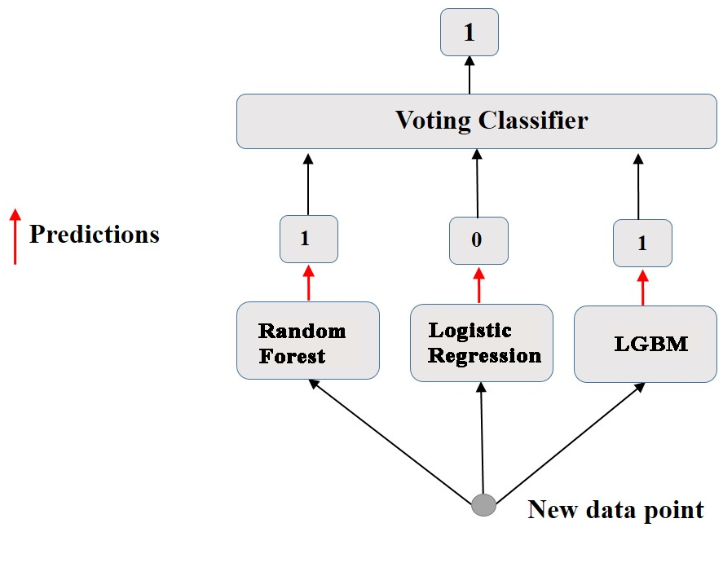
RESULTS
Empirical results
Logical Flow diagram

Slide 13
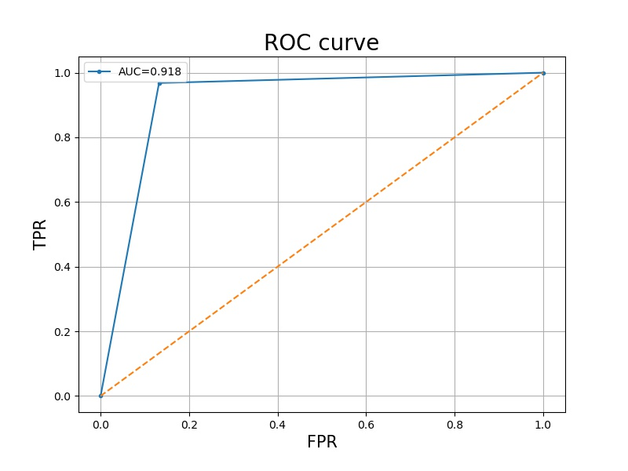
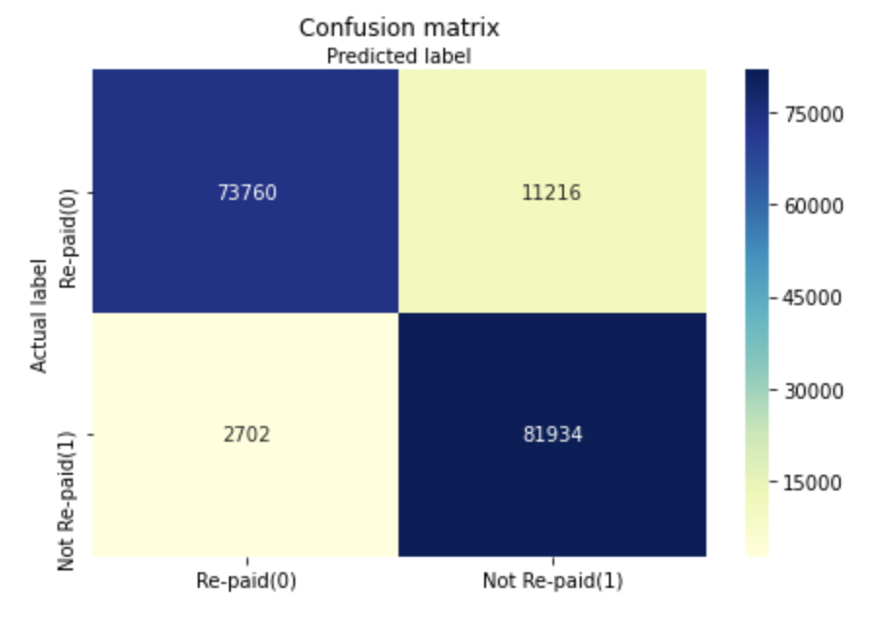
Evaluation Results
Confusion Matrix

Slide 14
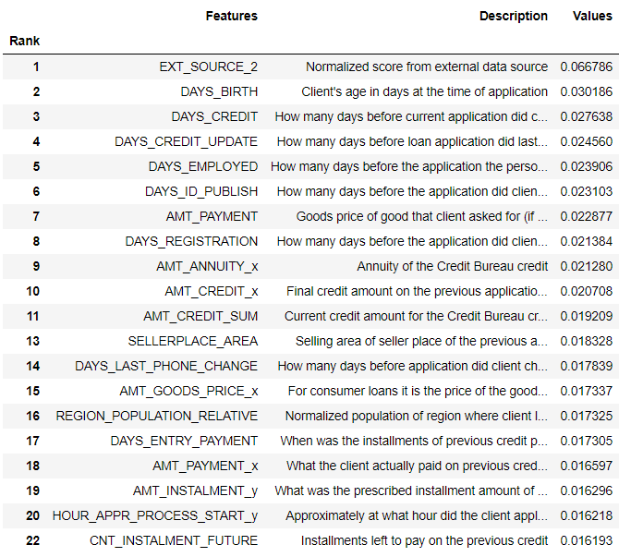
CONCLUSION
Results of Top 20 feature importances out of 95
BorutaPy played an important role in selecting the most important features during the upsampling process and therefore Models gave the best results

Slide 15
Thank You

