Slide 1




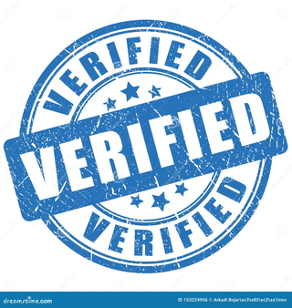
SIGNATURE VERIFICATION SYSTEM
Django Based Application Using Deep Learning Neural Networks
Presented by-
Puligilla Vaishnavi

Slide 2

INTRODUCTION
PURPOSE OF SIGNATURE VERIFICATION SYSTEM
A signature verification system is crucial for distinguishing forged and real signatures, ensuring authenticity and preventing fraudulent activities. It enhances security in applications like banking, legal documentation, and identity verification.

Slide 3
OBJECTIVE
Aim-
The objective of a signature verification system is to accurately authenticate and distinguish genuine signatures from forgeries, ensuring secure and reliable identity verification
Key Features-
Backend: Django (Python)
Frontend: HTML & CSS
Integration of Deep Learning Models for prediction.

Slide 4
SYSTEM ARCHITECTURE
1
2
3
4
User Authetication
Image Input
User Upload Image
Image Processing
5
6
Deep Learning Models Analysis
Prediction and Accuracy display

Slide 5
TECHNOLOGY
STACK
DEEP LEARNING MODELS
USED
•Backend: Django (Python)
•Frontend: HTML, CSS
•Deep Learning Frameworks:
•Neural Networks: CNN, RNN, CRNN, BiLSTM, BiRNN
•Database: SQLite/MySQL
•Libraries: OpenCV, NumPy, scikit-learn
CNN: Extracts spatial patterns and unique features from the signature image for analysis.
RNN: Processes temporal and sequential relationships in extracted signature features.
CRNN: Integrates spatial and sequential analysis for enhanced signature verification accuracy.
BiLSTM/BiRNN: Captures bidirectional feature context for robust signature classification.

Slide 6
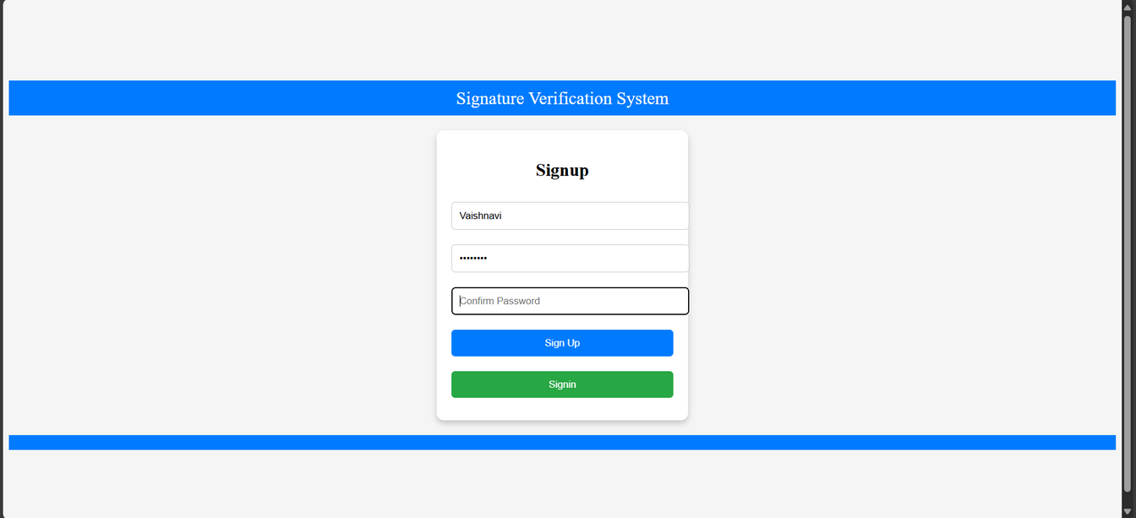
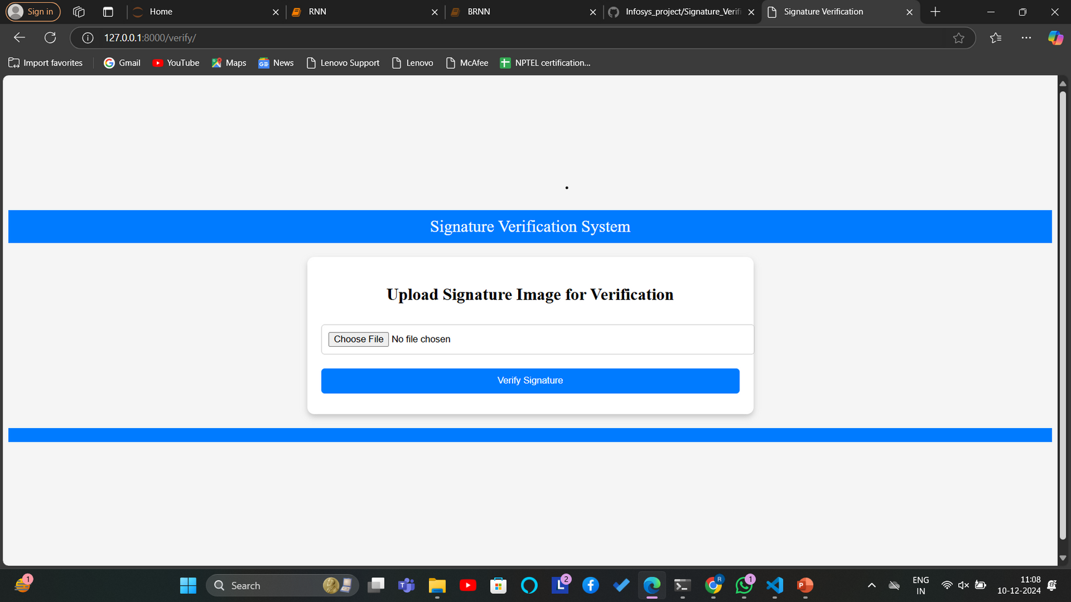
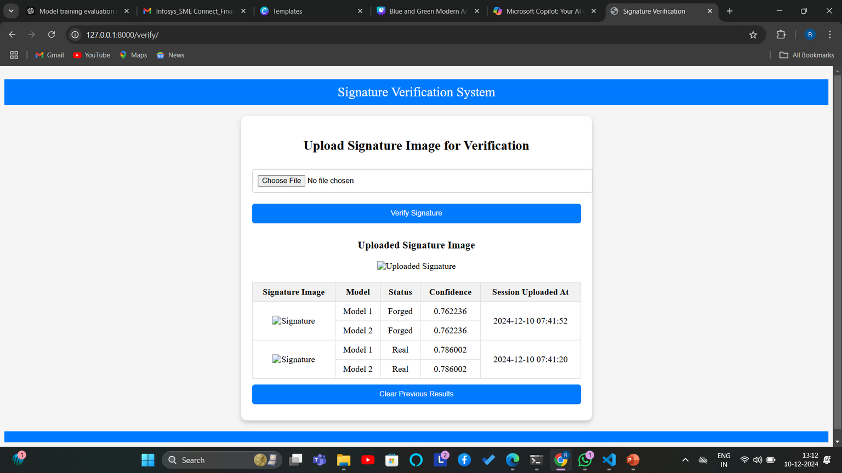
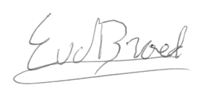
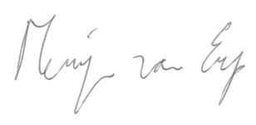
SIGNATURE VERIFICATION RESULTS

Slide 7

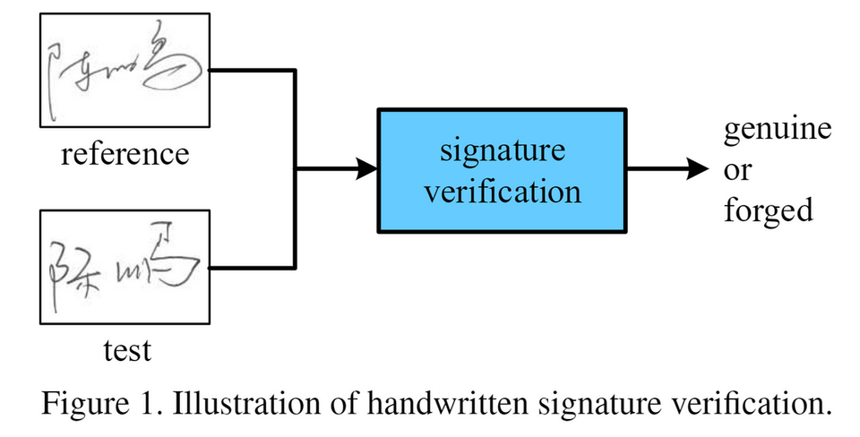
KEY ASPECTS
Intuitive User Interface: Easy and straightforward file upload process.
Precise Predictions: Leveraging deep learning models for high accuracy.
Instant Processing: Analyzes signatures swiftly and effectively.
Robust and Scalable: Built on Django for enhanced security and adaptability.

Slide 8
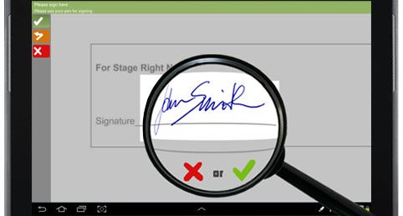
APPLICATIONS
Banking: Verifying signatures on checks and transactions to prevent fraud.
Legal: Authenticating signatures on contracts and agreements.
Government: Validating signatures on official forms and documents.
E-commerce: Ensuring secure signature verification for online purchases.
Healthcare: Verifying signatures on medical records and prescriptions.

Slide 9



CONCLUSION & FUTURE SCOPE
Signature verification with deep learning improves security and accuracy in authentication.
Future scope includes integrating multi-modal biometrics for enhanced reliability.
THANK YOU

