Slide 1
NFT Sales Analytics Dashboard
By
Muthukumar .K
Vaishnavi .N

Slide 2
Introduction
Overview
It is a trading system where users can sell,cancel and buy a NFT at anywhere in any collection.By our dashboard visualization,users can easily analyse the trading system and plan accordingly like when to sell or buy the NFTs.
This project shows nft sales analytics dashboard to explore yearly,monthly,weekly,daily analysis growth of each NFT collection.This enables users to interact and can
flip NFT to make profit.

Slide 3

Existing System
Each collection has its floor price,volume,ownership etc..But users are unable to compare this information with other collections at the same time.Every collection represents their items to sales and buyers have to wait and look for the particular time to get it.

Slide 4

Proposed System
By overcoming these, we created a dashboard of visualizing the necessary of each collections such as minting items,total quantity and particularly sales analysis which helps users to buy the items and sell the items to their needs , they able to know which is the most trending one and trusted one to mint,sell,buy etc..,

Slide 5
Flow Chart
Node JS
Fitting JSON data to Model
NFT Data
Response API Data
Visualize data with Graphs

Slide 6
Hardware requirements Software requirements
Memory ( RAM ) : 4GB
Display : At least 1440x900 or 1600x900 (16:9) required
CPU : 1 Gigahertz (GHz) 64-bit (x64) processor or better recommended
Operating System : Windows 8.1 / Windows Server 2012 R2, or later
.NET framework : .NET 4.6.2 or later

Slide 7


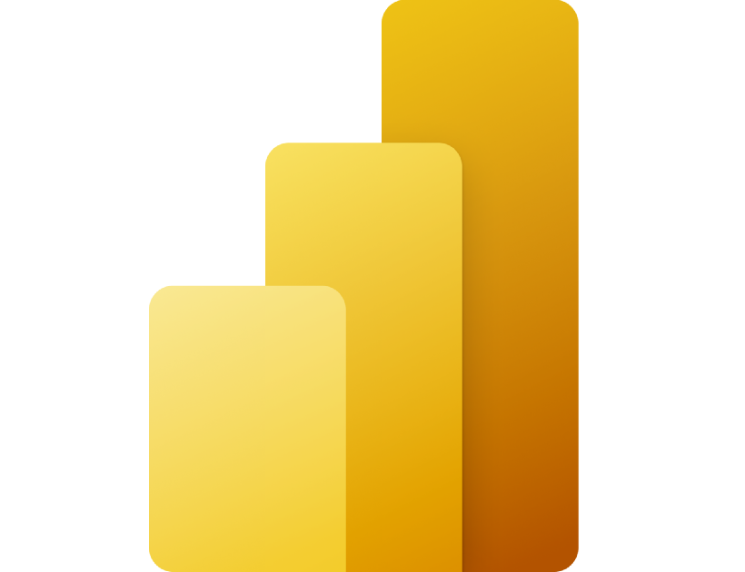
Software Used
Data API
Back-end
Analytics tool
nftport.xyz provides free API data with API key about NFT . nftport docs provides each api for all api datas. But it provides 50 datas per request .
Node js used to iterate the request to get 1000s of data at single time
Power BI
Power BI used to create dashboards to visualize our NFT data in a structured manner

Slide 8
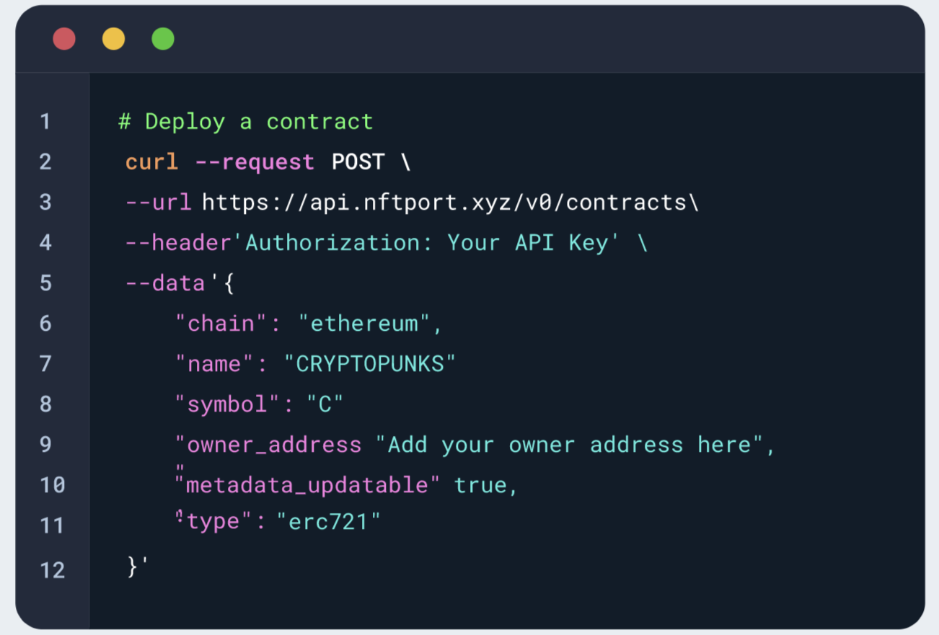
Experimental Investigations
While doing this project,we gathered the insights of nft analysis and gained some knowledge of visualization graphs,statistics and more about nft sales.

Slide 9
Advantages Disadvantages
The merit of this project is users who want to sell and buy the items in a proper collection of items,they easily found out the collection by analysing our dashboard.
The demerit of this project is each collection will update in every seconds.so the user have to look carefully and start to invest accordingly , it's all at your own risk and we are not responsible for price drops .

Slide 10
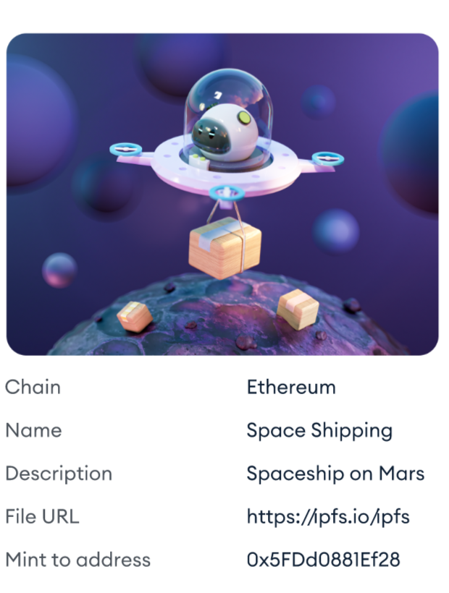
Applications
Our Dashboard majorly used in NFT sales Analytics
This dashboard analytics not only for the sales domain, It is also used for market, business, ecommerce, cryptocurrency etc… without analysing we cannot do or take decision of anything.This becomes the major part of all the domain.

Slide 11
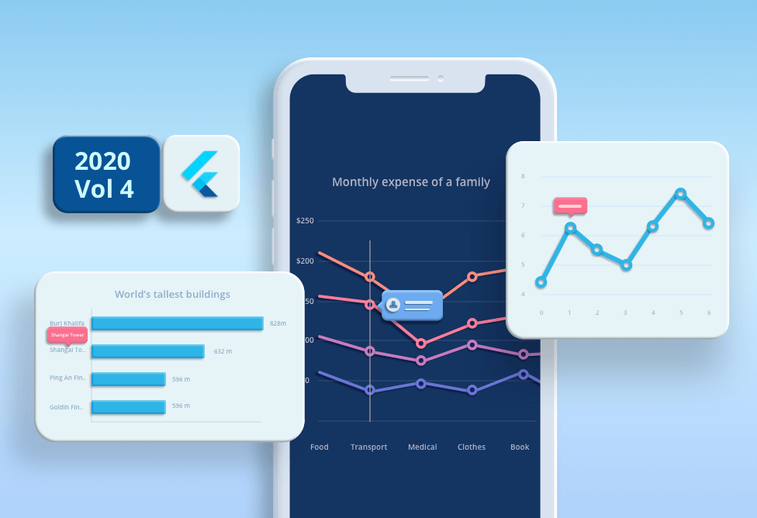
Future Scopes
our future scope is to visualize the dashboard analytics in live update at every seconds that is to combine every collections sales analytics.
From that we able to know which is top trending collections at which month/year.

Slide 12
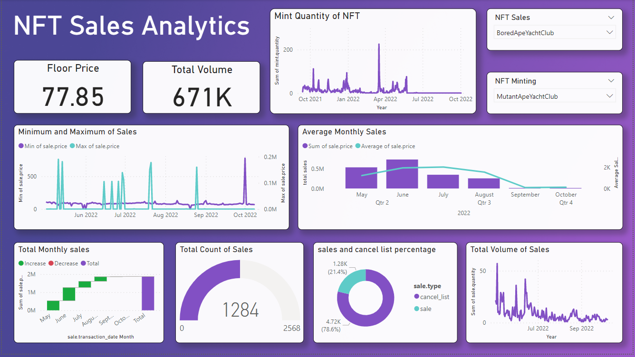

Slide 13
Result
Github
Analytic File : https://github.com/VaishnaviRaj6/NFTSalesDashboard.git
BackEnd File: https://github.com/VaishnaviRaj6/NFTdata-Backend.git
PowerBI
Published File: Click Here to View the Dashboard

Slide 14
Conclusion
This project helps to analyse the nft sales of each top collections and makes users to interact and trade easily

