Slide 1
IBM University Engagement Project Submission
“Exploring the Power of Agentic AI with IBM Granite and LangFlow”

Slide 2

Project Tile – [AI Travel Planner Agent]
Domain of Project – [Travel & Tourism ]
Student Name | Recent Passport Photo | Email ID | Mobile number [WhatsApp]
Vaishnavi Sudhir Raut |  | vaishraut2004@gmail.com vsraut2004@gmail.com | 9021803545

Slide 3
Problem Statement -
The Challenge
Travel planning can be overwhelming, requiring users to search multiple platforms for destinations, accommodations, transportation, weather updates, and local recommendations. Creating a personalized itinerary that matches budget, interests, travel dates, and preferences is often time-consuming and inefficient. Without intelligent assistance, travelers may miss important information, overspend, or fail to optimize their travel experience.
The Objective
Build an AI-powered Travel Planner Agent that delivers personalized travel planning and recommendations for individuals, families, and groups. The solution should:
Personalized Travel Plans – Generate customized itineraries based on destination, budget, travel dates, number of travelers, and interests.
Destination Discovery – Recommend suitable attractions, activities, hotels, and local experiences tailored to user preferences.
Budget Optimization – Provide estimated travel expenses, accommodation costs, transportation options, and budget breakdowns.
Real-Time Travel Assistance – Incorporate weather information, travel alerts, and local guidance to improve trip planning and decision-making.

Slide 4
Technology Used
IBM Cloud Lite – Cloud platform for hosting and AI services
IBM watsonx.ai – AI platform for generating travel recommendations
IBM Granite Model – Large Language Model for itinerary generation
React.js – Frontend development
Vite – Fast frontend build tool
Tailwind CSS – Responsive and modern UI design
FastAPI – Backend API development
Python – Backend programming language
REST APIs – Communication between frontend and backend
Multi-Agent Architecture – Destination, Budget, Itinerary, Weather, and Travel Tips Agents
Git & GitHub – Version control and project repository

Slide 5
Proposed Solution -
Develop an AI-Powered Travel Planner Agent using IBM watsonx.ai, IBM Granite Model and IBM Cloud Lite that generates personalized travel plans based on user preferences, budget, travel dates, and interests.
The system utilizes a Multi-Agent Architecture consisting of Destination, Budget, Itinerary, Weather, and Travel Tips Agents to provide:
Personalized destination recommendations
Day-wise travel itineraries
Budget analysis and cost optimization
Hotel and transportation suggestions
Weather insights and travel alerts
Local attractions, food, and travel tips
A modern interactive dashboard presents all recommendations in an easy-to-understand format, enabling users to plan their trips efficiently and make informed travel decisions.
Outcome: A smart, AI-driven travel assistant that transforms complex trip planning into a seamless, personalized, and enjoyable experience.

Slide 6
Workflow Components Used –
User Input Node
Travel Orchestrator
IBM Granite Model Node
Destination Agent
Budget Agent
Itinerary Agent
Weather Agent
Output Dashboard

Slide 7
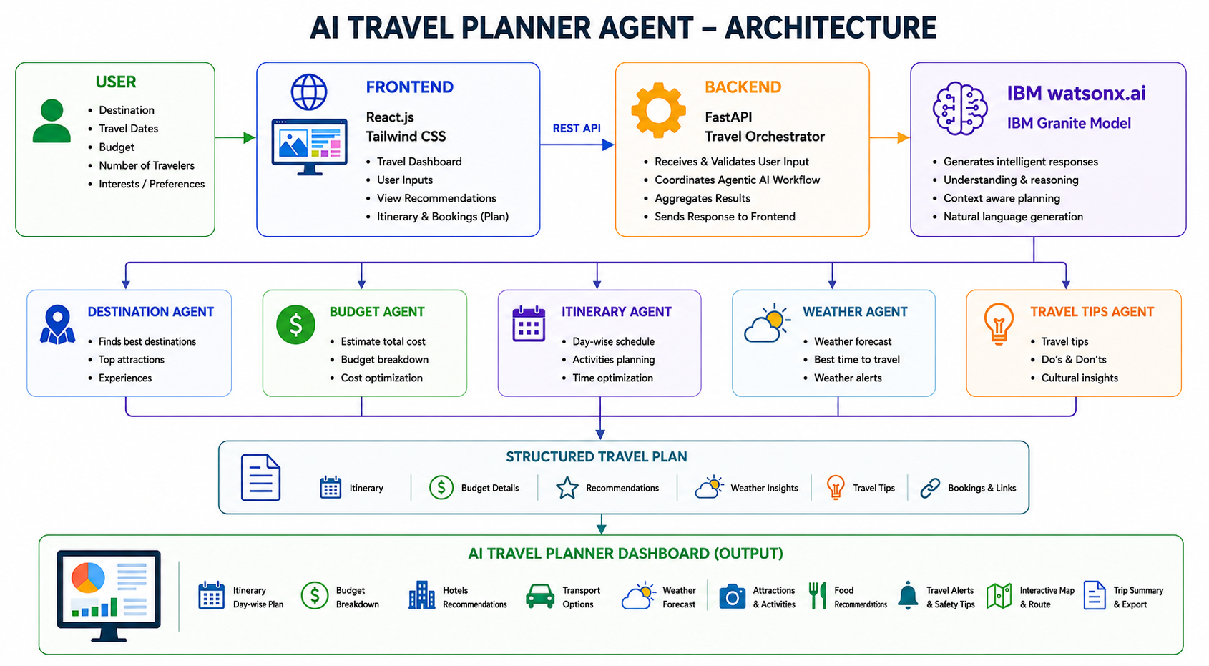
Architecture blueprint:

Slide 8

Role of Agentic AI in the solution
Role of Agentic AI in AI Travel Planner Agent
Understands user preferences such as destination, budget, travel dates, and interests.
Coordinates multiple specialized agents to perform different travel-planning tasks.
Generates personalized travel itineraries tailored to individual requirements.
Optimizes travel budgets by recommending cost-effective accommodation and transportation.
Provides intelligent recommendations for attractions, food, hotels, and activities. Analyzes weather and travel conditions to improve trip planning.
Offers travel alerts, safety tips, and local guidance for a better travel experience. Combines outputs from all agents into a single, comprehensive travel plan.

Slide 9
Novelty and Uniqueness
🔹 Multi-Agent AI Architecture – Uses specialized AI agents for destination planning, budgeting, itinerary generation, weather analysis, and travel recommendations.
🔹 Personalized Travel Planning – Creates customized travel plans based on user preferences, budget, dates, and interests.
🔹 IBM watsonx.ai Powered – Leverages IBM Granite Model for intelligent travel recommendations and personalized itinerary generation.
🔹 Smart Budget Optimization – Provides cost-effective suggestions for accommodation, transportation, and activities.
🔹 Weather-Aware Recommendations – Incorporates weather insights and travel alerts into itinerary planning.
🔹 Interactive Travel Dashboard – Displays itineraries, budgets, hotels, attractions, transport options, and travel tips in a user-friendly dashboard.
🔹 End-to-End Travel Assistance – Combines destination discovery, itinerary generation, travel guidance, and safety recommendations in one platform.
🔹 Scalable Agentic AI Framework – Easily extendable with future integrations such as live booking, maps, and real-time travel services.

Slide 10
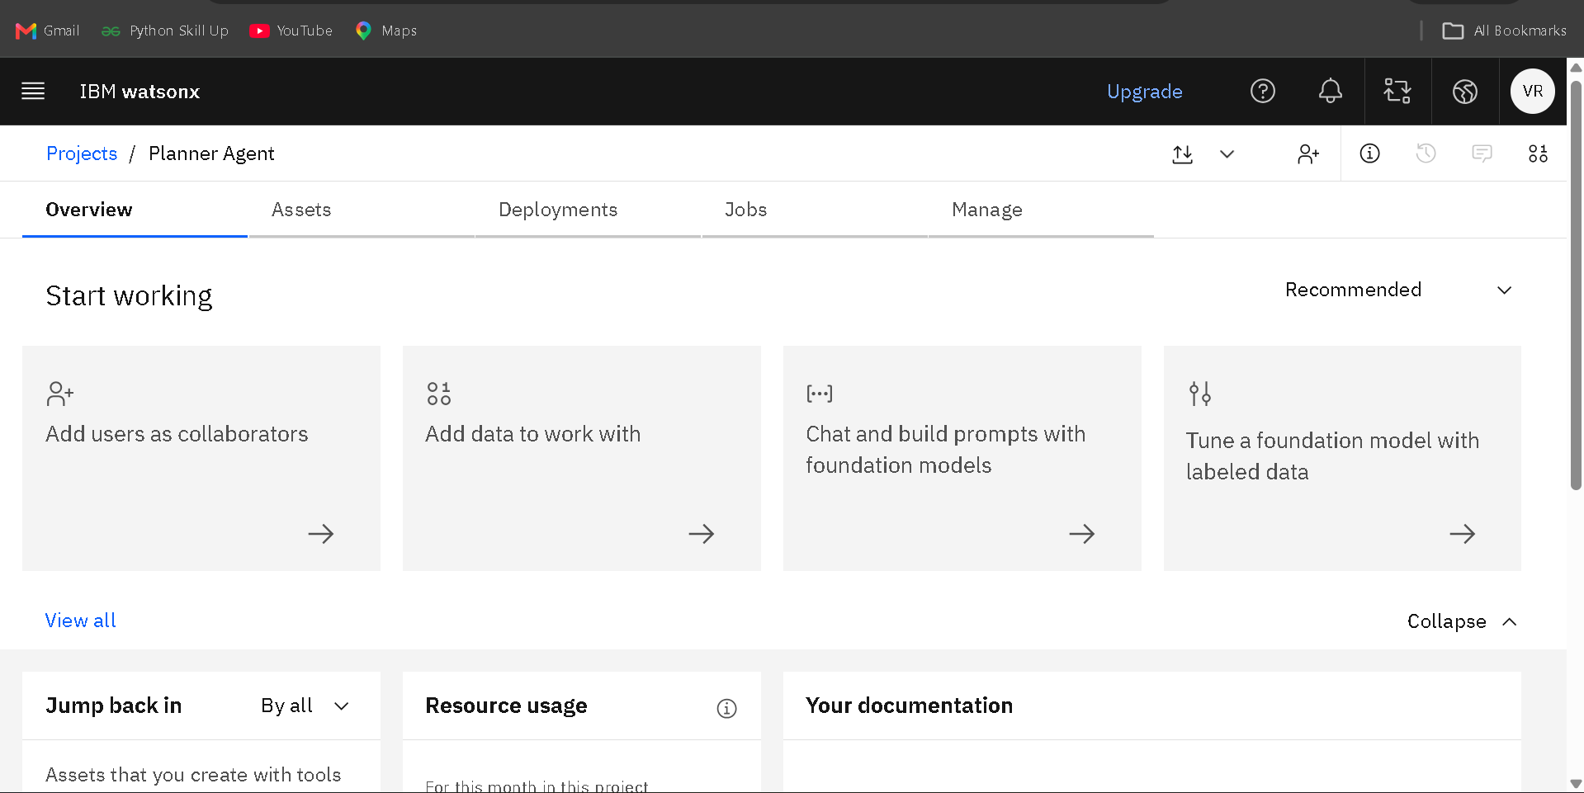
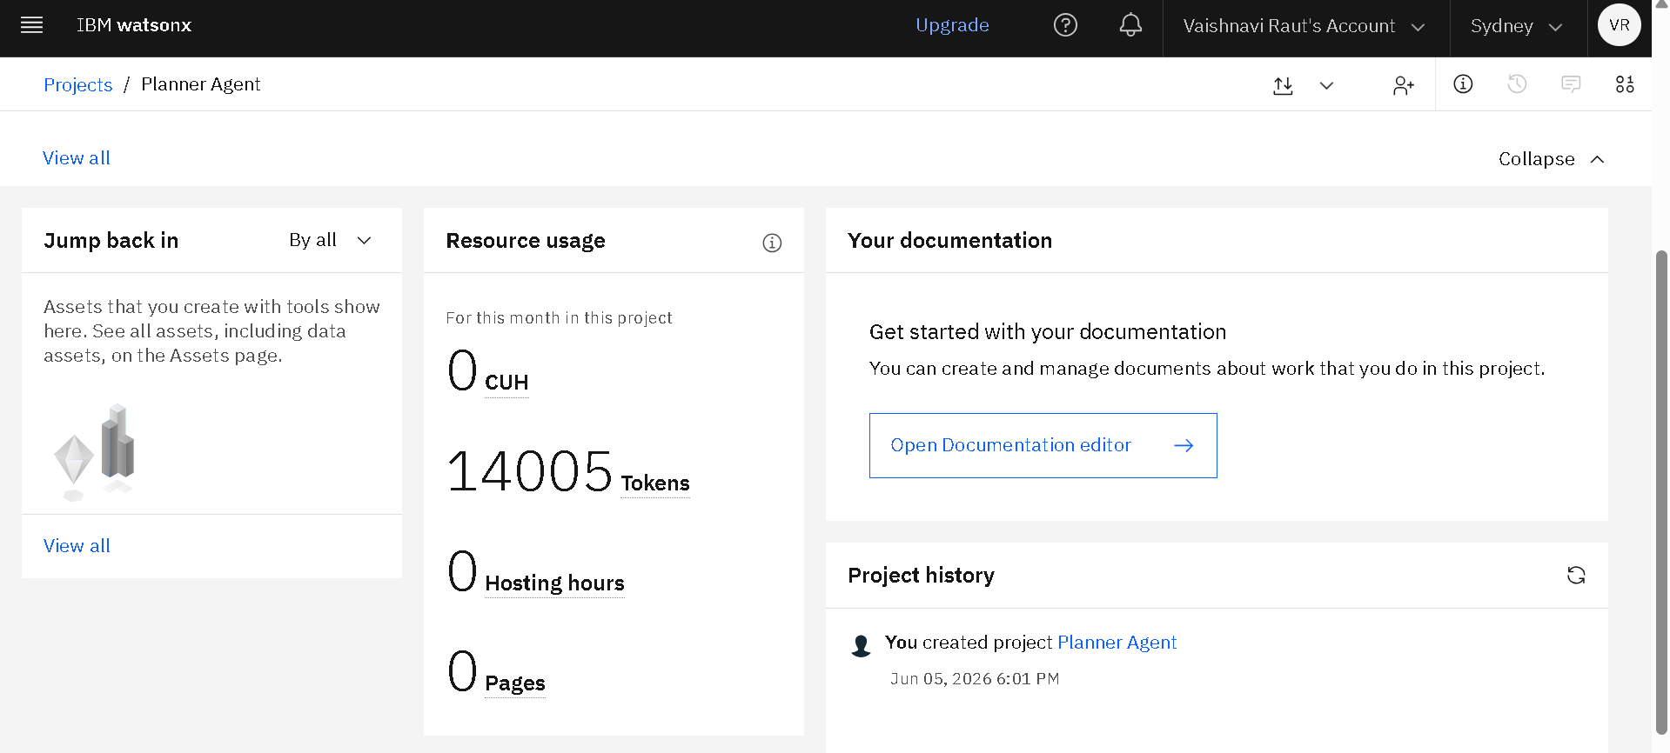
IBM Tools & Platform Usage

Slide 11
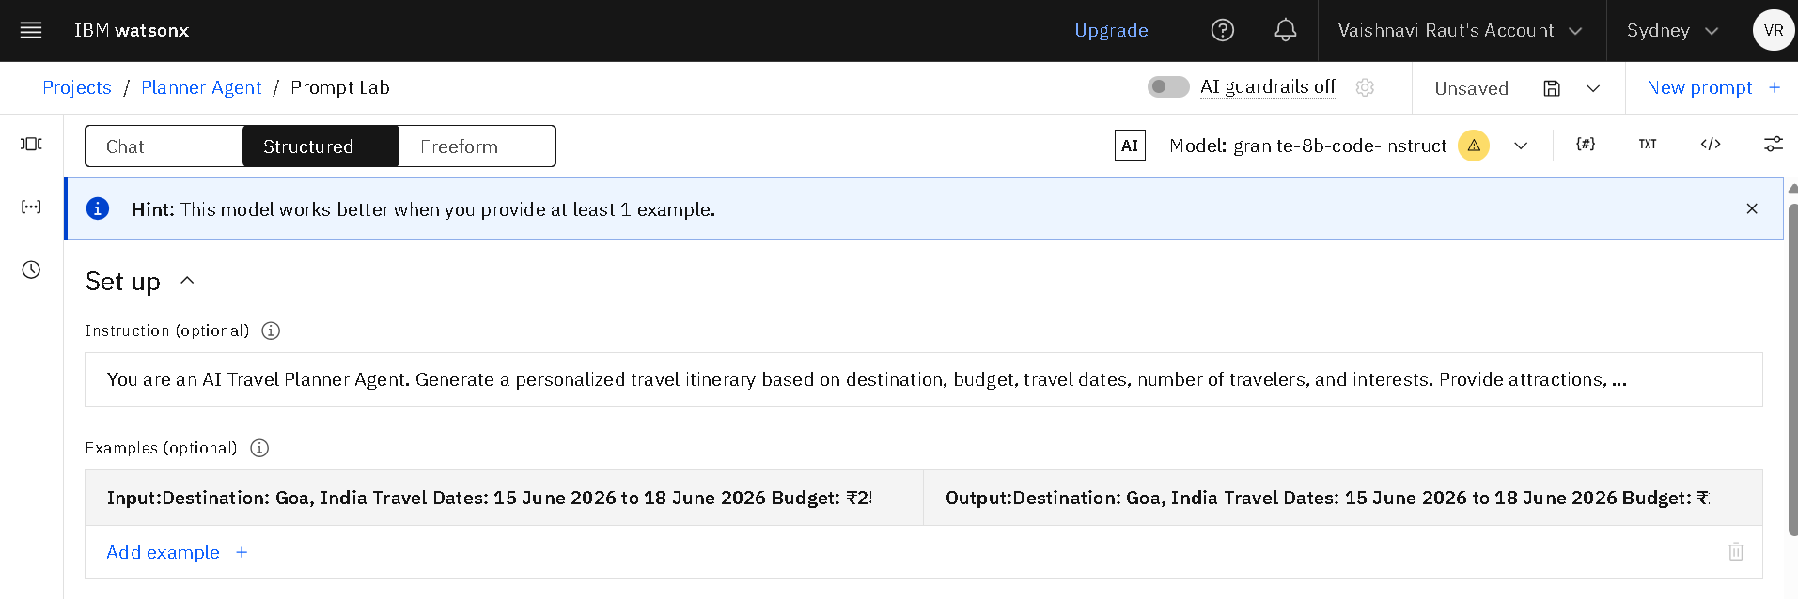
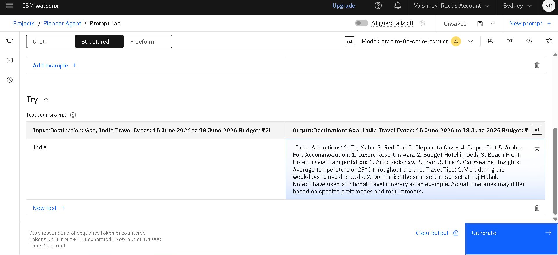

Slide 12
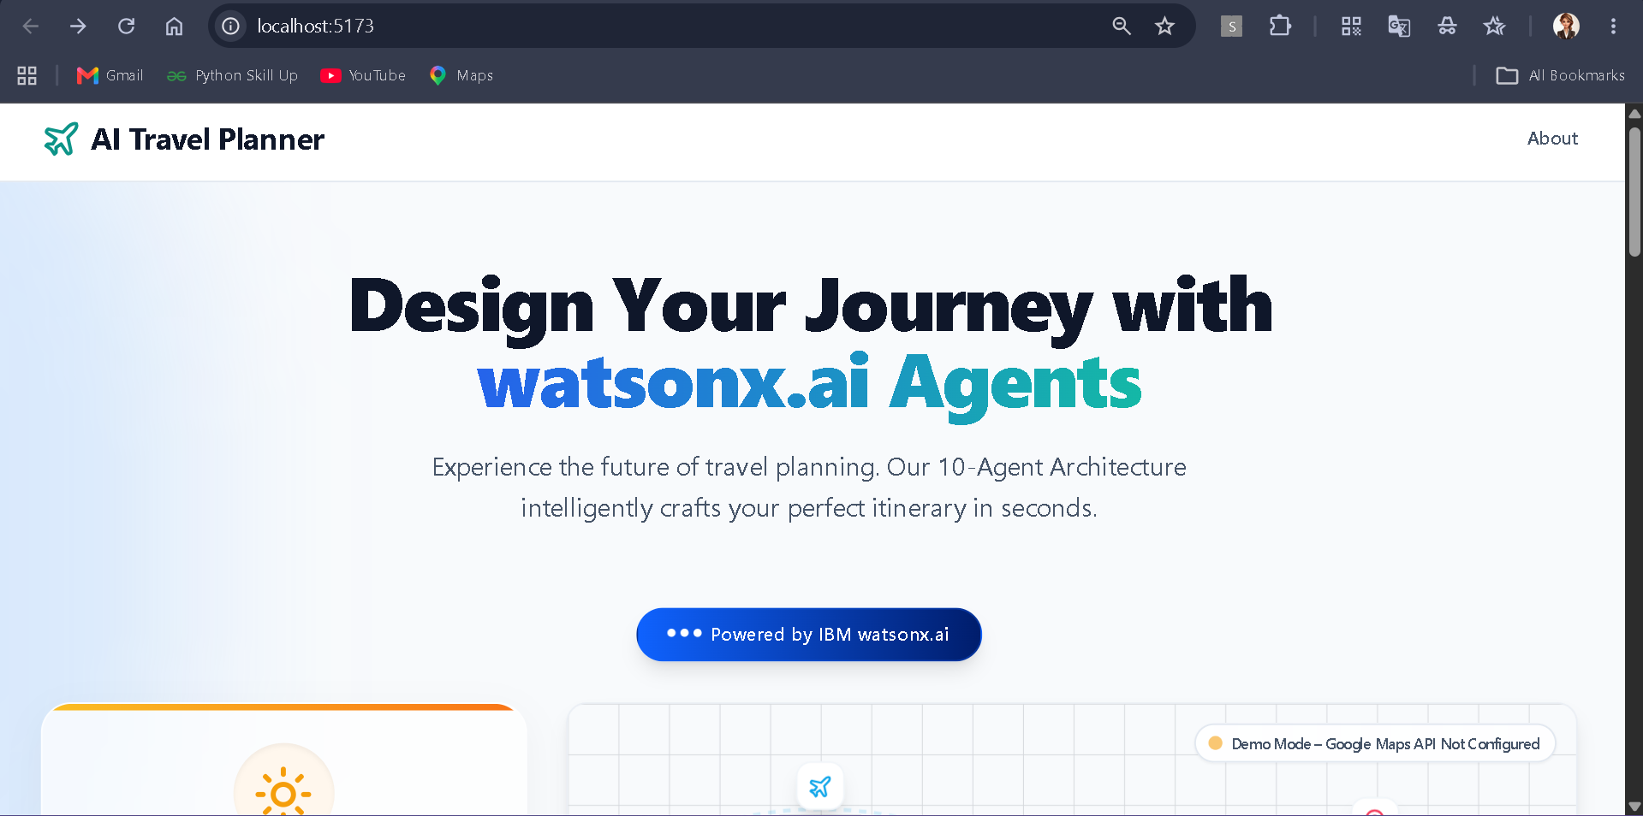
AI Travel Planner Agent – User Interface & Results

Slide 13
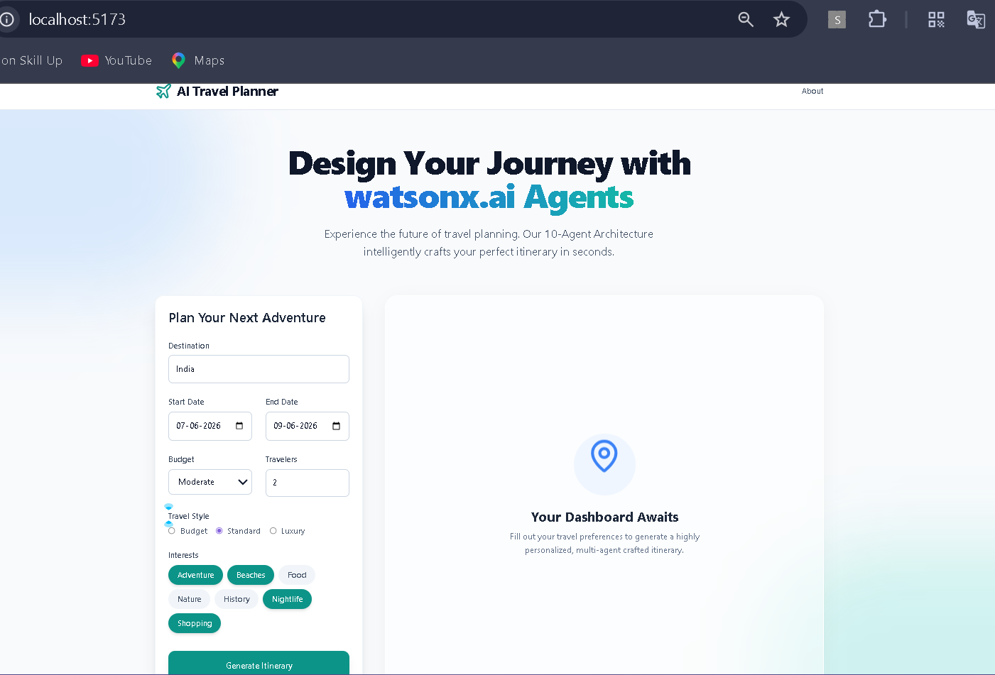

Slide 14
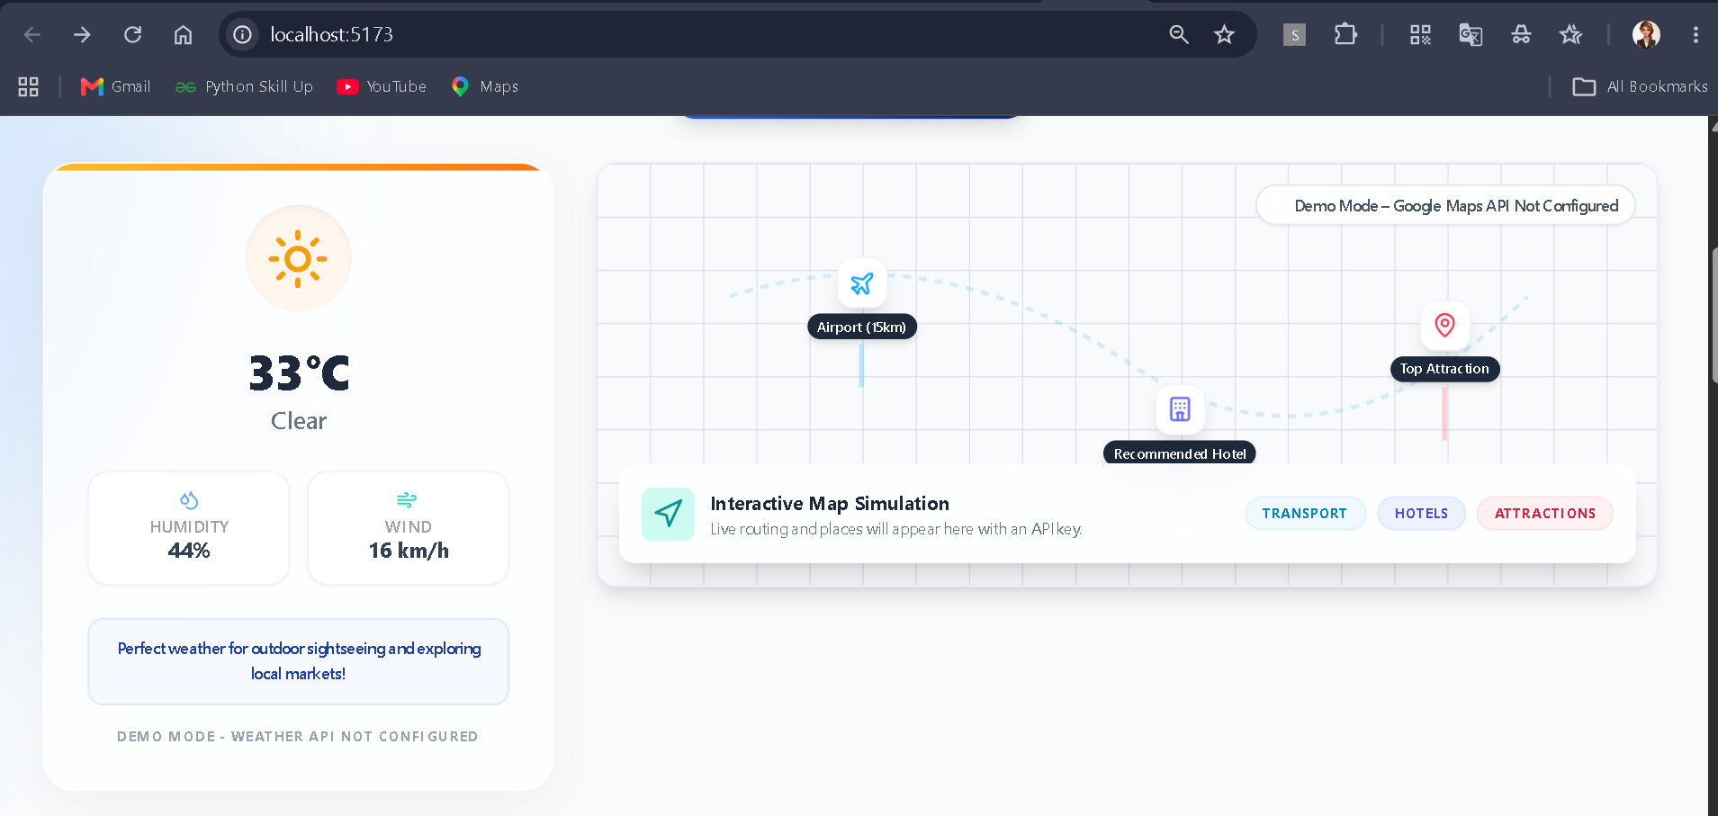
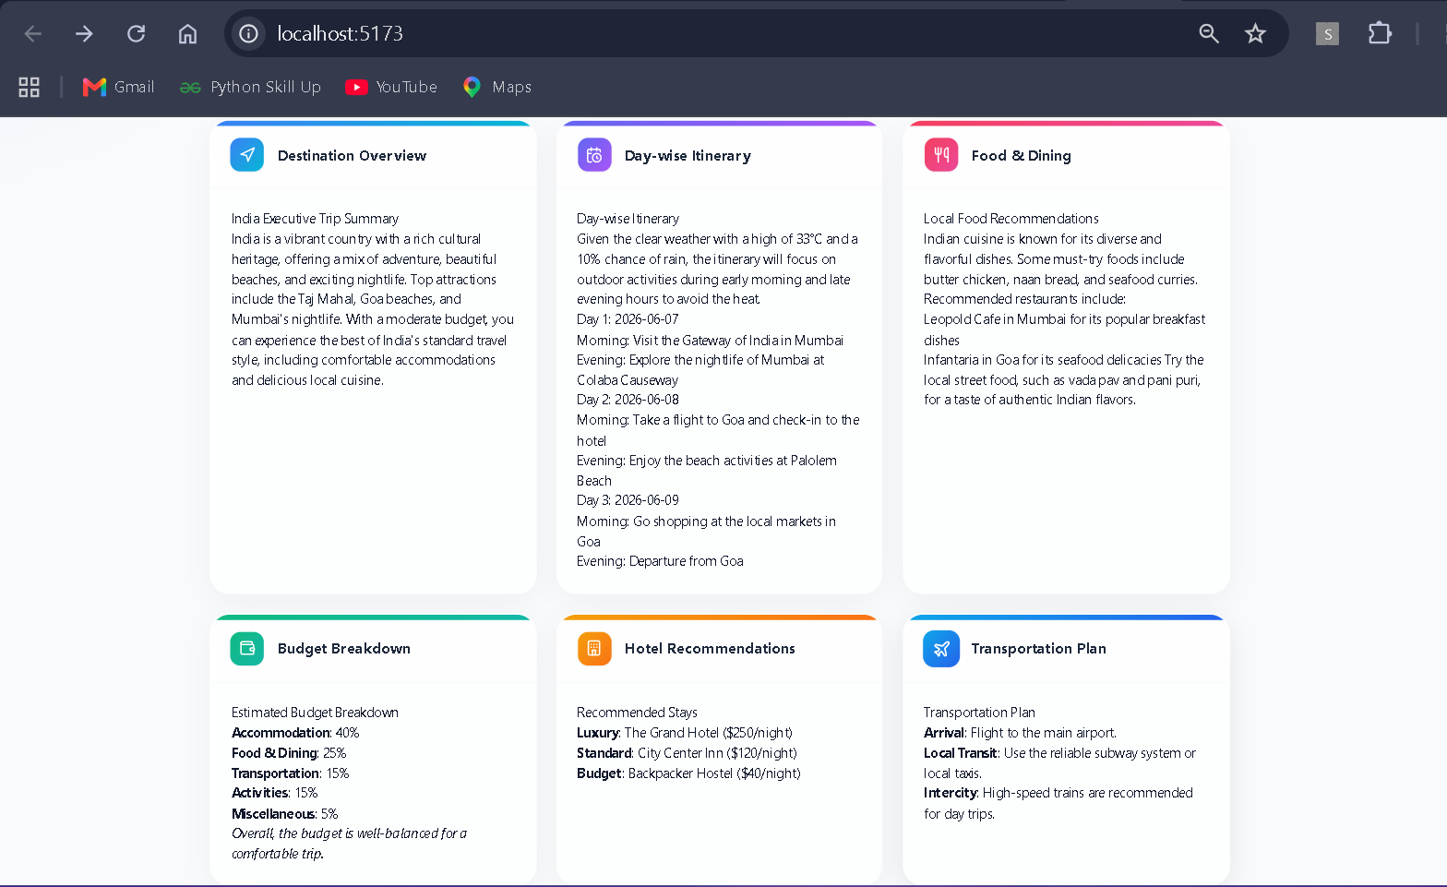

Slide 15
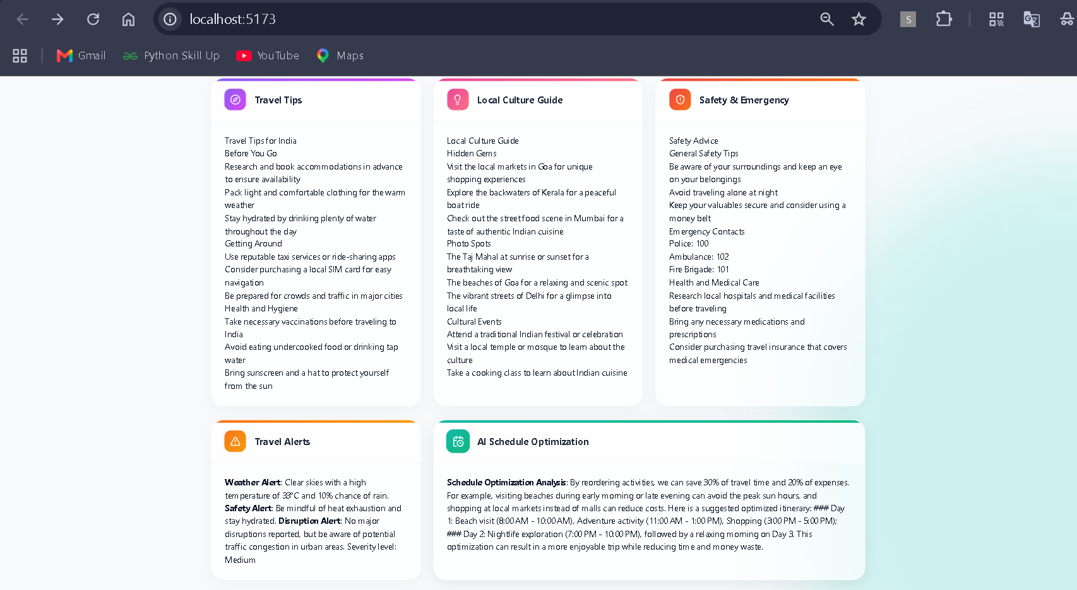

Slide 16
Git Hub Link
Source code, project documentation, and implementation details are available in the repository.
https://github.com/VaishnaviRaut2004/AI-Travel-Planner-Agent

Slide 17
Future Scope
Real-Time Booking Integration – Direct integration with airline, train, bus, and hotel booking platforms for instant reservations
Live Travel Updates – Real-time weather forecasts, flight delays, traffic conditions, and travel advisories.
Voice-Based Travel Assistant – Allow users to plan and manage trips using voice commands and conversational AI.
Multi-Language Support – Generate travel plans and recommendations in multiple languages for global users.
Smart Route Optimization – AI-powered route planning based on traffic, weather, and traveler preferences.
Personalized Learning System – Learn from user behavior and past trips to provide increasingly accurate recommendations. Collaborative Trip Planning – Enable families, friends, and groups to plan and manage trips together.
AR/VR Travel Preview – Virtual destination exploration before booking a trip.
Expense Tracking & Budget Management – Real-time monitoring of travel expenses and spending analysis.
Mobile Application Deployment – Extend the platform to Android and iOS for seamless travel assistance on the go.
·
·

Slide 18


