Slide 1



Personal Loan Modelling
Elevating Business with Strategic Excellence
Presented by:
Chindam Sumeeth

Slide 2


PROJECT OBJECTIVE
Understand customer behaviour towards personal loan acceptance. Analyse financial, demographic, and banking-related factors. Prepare clean and meaningful data for analysis and modelling. Identify key feature that influence loan acceptance.

Slide 3

DATASET OVERVIEW
Total Records: 5000customers
Total Features: 14columns Contains:
Customer demographics (Age, Experience, Education) Financial details (Income, CCAvg, Mortgage) Banking details (CD Account, Securities Account, Online, CreditCard) Target variable: Personal Loan (Yes/No)

Slide 4
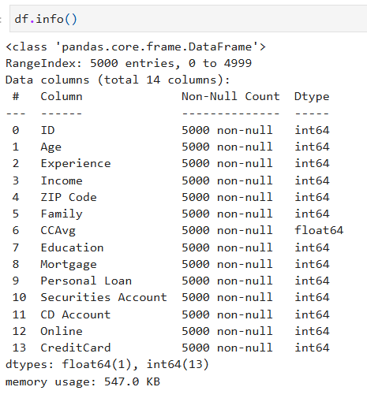
DATA UNDERSTANDING
Nomissing values.
Noduplicate records. Numerical + Categoricalfeaturesclearly defined. Income, CCAvg, Mortgage show right- skewed distribution. Understood basic patterns and behaviour of each variable.

Slide 5
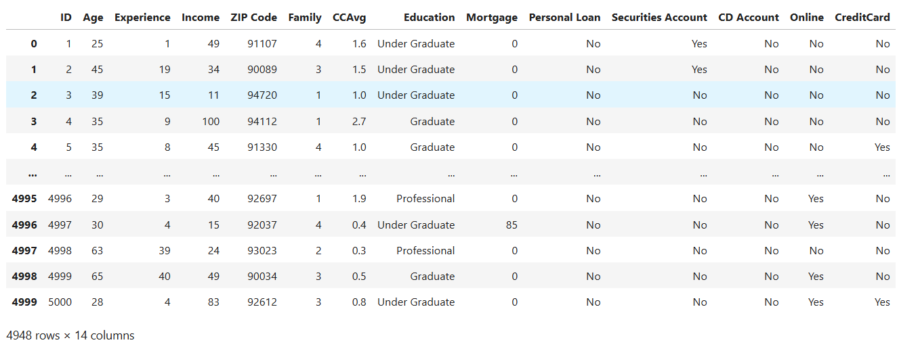
data cleaning
Converted binary columns(0/1) → Yes/No.
Converted Education: 1
Under Graduate,
→
2 → Graduate, 3 → Professional.
Removed negative experience values (–1, – 2, –3).
Kept realistic outliers based on Kaggle description.
Cleaned dataset size: 4948 valid rows.
Your paragraph text

Slide 6

OUTLIER & CORRELATION
UsedIQRandZ-Scoreforoutlier detection.
Strongcorrelationfound:Age ↔ Experience (0.99). Moderate correlation: Income ↔ CCAvg (0.65).

Slide 7
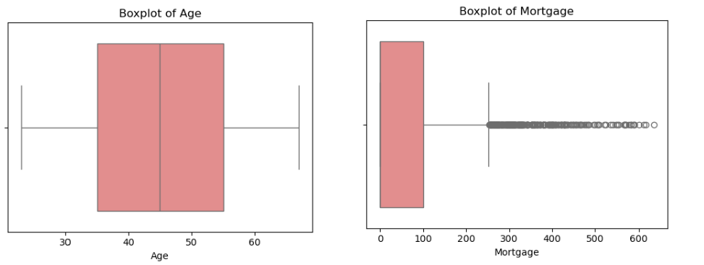
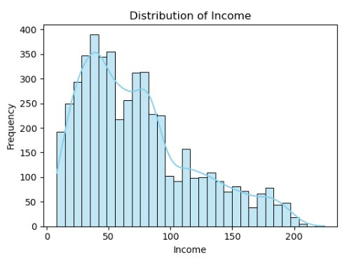
UNIVARIATE ANALYSIS
Income: Right-skewed; most customers
fallinthe medium-income group.
CCAvg: Majority spend less than 2 units monthly on credit cards
. Mortgage: Many customers have 0 mortgage; a few have very high values. Age: Mostly between 35–55 years. Experience: Ranges from 0–43 years after cleaning negative values. Education: Under Graduates form the largest group.

Slide 8

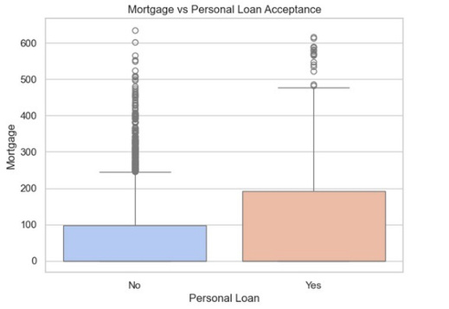
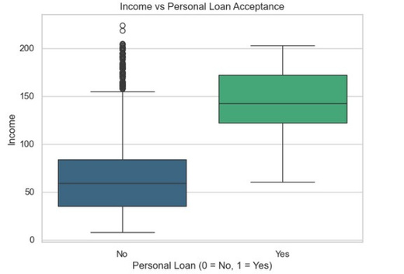
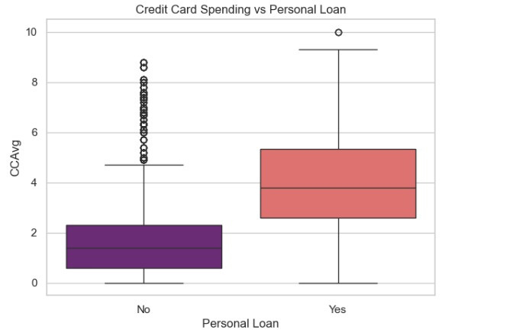
BIVARIATE ANALYSIS NUMERICAL FEATURES
LoanAcceptors usually have:
Higher Income Higher Credit Card Spending (CCAvg) Higher Mortgage amounts Conclusion: Financially active customers accept more loans.

Slide 9
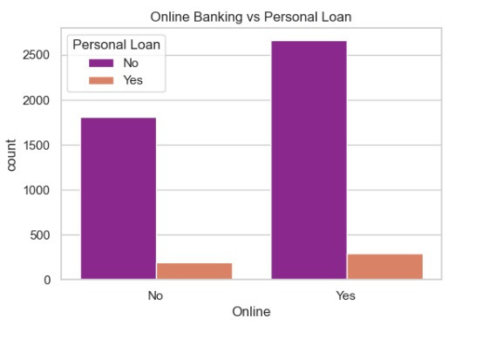
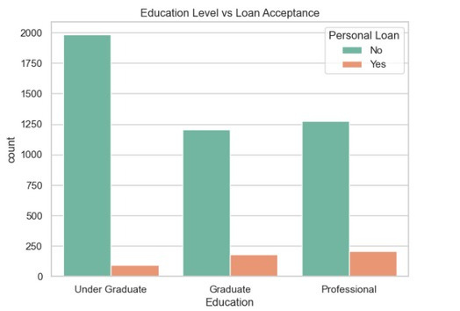
BIVARIATE ANALYSIS – CATEGORICAL FEATURES
Professionals accept more loans than
undergraduates. Customers with CD Accounts show higher acceptance. Credit Card users accept loans more often. Online banking users have slightly higher acceptance.

Slide 10
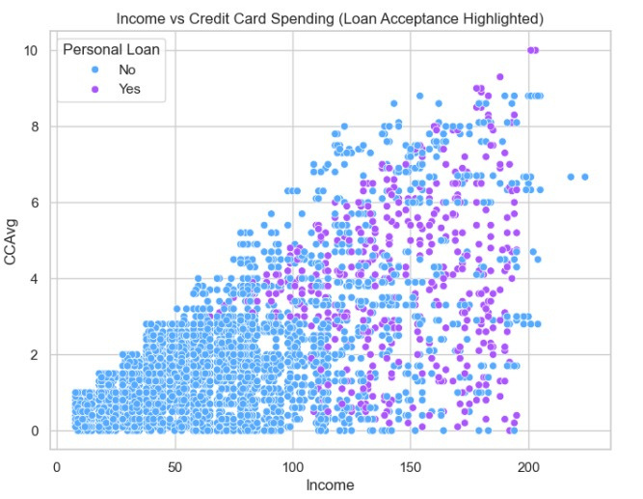
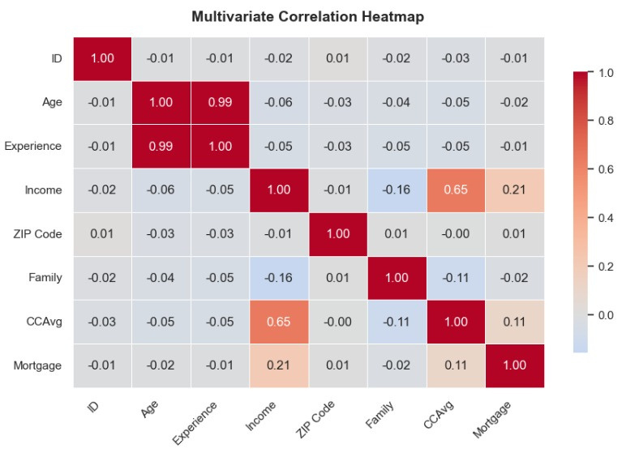
MULTIVARIATE INSIGHTS
IncomeandCCAvghaveapositive trend.
Loanacceptanceheavilyclusters in high-income,high- spendingcustomers. Correlation heatmap confirms key influencing variables.

Slide 11


KEY FINDINGS
Income, CCAvg, Mortgage are having high chances to accept the presonal laon.
Education level plays an important role.
CD Account & CreditCard ownership has the chance of acceptance.
Online customers react more to offers.

Slide 12


FINAL CONCLUSION
Dataset successfully cleaned and analysed.
Identified strongfinancial andbehavioural indicators for loan acceptance. Target high-income and high-spending customers. Focus marketing on Professionals & Graduates. Provide attractive offers to customers with CD accounts and credit cards. Promote loan offers more through digital/online channels.

Slide 13

THANK YOU
For Your Attention
Linkedin:
sumeeth-chindam
Email:
chindamsumeeth12@gmail.com

