Slide 1


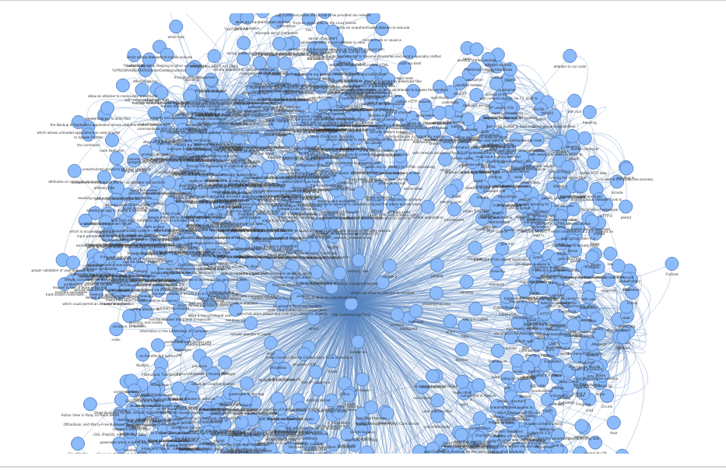



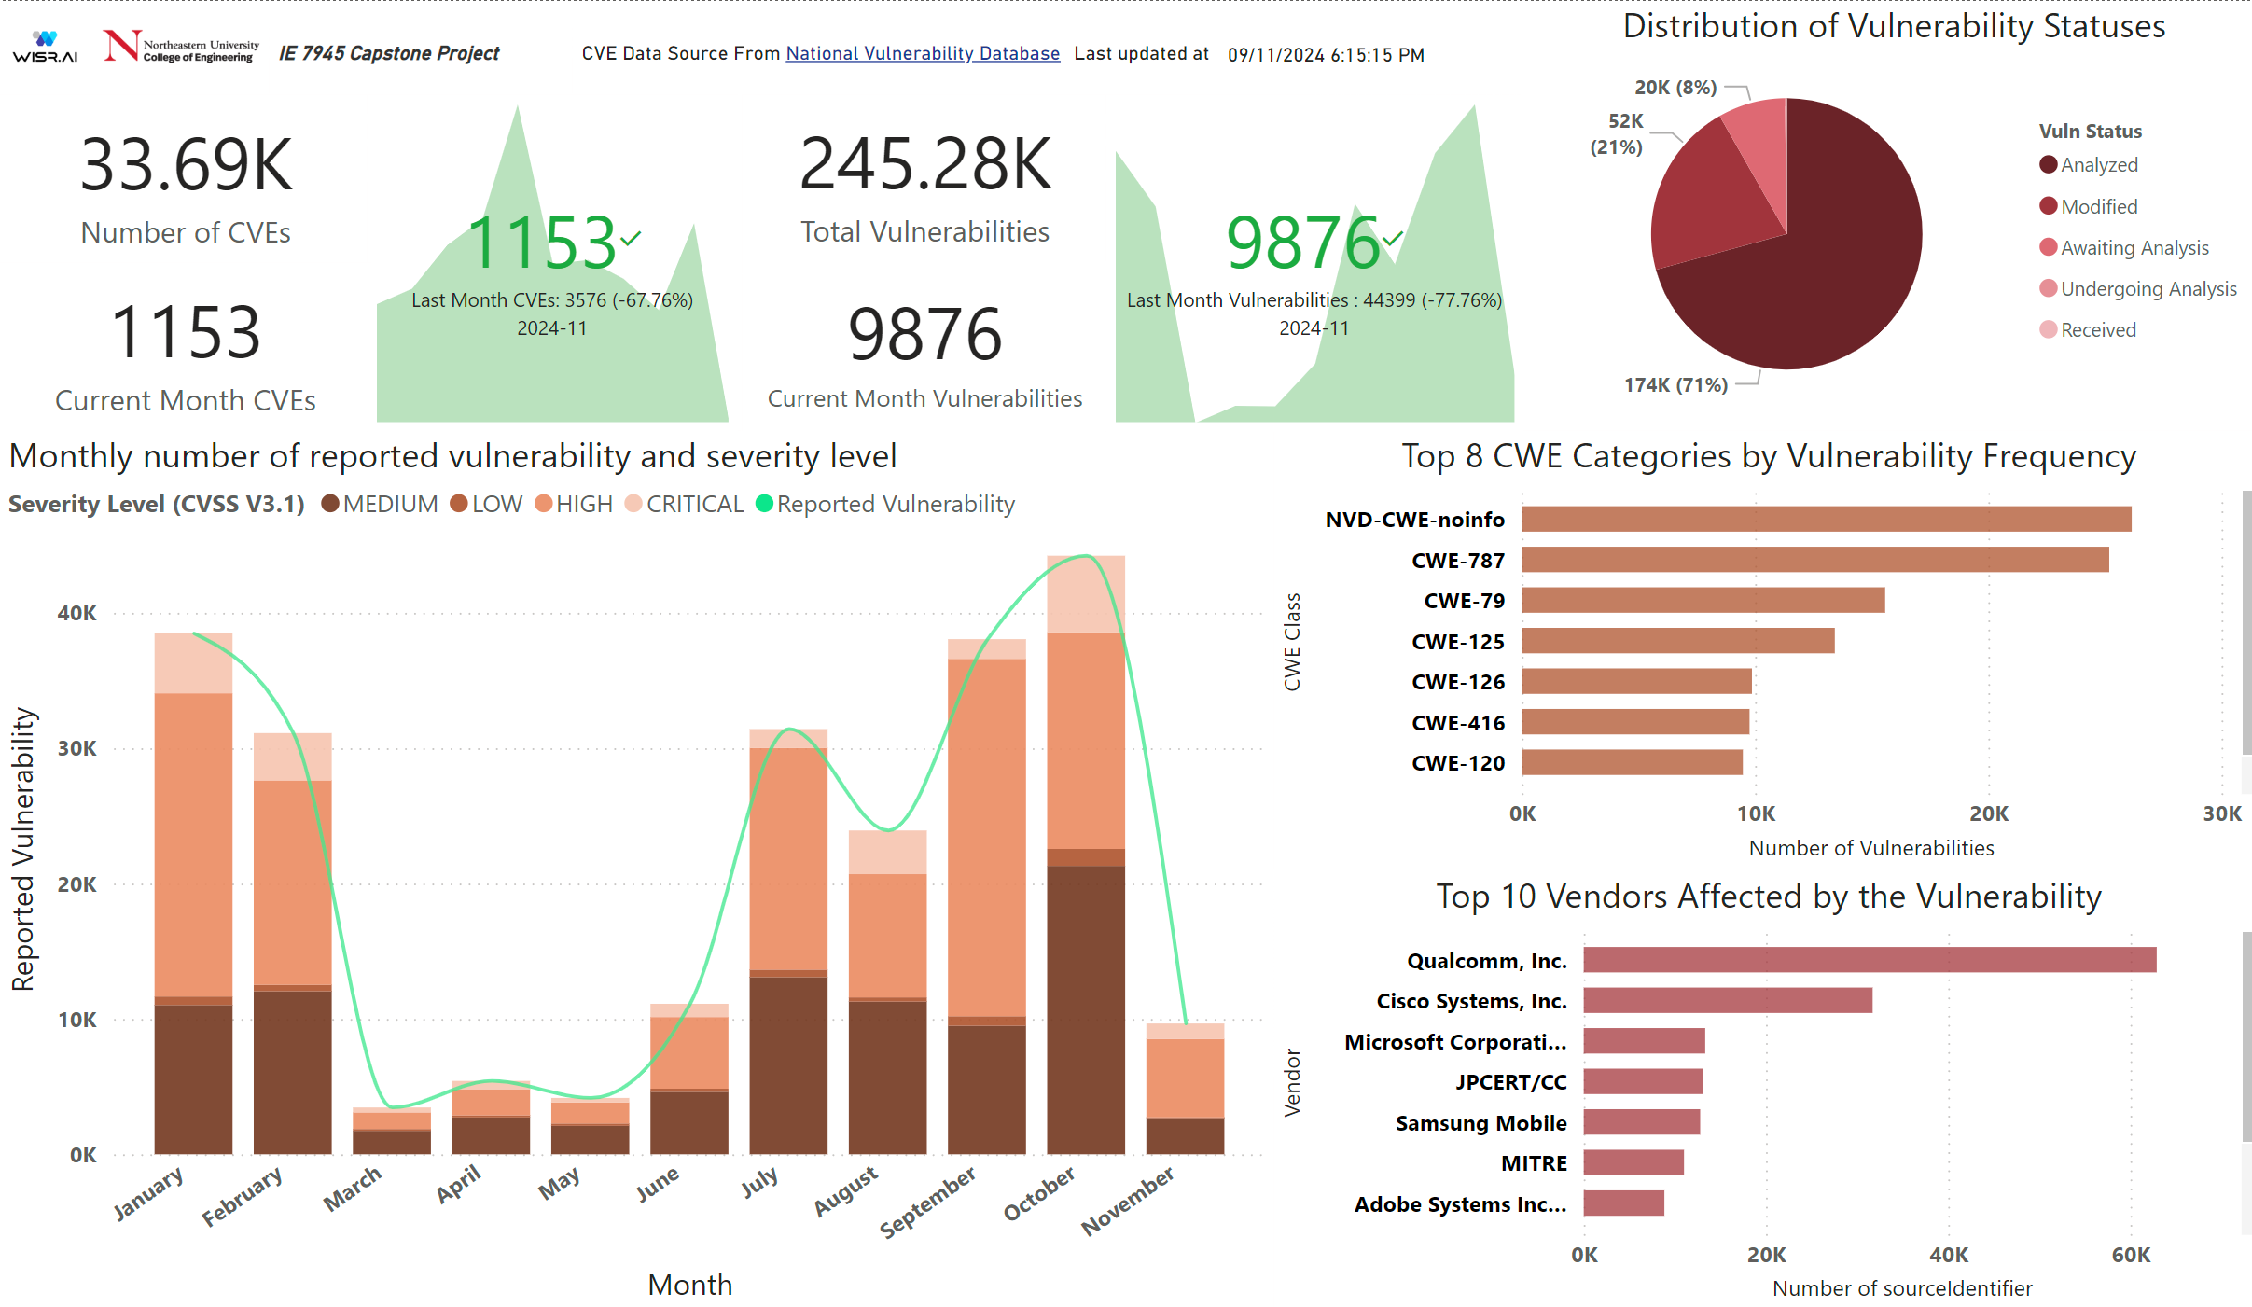
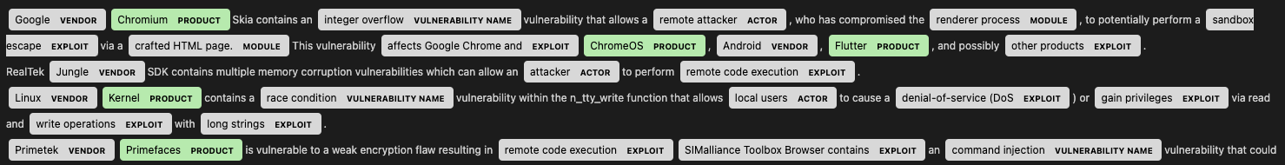
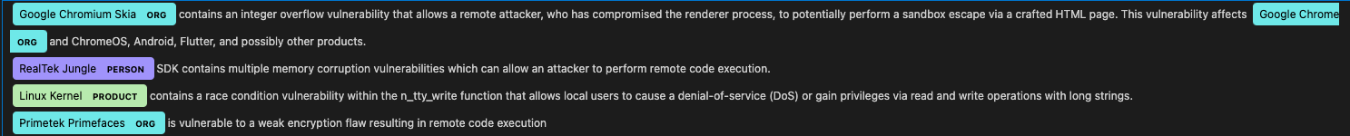
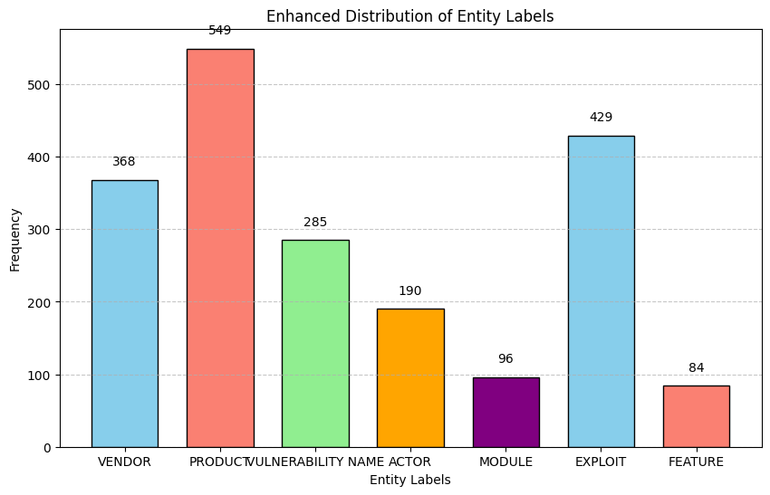
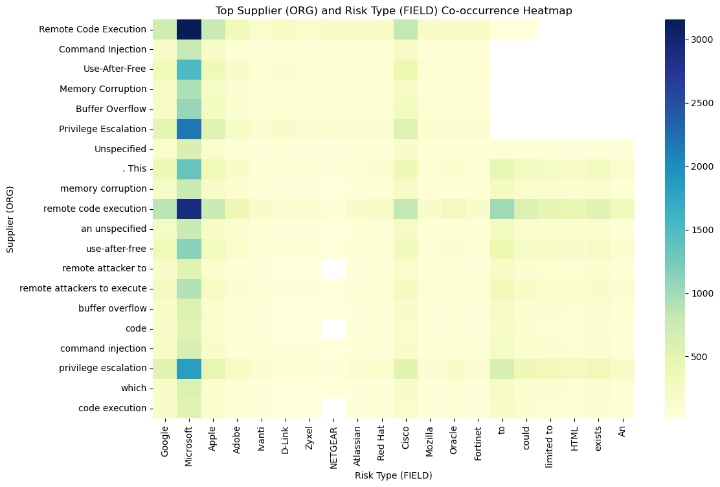

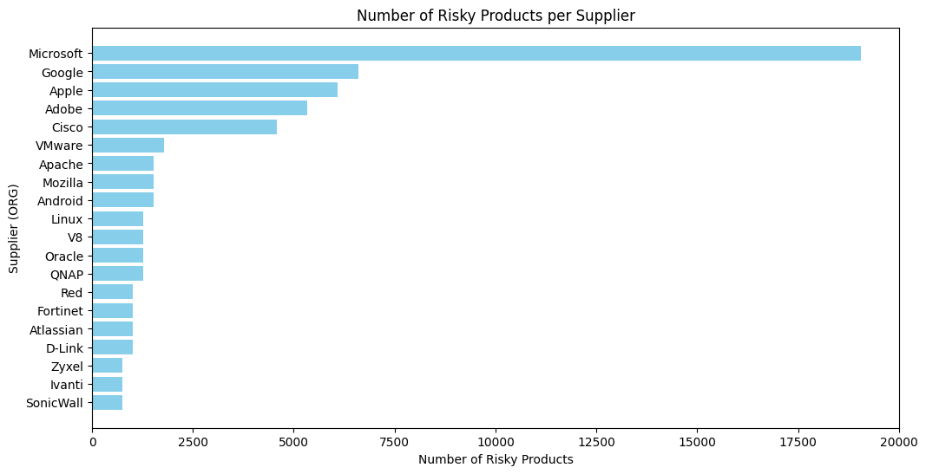



From Data Overload to Clear Insights: Tackling Vulnerabilities with AI
Vaishnavi Sadul, Dhaval Jariwala, Yihua Cai, Yuze Li
College of Engineering, Northeastern University, Vancouver
Introduction
Methodology
The Interactive Knowledge Graph revealed connections and clusters we couldn't see in spreadsheets
What if understanding cybersecurity data wasn’t a headache?
Our project uses AI to simplify complex data from the National Vulnerability Database (NVD) into clear, actionable insights.
Key features include:
Dashboards: Explore trends effortlessly.
Smart Tagging: Highlight critical details.
Visual Maps: Reveal connections between vulnerabilities.
With just a few clicks, anyone can make sense of overwhelming cybersecurity data.
Dataset: Utilized the Known Exploited Vulnerabilities (KEV) and Common Vulnerabilities and Exposures (CVE) lists from NVD.
KEV: Served as a training dataset for custom NER tags.
CVE: Used for exploratory data analysis and testing.
NER Annotation:
Annotated entities such as "vulnerability name" and "short description" using a custom SpaCy pipeline.
Compared pre-trained SpaCy models with fine-tuned models.
Exploratory Data Analysis:
Visualized key trends and patterns in the dataset using a Streamlit-based EDA Dashboard.
Model Development:
Evaluated the performance of NER models on precision, recall, and F1-score.
Enhanced model performance using iterative annotation and testing.
The Dashboard made complex data easy to explore with just a few clicks.
Conclusion
Proactive Approach: Helps organizations shift from reacting to risks to preventing them.
Simplifying Cybersecurity: Our project turns complex data into clear, actionable insights.
What’s Next?: Future updates like explainable AI and predictive analytics
The Impact: A step forward in cybersecurity landscape with confidence.
Why does it matter?
Imagine replacing hours of manual searching with just a click away on an interactive app!
The Custom Model outperformed the generic one, recognizing patterns more accurately in our dataset.
Results
Reveals hidden patterns and connections for deeper insights.
Saves valuable time by replacing hours of manual work with instant analysis.
Helps organizations shift from reactive responses to proactive risk management.
Heatmap of Supplier and Risk ​
type Co-occurrence:
Acknowledgments
We thank Wisr AI, especially CEO Rob Goehring, for their collaboration and support. Special thanks to Prof. Dr. Qurat Ul-Ain-Azim for their invaluable feedback, which greatly contributed to this work.
Bar Chart of Number of Risky Products per Supplier:
Useful Links
NER identifies critical entities from unstructured data, while the Knowledge Graph visualizes their relationships, uncovering risk pathways and enabling precise, proactive decision-making.
Click to view our interactive Dashboard!

