Slide 1
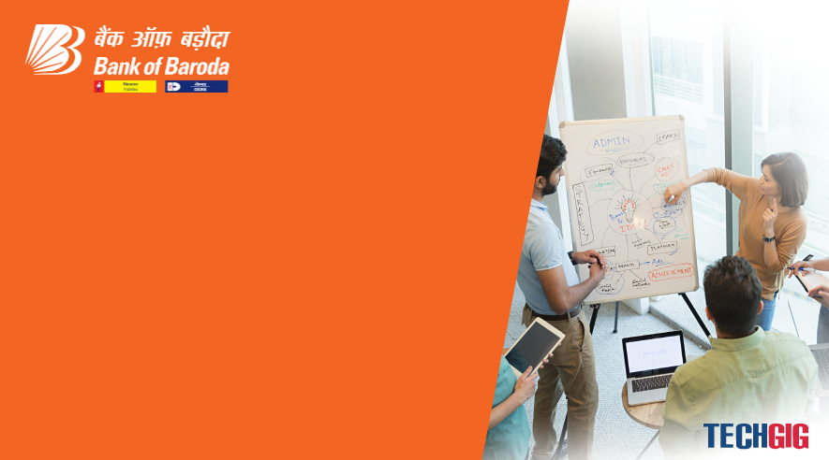
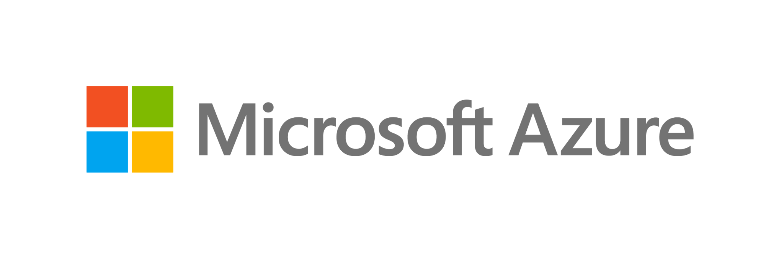
Bank of Baroda Hackathon - 2022
Technology Partner
Your Team Name : VS_07
Your team bio : We are bunch coding enthusiasts trying to solve some interesting issues
Date : 20/09/2022

Slide 2
Problem Statement?
In this new era of technology, virtual spaces and information, a pillared sector of society like banking is still falling behind and yet we see a few attempts to catchup in this information age.
One of such issue is of cheque processing, Bank cheques are still majorly used for financial transactions all over the world. A large number of cheques are processed manually on a daily basis, thereby requiring a lot of time, money and human effort.
In such a manual verification, information like date, signature, amount present on the cheque has to be physically verified which involves multiple levels of screening and vigilance to ensure regulatory guidelines.
For all these reasons, major parts of this process are manually done. Guidelines involve verifying account information, some technical details present in the cheques and signature verification too.
To ease such tedious process, we propose a system for Automatic data entry of date, Amount and Payee's name, bank etc. and also to verify signatures and detect any potential fraud due some fallacy in the system.

Slide 3
User Segment & Pain Points
Banks and ATMs would be early adopters of the product.
Automated Cheque Processing benefits consumers by:
1. Making funds available faster
2. Allowing quicker access to the digital image of their processed cheques
3. Detecting potential fraud sooner.

Slide 4
Pre-Requisite
MiddleStone: time reduced by 83%
SMARTCHEQUE:
Reduce processing cost like courier transportation for physical cheque to be procesed, and cheque handling.
Streamline bussiness process- minimise manual data entry and dependency on third-party, decrease risk of errors caused by human intervention.
3. Klippa services
4. Parascript solutions

Slide 5
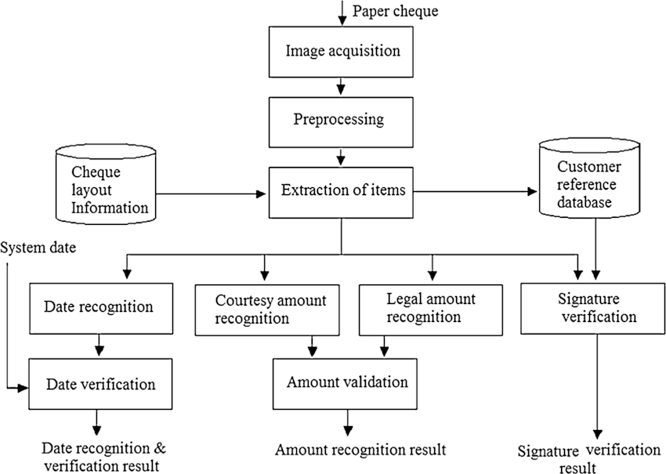
SOLUTION:
In this era of Information technology, where processes are supposed to speed up and deliver more efficient and true data to the end consumer of this model. We wish to propose our solution as a way to assist the banking sector in order help them in the tedious process of Cheque verification system which will allow Automatic data entry of important fields on Cheque and also to verify the fed data as well as signature

Slide 6
METHODOLOGY
1.Image Acquisition: This step deals with acquiring the image.
2.Preprocessing: Some pre-processing is applied on the image to reduce noise. This also includes authentication of document.
3.Handwritten text Recognition: After preprocessing handwriting recognition is used to find the amount written on cheque. It then recognizes legal and courtesy amount and also compares it.
4.Signature Recognition: This is the main step in the processing system. Signature verification is a technique used by banks, intelligence agencies and high-profile institutions to validate the identity of an individual. Signature verification is often used to compare signatures in bank offices and other branch capture. An image of a signature or a direct signature is fed into the signature verification software and compared to the signature image on file. This step is important in the processing of cheque.
5.Multilingual Support: Azure’s Custom Translator will be used for translating the cheque if it is written in any other language except for English.

Slide 7
APPROACH FOR SIGNATURE VERFICATION
Segmentation of image into meaningful images
Signature verification
Indication of verified signature
Input
(Image)
File saved/ can be displayed
OCR (Optical Character Recognition System)

Slide 8
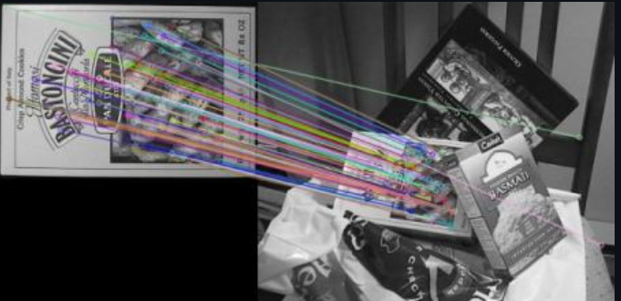
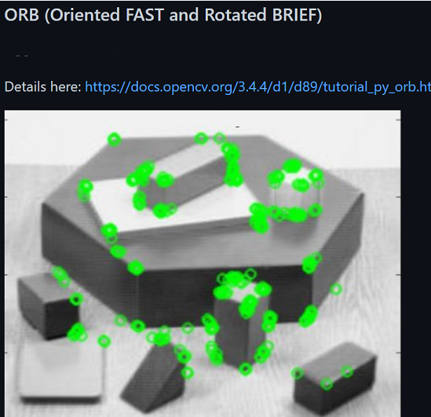
Signature Verification
Brute-Force matcher is simple. It takes the descriptor of one feature in first set and is matched with all other features in second set using some distance calculation. And the closest one is returned.
Brute-Force Matching with ORB Descriptors
Brute-Force Matching with SIFT Descriptors

Slide 9
Azure tools or resources for MULTILINGUAL SUPPORT
We will be using following resources of Azure for Multilingual support 1. Azure Cognitive Services Translator 2. Custom Translator 3. Translator Language Support We will be preferring Custom Translator.Custom Translator is a feature of the Microsoft Translator service, which enables Translator enterprises, app developers, and language service providers to build customized neural machine translation (NMT) systems. The customized translation systems seamlessly integrate into existing applications, workflows, and websites.

Slide 10
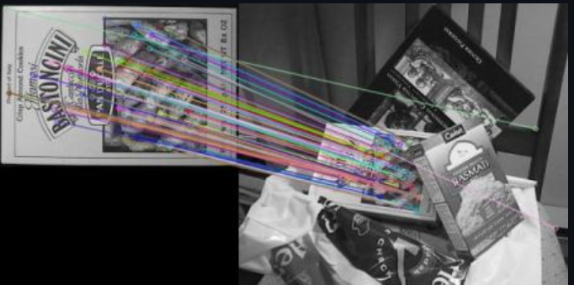
GitHub Repository Link & supporting diagrams, screenshots, if any
How far it can go?
The proposed solution can help banking sector and to save hours of tedious work for a single cheque verification and will also save us from manual labor, thus it inconspicuously will reduce the human efforts and also allow excellent language support and signature verification system to ease the laborious work of going through all the hassle of a single cheque verification and for the transaction to take place shorturl.at/bflv5
The query image to the left is matched with the trained image in the right which will help us in signature detection as well as OCR(optical character recognition)
For OCR we have;
Tesseract
Ocular

Slide 11
Our Team
Vaishnavi Shastri
Deepanshu Sharma
Sarveshwar Kohale

Slide 12
Thank You

