Slide 1



KONGU ENGINEERING COLLEGE
PERUNDURAI ERODE-638060
COMPUTER SCIENCE AND ENGINEERING
AI-BASED AUTOMATIC
ANSWER EVALUATION USING SEMANTIC SIMILARITY
MENTOR: S.KARTHIKA
PRESENTED BY:
VAISHNAVI S 23CSR231
SREYA R 23CSR212
SRI AKASH I M 23CSR213

Slide 2


PROBLEM STATEMENT
PROBLEM STATEMENT
Manual evaluation of descriptive answers is:
Time-consuming
Subjective and inconsistent
Difficult for large numbers of students
Prone to human errors
Existing automated systems mostly depend on keyword matching, which cannot understand the actual meaning of student answers.
Hence, there is a need for an intelligent system that evaluates answers based on semantic understanding rather than exact word matching.
Scholarship information is scattered, causing wasted time and missed opportunities.
Manual applications require re-entering the same details repeatedly.
Lack of automated alerts leads to missed deadlines and untracked applications.
The process is inefficient and lacks transparency, creating barriers for students.

Slide 3
OBJECTIVES
Develop an AI-based descriptive answer evaluation system.
Understand the semantic meaning of student answers.
Compare student answers with model answers using NLP.
Calculate similarity scores automatically.
Assign marks fairly and consistently.
Generate meaningful feedback.
Reduce teachers' evaluation time.

Slide 4
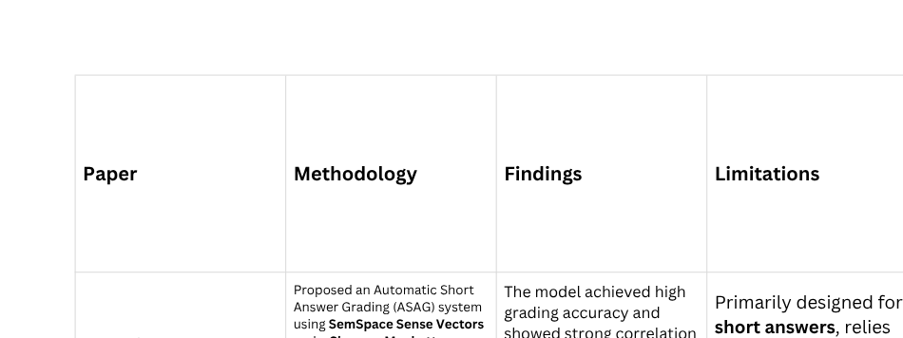
LITERATURE SURVEY

Slide 5
RESEARCH GAP IDENTIFIED
Most existing systems are designed primarily for short answer grading and are not suitable for evaluating long descriptive answers.
Existing approaches mainly focus on semantic similarity or answer retrieval, but do not provide a complete solution that includes automatic mark allocation and feedback generation.
Many deep learning and LLM-based models require high computational resources, making them difficult to deploy in educational institutions with limited infrastructure.
Personalized and constructive feedback for students is often limited or absent.
Therefore, there is a need for an efficient AI-based system that can evaluate descriptive answers using semantic similarity, automatically assign marks, and generate meaningful feedback in a scalable and user-friendly manner.

Slide 6
PROPOSED SOLUTION
Proposed Work
Develop an AI-powered automatic descriptive answer evaluation system using:
Natural Language Processing (NLP)
Sentence Embeddings
Semantic Similarity
Automatic Mark Allocation
Feedback Generation

Slide 7
PLANNED INNOVATION
✔Semantic understanding instead of keyword matching
✔ AI-generated personalized feedback
✔ Automatic mark calculation
✔ Supports multiple writing styles
✔ Faster evaluation
✔ Scalable for educational institutions

Slide 8
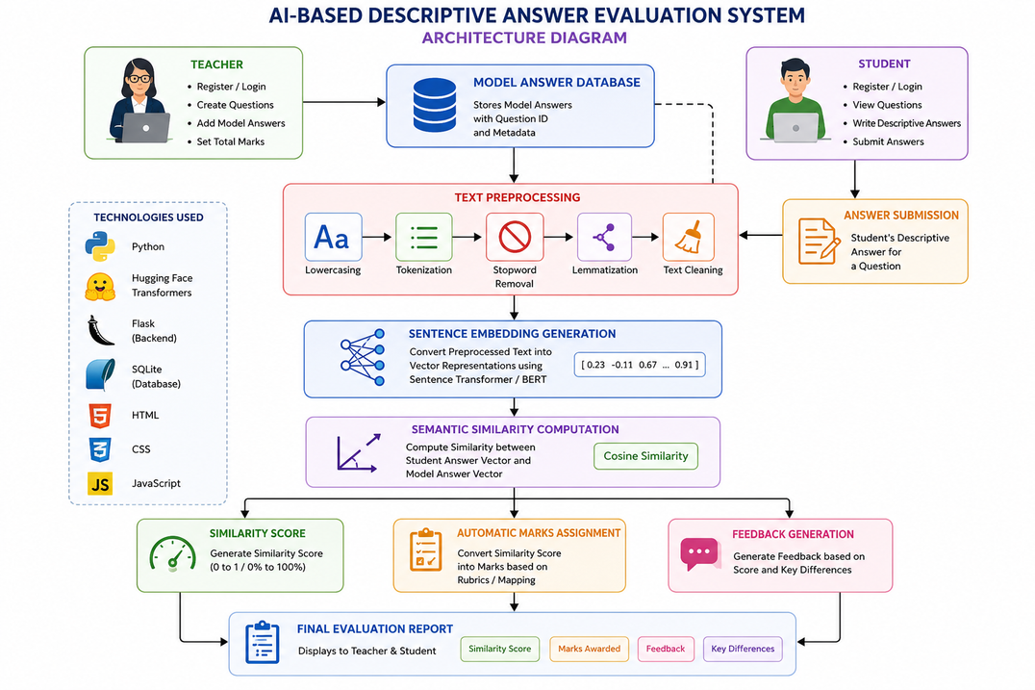
ARCHITECTURE DIAGRAM

Slide 9
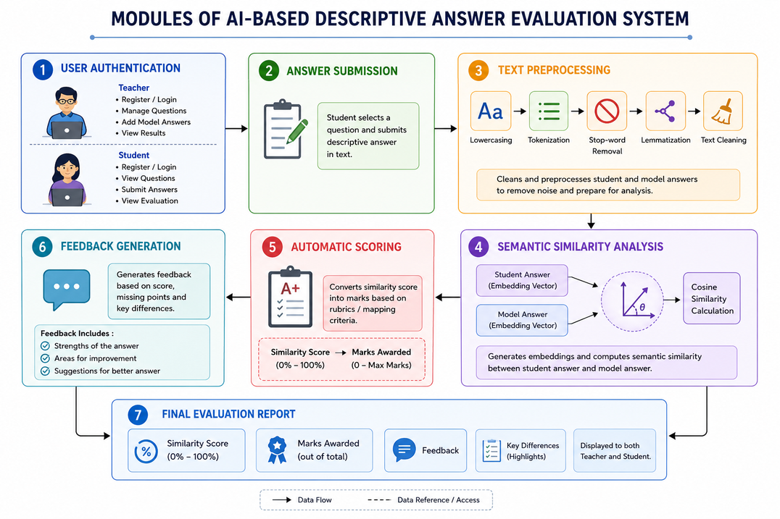
MODULES OF A PROJECT

Slide 10
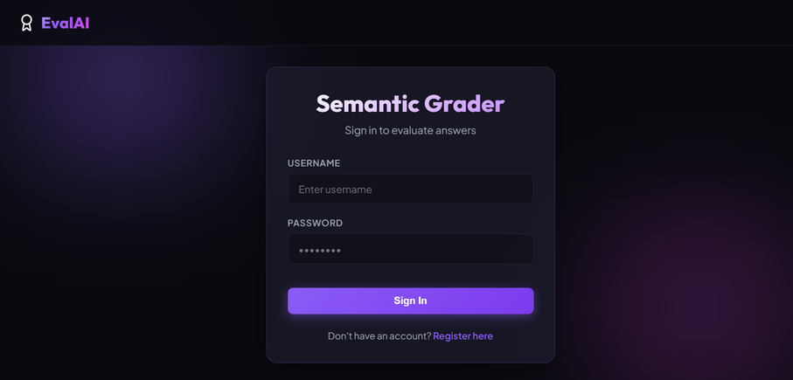
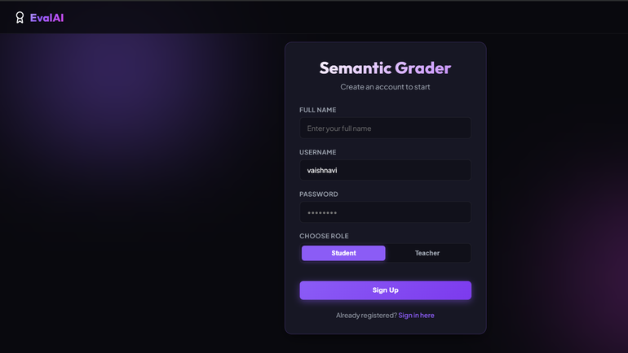
IMPLEMENTATION

Slide 11
