Slide 1


Foundation for Innovation and Technology Transfer
CAPSTONE PROJECT
COURSE : AI BUILDER
Title: Plant Disease Detection using Machine learning
Date: 28.02.2024
Presented by: Team
Members Name :
1. Vaishnavi Thakur
2. Pragya Shrivastava
3. Nimisha Tiwari
4. Disha Mathankar
Regn. ID:
Course: AI Builder
Course Code:
Mentor Name: Prof. Abhishek Gagneja

Slide 2
Contents Overview
1. Introduction
2. About team
3. Project Plan
4. Objectives
5. Methodology
6. Review of the Models Used
7. Experimental Results
8. Conclusion
9. References

Slide 3

Introduction
Role of plants :
Plays a vital role in daily life by providing essential sustenance, contributing to economic stability, and supporting ecosystems through oxygen production and carbon sequestration.
Reason for Plant Disease :
Plant diseases can be caused by pathogens like fungi, bacteria, and viruses or be made more susceptible to disease by extreme temperatures or humidity levels.
Critical Need for Plant Disease Detection :
To safeguard crop health, ensure food security, and preserve agricultural economies, and address global challenges related to hunger, economic stability, and sustainability.
Challenges for Plant Disease Detection :
Timely and accurate identification of plant diseases.
Taditional methods of disease identification relies heavily on human expertise, which can be time-consuming, subjective, and prone to errors.
Regions with limited access to expert knowledge or diagnostic facilities.
Model Objective :
Provide rapid and precise diagnoses based on visual symptoms, empowering farmers and agricultural stakeholders to effectively manage crop diseases and protect global food supplies.

Slide 4
Contribution by team members
S. No. | Member | Task | Contribution
1. | Vaishnavi Thakur | Research | Came up with Medical Diagnosis Project idea.
 |  | Relevant resources | Worked on finding a suitable article for understanding the project and relevant you-tube resource to get started with the project.
 |  | Data collection & Preprocessing | Collectively worked on dataset classified into 3 classes. And after worked on Dataset classified into 38 classes.
 |  | Model Training & Evaluation | Tried for VGG19 classifier and other classifiers.
 |  | Novel architecture development | Worked upon graphical representation of model using confusion matrix , graphs and classification report .
 |  | Documentation | Worked for final report and assisted in the content for 6 slides and finalizing the report and presentation.
Table 2.1. About Team

Slide 5
Contribution by team members
S. No. | Member | Task | Contribution
2. | Pragya Shrivastava | Research / Ideation | Came up with Plant Detection Classification Project idea.
 |  | Relevant resources | Worked on finding a suitable dataset for collection for the project which could fit in our model designing.
 |  | Data collection & Preprocessing | Collectively worked on dataset classified into 3 classes.
 |  | Model Training & Evaluation | Tried for VGG19 classifier and other classifiers.
 |  | Novel architecture development | Worked upon graphical representation of model using confusion matrix , graphs and classification report .
 |  | Documentation | Worked for final report and assisted in the content for 6 slides.
Table 2.2. About Team

Slide 6
Contribution by team members
S. No. | Member | Task | Contribution
3. | Nimisha Tiwari | Research and Ideation | Proposed Movie recommendation project after engaging in numerous searches .
 |  | Relevant resources | Gone through various Articles and analysed problem statements for decided topic.
 |  | Data collection & Preprocessing | Collectively worked on dataset classified into 3 classes.
 |  | Model Training & Evaluation | Tried for VGG19 classifier and other classifiers.
 |  | Novel architecture development | Worked upon graphical representation of model using confusion matrix , graphs and classification report .
 |  | Documentation | Initially created draft report further divided our presentation with 6 slides respectively.
Table 2.3. About Team

Slide 7
Contribution by team members
S. No. | Member | Task | Contribution
4. | Disha Mathankar | Research / Ideation | Came up with Book Recommendation Project idea.
 |  | Relevant resources | Explored Github Repositories and looked for best outcomes and details for the selected project idea.
 |  | Data collection & Preprocessing | Collectively worked on dataset classified into 3 classes.
 |  | Model Training & Evaluation | Tried for VGG19 classifier and other classifiers.
 |  | Novel architecture development | Worked upon graphical representation of model using confusion matrix , graphs and classification report .
 |  | Documentation | Initially created draft report further divided our presentation with 6 slides respectively.
Table 2.4. About Team

Slide 8
Outcome Achived as a team
S. No. | Task | Outcome
1. | Research / Ideation | Decided to build a Model on Plant Disease Detection
2.
 | Relevant resources | Explored, you tube resources, articles, kaggle and Github Repositories and looked for best outcomes and details for the selected project idea.
3.
 | Data collection & Preprocessing | Worked on dataset comprising of 3 classes splitted into Train., Test and Validation sets.
4.
 | Model Training & Evaluation | Tried for various classifiers and found CNN VGG19 Model to be the most appropriate one giving highest accuracy .
5.
 | Novel architecture development | Worked upon graphical representation of model using confusion matrix , graphs and classification report .
6.
 | Documentation | Created the Final Report and Presentation.
Table 2.5. About Team

Slide 9
Project Plan

Slide 10
Project Schedule
S. No | Phase | Tasks | Started On | Duration (Days)
1. | Literature Survey | Identify revelavnt research | 9th Feb 2024 | 2
 |  | Read and analyze the papers
 |  | Summary of literature survey
2. | Data collecction & Preprocessing | Data collection | 11th Feb 2024 | 1
 |  | Data labelling, cleaning, augmentation | 12th Feb 2024 | 1
3. | Model Training | VGG19(Pre -trained) | 13th Feb 2024 | 1
 |  | Seqential | 15th Feb 2024 | 2
 |  | Logestic Regression | 17th Feb 2024 | 1
 |  | LinearDiscriminantAnalysis
 |  | KNeighborsClassifier
 |  | DecisionTreeClassifier
 |  | RandomForestClassifier
 |  | GaussianNB
 |  | SVC
 |  | XGBClassifier
Table 3.1. Project Schedule

Slide 11
Project Schedule (Contd.)
Table 3.2. Project Schedule
S. No | Phase | Tasks | Started On | Duration (Days)
3. | Model Evaluation | Analysis of Results | 18th Feb 2024 | 2
4. | Novel architecture development | Design and implement the novel architecture | 20th Feb 2024 | 1
 |  | Hyperparameter tuning
5. | Documentation | Draft report preparation | 21st Feb 2024 | 1
 |  | Final report preparation | 22nd Feb 2024 | 1
 |  | Presentation preparation | 23th Feb 2024 | 3
- | - | Total Duration | - | 16

Slide 12
Objectives
Early vision :
Developing a deep learning architecture to classify leaf images foremost into healthy or unhealthy and proceeding with categorizing unhealthy ones into the following –
o Rusty
o Powdery
Comparing the model's performance based on the Accuracies, Robustness to variations, Efficiency and Generalizability calculated on implementing various machine learning algorithms.
Review the results for various hyperparameters.
Aim for societal advancement :
Plant disease identification is a laborious task and at the same time less accurate and geographically limited. Our project will take less effort, less time and give more accurate results. This model will help the farmers/gardner’s detect the plant diseases so that they can be cured on time and can assure better plant growth.

Slide 13
Methodology

Slide 14
Data Collection
This project utilized a publically accessible dataset available on Kaggle .
Data Set Details
• Small image dataset with (value) leaf scanned image.
• Images were in JPEG format.
• Class Distribution
Healthy
Powdery
Rusty

Slide 15
Data Preprocessing and Augmentation
Image Preprocessing
• All images are resized into 256*256 dimensions.
Dataset Formation
• We directly used the processed Dataset.
Data Normalisation
• NumPy array shape (32,256,256,3) for images for class labels.
• Used flatten () method to return a 1-Dimensional Array from an multi dimensional array of images.
External Validation Dat
• Used Dataset comprised of 60 images belonging to the 3 classes for Validation.

Slide 16
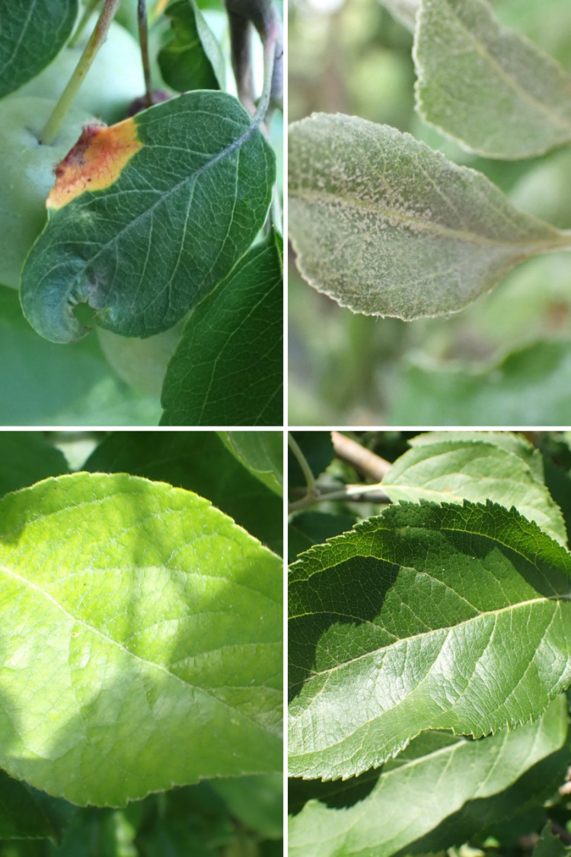
Sample Images

Slide 17
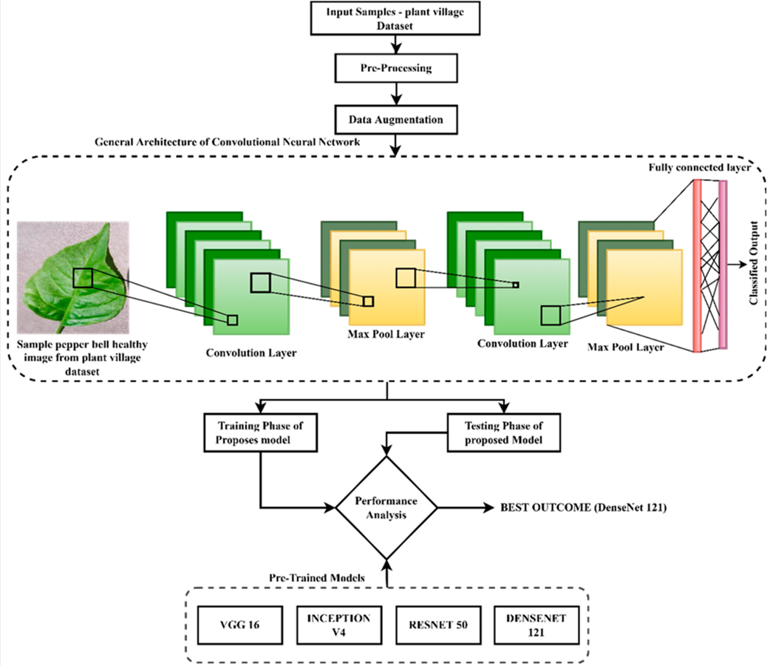
Model Training

Slide 18
Model Training
Model Architecture:
Sequential model with Conv2D and MaxPooling2D layers.
Three Conv2D layers with increasing filter sizes.
Flatten layer followed by two Dense layers and a softmax output layer.
Model Compilation : Adam optimizer, categorical crossentropy loss, accuracy metric.
Callbacks:
EarlyStopping: Monitors validation accuracy for early termination.
ModelCheckpoint: Saves the best model based on validation accuracy.
Training:
Fit using fir_generator with validation data, models trained with a batch size of 32.
Utilizes 16 steps per epoch for 4 / 10 epochs.
Multiple models trained on the preprocessed dataset using 5-fold stratified cross-validation.
Results:
Training and validation metrics stored in history_seq.
Best model saved as 'best_model_seq.h5'.

Slide 19
Model Evaluation
Hyperparameter Specifications :
Hyperparameters | Value
Epochs | 10
Activation | ReLu
Regularization | Batch Normalization
Optimizer | Adam
Output classes | Dataset (1)- 3 classes / Dataset (2) - 38 classes
Model Performance Evaluation
Accuracy
Precision
Recall
F1-Score
Metrics evaluated during testing process.

Slide 20
Review of the Models used

Slide 21
1. VGG19 (Pre-trained)
VGG19 has already learned intricate visual features from vast image datasets, making it adept at recognizing various patterns.
Input Layer: Accepts input images (typically 256x256x3).
Convolutional Layers (Conv1_1 to Conv5_4): Extract features using 3x3 filters with stride 1 and same padding.
Max Pooling Layers (MaxPool): Downsample feature maps.
Fully Connected Layers (FC6, FC7, FC8): Perform classification/regression tasks.
Flatten Layers: Flatten feature maps into a vector.
ReLU Activation: Introduce non-linearity after each layer.
Model Parameters
Total parameters 20122691
Trainable parameters 98307

Slide 22
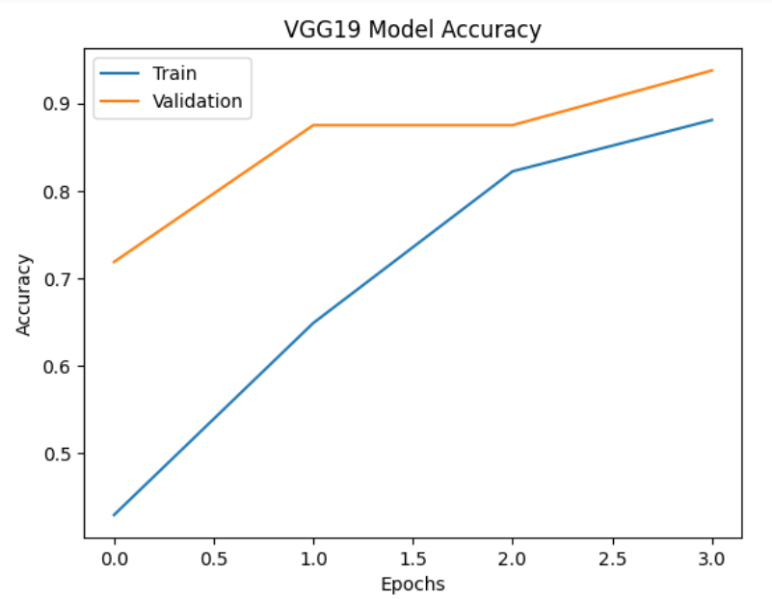
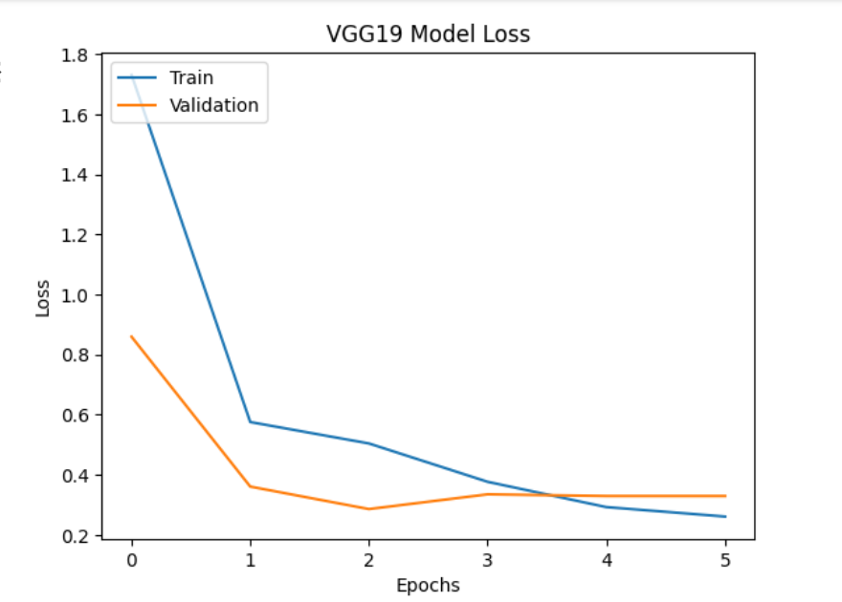
1. VGG19 (Pre-trained)(Contd.)
Glimpses of training

Slide 23
2. Sequential CNN
The sequential convolutional neural network (CNN) architecture consists of several layers:
Convolutional Layers: Four Conv2D layers with increasing filter sizes (32, 64, 128) and (3, 3) kernel size, applying ReLU activation.
Max Pooling Layers: Two MaxPooling2D layers with (2, 2) pool size.
Flatten Layer: Converts the 2D feature maps into a 1D feature vector.
Dense Layers:
Two Dense layers for classification.
The first Dense layer has 128 units with ReLU activation.
The second Dense layer has 3 units with softmax activation for multi-class classification.
Model Parameters
Total parameters 14843878
Trainable parameters 14843878
No pre-trained weights used

Slide 24
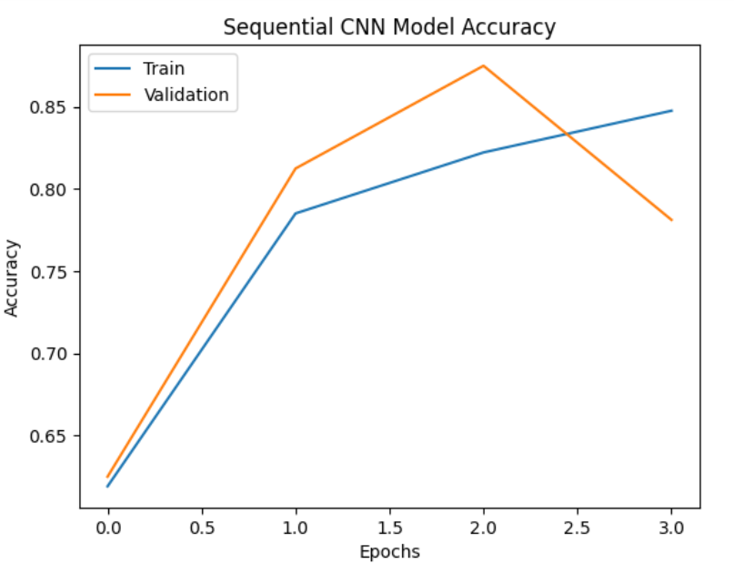
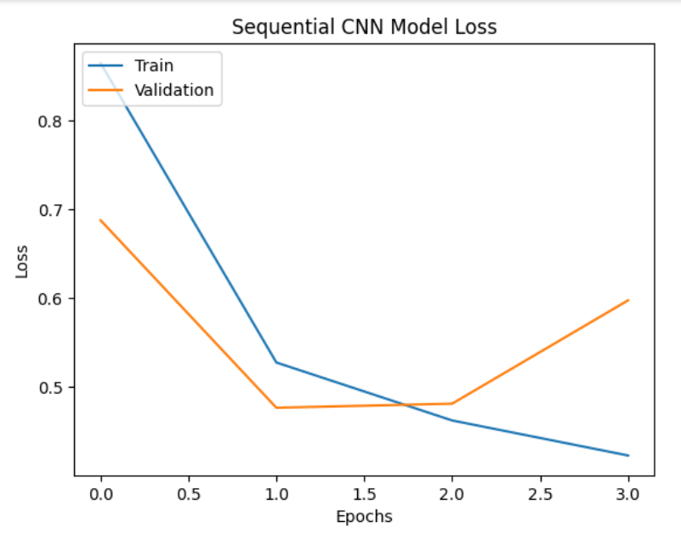
2. Sequential CNN (Contd.)
Glimpses of training

Slide 25
3. Other Classifiers
In other classifiers dictionary we have used Logistic Regression, Linear Discriminant Analysis (LDA), K-Nearest Neighbors (KNN), Decision Tree Classifier, Random Forest Classifier, GaussianNB, Support Vector Classifier (SVC) and XGBoost Classifier.
For each classifier in the dictionary classifiers
Cross-validation is performed using 5-fold cross-validation on the training data to evaluate the classifier's performance.
The average cross-validation score is calculated.
Each classifier is fitted to the entire training dataset.
Predictions are generated on the validation dataset using the trained classifier.
Confusion matrices are computed for each classifier's predictions compared to the true labels of the validation dataset.
Accuracy scores are calculated for each classifier's predictions.
Results, including classifier names and their corresponding accuracies, are stored for comparison.

Slide 26
3. Other Classifiers (contd.)
Based on the confusion matrices:
Linear Discriminant Analysis and Support Vector Machine show relatively balanced performance across classes.
Decision Tree and K Nearest Neighbors struggle with misclassification and class imbalance.
Logistic Regression, Random Forest, Gaussian Naive Bayes, and XGBoost demonstrate moderate performance but may require further tuning or handling of class imbalance for improved accuracy.

Slide 27
Experimental Results

Slide 28
Model Description
Table 7.1. Model Description
S. No. | Model | Transfer Learning | Optimiser | Number of Parameters | Number of trainable Paramerers
1. | VGG19 | Yes | Adam | 20122691 | 98307
2. | Sequential CNN | Yes | Adam | 14839363 | 14839363

Slide 29
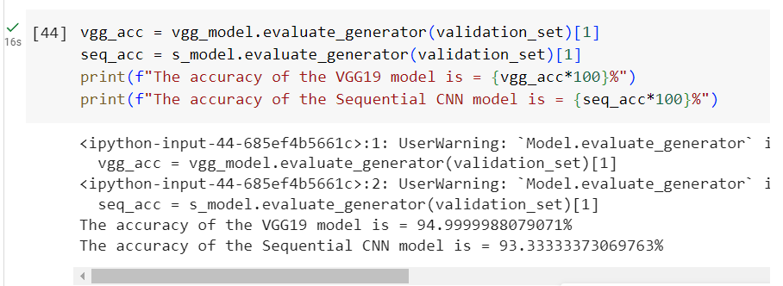
Classification Report
S. No.0 | Model | Average Accuracy | Average Precision | Average Recall | Average F1- Score
1. | VGG19 | 98.33 | 0.85 | 0.84 | 0.84
2. | Sequentail CNN | 88.33% | 0.91 | 0.89 | 0.89

Slide 30
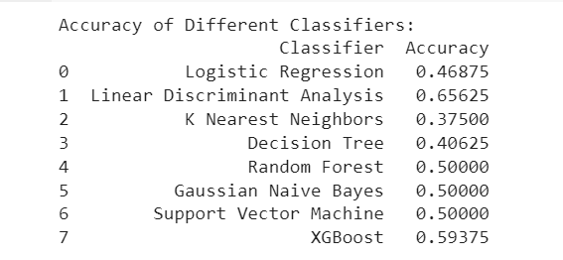
Other Classifiers

Slide 31
Conclusion
Compared and contrasted deep learning models for plant disease prediction and built novel architectures for improved accuracy
Literature survey laid the foundation for model selection with state-of-the-art techniques
1382 Leaf images split into training (1322) and external validation sets (60)
Utilized 5 and 10-fold cross-validation for rigorous training and evaluation.
Models demonstrated 3-class classification capabilities (Healthy, Powdery, Rusty)
A new architecture having 3 residual blocks, a DSC block, 2 fire modules, a convolution layer with max-pooling, and dense layer (VGG19) was found most efficient.
Accurate plant disease prediction improves plant outcomes and healthcare efficiency.
Early detection and precise classification lead to timely interventions and better treatment planning
Lasting positive impact on healthcare practices and inspiration for future deep learning research.

Slide 32
References
Articles :
https://www.mdpi.com/2073-4395/12/10/2395#:~:text=A%20CNN%2Dbased%20deep%20learning,classification%2C%20a%20CNN%20was%20used.
https://github.com/ardendertat/Applied-Deep-Learning-with-Keras/tree/master
https://www.frontiersin.org/journals/plant-science/articles/10.3389/fpls.2016.01419/full
Data set 1 : https://www.kaggle.com/datasets/rashikrahmanpritom/plant-disease-recognition-dataset
Data set 2 : https://www.kaggle.com/datasets/vipoooool/new-plant-diseases-dataset/data
Youtube Resource :
https://youtu.be/amt9ZmGofJk?si=v4kQIy_pVjYCha4g
https://youtu.be/148eu_foNo8?si=Ebb2LgFcAoyCx0vf
https://youtu.be/zrHmtH8u3UM?si=PDDZV7__u9L8DCrr

