Slide 1
Presidency School of Artificial Intelligence and Advanced Computing
PIP7500 Dissertation/Internship-I
ZEROTH REVIEW
TITLE:
PRESENTED BY,
STUDENT NAME
ROLL NO
DEPARTMENT
GUIDED BY,
SUPERVISOR NAME
DESIGNATION

Slide 2
Overview
Title Slide
Abstract
Problem Statement
Proposed Method
Hardware & Software Details
References

Slide 3
Abstract
The proposed project presents an AI-Based Intelligent Question Paper Generation System that automatically creates customized and multiple unique question-paper sets based on an institute’s official course plan. The system provides a web-based interface where faculty can upload course plans in PDF, DOC, or DOCX format, select modules, define total marks, specify question types and marks distribution, and optionally configure Course Outcomes (COs) and cognitive levels. NLP, document processing, embeddings, and Retrieval-Augmented Generation (RAG) are used to extract modules, topics, subtopics, COs, and syllabus content. An LLM generates conceptual, application-based, scenario-based, and higher-order questions according to faculty requirements. Each question is mapped with its marks and CO level. Semantic similarity techniques identify and remove duplicate or conceptually similar questions across sets. A validation engine verifies marks, module distribution, syllabus relevance, difficulty, and uniqueness. Faculty can preview, edit, delete, regenerate, and approve questions. Approved papers are stored in a database and exported as PDF or DOCX, reducing workload while ensuring balanced, syllabus-oriented, and customizable question papers.

Slide 4
Problem Statement
Manual Question Paper Preparation: Faculty members spend significant time manually preparing question papers, selecting questions, assigning marks, and ensuring proper syllabus coverage.
Limited Customization: Existing question-paper generation systems often follow fixed marks patterns and predefined templates, making it difficult for faculty to specify their own question types, module-wise distribution, total marks, COs, and cognitive levels.
Duplicate and Repetitive Questions: Generating multiple question-paper sets manually can result in repeated or semantically similar questions, reducing the uniqueness and quality of different sets.
Difficulty in Maintaining Academic Standards: Ensuring proper syllabus coverage, Course Outcome (CO) mapping, Bloom’s cognitive levels, question difficulty, and accurate marks distribution is challenging during manual preparation.
Lack of Automated Validation: Existing approaches may not automatically verify whether the generated paper satisfies all specified constraints, creating the need for an intelligent system that can generate, validate, customize, and export multiple balanced question-paper sets efficiently.

Slide 5
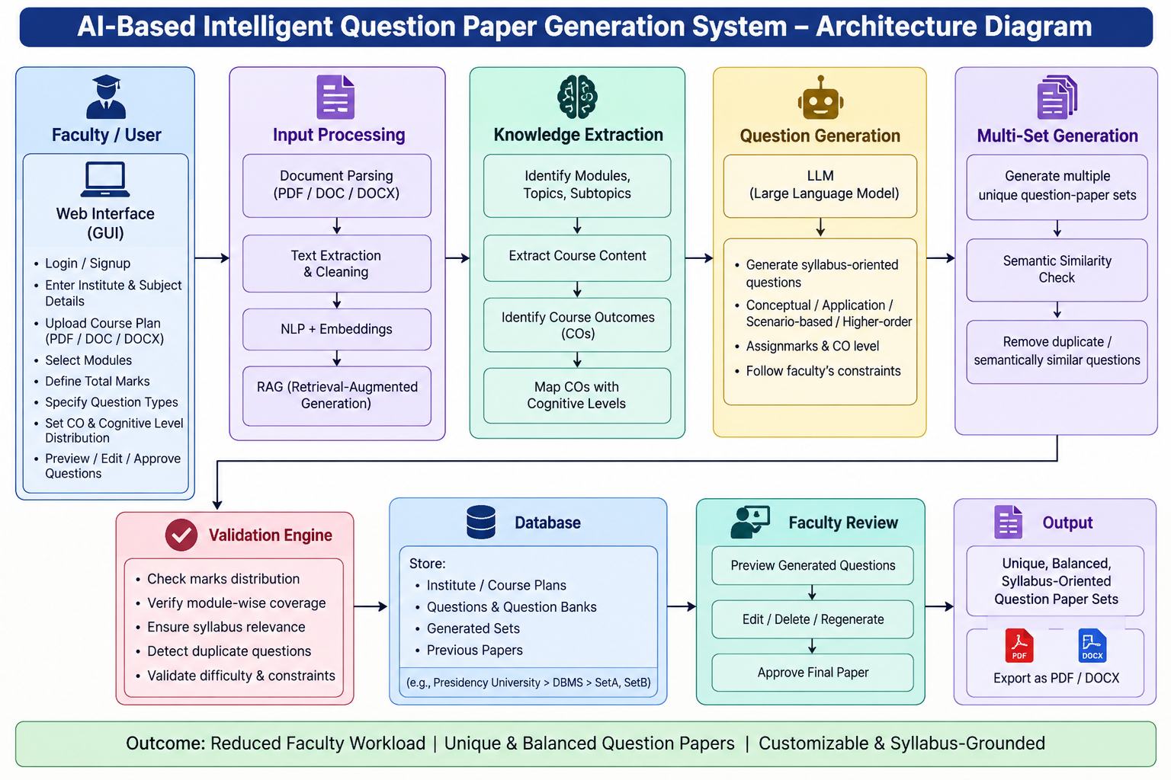
Proposed Method

Slide 6
Hardware & Software Details
Hardware Details
Processor: Intel Core i5 or equivalent processor
RAM: Minimum 8 GB
Storage: Minimum 256 GB HDD/SSD
System Type: 64-bit operating system
Internet: Stable internet connection for AI and database services
Software Details
Operating System: Windows 10/11 or Linux
Programming Language: Python
Frontend: HTML, CSS, JavaScript
Backend: Flask / Django
Database: MySQL / PostgreSQL
AI Tools: NLP, Embeddings, RAG, and LLM
Document Processing: PDF, DOC, and DOCX processing libraries
Development Tool: VS Code / Jupyter Notebook
Output: PDF and DOCX generation support

Slide 7
LITERATURE SURVEY
S.No | Title | Author | Year | Method | Pros | Cons
1 | eBloomDQG: Integrating Cognitive Level Alignment with Encoder-Decoder Architecture for Deep Question Generation | N. Aisyah, D. Purwitasari, R. N. E. Anggraini, S. D. Ravana | 2026 | Encoder-Decoder, eBloom, NLP, Knowledge Base | Generates questions aligned with Bloom’s cognitive levels; improves question quality. | Requires suitable training data and may need further domain adaptation.
2 | CQELedu: Design and Implementation of a LangChain and GPT-4o Mini-Based Web Application for Custom Question Generation and Error-Based Learning in Education | D. Kim, S. Won Park, J. Lee | 2025 | LangChain, GPT-4o Mini, LLM-based question generation | Supports customized questions and generates follow-up questions based on errors. | Scalability and multilingual support require further improvement.
3 | MCQs Generation With Large Language Models: A Survey of Methodologies, Evolution, and Open Research Issues | M. R. Anwar, S. Khalid, S. Alshahrani, H. S. M. Bilal, M. Aldawsari | 2026 | LLM-based MCQ generation, preprocessing, key selection, distractor generation | Provides a broad overview of automatic MCQ generation and evaluation methods. | Mainly focuses on MCQs and does not provide a complete customized question-paper system.
4 | QARR-QGF: A Dual-Module Data Augmentation Framework for Enhanced Few-Shot Question Answering | S. W. Tan, C. P. Lee, K. M. Lim, A. Alqahtani | 2025 | Data augmentation, question generation, semantic filtering | Improves question diversity and performance with limited training data. | Primarily designed for question answering rather than complete examination-paper generation.
5 | Medical Knowledge-Based Differential Image Visual Question Answering | F. Lu, S. Liu, W. Lu, P. Chen, B. Ding | 2025 | Knowledge embeddings, feature processing, attention, answer generation | Combines external knowledge with question-answer generation and improves contextual understanding. | Designed for medical visual QA and is not directly applicable to syllabus-based question papers.

Slide 8
LITERATURE SURVEY
S.No | Title | Author | Year | Method | Pros | Cons
6 | UQA-RAG: Enhancing Urdu Question-Answer Retrieval With Semantic Similarity and LLMs | T. F. Khan, M. Arslan, F. Alturise, A. H. Almutairi, M. T. Raza | 2026 | RAG, Hybrid Retrieval, Semantic Similarity, LLMs | Improves contextual retrieval by combining semantic and lexical search; provides highly relevant answers. | Designed mainly for Urdu QA and requires suitable retrieval resources.
7 | MGPRAG: Enhancing Medical Large Language Models via Precision Retrieval-Augmented Generation | Y. Shen, D. Xu, X. Li, L. Fu, H. Liu | 2025 | Knowledge Graph, RAG, Dynamic-Frozen Encoder | Provides precise knowledge retrieval and improves generation quality. | Domain-specific medical design limits direct application to general education.
8 | KAIR: Knowledge-Aware Iterative Retrieval for Multiagent Systems | S. Song, S. Chawla, V. K. Madisetti | 2026 | Iterative Retrieval, RAG, LLM Agents | Refines queries iteratively and improves evidence-based reasoning and retrieval accuracy. | More complex architecture may increase processing time and implementation cost.
9 | Evolutionary-Algorithm-Based Automatic Prompt Generation for Vision-Language Model Evaluation | W. Li, M. Hui, W. Xiaolu, L. Shujuan | 2026 | Evolutionary Algorithm, Prompt Generation, Semantic Evaluation | Produces optimized prompts and improves semantic relevance and evaluation quality. | Developed mainly for vision-language evaluation rather than educational question generation.
10 | ContextualCoder: Adaptive In-Context Prompting for Programmatic Visual Question Answering | R. Shen, N. Inoue, D. Guan, R. Cai, A. C. Kot, K. Shinoda | 2025 | LLM Prompting, In-Context Learning, Contextual Selection | Improves context-aware prompting and supports better question-answer reasoning. | Focuses on visual question answering and requires additional models for visual processing.

Slide 9
LITERATURE SURVEY
S.No | Title | Author | Year | Method | Pros | Cons
11 | Synthetic Data Generation Using Large Language Models: Advances in Text and Code | M. Nadǎş, L. Dioşan, A. Tomescu | 2025 | LLM-based synthetic data generation, prompting, RAG, self-refinement | Provides controllable and diverse synthetic text; useful when real training data is limited. | Generated content may contain factual errors, bias, and unrealistic data patterns.
12 | AI-Driven Personalized Learning and Remedial Recommendation Through Knowledge Concept-Centric Evaluation | N. Pradeesh, M. G. Thushara, K. Arun Krishna, V. Pranav, S. Krishnamoorthy | 2025 | RAG, Knowledge Tracing, adaptive question generation | Generates contextually aligned questions and supports Course Outcomes and learning objectives. | Mainly focuses on personalized learning rather than complete automated question-paper generation.
13 | VQA-Guided Diffusion: Enhancing Text-to-Image Generation With Semantic Feedback From Visual Question Answering | D. B. Bhowmik, I. Maity, A. K. Pati | 2026 | NLP, VQA, semantic feedback, iterative generation | Uses semantic verification and feedback to improve generated content. | Focuses on text-to-image generation and is not directly applicable to educational question generation.
14 | PowerIntelBench: Benchmarking Evidence-Grounded and Explainable Reasoning in Power Knowledge Management | T. Yang, J. Han, C. Zhang, J. Huang | 2026 | LLM evaluation, evidence retrieval, knowledge management, QA benchmarking | Supports evidence-grounded and traceable LLM responses; useful for evaluating generated content. | Designed for power-standard knowledge management rather than academic question-paper generation.
15 | GRAVITY: Graph-Based Reasoning With Attention and Visual Information Using Transformers for Yielding Answers | H. N. Chaudhry, F. Kulsoom, Z. Ullah Khan | 2025 | Graph Attention Networks, Transformers, semantic reasoning | Improves contextual reasoning by combining structured relationships with language information. | Primarily designed for visual question answering and requires complex model architecture.

Slide 10
LITERATURE SURVEY
S.No | Title | Author | Year | Method | Pros | Cons
16 | Foundation Models in Autonomous Driving: A Survey on Scenario Generation and Scenario Analysis | Y. Gao et al. | 2026 | Foundation Models, LLMs, VLMs, Multimodal LLMs | Provides diverse scenario generation and analysis using advanced AI models. | Focuses on autonomous driving rather than educational question generation.
17 | Decoding the Mystery: How Can LLMs Turn Text Into Cypher in Complex Knowledge Graphs? | I. Mandilara, C. M. Androna, E. Fotopoulou, | 2025 | LLM, Knowledge Graph, Text-to-Cypher, Schema-aware generation | Supports semantic understanding and structured knowledge retrieval. | Complex queries can reduce accuracy and require knowledge-graph infrastructure.
18 | Question Answering on Lengthy Arabic Narrative Books | M. A. Ateeq, S. Tiun, H. Abdelhaq, W. Kaur | 2026 | RAG, LLM-generated question-passage pairs, semantic retrieval | Improves retrieval from lengthy documents and reduces LLM processing cost. | Designed for Arabic narrative books and requires additional processing for other domains.
19 | Hybrid Layered Retrieval and Task-Aware Embeddings for Efficient Persian RAG Systems | T. Zoughi, E. Arianyan, M. Mahmoudi, | 2026 | Hybrid RAG, FAISS, BM25, task-aware embeddings | Improves retrieval accuracy, efficiency, and scalability. | Performance can depend on hardware and language-specific embedding models.
20 | TelecomGPT: A Framework to Build Telecom-Specific Large Language Models | H. Zou et al. | 2025 | Continual pre-training, instruction tuning, alignment tuning | Improves domain-specific LLM performance using specialized datasets. | Requires large domain-specific datasets and significant computational resources.

Slide 11
LITERATURE SURVEY
S.No | Title | Author | Year | Method | Pros | Cons
21 | Question Answering on Lengthy Arabic Narrative Books | M. A. Ateeq, S. Tiun, H. Abdelhaq, W. Kaur | 2026 | RAG, annotation-free retriever, synthetic question-passage pairs, semantic coherence scoring | Improves retrieval from lengthy documents and reduces LLM processing cost. | Mainly designed for Arabic narrative documents and requires additional adaptation for educational syllabi.
22 | Hybrid Layered Retrieval and Task-Aware Embeddings for Efficient Persian RAG Systems | T. Zoughi, E. Arianyan, M. Mahmoudi, M. Aghdamifard, M. Nikoogoftar | 2026 | TILHR-RAG, FAISS, BM25, task-aware embeddings | Provides accurate and efficient retrieval by combining semantic and keyword search. | Performance depends on suitable embeddings and computational resources.
23 | TelecomGPT: A Framework to Build Telecom-Specific Large Language Models | H. Zou et al. | 2025 | Continual pre-training, instruction tuning, alignment tuning | Improves LLM performance for domain-specific knowledge and tasks. | Requires domain-specific datasets and considerable computational resources.
24 | A Systematic Literature Review of Hallucinations in Large Language Models | C. Woesle, L. Fischer-Brandies, R. Buettner | 2025 | PRISMA-based systematic review, hallucination detection and mitigation | Identifies major hallucination problems and emphasizes verification mechanisms for reliable LLM outputs. | Only a small portion of existing studies use fully integrated validation architectures.
25 | Enhancing the Precision and Interpretability of Retrieval-Augmented Generation (RAG) in Legal Technology: A Survey | M. Hindi, L. Mohammed, O. Maaz, A. Alwarafy | 2025 | RAG, information retrieval, knowledge graphs, LLM, evaluation metrics | Improves understanding of RAG pipelines, retrieval methods, evaluation, and hallucination reduction. | Focuses mainly on legal applications and requires domain-specific knowledge for other fields.

Slide 12
References
[1] N. Aisyah, D. Purwitasari, R. N. E. Anggraini, and S. D. Ravana, “eBloomDQG: Integrating Cognitive Level Alignment with Encoder-Decoder Architecture for Deep Question Generation,” IEEE Access, 2026, doi: 10.1109/ACCESS.2026.3721532.
[2] D. Kim, S. Won Park, and J. Lee, “CQELedu: Design and Implementation of a LangChain and GPT-4o Mini-Based Web Application for Custom Question Generation and Error-Based Learning in Education,” IEEE Access, vol. 13, pp. 208932–208947, 2025, doi: 10.1109/ACCESS.2025.3639087.
[3] M. R. Anwar, S. Khalid, S. Alshahrani, H. S. M. Bilal, and M. Aldawsari, “MCQs Generation With Large Language Models: A Survey of Methodologies, Evolution, and Open Research Issues,” IEEE Access, vol. 14, pp. 10991–11018, 2026, doi: 10.1109/ACCESS.2026.3652006.
[4] S. W. Tan, C. P. Lee, K. M. Lim, and A. Alqahtani, “QARR-QGF: A Dual-Module Data Augmentation Framework for Enhanced Few-Shot Question Answering,” IEEE Access, vol. 13, pp. 160722–160736, 2025, doi: 10.1109/ACCESS.2025.3609472.
[5] C. C. So, C. H. Lee, D. Yang, A. W. K. Loh, and C. K. Sze, “Automatic Generation of High-Quality MCQs With LLMs for Artificial Intelligence Education,” IEEE Access, vol. 13, pp. 184332–184347, 2025, doi: 10.1109/ACCESS.2025.3624820.

Slide 13
References
[6] N. Pradeesh, M. G. Thushara, K. Arun Krishna, V. Pranav, and S. Krishnamoorthy, “AI-Driven Personalized Learning and Remedial Recommendation Through Knowledge Concept-Centric Evaluation,” IEEE Access, vol. 13, pp. 207817–207837, 2025, doi: 10.1109/ACCESS.2025.3638427.
[7] M. A. Ateeq, S. Tiun, H. Abdelhaq, and W. Kaur, “Question Answering on Lengthy Arabic Narrative Books,” IEEE Access, vol. 14, pp. 20734–20755, 2026, doi: 10.1109/ACCESS.2026.3661853.
[8] T. Zoughi, E. Arianyan, M. Mahmoudi, M. Aghdamifard, and M. Nikoogoftar, “Hybrid Layered Retrieval and Task-Aware Embeddings for Efficient Persian RAG Systems,” Journal of Web Engineering, vol. 25, no. 5, pp. 765–796, 2026, doi: 10.13052/jwe1540-9589.2552.
[9] C. Woesle, L. Fischer-Brandies, and R. Buettner, “A Systematic Literature Review of Hallucinations in Large Language Models,” IEEE Access, vol. 13, pp. 148231–148253, 2025, doi: 10.1109/ACCESS.2025.3601206.
[10] M. Hindi, L. Mohammed, O. Maaz, and A. Alwarafy, “Enhancing the Precision and Interpretability of Retrieval-Augmented Generation (RAG) in Legal Technology: A Survey,” IEEE Access, vol. 13, pp. 46171–46189, 2025, doi: 10.1109/ACCESS.2025.3550145.

Slide 14
Check List
Base paper Hard Copy to be submitted
Hard copy to be uploaded in drive named as RollNo_basepaper
PPT to be uploaded in the drive named as RollNo_Zeroth review ppt
Attendance Sheet signed by Guide

