Slide 1
Concept Engineering Mixed-Technology Systems
Presented by:
Sri Ram -
Raghul Balakrishnan - 5361911
Guided by:
Prof. Dr. -Ing. Mirco Meiners

Slide 2
Objective
System Overview
What is Σ∆ modulator?
Behavioral modelling (MATLAB, SIMULINK)
Circuit design (LTSPICE, XSCHEM)

Slide 3
Objective
IC level designing of an ACD based on ADS1115, understanding the working principle of an ADC via circuit simulations and an IC design in Xschem based on SG13G2 package. SG13G2 is a 130nm process architecture based package developed by IHP.

Slide 4
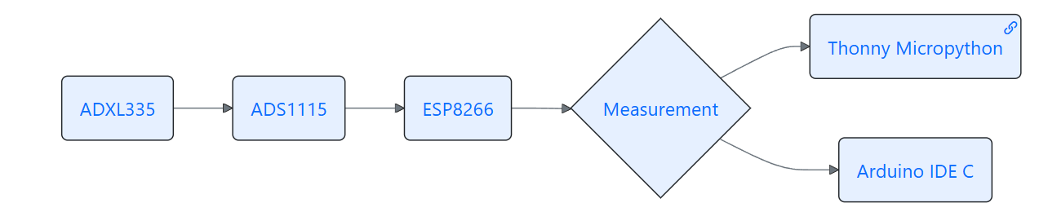
System Overview

Slide 5
What is Σ∆ modulator?

Slide 6
High-Resolution ADC Technique – Converts analog signals to digital by oversampling and noise shaping, improving precision.
Uses Feedback & Integration – Employs an integrator, comparator, and DAC in a feedback loop to refine signal accuracy.
Ideal for Low-Frequency Signals – Commonly used in audio processing, medical imaging, and high-precision measurements.

Slide 7
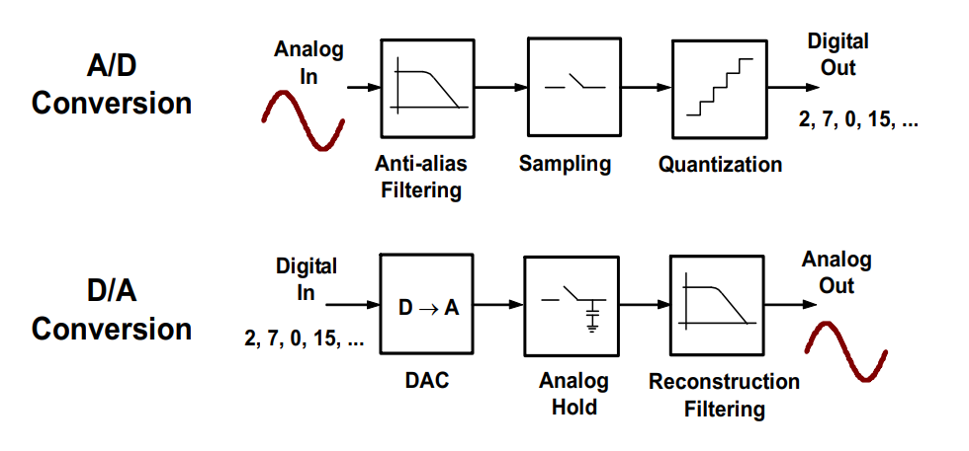
Building Block of Σ∆ Modulator

Slide 8
Behavioral modelling (MATLAB, SIMULINK)

Slide 9
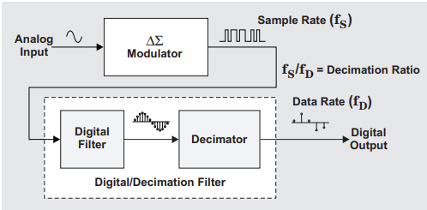
Behavioral Model of Sigma Delta Modulator
Basically, these converters consist of an oversampling modulator followed by a digital/decimation filter that together produce a high-resolution data-stream output.

Slide 10
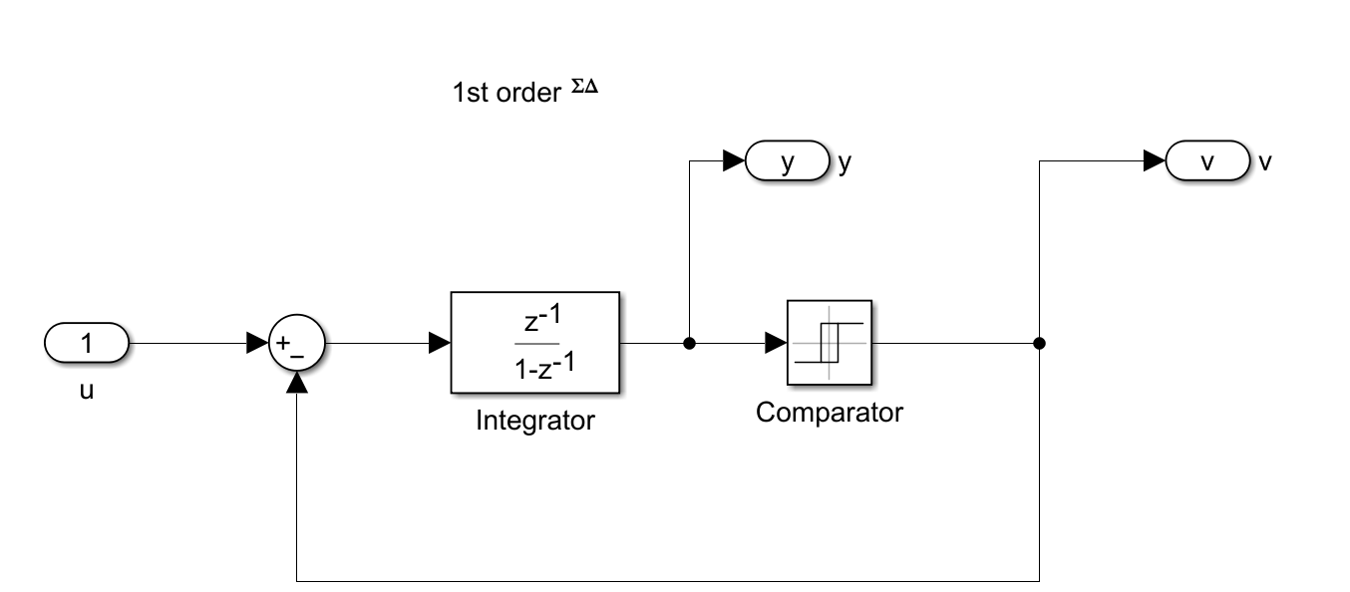
Simulink Implementation of 1st order Sigma Delta Modulator

Slide 11
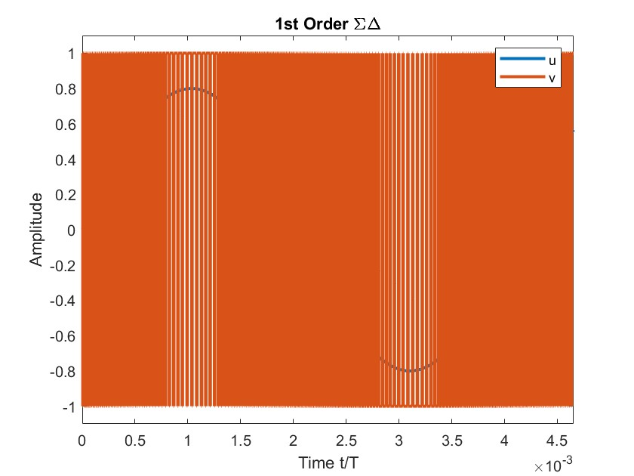
MATLAB Output of 1st order Σ∆ Modulator

Slide 12
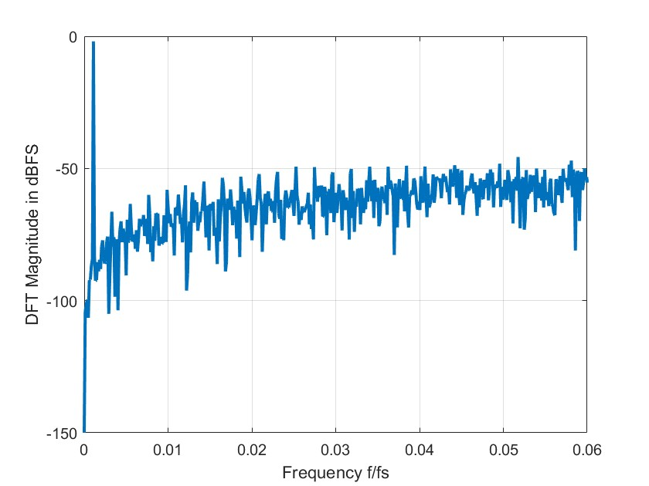
Spectral Analysis output of 1st Order Sigma Delta Modulator
Spectral Analysis by using FFT with OSR=512

Slide 13
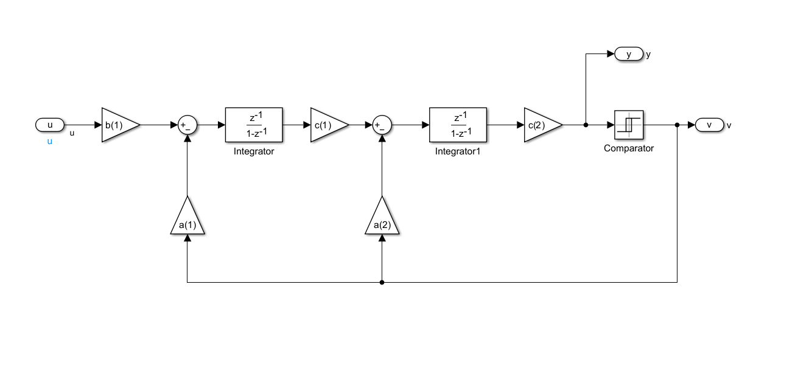
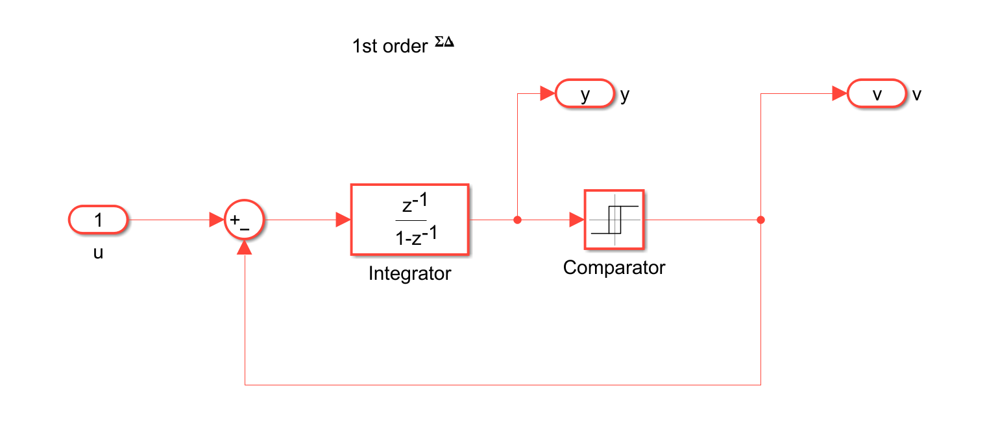
Simulink Implementation of 2nd order Sigma Delta Modulator

Slide 14
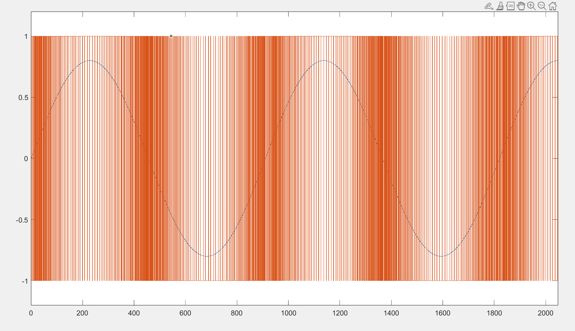
MATLAB Output of 2nd order Σ∆ Modulator

Slide 15
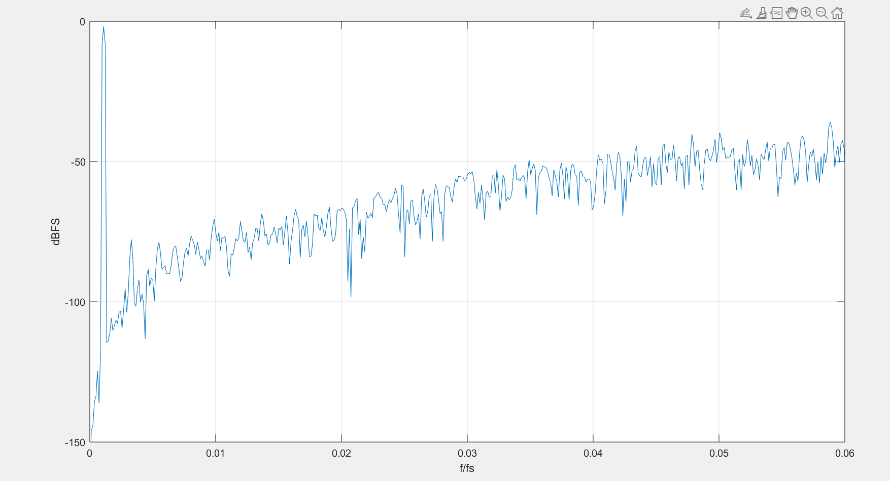
Spectral Analysis output of 2nd Order Sigma Delta Modulator
Spectral Analysis by using FFT with OSR=512

Slide 16
Circuit design (LTSPICE)

Slide 17
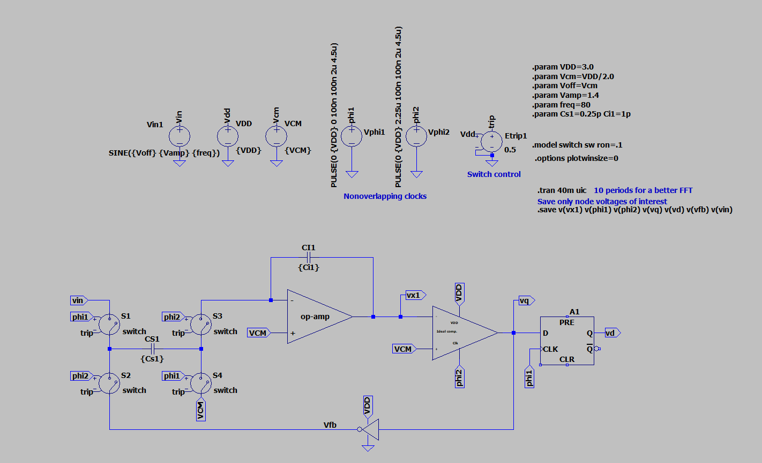
LTSpice Setup of 1st order Σ∆ Modulator
The below circuit represents the First Order Delta Sigma Modulator.

Slide 18
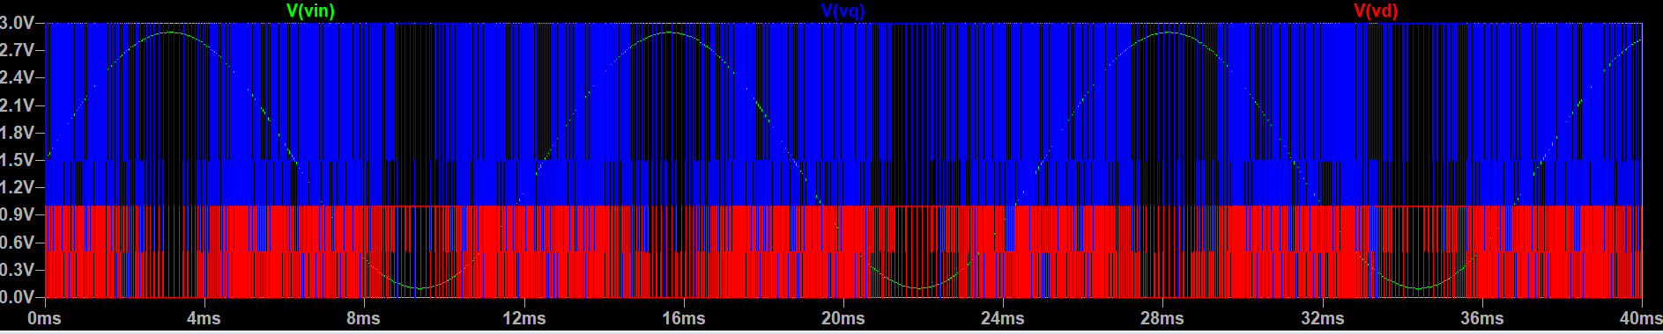
LTSpice Output of 1st order Σ∆ Modulator
The below graph represents the Input and Output signal of the First Order Delta Sigma Modulator.

Slide 19
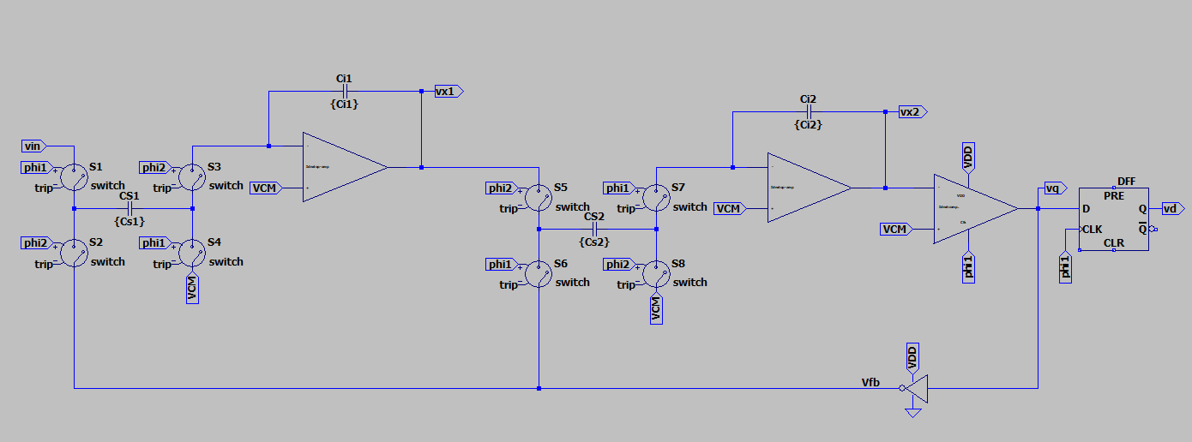
LTSpice Setup of 2nd order Σ∆ Modulator
The below circuit represents the Second Order Delta Sigma Modulator.

Slide 20
Circuit design (XSCHEM)

Slide 21
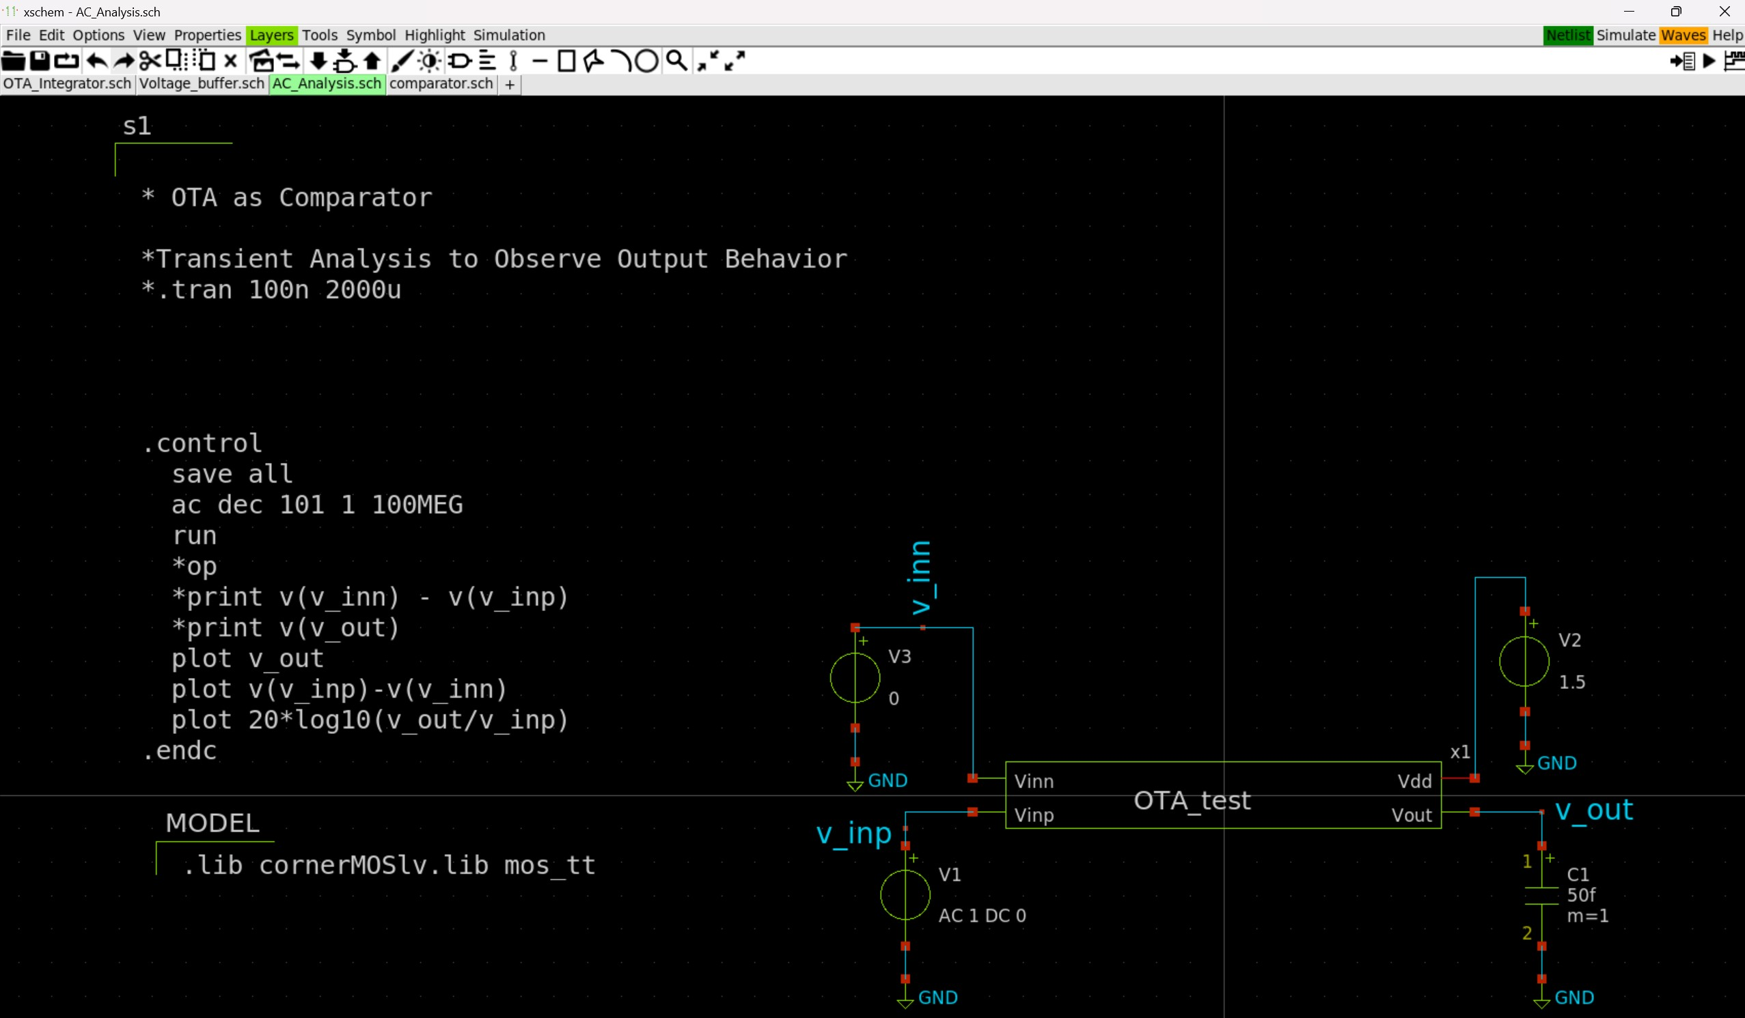
AC Analysis of OTA
We started by performing the ac analysis and then plotting the gain in logerithimic plot, we received a gain of 40Db.

Slide 22
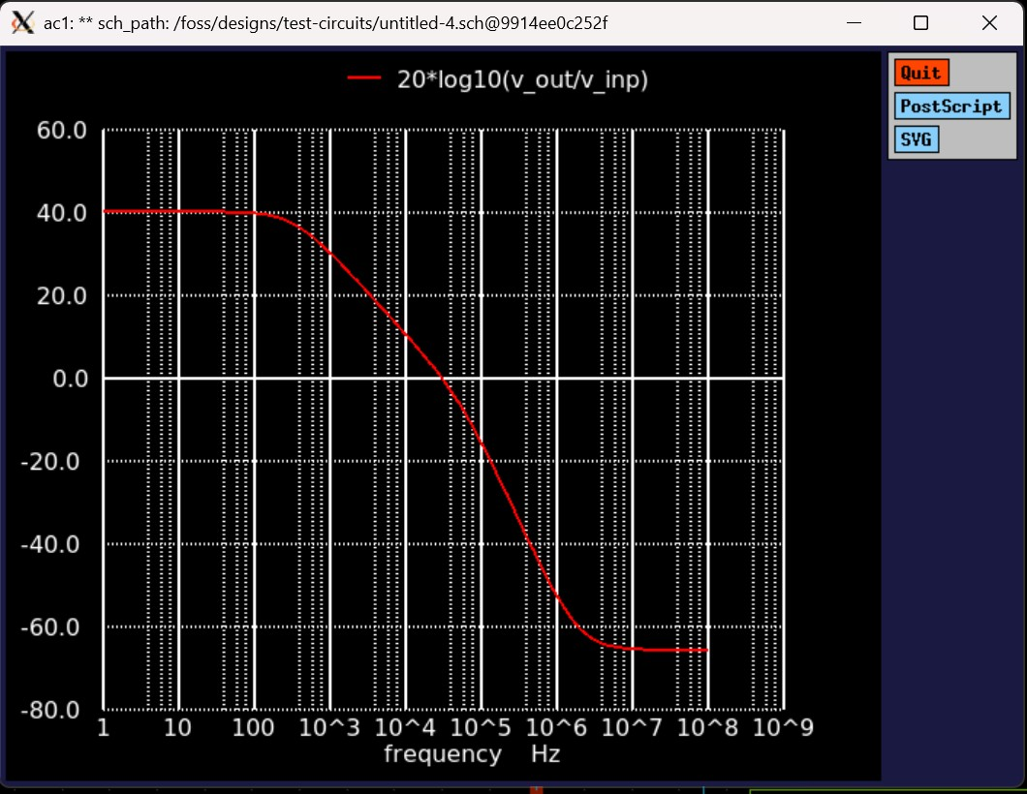
AC Analysis Output

Slide 23
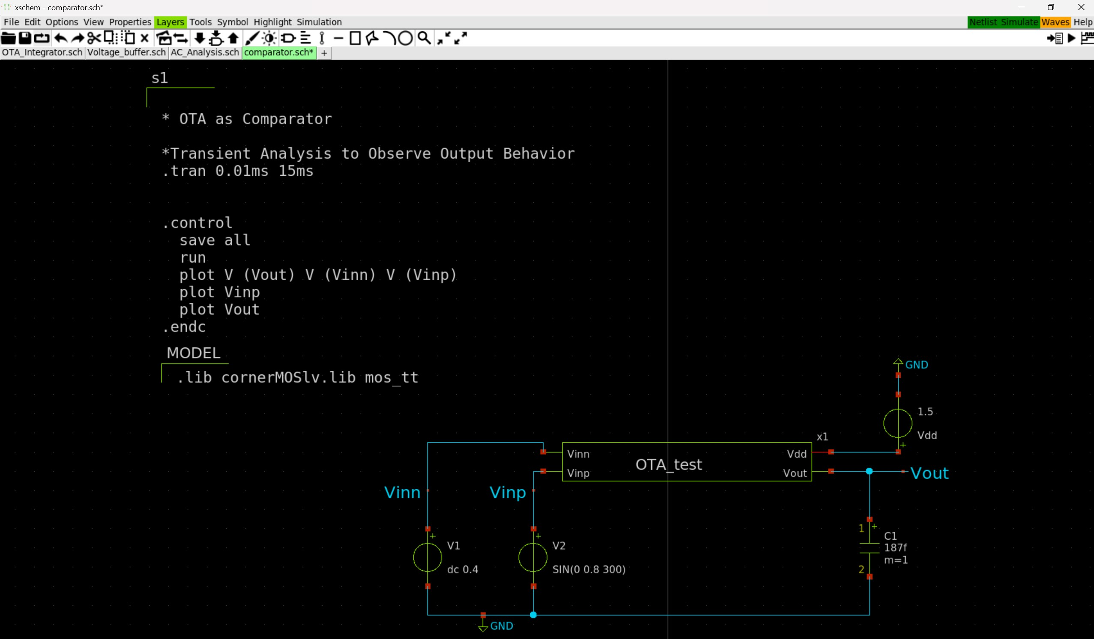
OTA as a Comparator
To further test the working of the OTA and also, there is a comparator part in the IDSM1 & IDSM2 we have designed a test bench to use OTA as a comparator, with few tested examples we were about to observe the expected behaviour of OTA as a comparator

Slide 24
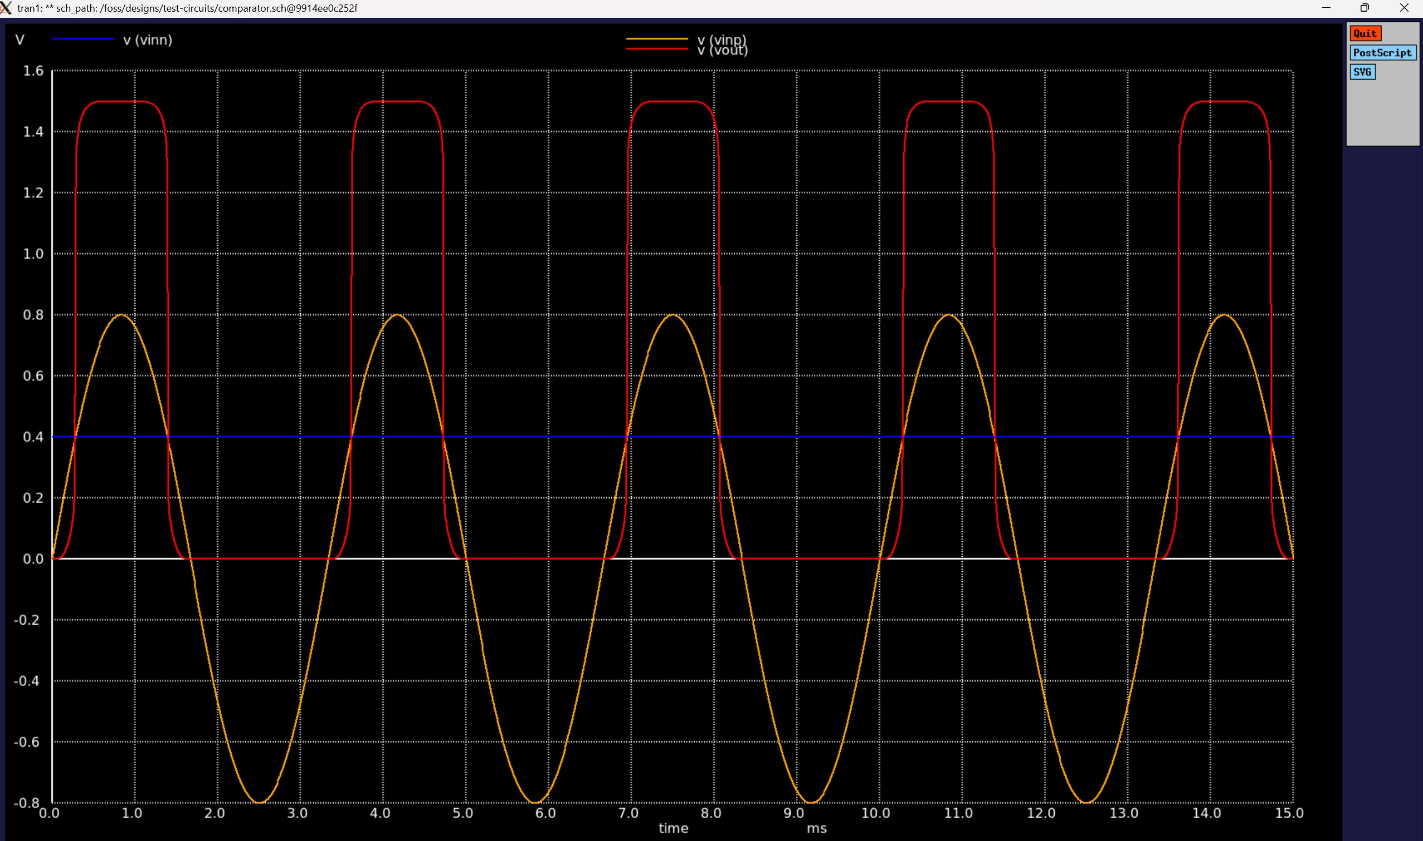
OTA Comparator Output

Slide 25
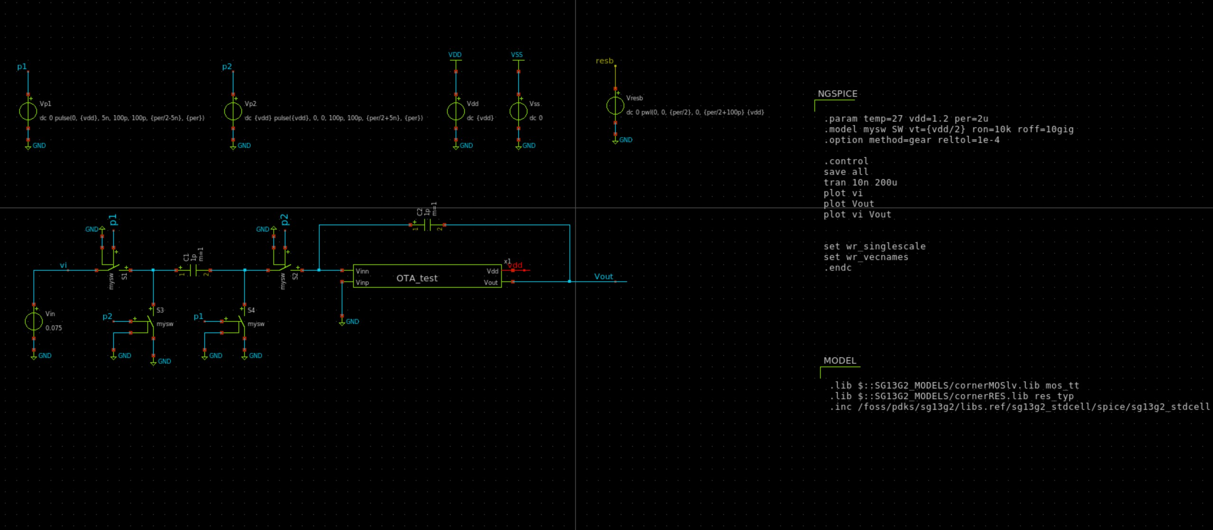
OTA as an Integrator
Now that we know that the OTA is working as expected we start by desiging an OTA as a integrator using the switched capacitor integrator.

Slide 26
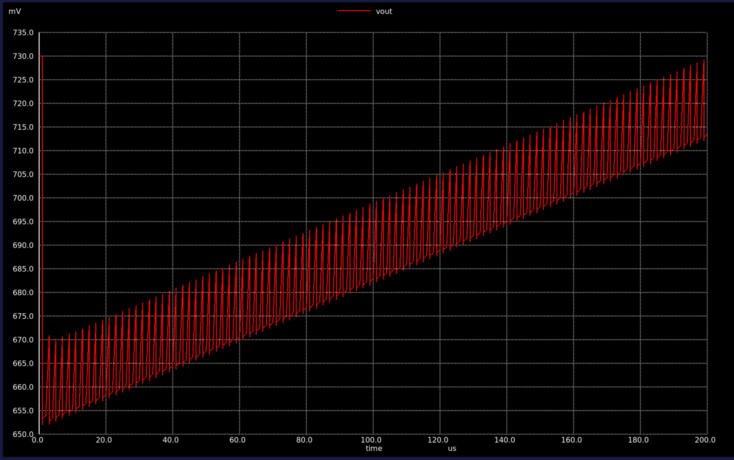
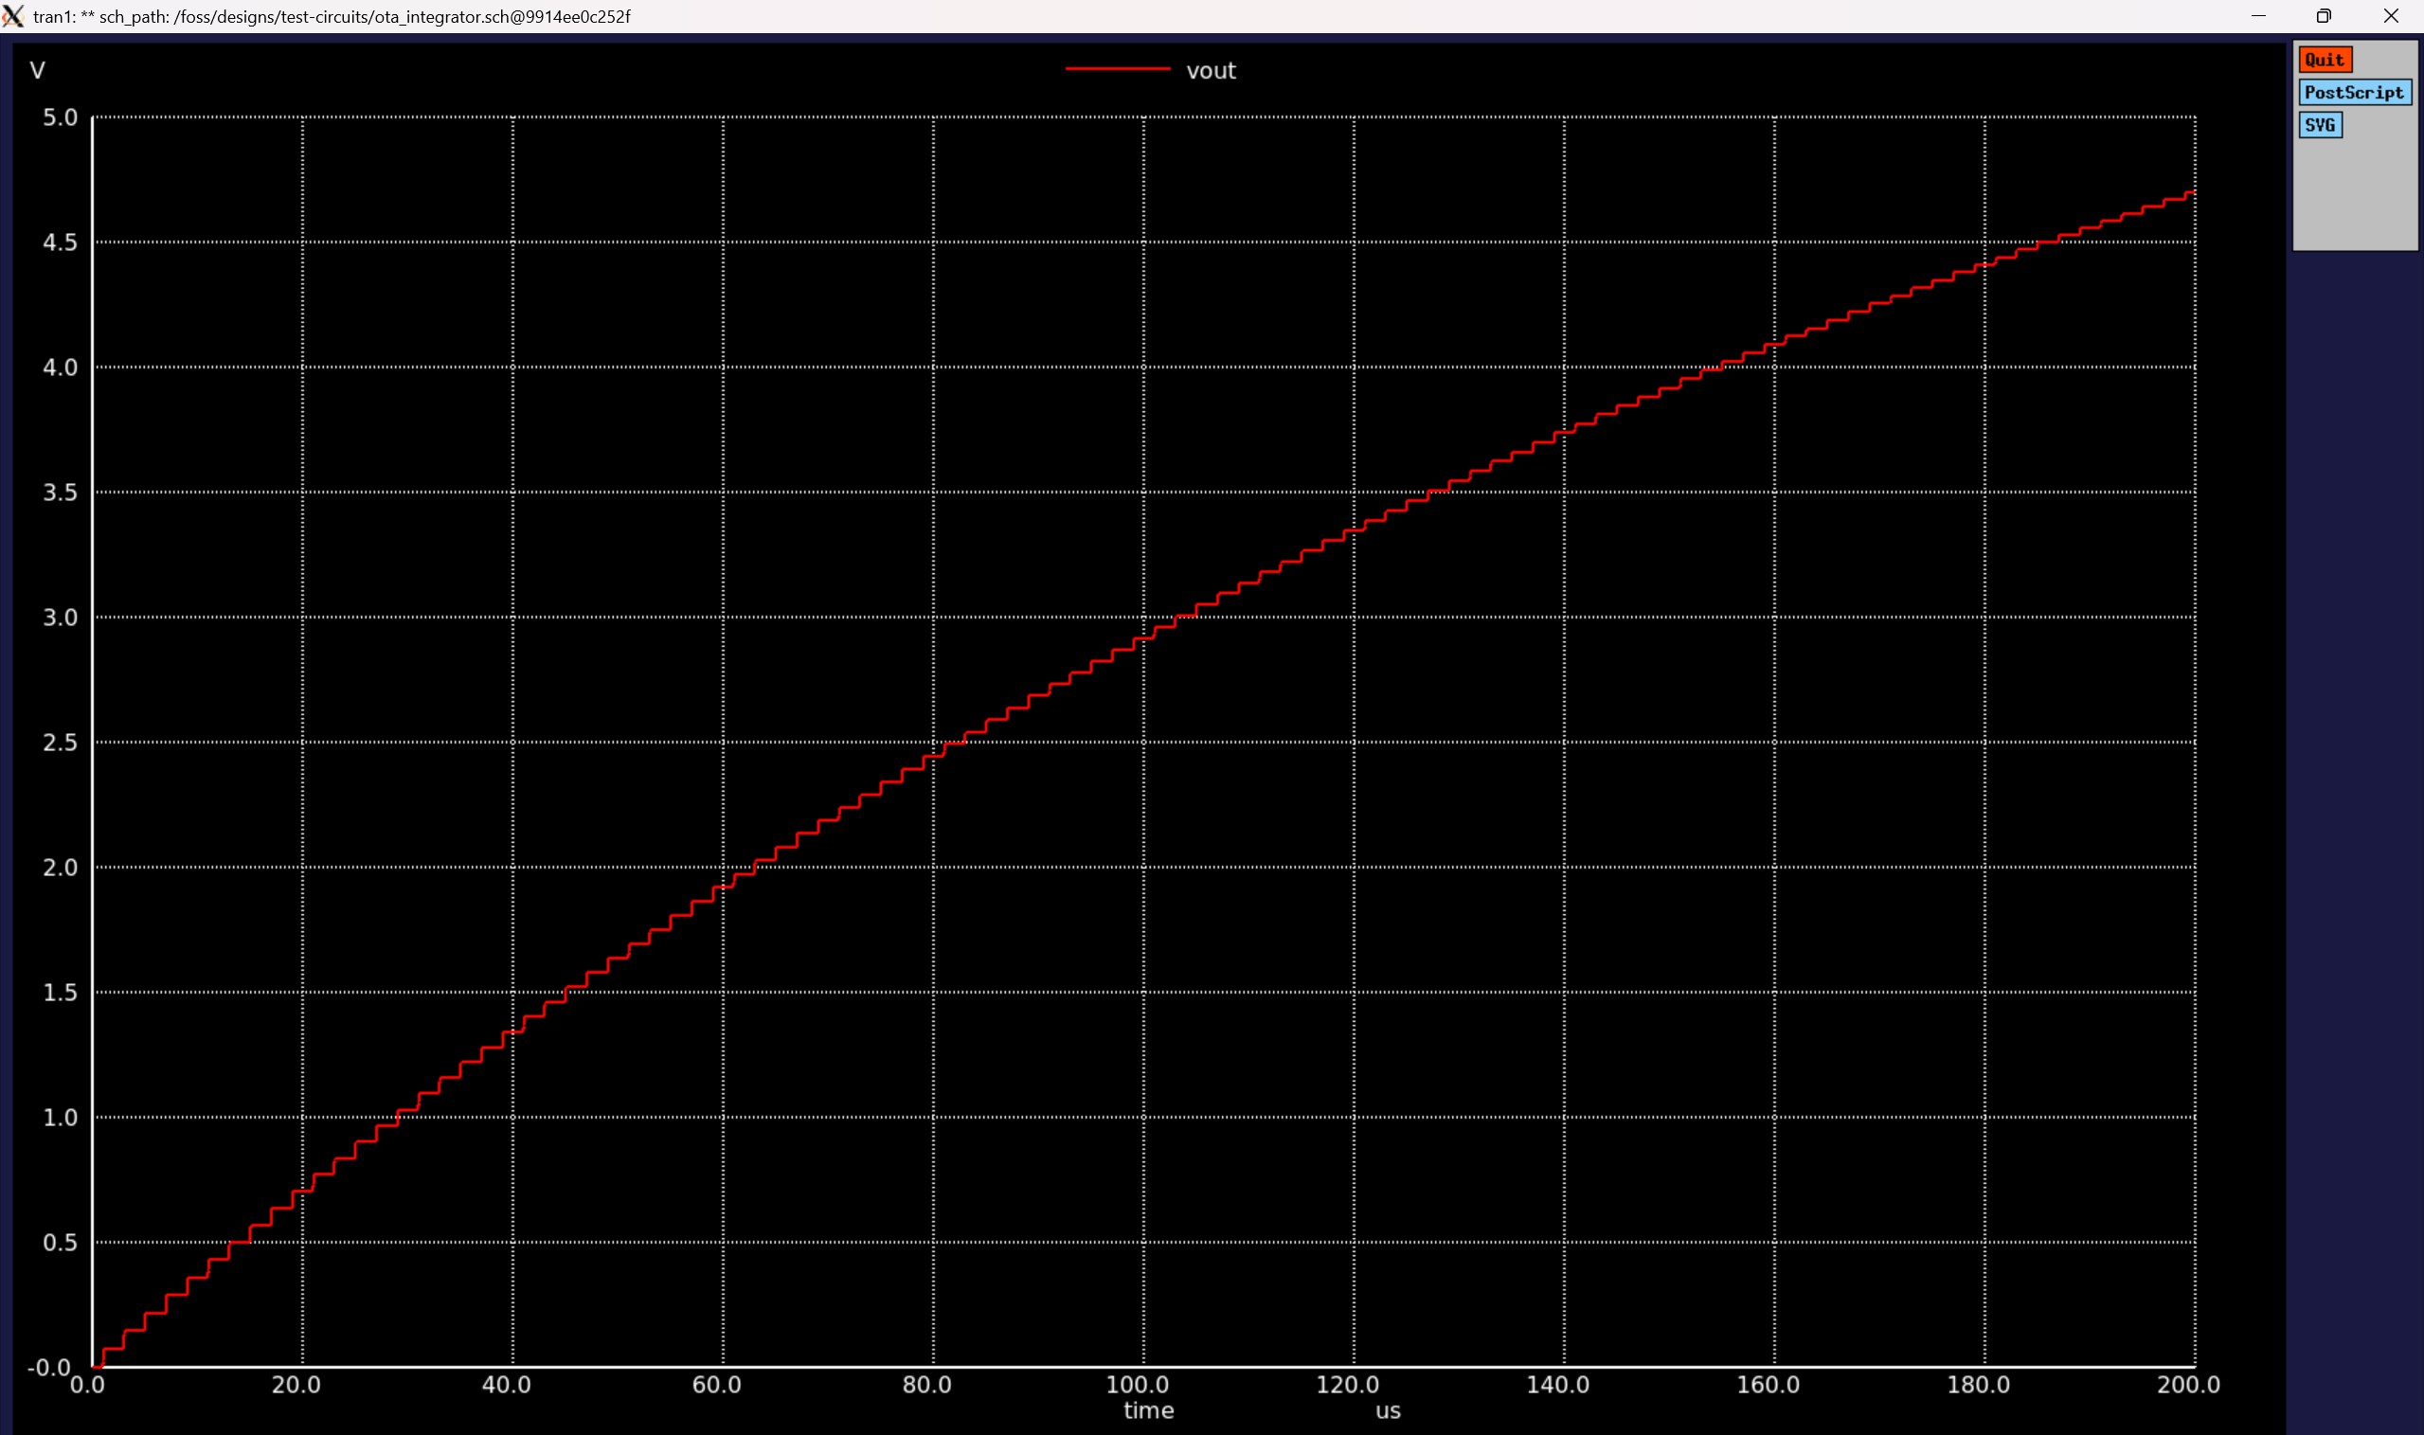
OTA Integrator Output

Slide 27
References
https://iic-jku.github.io/analog-circuit-design/#sec-basic-ota
https://iic-jku.github.io/analog-circuit-design/sizing/sizing_mosfet_diode-preview.html
B. E. Boser and B. A. Wooley. The design of sigma-delta modulation analog-to-digital converters. IEEE Journal of Solid-State Circuits, 23(6):1298--1308, December 1988.
Bernhard E. Boser. Eecs247: Analog-digital interface integrated circuits. Course notes, University of California Berkeley, February 2003.
Michael Clifford. Fundamental principles behind the sigma-delta adc topology: Part 1. Technical report, Analog Devices (AD), January 2016.
Michael Clifford. Fundamental principles behind the sigma-delta adc topology: Part 2. Technical report, Analog Devices (AD), February 2016.

Slide 28
Vielen Dank!
Neustadtswall 30
D-28199 Bremen
T +49 421 59050
F +49 421 5905 2292
info@hs-bremen.de
hs-bremen.de

