Slide 1

Capstone Project
House Price Prediction
Team member:
Deepti Joshi
Vaishnav U
Batch: PGDDSBA July 2022

Slide 2
Agenda
Introduction, problem statement, and objective of the project
Data processing
Dimension reduction
Exploratory Data Analysis
Model building and performance evaluation
Insights and recommendation

Slide 3

Introduction problem statement and objective of the project
Business problem
A house value is simply more than location and square footage. Like the features that make up a person
an educated party would want to know all aspects that give a house its value. For example, you want to sell a house and you don’t know the price which you may expect — it can’t be too low or too high.
To find house price you usually try to find similar properties in your neighborhood and based on gathered data you will try to assess your house price.
Objectives
The objective of the House Price Prediction Data Science Project is to develop a reliable and accurate predictive model for estimating house prices.
This model aims to incorporate various influential factors, such as location, size, amenities, and historical sales data, to provide actionable insights for homebuyers, sellers, real estate agents, and financial institutions.
By leveraging machine learning algorithms and comprehensive datasets, the project seeks to enhance decision-making in the real estate industry and contribute to the field of data-driven real estate analysis.
Aim
The business model proposed in this project aims to revolutionize the assessment of house value by going beyond traditional methods that focus solely on location and square footage.
By considering a comprehensive range of factors that contribute to a house's worth, the model seeks to provide homeowners, sellers, and real estate professionals with a more accurate estimation of house prices.
This will enable them to make informed decisions, set competitive asking prices, and facilitate efficient transactions in the real estate market..

Slide 4

Data Report
Data source: From Great learning .
Data type: 16 numeric features, 6 categorical and 1 date-time feature with target variable “price”. Some features should be numeric instead of object.
Duplicate data: no duplicate data.
Missing data: There are few missing values.
Data size : number of rows: 21613 , number of columns : 23
Special character: special character like “$” is present in the data.
Outlier treatment : Outlier present in the data.
Feature extraction: creating new column 'is_renovated‘, ‘location’, 'years_old‘.
Remove columns: living_measure, lot_measure, 'Sold_date‘, 'yr_built‘, 'yr_renovated','zipcode‘.

Slide 5

Data Processing
Steps
Below are the steps performed on the dataset as part of data processing.
Descriptive statistic and null value condition check.
Duplicate value and special character check and removing them.
Treating and removing invalid attributes.
Detecting outlier and capping them
Handling multicollinearity.
Feature concatenation as per domain knowledge.
Info of Cleaned data
The data has undergone thorough pre-processing and cleaning, resulting in a refined and reliable dataset.
Shape of dataset: number of rows: 20932, number of columns: 17.
There are no missing values.
Duplicate values: There are no duplicate values in the data.
Data types-We can see there are 8 columns of float data type, 2 columns of integer data type and 7 columns of object data type.

Slide 6
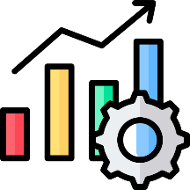
Exploratory Data Analysis
Exploratory Data Analysis (EDA) is a process of examining and analyzing data sets to gain insights, discover patterns, and identify relationships between variables. It is an essential step in the data analysis pipeline and helps in understanding the data before applying more advanced statistical or machine learning techniques:
EDA is the process of analyzing data to find patterns, relationships, and anomalies.
It involves using descriptive statistics, visualizations, and data manipulation techniques.
EDA helps in understanding the data before applying advanced analysis methods.
It aids in decision-making by providing insights and identifying relevant variables.
EDA is an iterative process that may lead to new questions and further exploration.
It plays a crucial role in data validation, identifying data quality issues, and feature engineering.
EDA facilitates better understanding, interpretation, and modeling of the data.

Slide 7
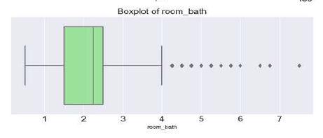
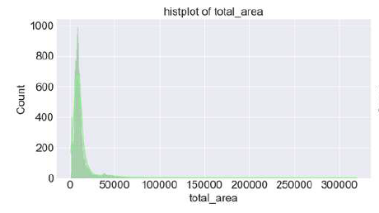
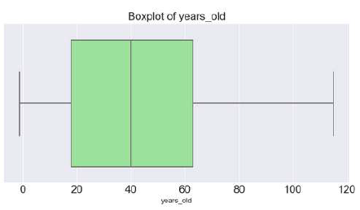
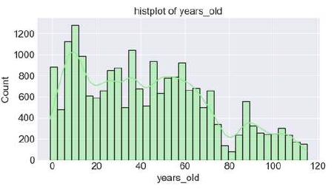
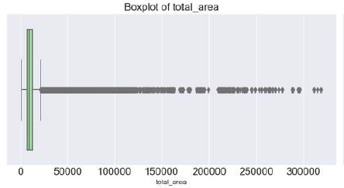
Univariate analysis
Insights
Number of Bathrooms: The most common count is 2, with outliers for larger properties. The average is around 2.2 bathrooms, and the distribution is skewed towards lower values.
Age of the Building: Minimum age of building is 20 and maximum age is 60 average age is 40 years old.
Total Area: There is a wide range of total areas, with outliers for exceptionally large properties.
The histogram reveals a right-skewed distribution of data points for the variable "total area." Additionally, the columns "room_bath" and "years old" do not exhibit a normal distribution.

Slide 8
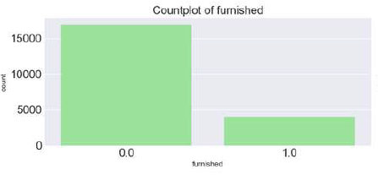
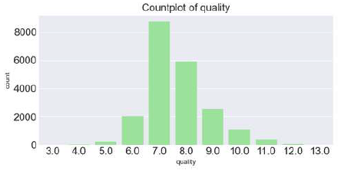
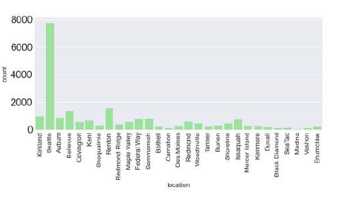
CATEGORICAL UNIVARIATE ANALYSIS
Furnished:
The countplot shows that the majority of houses in the dataset are furnished, with a higher frequency compared to unfurnished properties.
This suggests that furnished houses are more common or in higher demand in the market represented by the dataset
Quality:
The countplot reveals a relatively balanced distribution across different quality ratings, indicating a fair representation of houses at each level.
There is a slightly higher count of houses with average to above-average quality ratings,
Location:
The countplot displays varying frequencies across different locations or neighborhoods, indicating differences in the number of houses available in each area.
Some locations show higher counts, suggesting they are more populous or preferred areas with a larger number of houses in the dataset

Slide 9
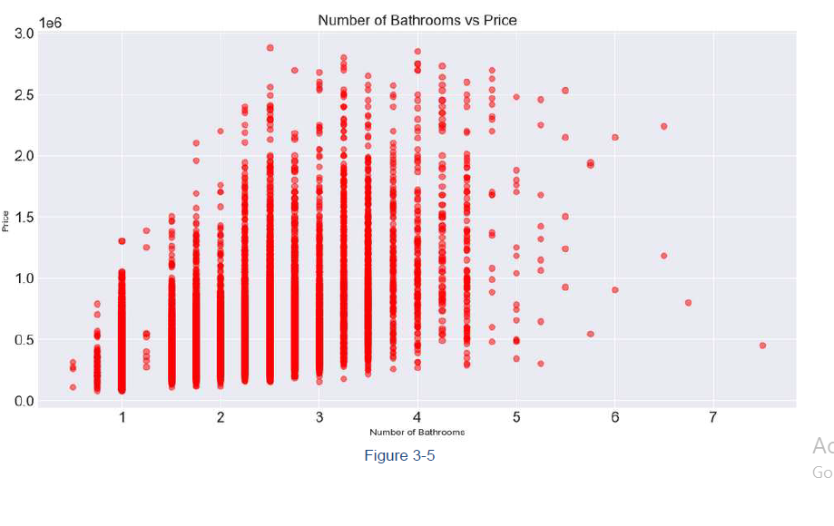
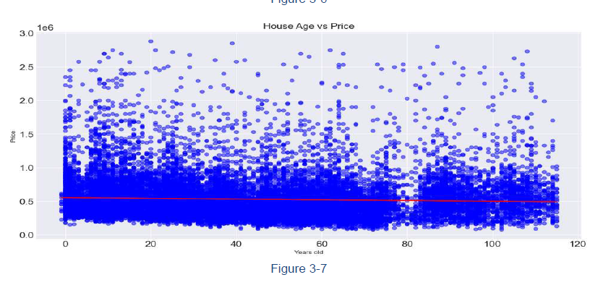
Bivariate analysis
Number of Bathrooms vs. Price:
The scatter plot shows the relationship between the number of bathrooms and house prices.
As the number of bathrooms increases, there may be a positive correlation with higher house prices.
This suggests that houses with more bathrooms tend to have higher prices, potentially indicating their desirability and added value.
House Age vs. Price:
The scatter plot displays the relationship between the age of houses and their corresponding prices.
There may not be a clear linear relationship between house age and prices.
Some houses, regardless of their age, may have high or low prices based on other factors such as location, condition, or renovations.

Slide 10
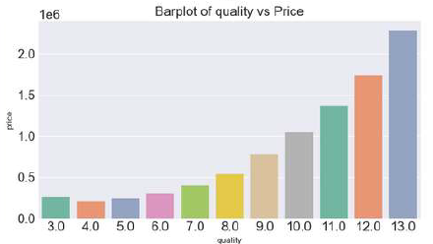
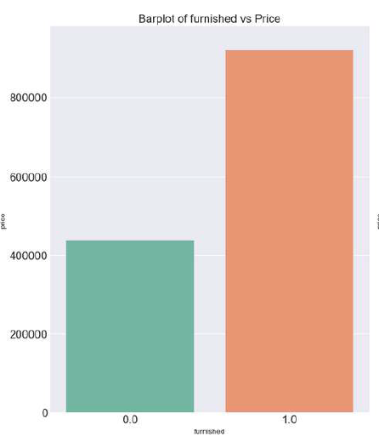
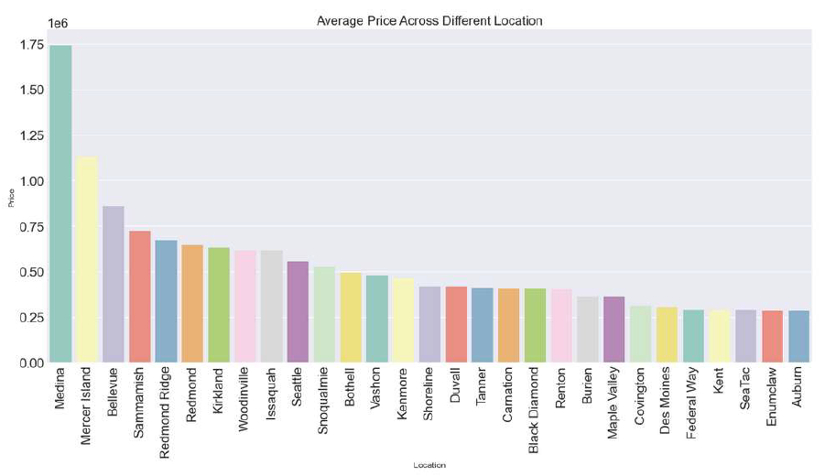
CATEGORICAL BIVARIATE ANALYSIS
Furnished:
Furnished properties tend to have higher average prices compared to unfurnished properties.
This suggests that furnishing adds value to houses and can contribute to higher pricing
Quality:
Higher-quality houses have higher average prices compared to lower-quality houses.
This indicates that the quality of a property positively impacts its pricing.
Location:
Houses in desirable locations have higher average prices compared to less desirable locations.
Location plays a significant role in determining house prices, with prime areas commanding higher values.
The analysis revealed that properties located in Medina tend to have higher prices compared to
properties in Auburn.

Slide 11
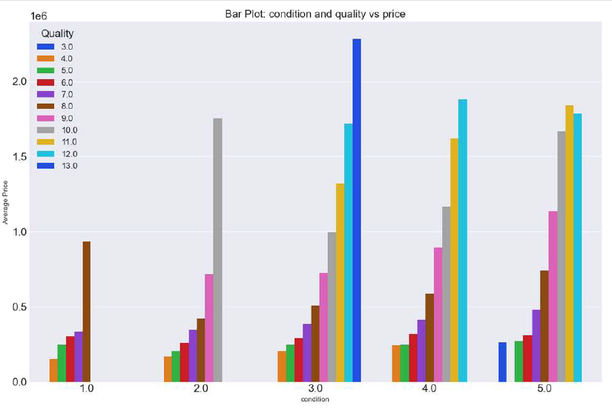
Multi-variate analysis
Insights
The multivariate bar plot displays the average house prices based on different combinations of condition and quality levels.
As the condition and quality ratings increase, the average house prices tend to rise accordingly.
Houses with a high condition rating and high-quality rating exhibit the highest average prices, indicating a positive relationship between condition, quality, and pricing.
Lower condition and quality ratings correspond to lower average house prices, suggesting that these factors impact the perceived value and market demand of properties.

Slide 12
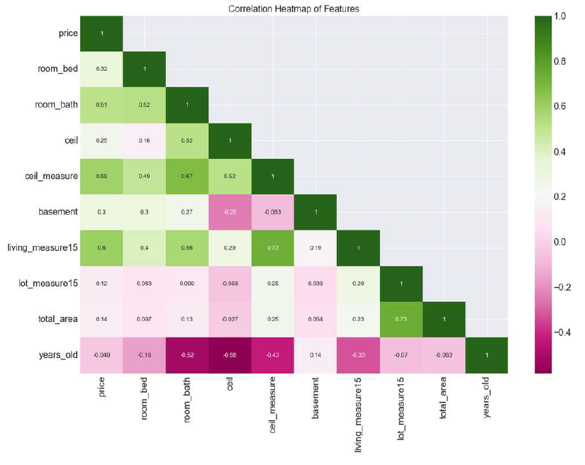
Correlation Analysis:
The correlation table heatmap reveals several insights about the relationships between various attributes and house prices.
The strongest positive correlation exists between price and living area measures. Additionally, the number of bedrooms and bathrooms show a moderate positive correlation,
while the age of the house has negative correlations with certain attributes like ceiling quality and the number of bathrooms.
Overall, the heatmap provides valuable information for understanding the factors influencing house prices. However, it's essential to remember that correlation does not imply causation, and further analysis is necessary to draw definitive conclusions.

Slide 13
Modeling Techniques
Modeling Techniques
Linear Regression:
Simple and interpretable model that establishes a linear relationship between dependent and independent variables.
Minimizes the difference between predicted and actual values using coefficient estimation.
Support Vector Regression (SVR):
Uses support vector machines to find a best-fit hyperplane that maximizes the margin around predicted values.
Handles non-linear relationships through kernel functions and performs well with limited noise.
Random Forest:
Ensemble model combining multiple decision trees for improved prediction accuracy.
Handles high-dimensional data, reduces overfitting, and provides feature importance.
Gradient Boosting:
Sequential ensemble technique that combines weak models by fitting subsequent models to residuals of previous models.
Produces a strong predictive model and handles complex relationships between variables.
Linear Regression:
Simple and interpretable model that establishes a linear relationship between dependent and independent variables.
Minimizes the difference between predicted and actual values using coefficient estimation.
Support Vector Regression (SVR):
Uses support vector machines to find a best-fit hyperplane that maximizes the margin around predicted values.
Handles non-linear relationships through kernel functions and performs well with limited noise.
Random Forest:
Ensemble model combining multiple decision trees for improved prediction accuracy.
Handles high-dimensional data, reduces overfitting, and provides feature importance.
Gradient Boosting:
Sequential ensemble technique that combines weak models by fitting subsequent models to residuals of previous models.
Produces a strong predictive model and handles complex relationships between variables.

Slide 14
Modeling Techniques
Bagging:
Ensemble technique that combines multiple models trained on random subsets of data to reduce variance.
Example: Bagging Regression.
Stacking:
Ensemble technique that combines predictions from multiple models using a meta-model. Allows models to complement each other and improve overall performance.
XGBoost:
Optimized implementation of gradient boosting with scalability and performance improvements. Includes regularization, parallel processing, and handling missing values.
Conclusion:
Regression models offer various techniques for predicting and understanding relationships in data. Ensemble methods like bagging and stacking improve prediction accuracy. XGBoost provides efficient implementation of gradient boosting for scalable performance.

Slide 15
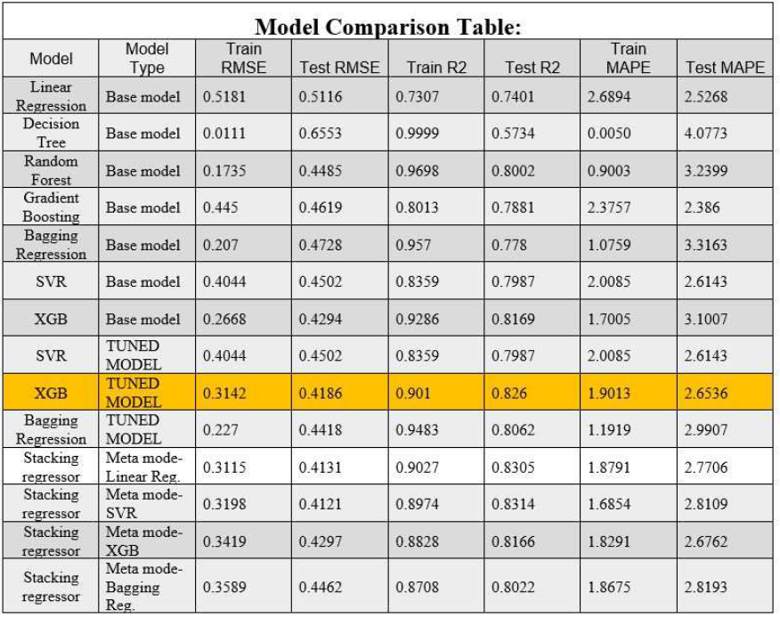
Model Performance
Evaluated multiple machine learning models, including Linear Regression, Decision Tree, Random Forest, Gradient Boosting, Bagging Regression, SVR, and XGBoost.
Stacking regressor with linear regression as the meta-model performed well but was not chosen due to interpretability concerns.
The final model selected is the Tuned XGBoost Regressor. Step-by-step model building involved creating an XGBoost Regressor, defining a parameter grid, performing Grid Search, and retrieving the best hyperparameters.
The final XGBoost model was trained with the best hyperparameters.
Model validation showed favorable metrics: RMSE (Training: 0.3142, Test: 0.4186), R2 (Training: 0.901, Test: 0.826), and MAPE (Training: 1.9013%, Test: 2.6536).
The chosen XGBoost model demonstrated accurate predictions, good generalization, and high variance explanation.
Important features in the model included furnished_1.0, quality ratings, location variables, years_old, and various property attributes.

Slide 16
Final recommendation
1. Develop AI-Powered House Valuation Tool:
Incorporate relevant feature variables for accurate property value estimates.
Provide homeowners with precise valuation using AI algorithms.
2. Market Accuracy and Comprehensive Nature:
Highlight comprehensive analysis beyond location and square footage.
Emphasize the tool's ability to consider multiple factors influencing house prices.
3. Provide Comparative Market Analysis Reports:
Offer insights on recent sales data, market trends, and property comparisons.
Empower homeowners with a deeper understanding of their local real estate market.
4. Partner with Real Estate Agents and Agencies:
Integrate the tool into their services for accurate pricing recommendations.
Strengthen agent credibility and enhance service offerings.
5. Implement User-Friendly Interface:
Ensure an intuitive, visually appealing, and easy-to-navigate interface.
Enhance user experience and encourage repeated usage.
6. Continuously Update and Improve the Model:
Incorporate new data and market trends for accurate predictions.
Gather user feedback to identify areas for improvement.
7. Offer Premium Services:
Provide additional offerings such as in-depth reports and personalized consultations.
Cater to users seeking comprehensive property information.
8. Build Trust and Credibility:
Share success stories, testimonials, and engage in content marketing initiatives.
Position the brand as a reliable authority in house price prediction

Slide 17


