Slide 1
Aggression Identification
Notes:
Line spacing + Page numbers

Slide 2
Table of Contents
01 Introduction
02 Dataset
03 Data Preprocessing
04 Models
05 Results & Conclusions

Slide 3
Introduction
01
Over the years, with the increase in the number of users as well as content on the internet, there has been a substantial increase in the number of aggression activities such as trolling, cyberbullying, hate speech, etc.
We used Facebook and other social media posts which contain such kind of aggressive words. After data preprocessing, we performed three strategies in text classification namely bag of words using TFIDF, word embedding using word2vec, BERT language model.

Slide 4
Dataset
02

Slide 5
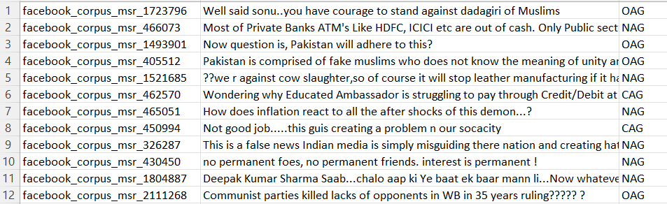
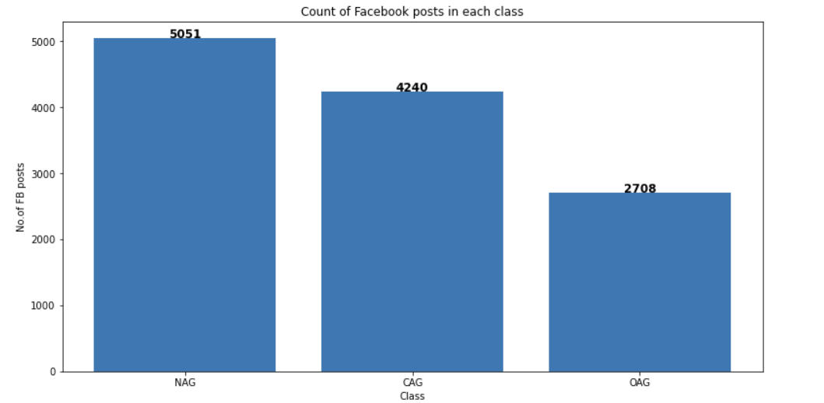
Data
Data Info
Taken from Facebook posts
A total of 15000 posts are present in CSV format
Each of the posts already classified based on the aggressiveness
Number of Classes
Overtly Aggressive
Covertly Aggressive
Non-Aggressive

Slide 6
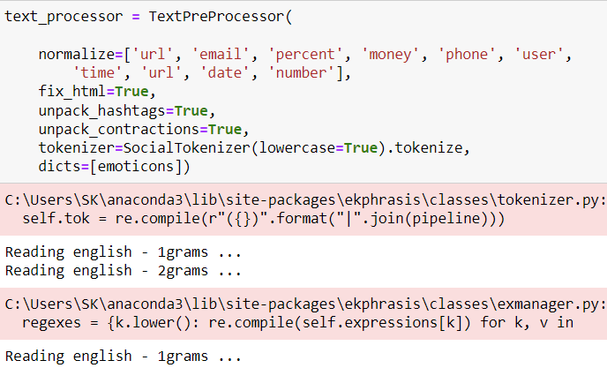
Data Preprocessing
03
Normalization – Removing all the unnecessary data such as URL, mail, etc.
Fixing all HTML tokens
Performing word segmentation on hashtags
Unpacking contractions ( can’t -> can not)
Tokenizer – converting the input string into tokens
Dictionary for replacing tokens extracted from the text with other expressions.

Slide 7
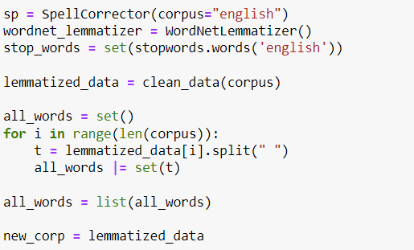
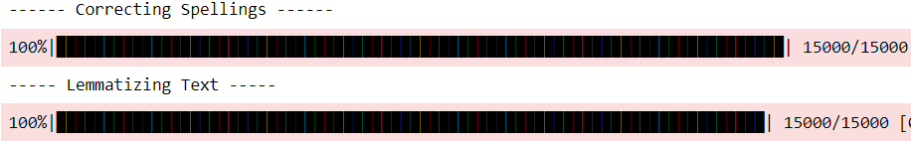
Cleaning the Data
Correcting Spellings
Lemmatizing Text Removing other forms of words and replacing them with the base form of it (removing –ing)

Slide 8
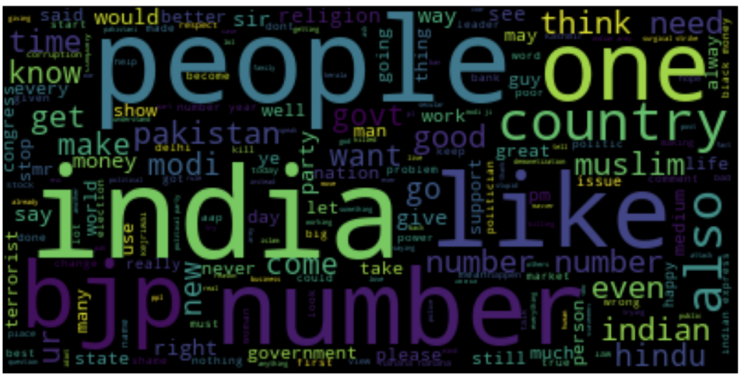
WordCloud

Slide 9
Three Strategies
Term Frequency Inverse Document Frequency
Word Embedding
BERT Language Model

Slide 10

TFIDF Vectorizer
Using TFIDF vectorizer, we perform feature extraction on the processed data
As they are a lot of features, we do feature selection using chi-squared method

Slide 11
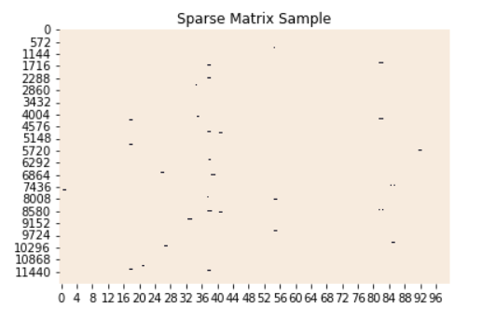
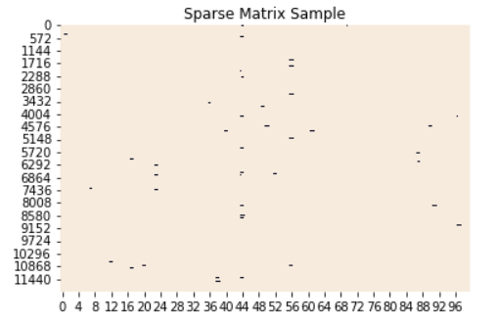
Feature Selection
After feature extraction, the vectorized corpus is very sparse. So, we apply feature selection using the chi-squared method based on the given p-value to select more relevant features.

Slide 12
ML Model Pipeline
TF-IDF Vectorizer
ML Classifier
Prediction

Slide 13
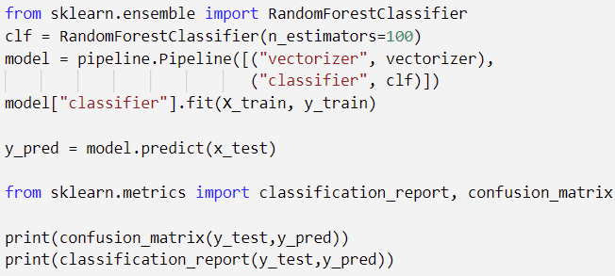
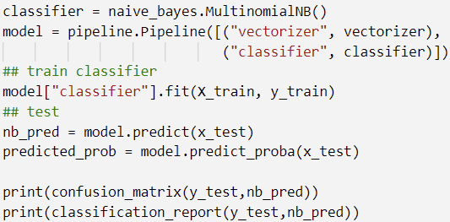
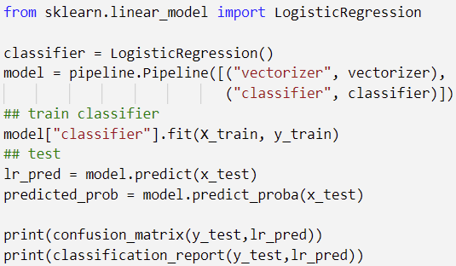
ML Classifiers

Slide 14
ML Models Metrics
 |  | Precision | Recall | F1 Score | Accuracy
Random Forest | 0 | 0.61 | 0.72 | 0.66 | 0.56
 | 1 | 0.48 | 0.48 | 0.48
 | 2 | 0.55 | 0.38 | 0.45
Multinomial Naïve Bayes | 0 | 0.63 | 0.69 | 0.66 | 0.55
 | 1 | 0.47 | 0.55 | 0.51
 | 2 | 0.54 | 0.31 | 0.40
Logistic Regression | 0 | 0.63 | 0.70 | 0.67 | 0.56
 | 1 | 0.49 | 0.49 | 0.49
 | 2 | 0.54 | 0.43 | 0.48

Slide 15



Confusion Matrix
RandomForest MultinomialNB LogisticRegression

Slide 16
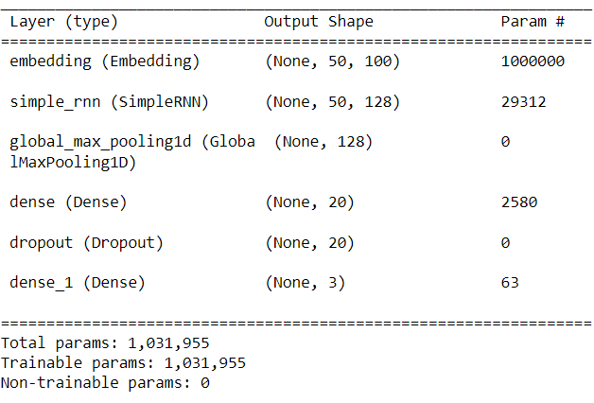
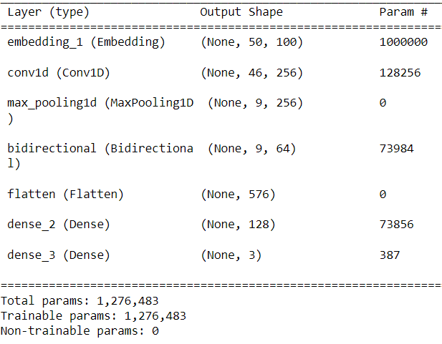
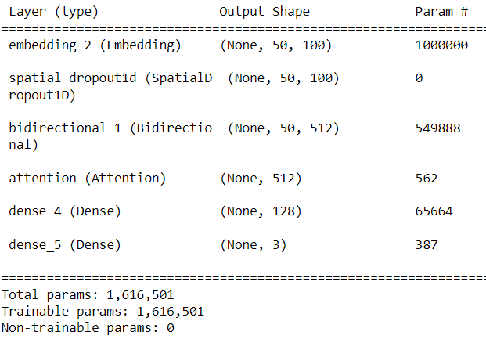
DL Architectures
RNN LSTM GRU

Slide 17
DL Models Metrics
 |  | Precision | Recall | F1 Score | Accuracy
Simple RNN | 0 | 0.66 | 0.54 | 0.60 | 0.51
 | 1 | 0.41 | 0.36 | 0.47
 | 2 | 0.49 | 0.38 | 0.43
LSTM | 0 | 0.66 | 0.55 | 0.66 | 0.51
 | 1 | 0.43 | 0.52 | 0.47
 | 2 | 0.45 | 0.43 | 0.44
GRU | 0 | 0.66 | 0.55 | 0.60 | 0.51
 | 1 | 0.43 | 0.52 | 0.47
 | 2 | 0.45 | 0.43 | 0.44

Slide 18
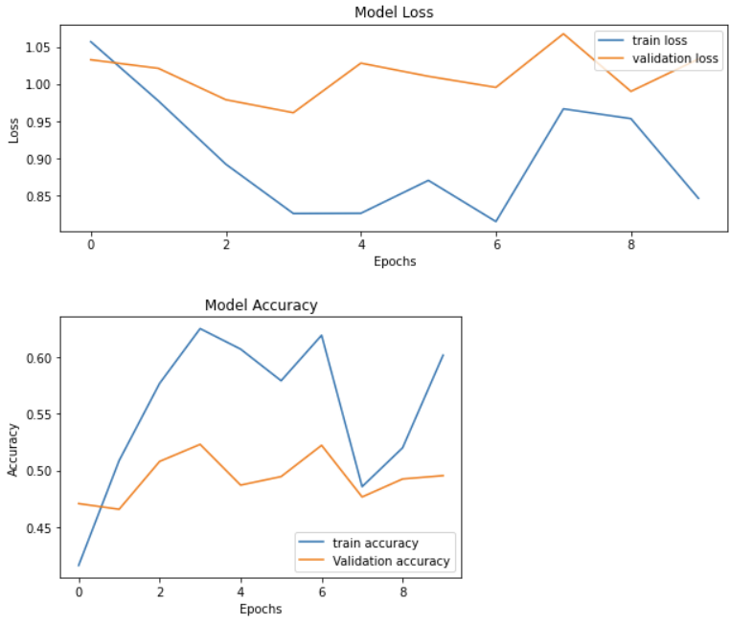
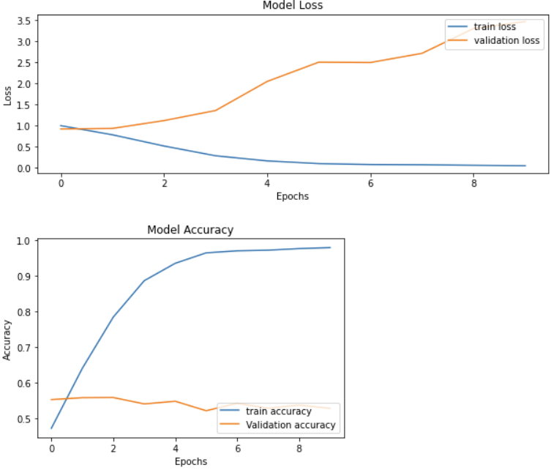
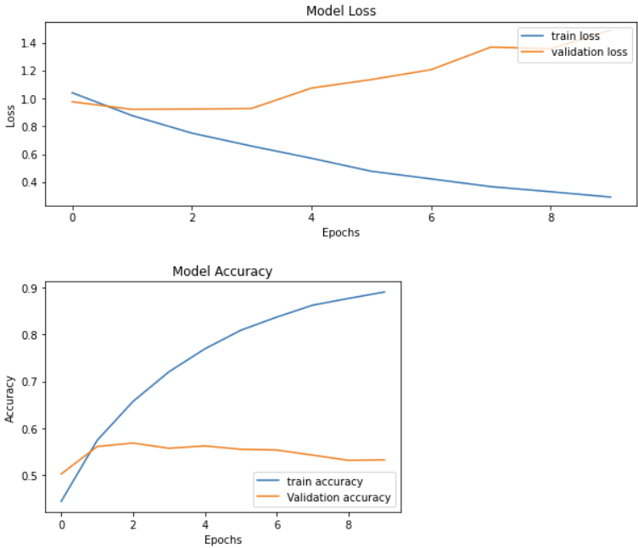
Loss and Accuracy Curves
RNN LSTM GRU

Slide 19



Confusion matrix
RNN LSTM GRU

Slide 20
Word Embeddings
Using TFIDF vectorizer, we perform feature extraction on the processed data
As they are a lot of features, we do feature selection using chi-squared method

Slide 21
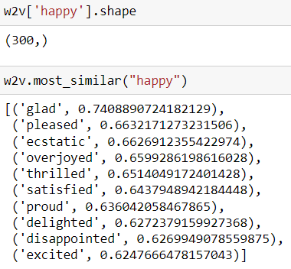

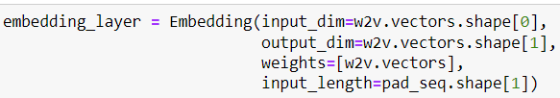
Word2Vec
We used a pre-trained word2vec model from google and performed LSTM to the obtained word embeddings

Slide 22
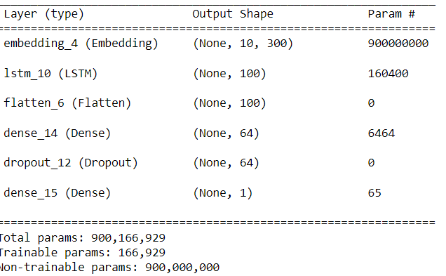
Word2vec+LSTM
Architecture
Results
Accuracy | 0.42
Precision | 0.42
Recall | 0.52
F1-score | 0.59

Slide 23
BERT Language Model
Initially, we will calculate the masks, idx, and segments for the given corpus using BertTokenizer with the help of a pretrained bert-base-uncased model.
Then we will combine into a single array and apply the function to our training and testing data.

Slide 24
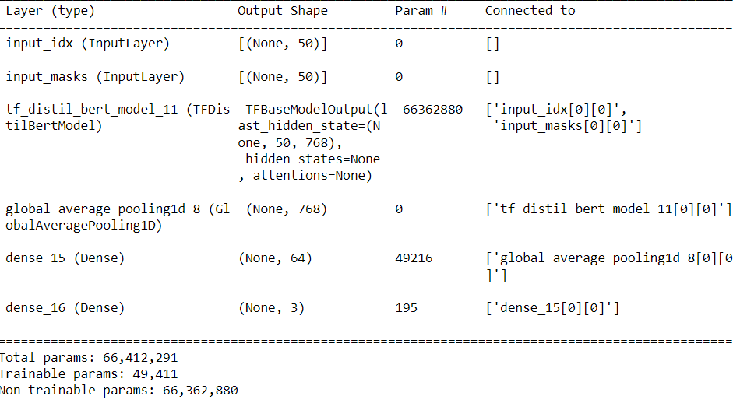
Model Architecture

Slide 25
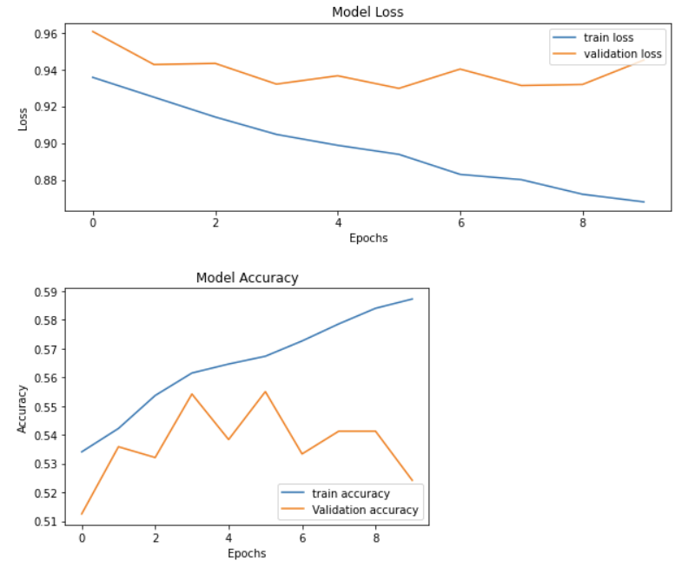
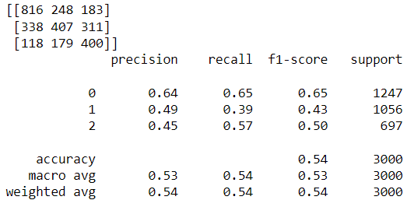
Results

Slide 26
Inference
We can observe that ML models achieved high accuracy by a close margin when compared to others.
There are also fewer misclassifications in the CAG class in DL models but OAG class misclassifications are more.
The BERT, while compared to others, achieved a slightly lesser accuracy but the toughest class OAG is classified pretty well.

Slide 27
Conclusion
The performance of the best systems in the task shows that aggression identification is a hard problem to solve.
Moreover, the performance of the neural networks-based systems as well as the other approaches do not seem to differ much.
If the features are carefully selected then classifiers like SVM and even random forest and logistic regression perform at par with deep neural networks.
On the other hand, we find quite a few neural networks-based systems not performing quite well in the task
Hence, we may point out the apparent “inconsistencies” in the annotation and need to get the annotations validated by multiple human annotators.

Slide 28
THANK YOU

