Slide 1
Machine Learning
© Templateswise.com
algorithms using Python
“A baby learns to crawl, walk and then run. We are in the crawling stage when it comes to applying machine learning.”
- Dave Waters

Slide 2
Team Members
Name Roll no
K V Sai Krishna - CB.EN.U4AIE19035
P Sri Vaishno - CB.EN.U4AIE19048
P Shankar - CB.EN.U4AIE19049
B Manjunath - CB.EN.U4AIE19015

Slide 3
Machine Learning
Machine learning is an application of artificial intelligence (AI) that provides systems the ability to automatically learn and improve from experience without being explicitly programmed.
The aim is to allow the machines to learn automatically without any kind of human intervention or assistance and adjust its actions or course accordingly.
The process of learning begins with observations or data, such as examples, direct experience, or instruction, in order to look for patterns in data and make better decisions in the future based on the examples that we provide to the machine.
A classifier is a machine learning model that is used to discriminate different objects based on certain features.

Slide 4
Problem Statement
The Idea
The Algorithm
The Data
Algorithms designed are KNN, SVM, LDA LogisticRegression, GaussianNB.
To classify the given data and predict a better solution using ML.
The collected data is Breast Cancer dataset from state Wisconsin, USA.

Slide 5
Logistic Regression algorithm

Slide 6
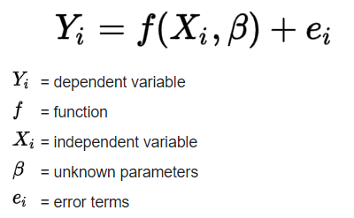
Regression:
Regression is a statistical method used in finance, investing, and other disciplines that attempts to analyze the relationship between one dependent variable (Y) and a series of independent variables(features).
The two primary uses for regression in business are forecasting and optimization.
It also helps fine-tune manufacturing and delivery processes.

Slide 7


Logistic Regression:
Logistic Regression is a supervised classification algorithm used when the dependent variable(target) is categorical.
The mathematical equations is,
Where, ℓ is the log-odds, p is the probability
b is the base(usually e), beta(i) are the parameters of the model
Upon solving the above equation we get a simplified form,
Where, Sb(x) = = Sigmoid function

Slide 8
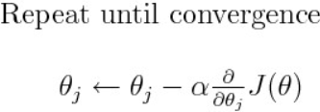
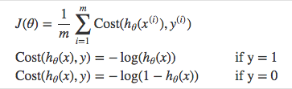
Decision boundary:
To predict which class a data belongs, a threshold can be set. Based upon this threshold, the obtained estimated probability is classified into classes.
For example, if predicted_value ≥ 0.5, then classify email as spam else as not spam.
Gradient descent:
The gradient descent, which is the extension of derivative in multi-dimensional space, tells the direction along which the loss or error is optimally minimized.
Cost function:
Instead of Mean Squared Error, we use a cost function called Cross Entropy, also known as Log Loss.

Slide 9
Implementation:
First, we will process the data by using different functions that are shown in the python code.
In order to map predicted values to probabilities, we use the sigmoid function. The function maps any real value into another value between 0 and 1.
Then we will initialize the parameters weight, bias and compute the gradient descent.
With those gradient values the parameters will be repeatedly updated until the model reaches convergence.
Finally, we will predict the class labels for the training data with the obtained optimal parameters and then evaluate the model using classification report metrics.

Slide 10
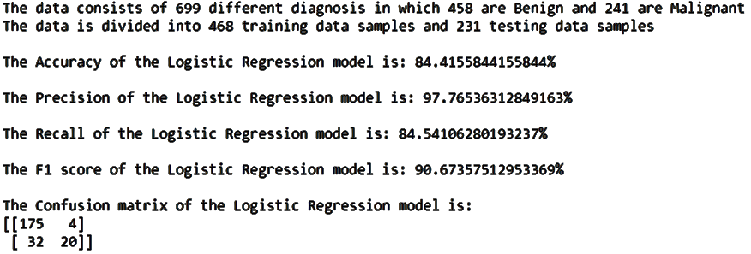
Results:
Input - Breast-cancer-Wisconsin
Split ratio - 0.67 (67% of the data is for training the ML model)
Output -

Slide 11
Applications and Advantages:
Predictive analysis
Operation efficiency
Supporting decisions
Correcting errors
New insights
It is easier to implement, interpret, and very efficient to train.
It makes no assumptions about distributions of classes in feature space.
It is very fast at classifying unknown records.
Good accuracy for many simple data sets and it performs well when the dataset is linearly separable but does not work for non linear data and for data where features are more than data points.

Slide 12
Gaussian Naïve Bayes algorithm

Slide 13
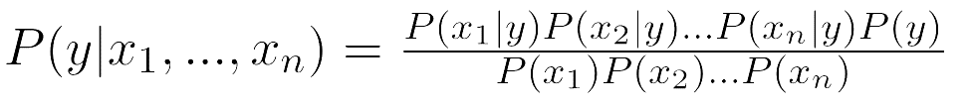
Naïve Bayes:
A Naïve Bayes classifier is a supervised probabilistic machine learning model that’s used for classification task. The crux of the classifier is based on the Bayes theorem.
The Bayes theorem states that:
Posterior
probability
No.of features
Class
Prior
Likelihood
Normalization constant

Slide 14
Parameters:
For the Bayes classifier, we need to “learn” two functions, the likelihood and the prior.
The problem with explicitly modeling P(X₁,…,X_{n} | Y) is that there are usually way too many parameters due to which:
We’ll run out of space
We’ll run out of time
And we’ll need tons of training data (which is practically not available)

Slide 15
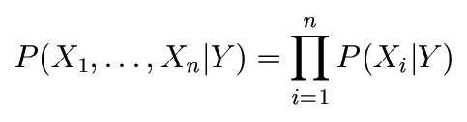
Assumption:
Assume that all features are independent given the class label Y
Mathematically speaking,

Slide 16


Gaussian Naïve Bayes:
When characteristic values are continuous in nature then an assumption is made that the values linked with each class are dispersed according to Gaussian that is Normal Distribution.
So, a Gaussian probability density function is used in place of the conventional conditional probability function.
Where,
and are the standard deviation and mean of the independent features.
$$σ$$
$$μ$$

Slide 17
The main functions involved are:
Mean - sum(datapoints)/(no.of datapoints)
Standard deviation - sqrt((sum(xi – mean)^2)/(no.of datapoints))
Probability - e^((-sum(xi – mean)^2)/(2*(std^2)))/sqrt(2*pi*(std^2))
Accuracy - (TP + FP)/(TP + FP + TN + FN)
Precision - (TP)/(TP + FP)
Recall - (TP)/(TP + FN)
F1-score - (2*Precision*Recall)/(Precision + Recall)
Confusion matrix - TP FP
FN TN
Classification report metrics

Slide 18
Implementation:
Initially, we will group the data based on its class label and calculate the individual standard deviations and means for the individually assumed features using NumPy and Pandas library.
Then we will train the ML algorithm by taking a fraction(usually around 67%) of the given dataset.
Finally, we will test the algorithm by taking the remaining portion of data and predict the class label for them.
Upon predicting, we compare the actual class label with the predicted class label of that particular datapoint and evaluate the ML model using classification report metrics.

Slide 19
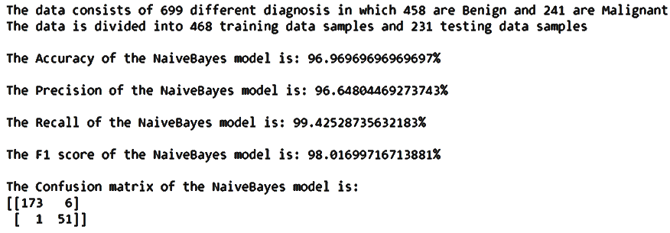
Results:
Input - Breast-cancer-Wisconsin
Split ratio - 0.67 (67% of the data is for training the ML model)
Output -

Slide 20
Applications and Advantages:
Spam Email classification
Medical diagnosis
Weather data classification
Sentiment Analysis
It is simple and easy to implement.
It doesn't require as much training data.
It handles both continuous and discrete data.
It is highly scalable with the number of predictors and data points.
It is fast and can be used to make real-time predictions but sometimes “speed comes with a cost”.

Slide 21
THANK YOU
and have a nice day

