Slide 1
IBM University Engagement Project Submission
“Exploring the Power of Agentic AI with IBM Cloud and Orchestrate”

Slide 2

Project Tile – AI-Based 5G Network Optimization Advisor
Domain of Project – Artificial Intelligence and Machine Learning for 5G Telecommunication Network Optimization
Student Name | Recent Passport Photo | Email ID | Mobile number [WhatsApp]
Vaishnavi Dadasaheb Tele |  | televaishnavi23@gmail.com | 9021687268

Slide 3
Problem Statement -
Problem Statement : AI-Based 5G Network Optimization Advisor
The Challenge
The rapid growth of 5G users and connected devices creates challenges such as network congestion, high latency, uneven resource utilization, and fluctuating network performance. Traditional network monitoring and optimization methods often require manual analysis and may not respond quickly to changing traffic conditions.
The Objective
To use AI/ML to analyze 5G network data, predict congestion, and provide intelligent optimization recommendations. The goal is to improve QoS, reduce latency, and efficiently utilize network resources.
⭐ Main Points
Collect Network Data – Gather traffic, latency, bandwidth, signal strength, and network usage data.
Analyze Performance – Analyze network conditions and identify performance issues.
Detect Congestion – Detect overloaded cells, high traffic, and network bottlenecks.
Predict Issues – Predict future traffic congestion and performance problems using AI/ML.
Optimize Resources – Recommend efficient bandwidth, spectrum, and resource allocation.
Generate Recommendations – Provide actionable optimization suggestions to network operators.
Monitor Improvements – Track QoS, latency, throughput, and overall network performance.
Advisor Dashboard – Display network status, predictions, and recommendations in an easy-to-understand dashboard.

Slide 4
Proposed Solution -
The AI-Based 5G Network Optimization Advisor is a smart system designed to improve the performance, efficiency, and reliability of 5G networks using Artificial Intelligence and Machine Learning. The proposed system collects and analyzes important network parameters such as traffic load, bandwidth usage, latency, signal strength, throughput, packet loss, and resource utilization from different network cells. AI/ML algorithms analyze both historical and real-time data to identify network congestion, overloaded cells, abnormal traffic patterns, and inefficient resource utilization. The system can also predict future congestion and potential network performance issues before they significantly affect users. Based on the analysis, the advisor generates intelligent recommendations such as traffic load balancing, bandwidth optimization, resource allocation, and network parameter adjustment. A centralized dashboard displays the current network status, detected issues, predicted problems, performance metrics, and recommended actions in an easy-to-understand format. This solution helps network operators make faster, data-driven decisions, reduce manual monitoring efforts, improve Quality of Service (QoS), minimize latency and congestion, and achieve more efficient utilization of 5G network resources.

Slide 5
Technology Used
Artificial Intelligence & Machine Learning – Traffic prediction, congestion detection, and optimization recommendations.
Python – Development of AI/ML models and data processing.
Pandas & NumPy – Network-data processing and analysis.
Scikit-learn – Machine-learning algorithms for prediction and classification.
TensorFlow/PyTorch – Deep-learning models, if required.
5G Network Technologies – Analysis of latency, bandwidth, throughput, signal strength, and traffic load.
SQL / MongoDB – Storage of network performance data.
Flask / FastAPI – Backend API for connecting the AI model with the application.
React.js / HTML, CSS, JavaScript – Interactive monitoring dashboard.
Matplotlib / Plotly – Network-performance visualization and graphs.
Cloud/Edge Computing – Real-time processing and scalable deployment.

Slide 6
Orchestrate component Used -
Data Collection Component – Collects 5G network metrics such as traffic, latency, bandwidth, and signal strength.
Data Processing Component – Cleans and prepares network data for AI/ML analysis.
AI/ML Prediction Component – Predicts traffic congestion and possible network issues.
Network Analysis Component – Identifies performance bottlenecks and inefficient resource utilization.
Optimization Engine – Generates recommendations for bandwidth, resource allocation, and traffic balancing.
Recommendation Component – Provides actionable suggestions to network operators.
Dashboard Component – Displays network status, predictions, alerts, and recommendations.
Database Component – Stores historical and real-time network performance data.

Slide 7
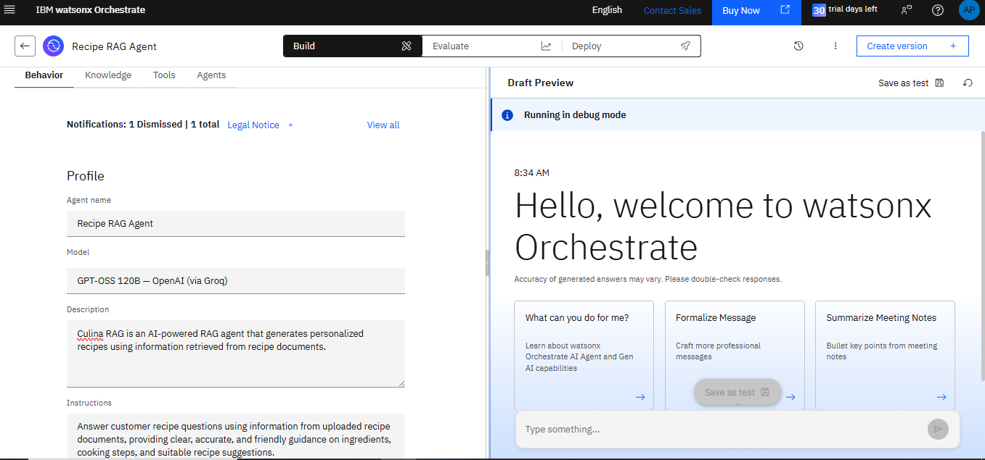
Agent Instructions Screenshot-

Slide 8
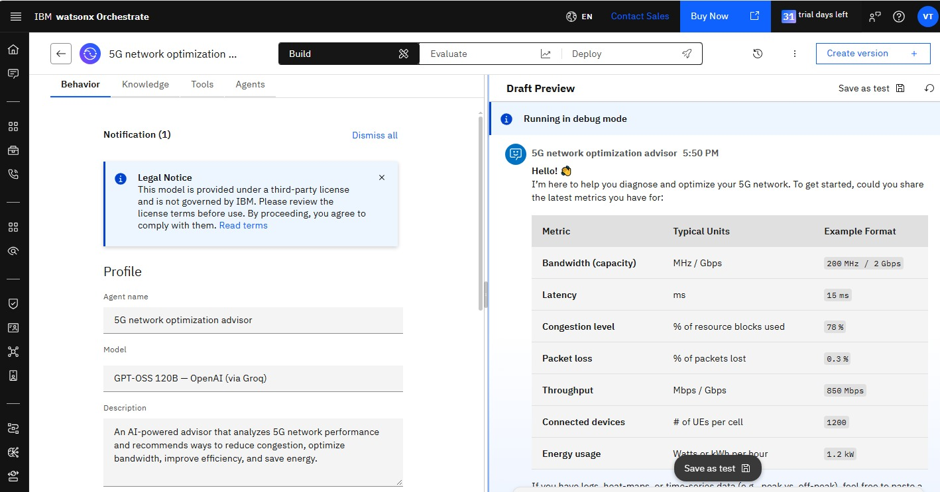
Prompt with output Screenshot:

Slide 9
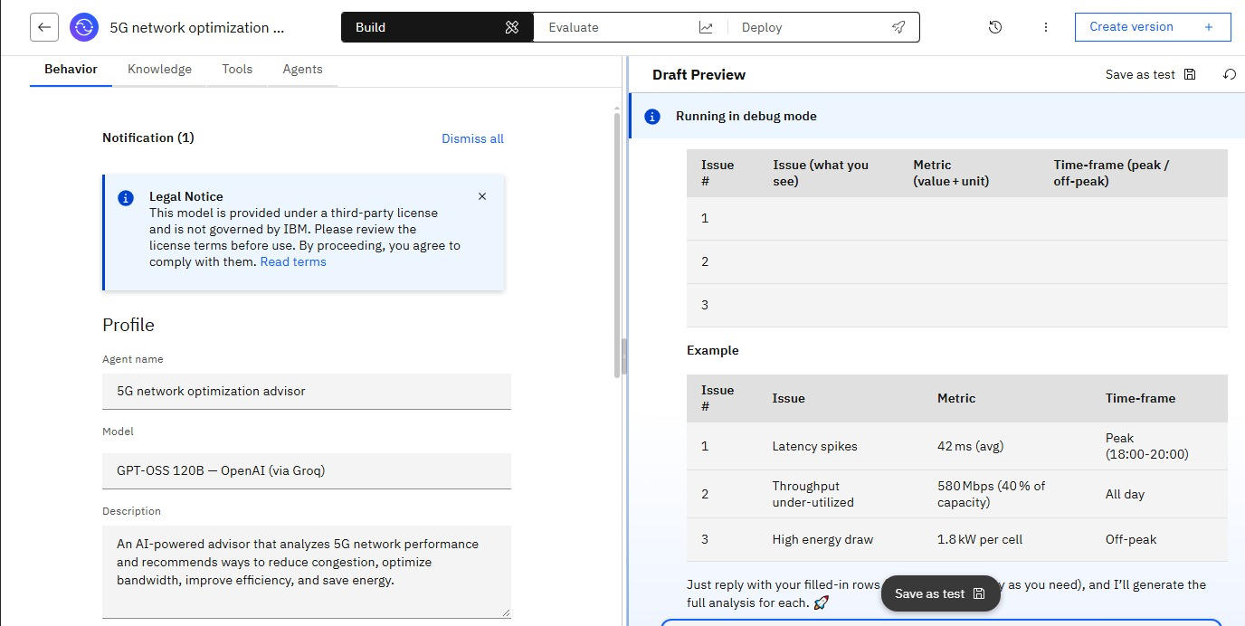
Other Applicable Screenshots:

Slide 10

Role of Agentic AI in the solution
Agentic AI acts as an intelligent decision-support agent that continuously monitors 5G network conditions, analyzes incoming data, detects problems, and decides what optimization actions should be recommended. It can coordinate different components such as data collection, ML prediction, network analysis, and the recommendation engine to provide context-aware solutions.
Monitor: Continuously monitors network performance.
Analyze: Examines traffic, latency, bandwidth, and resource usage.
Predict: Identifies potential congestion and performance issues.
Reason: Determines suitable optimization strategies based on network conditions.
Recommend: Suggests actions such as traffic balancing and resource allocation.
Learn: Uses historical results and feedback to improve future recommendations.
Report: Presents insights and recommendations through the dashboard.

Slide 11
Novelty and Uniqueness
Agentic AI-Based Advisor – Uses AI agents to analyze network conditions and generate context-aware recommendations.
Predictive Optimization – Predicts congestion and performance issues before they significantly affect the network.
Real-Time Network Analysis – Continuously analyzes traffic, latency, bandwidth, and resource utilization.
Actionable Recommendations – Suggests specific optimization actions instead of only displaying network statistics.
Adaptive Learning – Uses historical network data and feedback to improve future recommendations.
Unified Dashboard – Provides network status, predictions, alerts, and optimization suggestions in one interface.
Scalable Architecture – Can be extended to multiple 5G cells, network regions, and different network conditions.

Slide 12
Git Hub Link
Please create public github repository (Enable Add README button while creating repository) with format –
Please test and Paste the working Github URL –Make sure you have Uploaded following three files into your github repository
1) app.json file , 2) yourproblemstatement.pdf file 3) your projectpresntation.pptx file 4)any other files
·
·
·

Slide 13
Future Scope
Autonomous Network Optimization – Enable AI agents to automatically apply approved optimization actions.
6G Network Integration – Extend the system to support future 6G technologies and networks.
Advanced Traffic Prediction – Improve prediction of congestion and network demand using advanced AI models.
Edge AI Integration – Perform AI processing closer to users for faster decision-making and lower latency.
AI-Based Security – Detect abnormal network behavior and potential cybersecurity threats.
IoT & Smart City Support – Optimize networks supporting large numbers of IoT and smart-city devices.
Cloud-Native Deployment – Scale the advisor across multiple network regions using cloud infrastructure.
Continuous Learning – Improve recommendations using real-time network feedback and historical data.
·
·
·

Slide 14
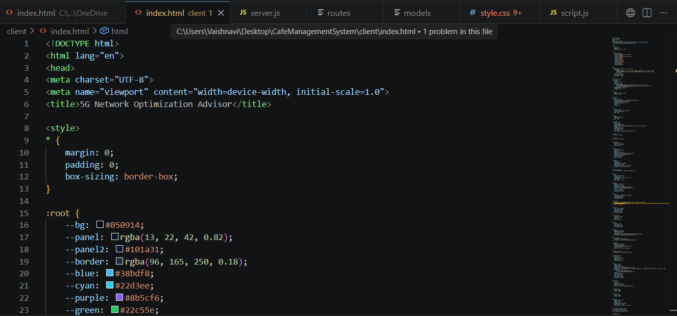

Slide 15
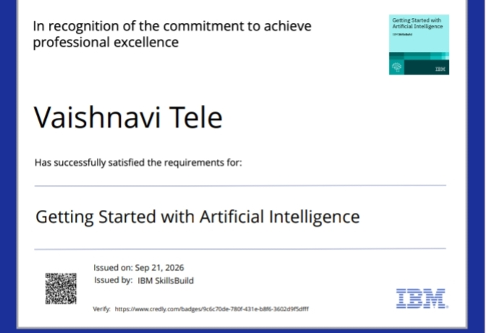
Certificates Earned:

Slide 16

Certificates Earned:​
IBM BOB Certificate

Slide 17


