Slide 1
EMPLOYEE DATA ANALYSIS
USING EXCEL
STUDENT NAME: VAISHNAVI.P
REGISTER NO:
312210942(8D8F820C641912EA8CE41B1A3D2C3423)
DEPARTMENT: B.COM(GENERAL)
COLLEGE: BHAKTAVATSALAM MEMORIAL COLLEGE FOR WOMEN

Slide 2

PROJECT TITLE
EMPLOYEE PERFORMANCE ANALYSIS
USING EXCEL

Slide 3


AGENDA
Problem Statement
Project Overview
End Users
Our Solution and Proposition
Dataset Description
Modelling Approach
Results and Discussion
Conclusion
3/21/2024 Annual Review

Slide 4

PROBLEM STATEMENT
“Our current way of tracking performance is old and not effective. It’s hard to see how employees are doing and give them the right feedback. We plan to use Excel to better organize and understand performance data. This will help us see strengths, fix problems, and make better choices for our employees and the company.”

Slide 5

PROJECT OVERVIEW
“This project focuses on improving our employee performance tracking by utilizing various Excel tools and techniques. We will use data manipulation techniques, conditional formatting, PivotTables, functions and formulas, Power Query, and charts and graphs to organize and analyze performance data. The goal is to create a more effective system for assessing employee performance, providing feedback, and making informed decisions.”

Slide 6

WHO ARE THE END USERS?
Organisation
Employers
Managers
HR Department
Employees

Slide 7

OUR SOLUTION AND ITS VALUE PROPOSITION
Conditional formatting: Highlights missing values in performance data to ensure completeness and accuracy.
Filter: Removes irrelevant or outlier data, allowing us to focus on key performance indicators.
Pivot table: Summarizes and aggregates performance data, providing clear and actionable insights.
Graph: Creates visual representations of performance trends, making it easier to interpret and communicate data.

Slide 8
Dataset Description
EMPLOYEE DATA - KAGGLE
Total Features - 26
Features used - 11
Employee ID
FirstName
Title
Business Unit
Employee Status
Employee Type
Employee Classification Type
Department Type
Gender Code
Performance Score
Current Employee Rating

Slide 9

THE "WOW" IN OUR SOLUTION
FORMULA:
=IFS(Z8>=5,"Very High",Z8>=4,"High",Z8 >=3,"Medium",TRUE,"Low")
This formula is used to find out the performance level of the employes which is derived as “Medium, Low, very high". And this performance level is used to get an graphical representation of the employees performance.
This formula categorizes employee performance into four levels:
"Very High" for scores of 5 or greater,
"High" for scores between 4 and 4.99,
"Medium" for scores between 3 and 3.99,
"Low" for scores below 3.
3/21/2024 Annual Review
9

Slide 10
MODELLING
Data Collection: Gather performance data from Kaggle, which provides a diverse range of datasets for analysis.
Features Collection: Identify and collect specific performance attributes, such as productivity metrics, quality scores, and attendance records.
Data Cleaning: Process the data to remove or correct inaccuracies and inconsistencies, ensuring a reliable dataset for analysis.
Performance Level: Categorize employees into performance levels (e.g., Very High, High, Medium, Low) using predefined criteria or formulas.
Pivot Table: Use PivotTables to summarize and aggregate performance data, enabling detailed analysis and comparison.
Graph Visualization: Create graphs and charts to visually represent performance trends and insights, making the data easier to interpret and communicate.
10

Slide 11
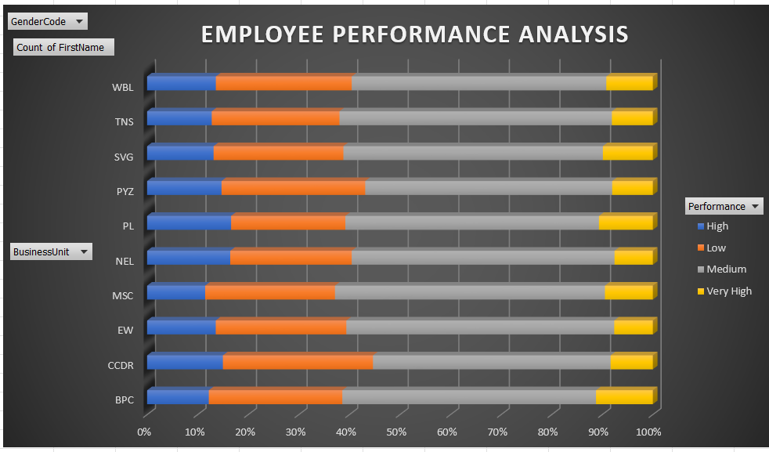
RESULTS
11

Slide 13
conclusion
The modeling process, utilizing data collected from Kaggle and structured through features collection, data cleaning, and performance level categorization, has significantly enhanced our employee performance analysis. By leveraging PivotTables for detailed summaries and graph visualizations for clear insights, we have transformed raw performance data into actionable intelligence. This approach not only simplifies performance assessments but also supports more informed decision-making, ultimately leading to more effective employee management and development.

