Slide 1

Toy Sales Report Dashboard
Tools Used: Power BI | SQL | Excel
Your Role: Data Analyst
Duration: Feb 2025 – Mar 2025
Comprehensive analysis of toy store performance, sales, and inventory metrics
PRESENTED BY: VAISHNAVI SWAPNIL RAUT

Slide 2
Goal Of Project:
To analyze toy sales data across multiple store locations to uncover sales trends, location-wise performance, product demand, and inventory insights for better business decision-making.
Sales Performance
Inventory Management
Business Decision-Making

Slide 3
The toy retail chain was struggling to track and compare sales performance across multiple store locations.
Toy store faced challenges such as:
Lack of centralized visibility into sales, profit, and inventory data.
Difficulty identifying high- and low-performing stores or products.
Inefficient inventory distribution causing overstock or stockouts.
Limited insights into location-based and seasonal sales trends.
Manual reporting leading to delayed decision-making.

Slide 4
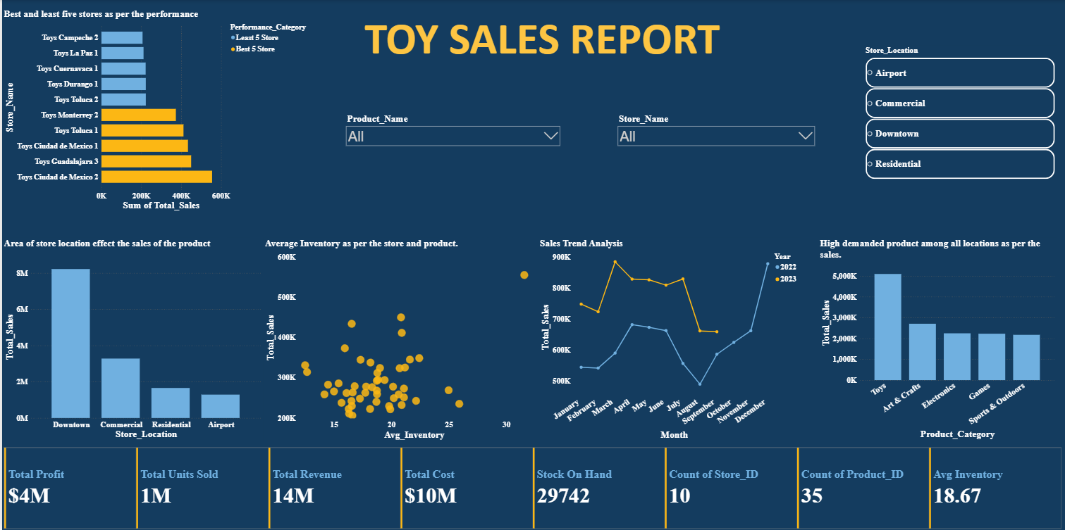

Slide 5
Strategic Recommendations
Focus on High-Performing Locations
  Invest more in marketing and inventory for Downtown and Commercial area stores to maximize revenue potential.
Reevaluate Low-Performing Stores
  Analyze reasons behind low sales in Residential and Airport areas; consider targeted promotions or store restructuring.
Optimize Inventory Management
  Use demand forecasting and real-time tracking to balance stock levels and reduce overstock or shortages.
Expand Top-Selling Product Categories
  Increase production and visibility of high-demand toys and trending product lines.
Seasonal Campaign Planning
  Launch promotional offers during peak months (March–April, December) to leverage high demand.

Slide 6

Thank You!

