Slide 1
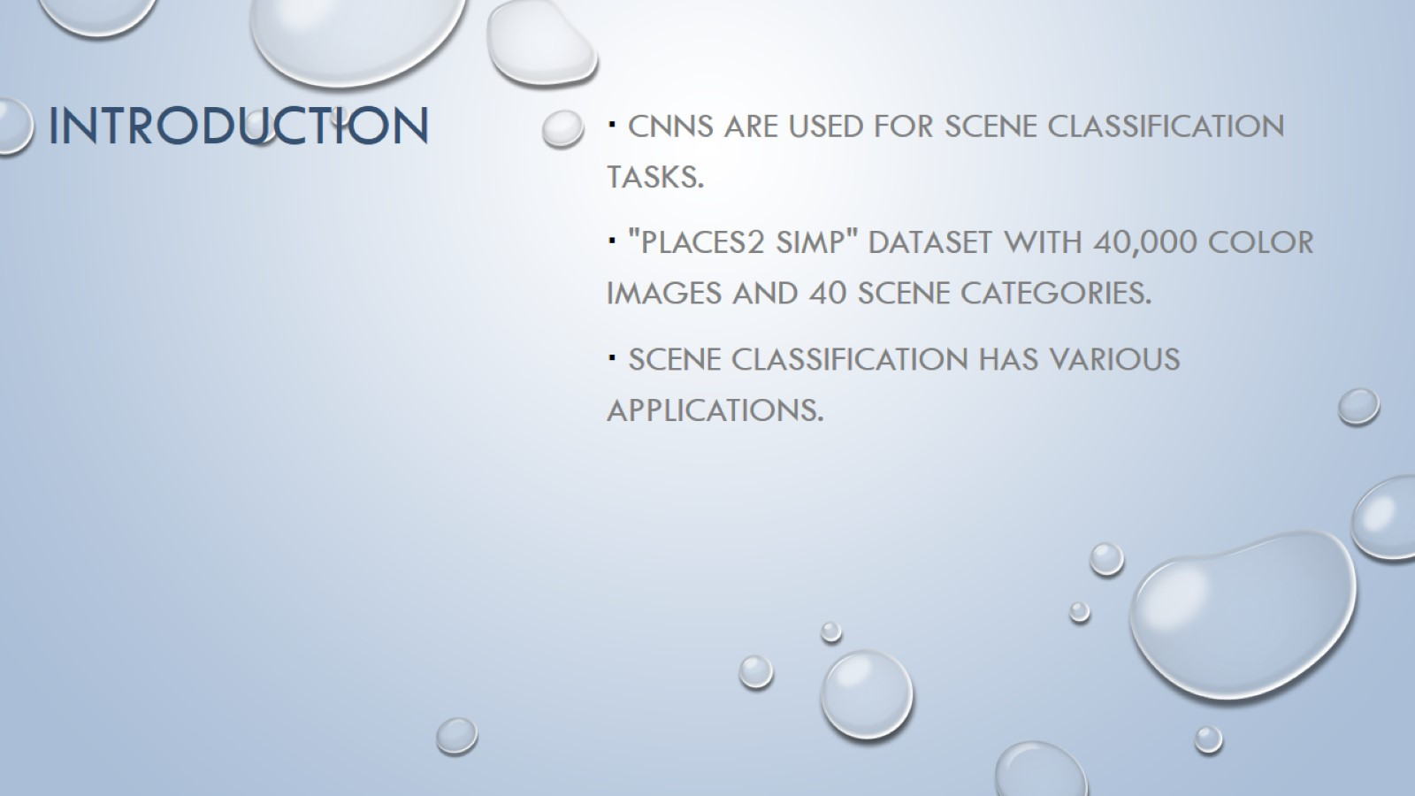
INTRODUCTION

Slide 2
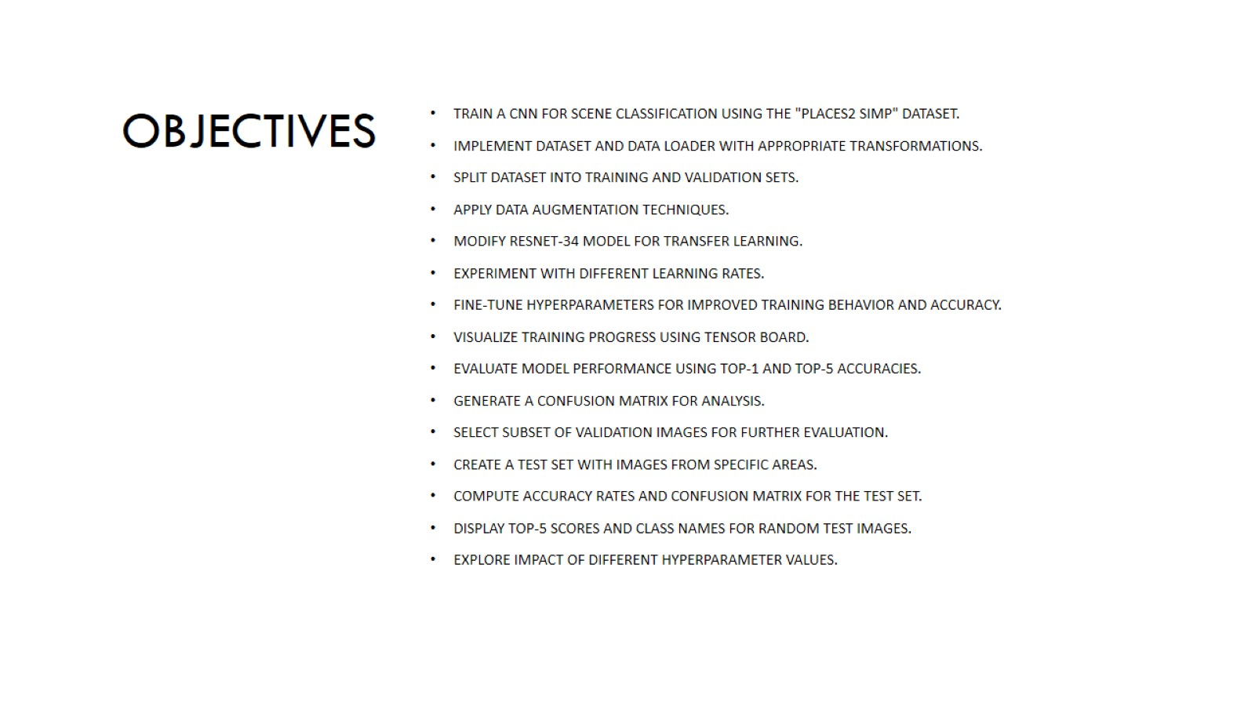
Objectives

Slide 3
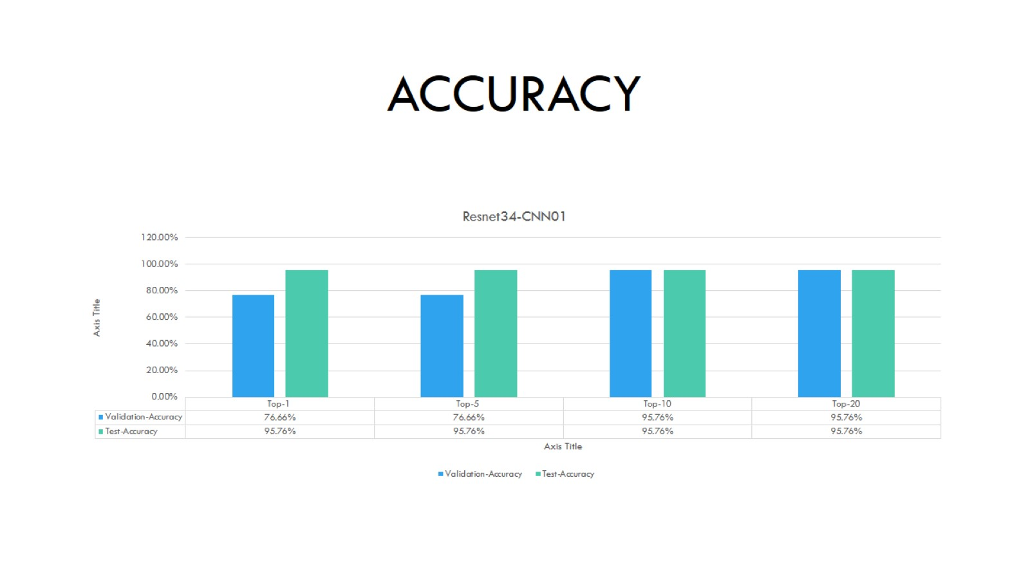
Accuracy
optimizer | Adam
Learning rate | 0.001
Feature extractor learning rate | 0.0001
Weight Decay | 0.0005
No of Epochs | 10
Train-batch-size | 300
Test-batch-size | 1024

Slide 4
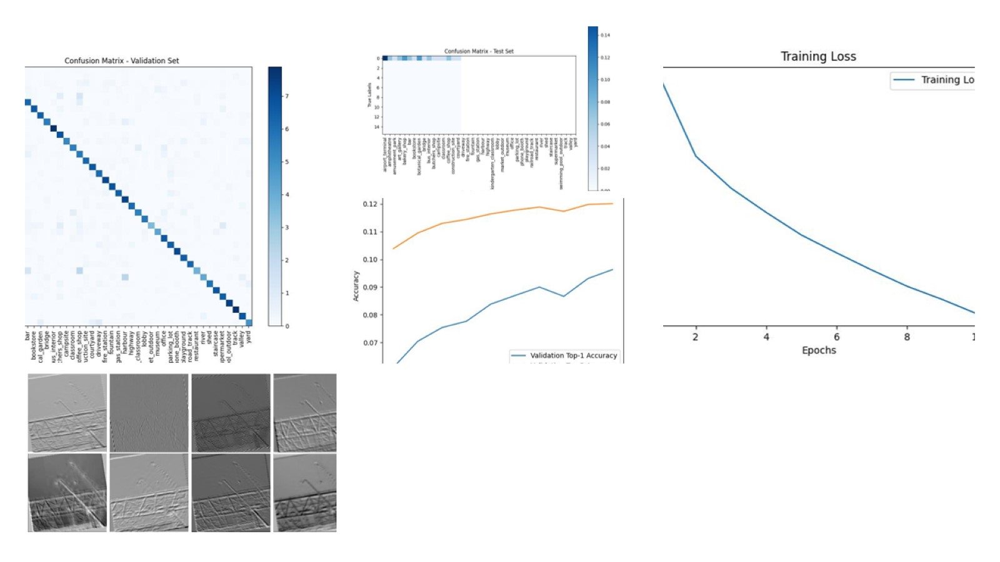
Resnet34- CNN01

Slide 5
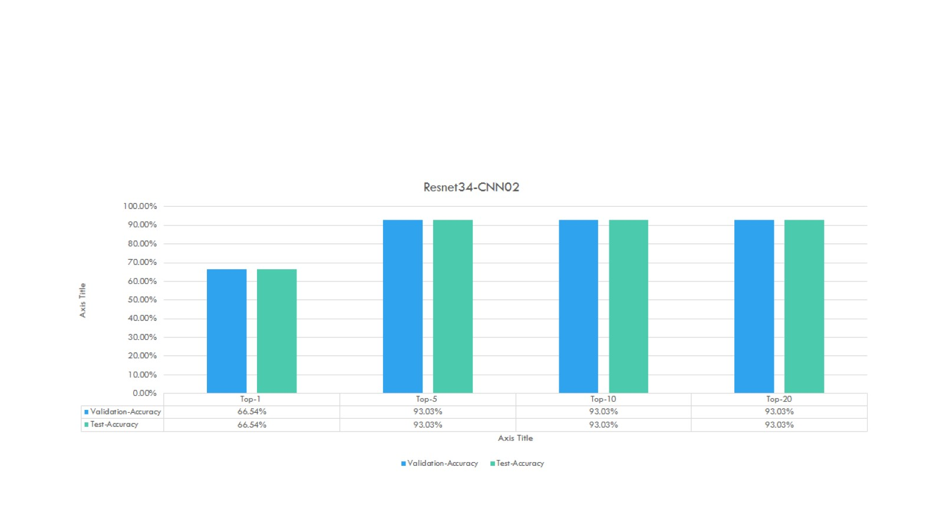
optimizer | Adam
Learning rate | 0.003
Feature extractor learning rate | 0.0003
Weight Decay | 0.0005
Momentum | 0.5
No of Epochs | 10
Train-batch-size | 150
Test-batch-size | 590

Slide 6
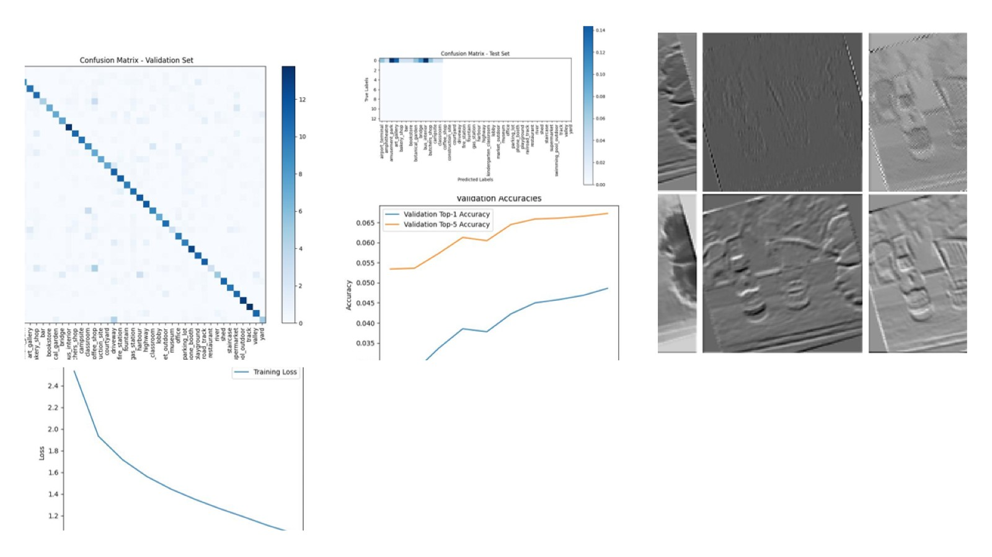
Resnet34-Cnn02

Slide 7
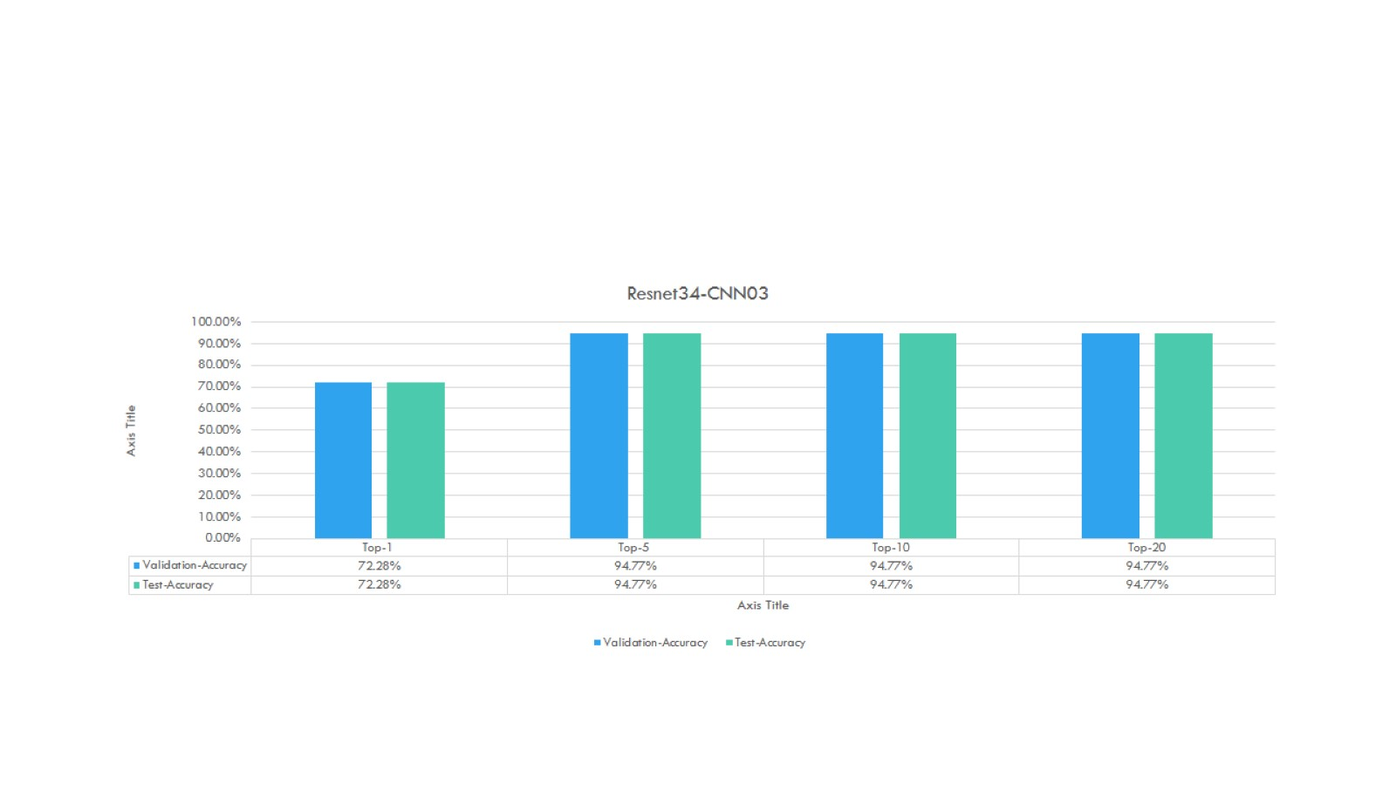
optimizer | Adam
Learning rate | 0.003
Feature extractor learning rate | 0.0003
Weight Decay | 0.0005
Momentum | 0.5
No of Epochs | 15
Train-batch-size | 300
Test-batch-size | 1024

Slide 8
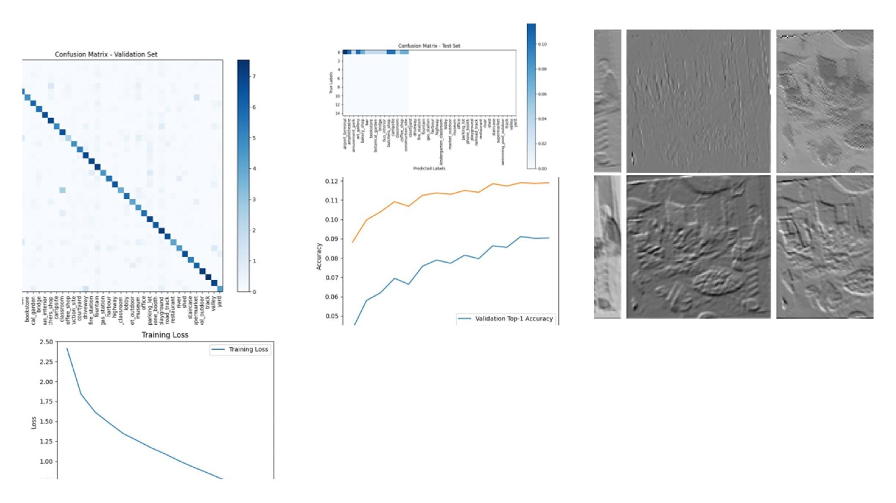
Resnet34-Cnn03

Slide 9
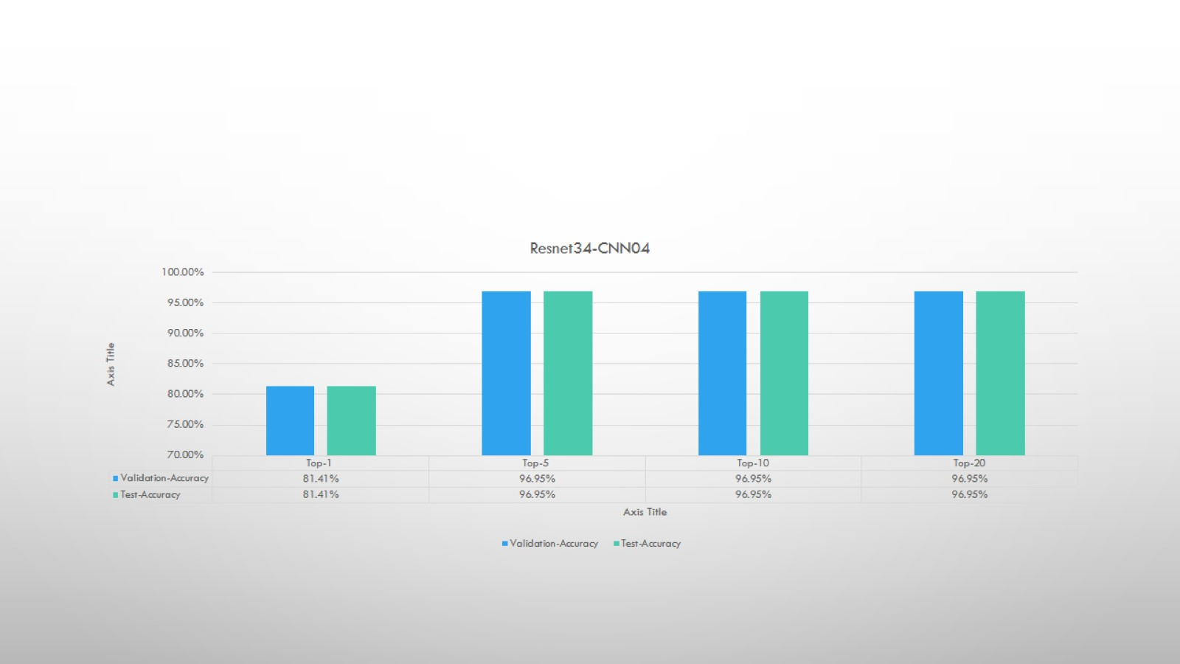
optimizer | Adam
Learning rate | 0.001
Feature extractor learning rate | 0.0001
Weight Decay | 0.0005
Momentum | 0.5
No of Epochs | 15
Train-batch-size | 150
Test-batch-size | 590

Slide 10
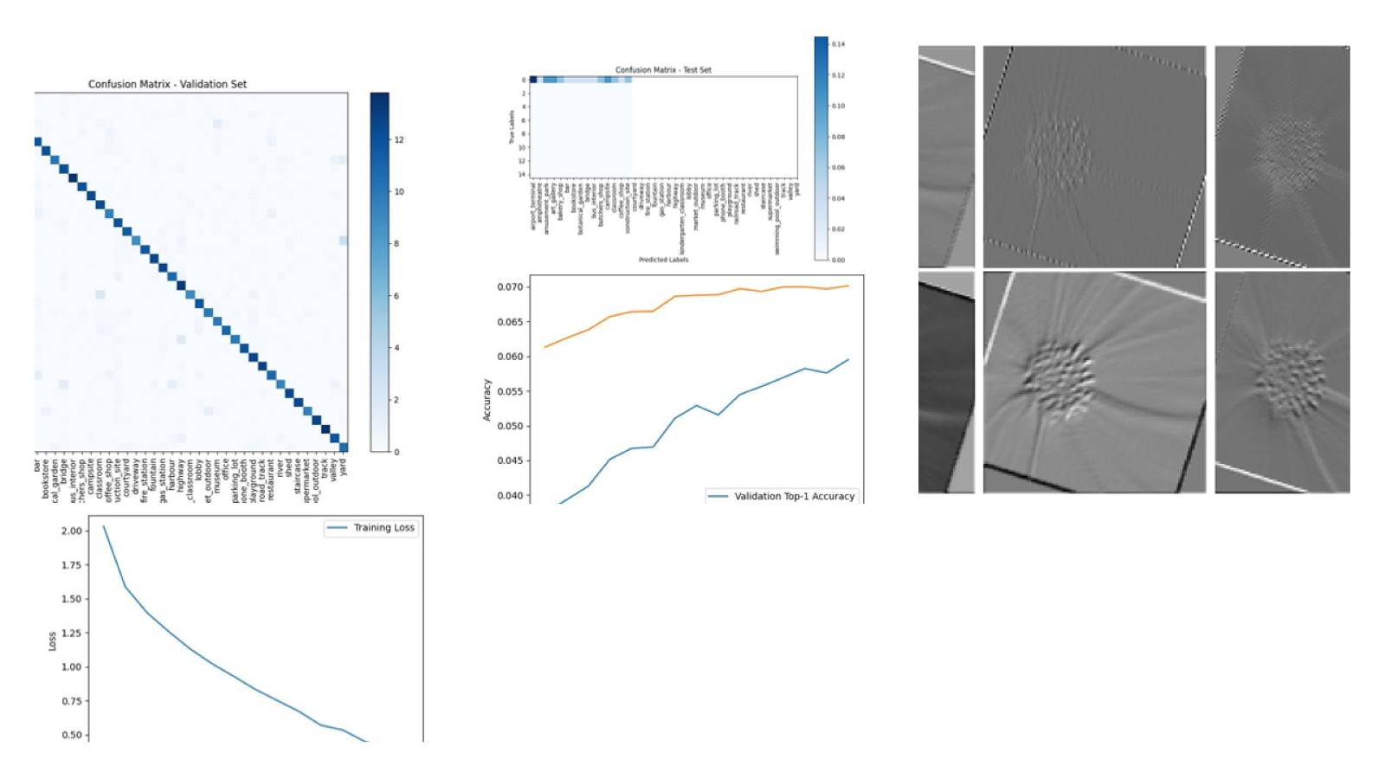
Resnet34-Cnn04

Slide 11
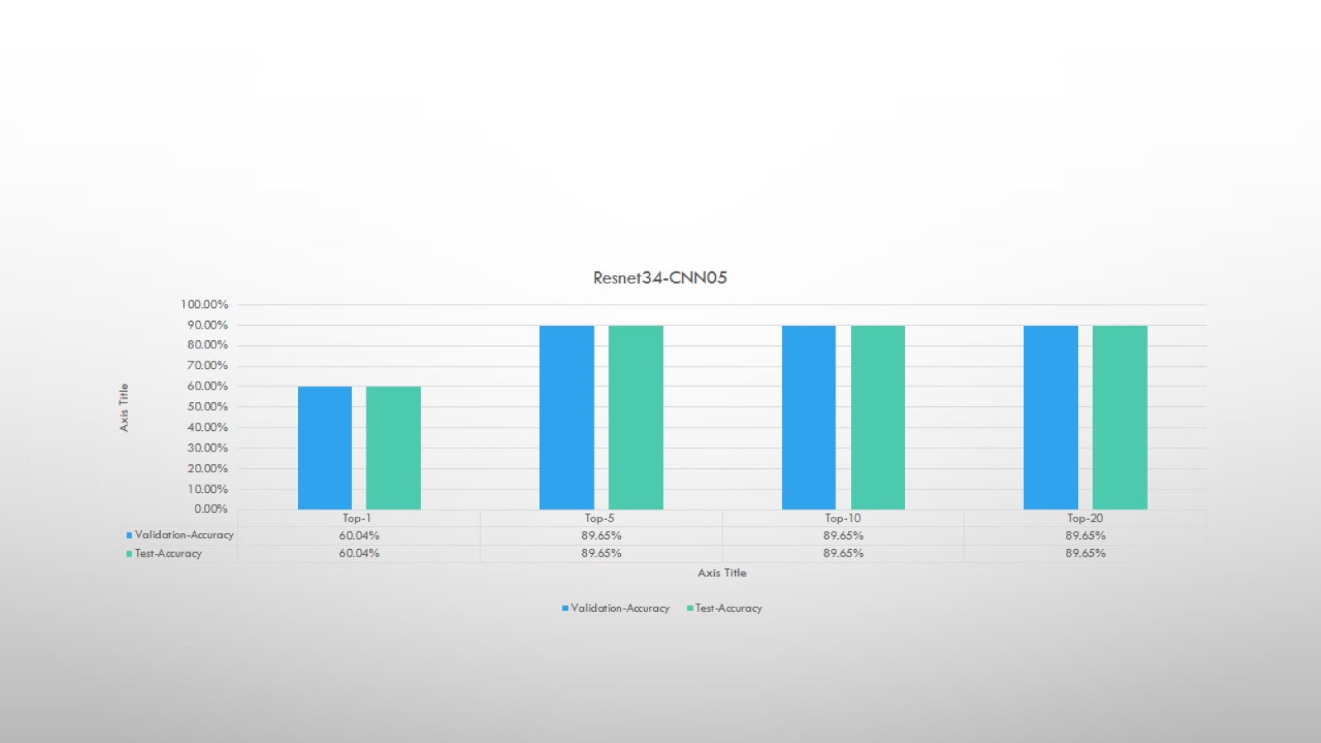
optimizer | SGD
Learning rate | 0.003
Feature extractor learning rate | 0.0003
Momentum | 0.5
Weight Decay | 0.0005
No of Epochs | 10
Train-batch-size | 300
Test-batch-size | 1024

Slide 12
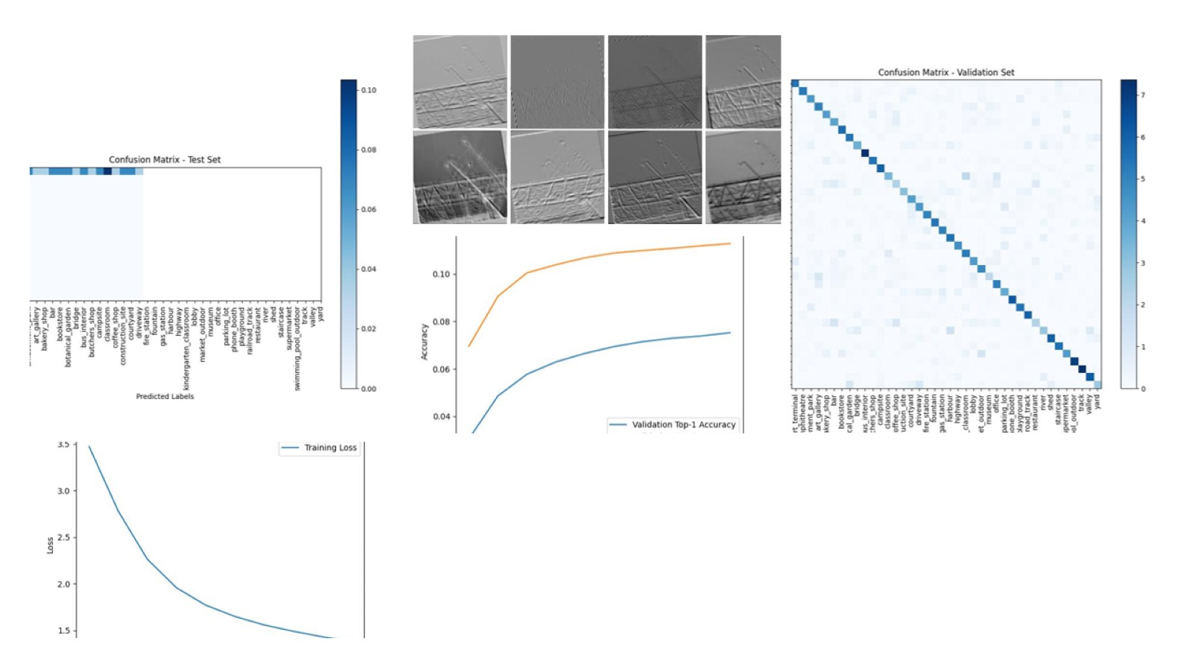
Resnet-Cn005

Slide 13
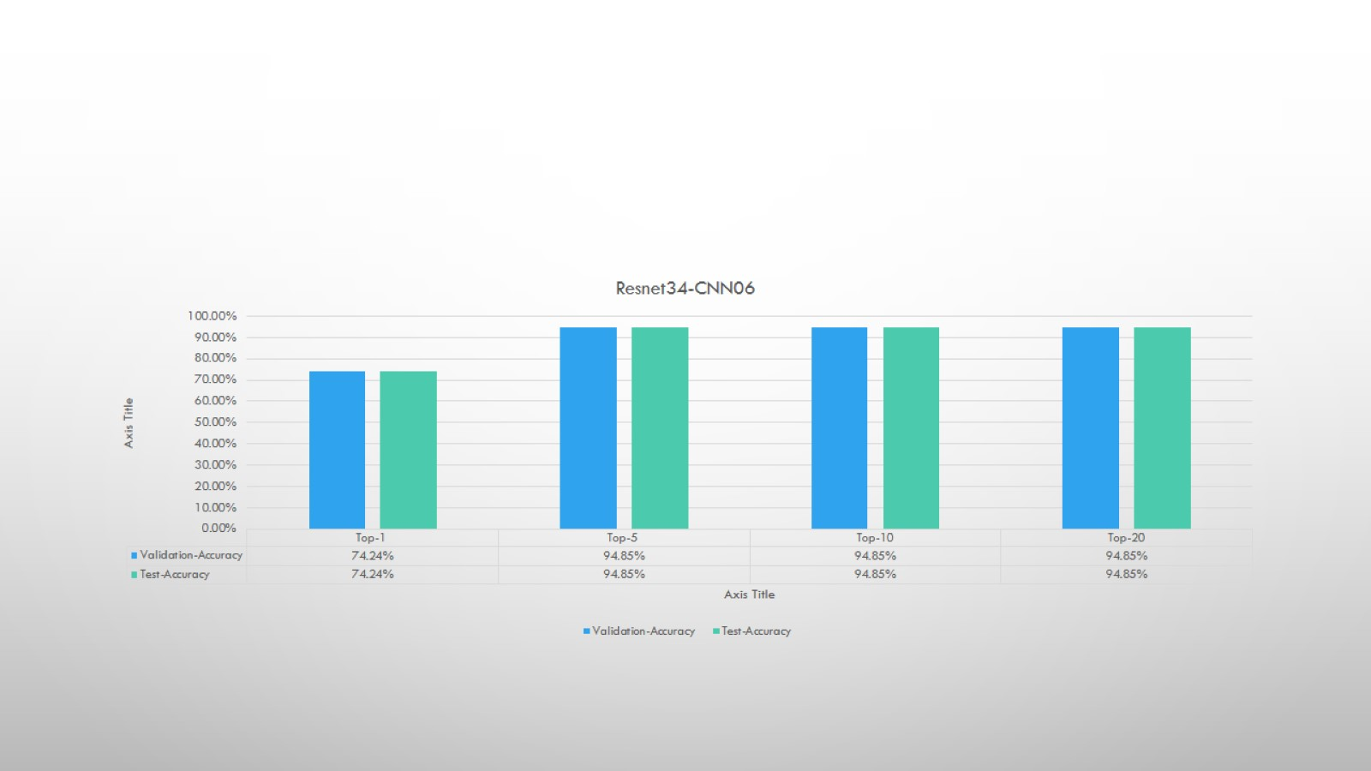
optimizer | amsgrad
Learning rate | 0.003
Feature extractor learning rate | 0.0003
Weight Decay | 0.0005
Momentum | 0.5
No of Epochs | 15
Train-batch-size | 300
Test-batch-size | 1024

Slide 14
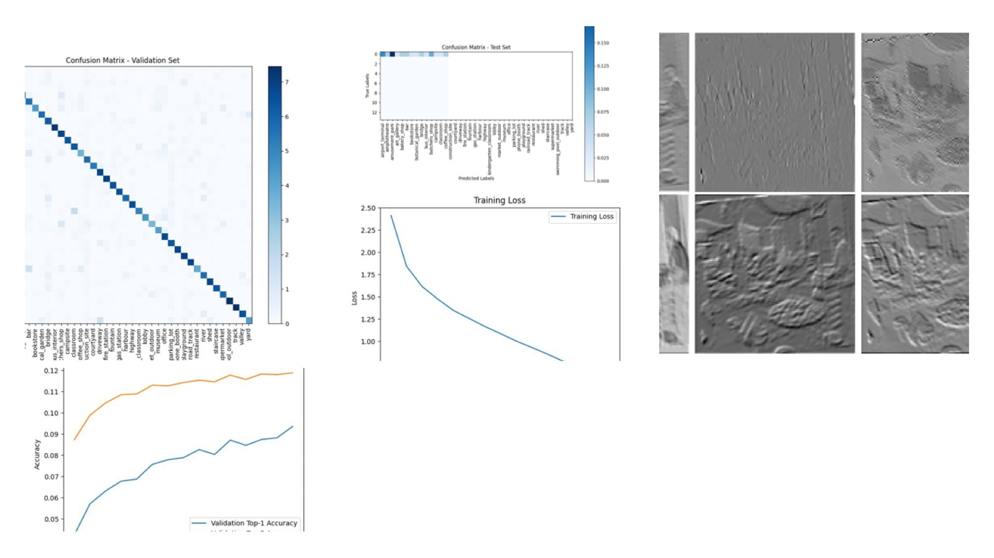
Resnet34-Cnn06

Slide 15
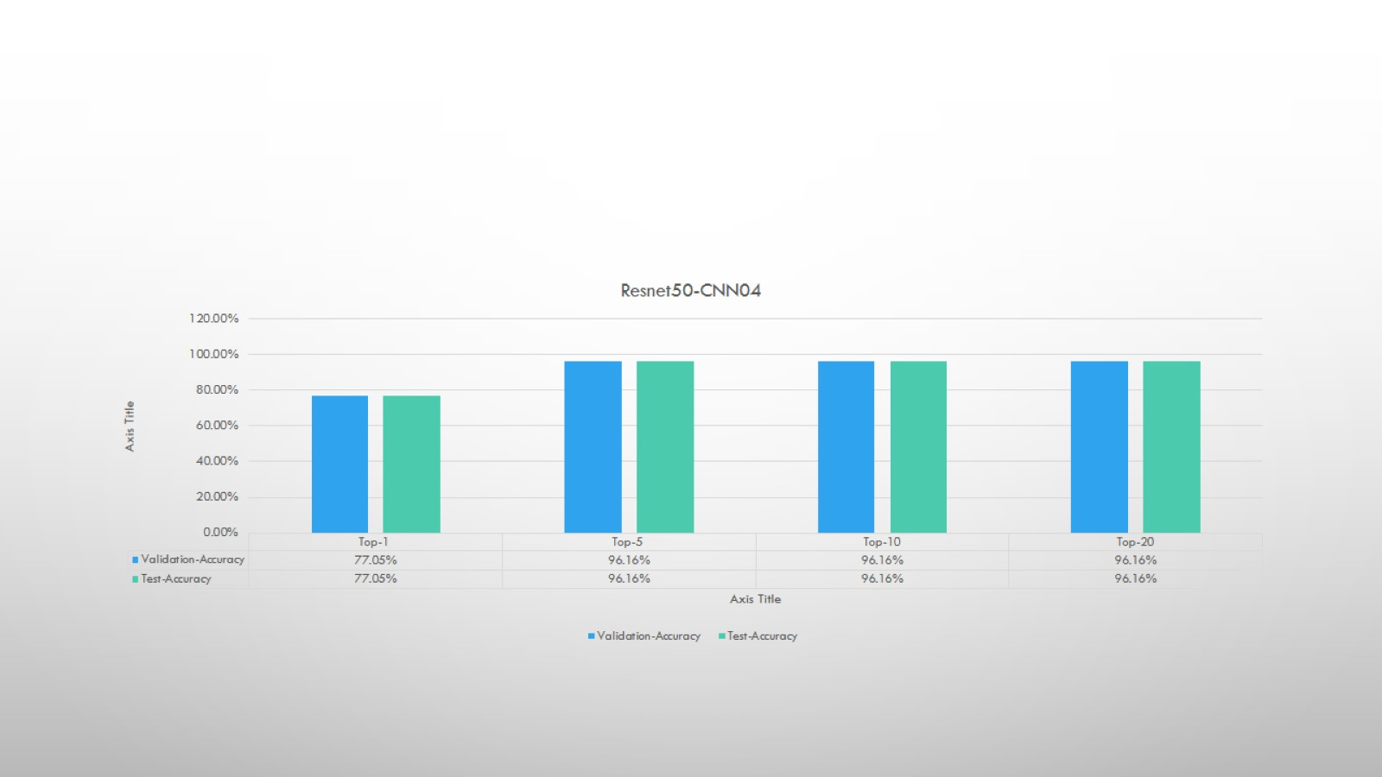
optimizer | Adam
Learning rate | 0.001
Feature extractor learning rate | 0.0001
Weight Decay | 0.0005
Momentum | 0.5
No of Epochs | 15
Train-batch-size | 150
Test-batch-size | 590

Slide 16
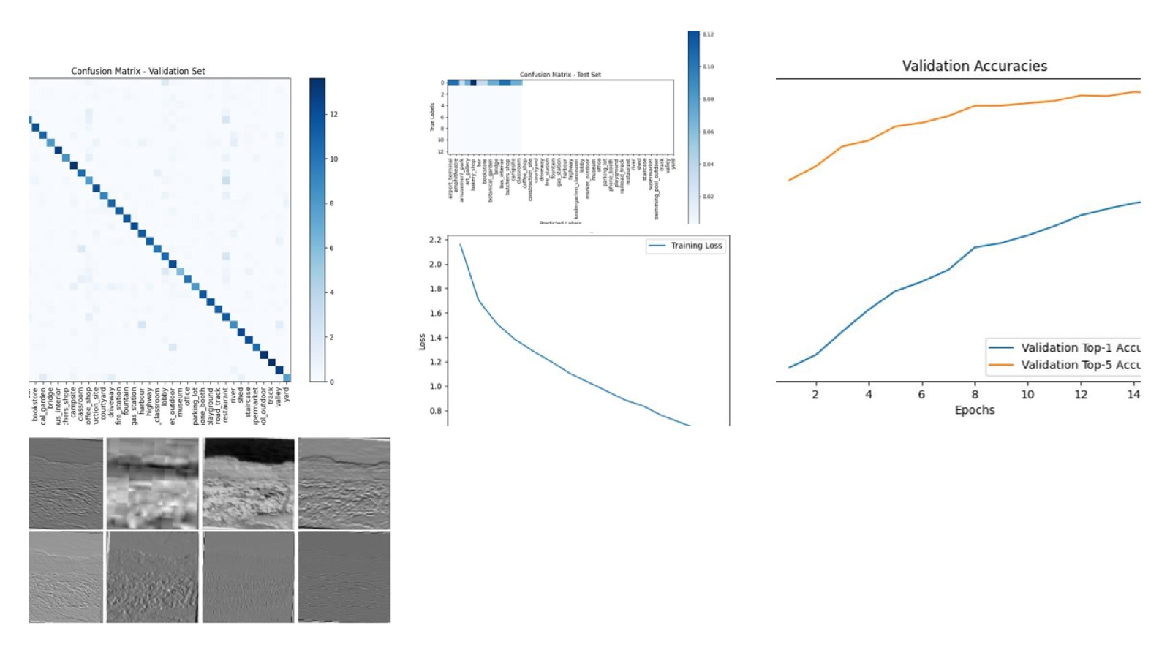
Renet50-Cnn04

Slide 17
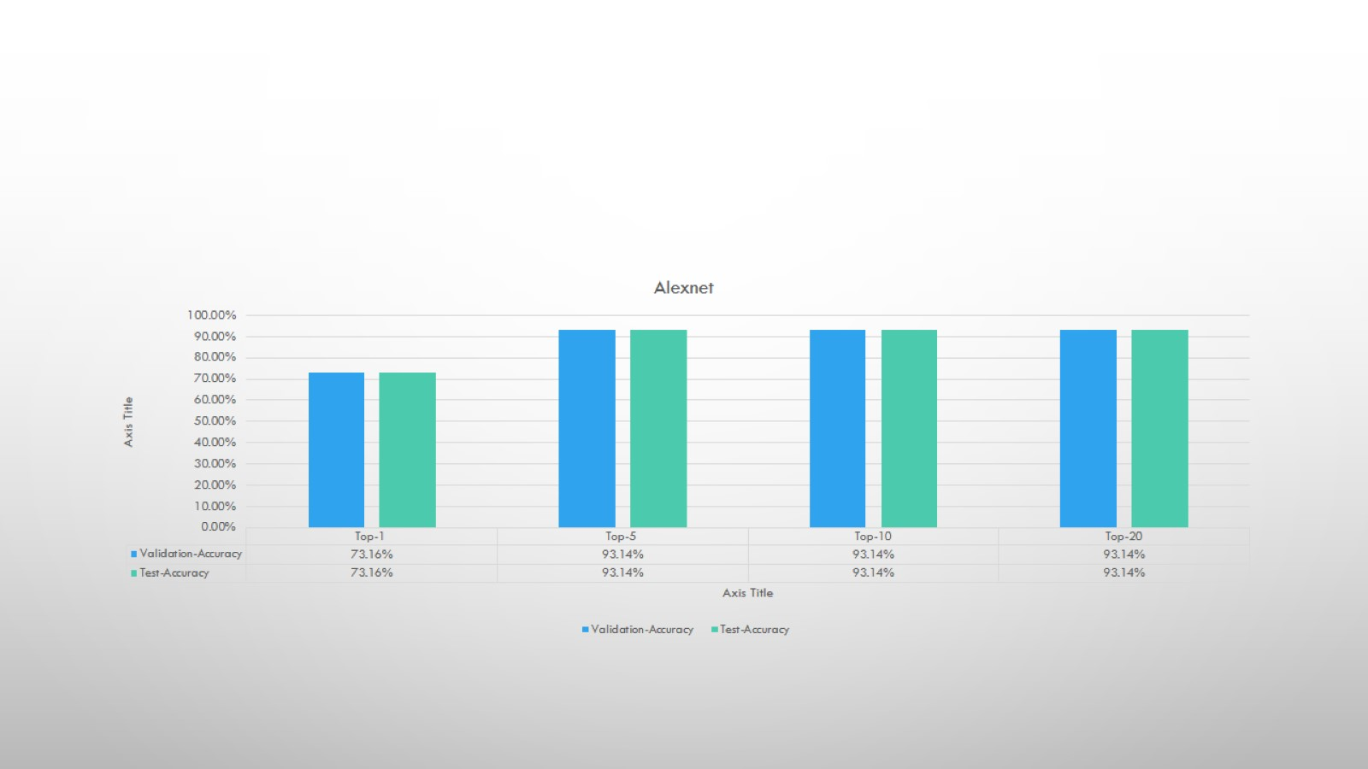
optimizer | Adam
Learning rate | 0.001
Feature extractor learning rate | 0.0001
Weight Decay | 0.0005
Momentum | 0.5
No of Epochs | 15
Train-batch-size | 150
Test-batch-size | 590

Slide 18
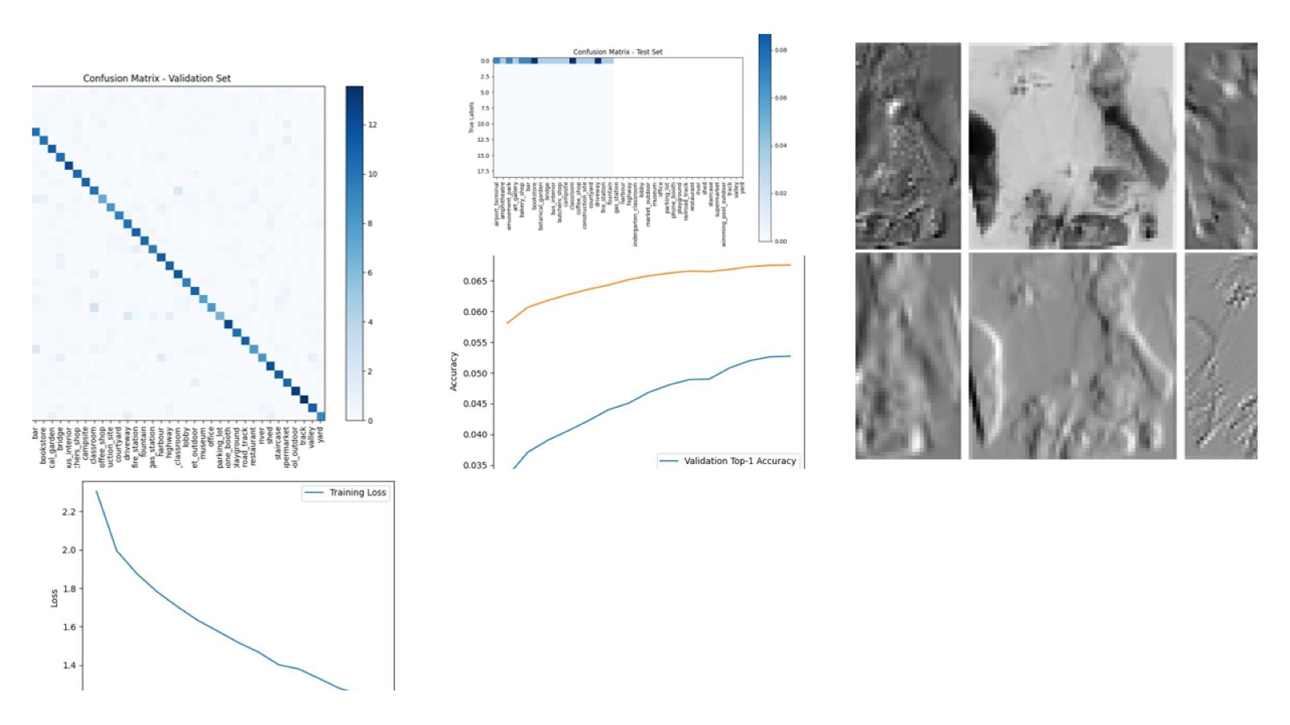
Alexnet

Slide 19
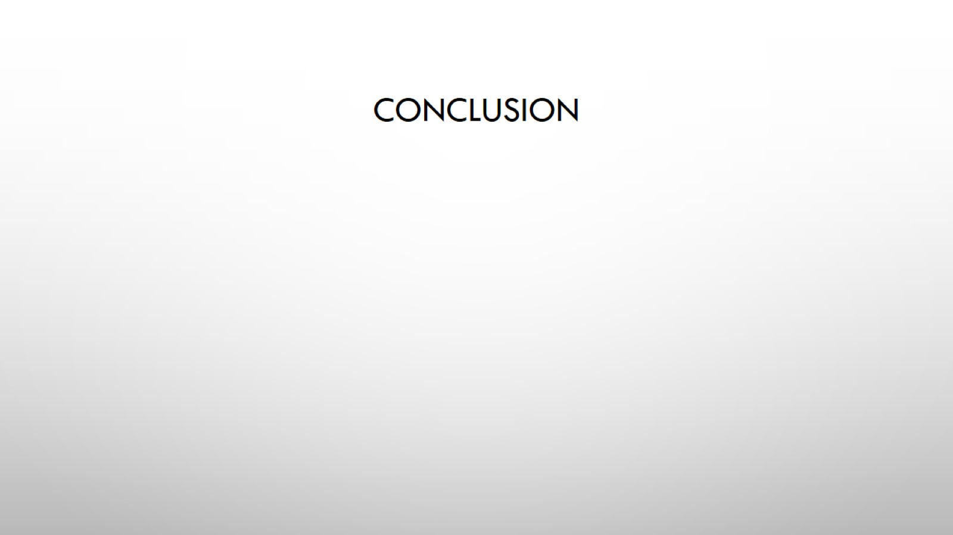
Conclusion

