Slide 1


Popular
Beauty Brands

Slide 2
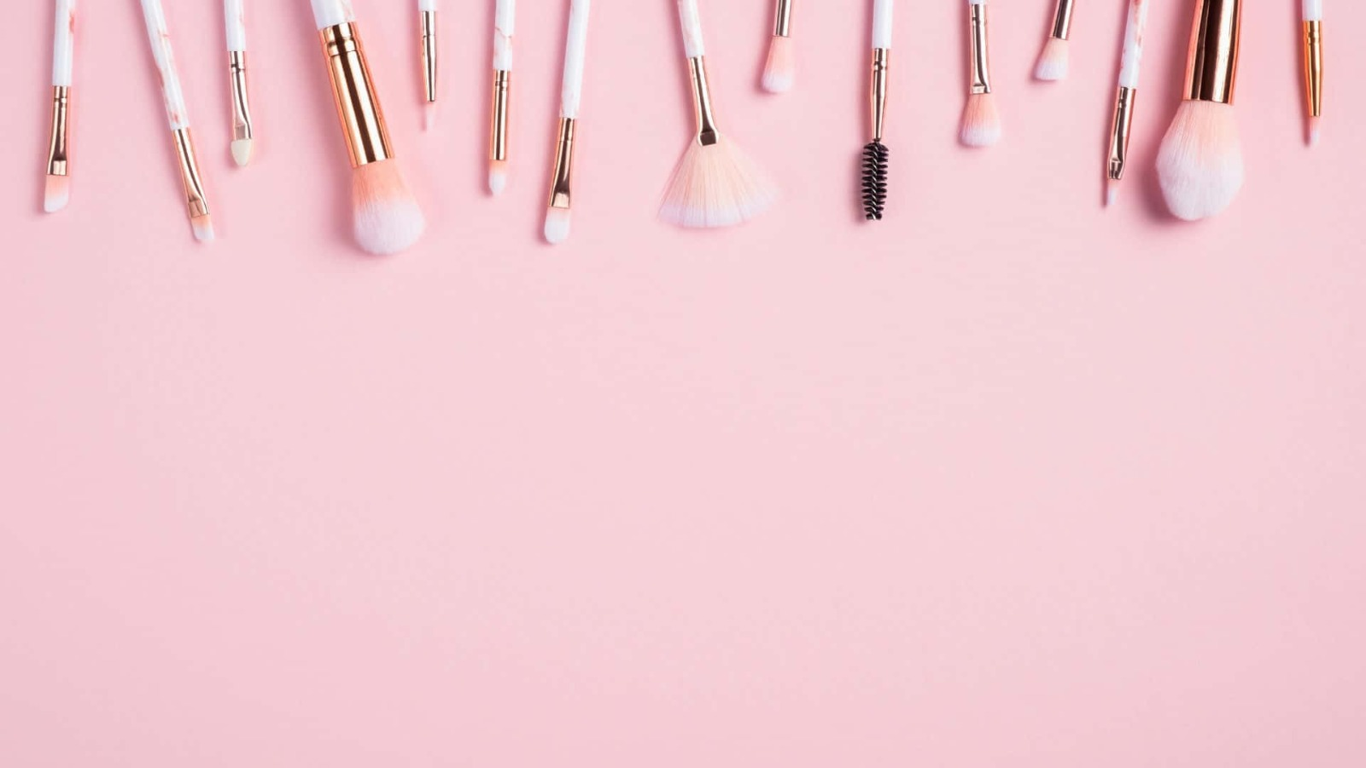
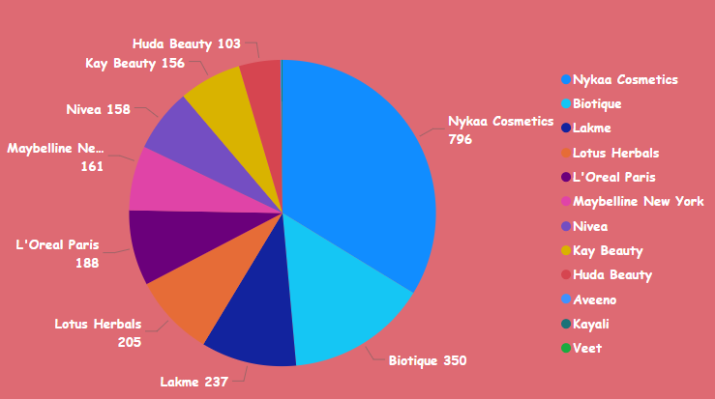
Product availability
Type: Pie Chart
Data: The chart visually represents the count of availability for various cosmetic brands. Each slice of the pie corresponds to a brand, and the size of the slice indicates the relative count of availability compared to other brands.
Key Observations:
Nykaa Cosmetics dominates with the largest slice, indicating it has the highest count of availability at 796.
Biotique comes in second with a count of 350.
Lakme has a count of 237.
Lotus Herbals follows with a count of 205.
L'Oreal Paris has a count of 188.
The remaining brands (Maybelline New York, Nivea, Kay Beauty, Huda Beauty) have smaller counts ranging from 103 to 161.

Slide 3

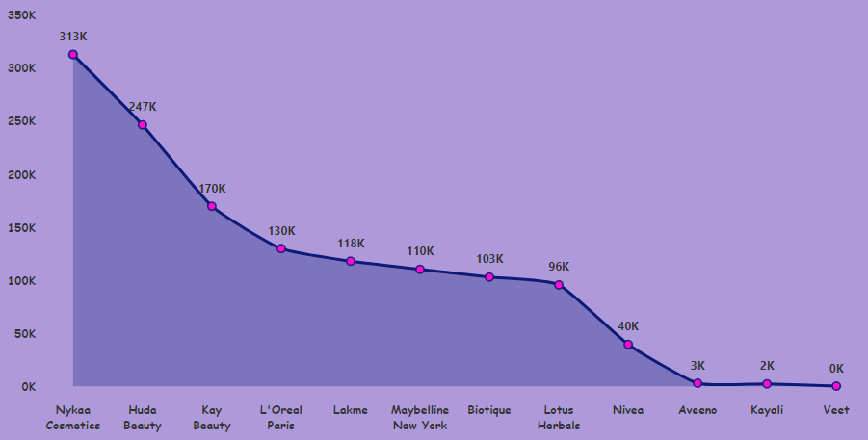
Total discount
Type: Line Chart with Shaded Area
Data: The chart visualizes the sum of price for various cosmetic brands, likely representing the total value of discounts offered. The x-axis represents the brand names, and the y-axis represents the sum of price values. A shaded area highlights the brands with the highest total discount values.
Key Observations:
Nykaa Cosmetics holds the highest total discount value at 313K (presumably 313 thousand units of currency).
Huda Beauty comes in second with a total discount value of 247K.
Kay Beauty has a total discount value of 170K.
L'Oreal Paris has a total discount value of 130K.
The remaining brands show a decreasing trend in discount values, with Lakme at 118K, Maybelline New York at 110K, Biotique at 103K, Lotus Herbals at 96K, Nivea at 40K, Aveeno at 3K, Kayali at 2K, and Veet at 0K.
Interpretation:
The chart clearly shows that Nykaa Cosmetics offers the highest total discounts, followed by Huda Beauty and Kay Beauty. The shaded area highlights the top three brands with the highest discount values, visually emphasizing their dominance in terms of total discounts offered. This information could be valuable for consumers looking for the best deals on cosmetic products.

Slide 4

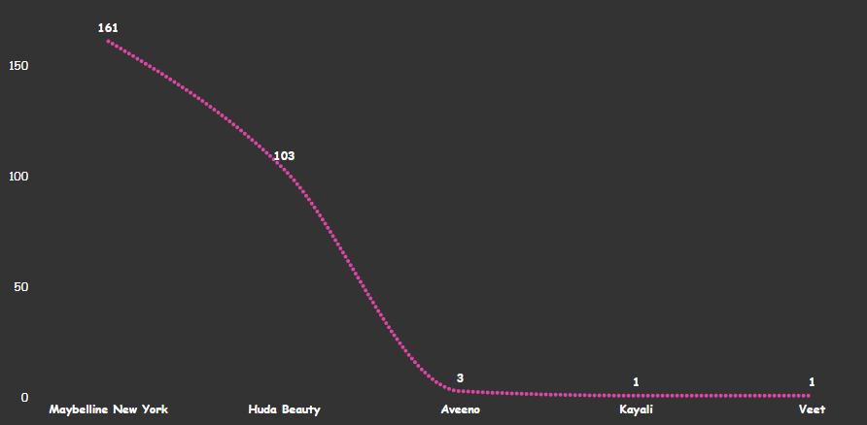
Type: Line Chart
Data: The chart visualizes the count of rating counts for five cosmetic brands with the lowest number of ratings. The x-axis represents the brand names, and the y-axis represents the count of rating counts.
Key Observations:
Maybelline New York has the highest count of rating counts among these five brands, with a value of 161.
Huda Beauty comes in second with a count of 103.
Aveeno has a count of 3.
Kayali and Veet have the lowest count of rating counts, with a value of 1 each.
Interpretation:
The chart clearly shows that Maybelline New York and Huda Beauty have significantly more ratings compared to the other three brands. Aveeno has a moderate number of ratings, while Kayali and Veet have very few ratings. This information suggests that Maybelline New York and Huda Beauty have a larger customer base or have been on the market longer, leading to more user reviews and ratings.
Bottom ratings brands

Slide 5

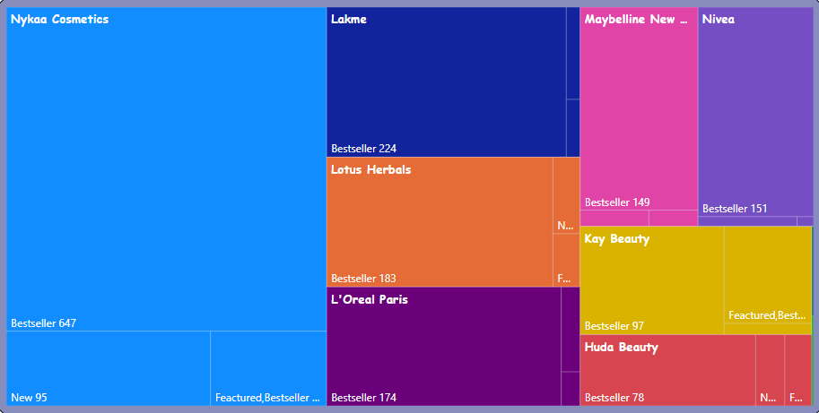
Type: Treemap
Data: The chart visualizes the distribution of rating tags associated with different cosmetic brands. The size of each rectangle (or tile) represents the count of ratings for a specific tag within a brand.
Categories and Details:
Category: Brand Name (e.g., Nykaa Cosmetics, Lakme, L'Oreal Paris)
Details: Rating Tags (e.g., Bestseller, New, Featured, Bestseller & Featured)
Key Observations:
Nykaa Cosmetics has the highest number of ratings overall, with a significant portion attributed to the "Bestseller" tag.
Lakme also has a high number of ratings, with a strong presence of "Bestseller" tags.
L'Oreal Paris shows a mix of "Bestseller" and "Featured" tags.
Maybelline New York and Nivea have a smaller number of ratings compared to the leading brands.
Kay Beauty and Huda Beauty have a presence of "Bestseller" and "Featured" tags.
Rating tags

Slide 6

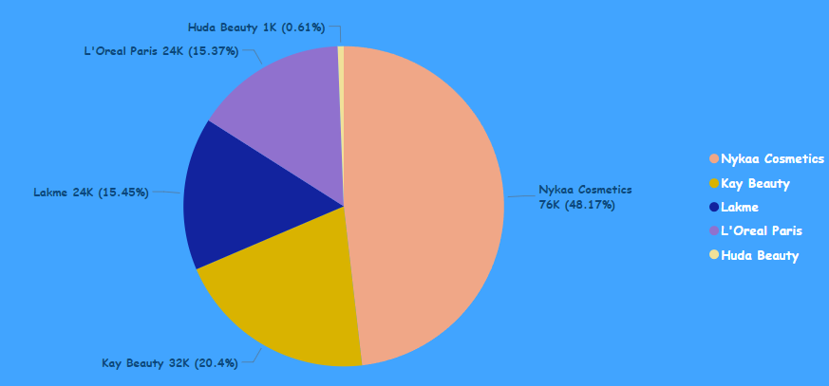
Type: Pie Chart
Data: The chart visualizes the sum of discounts offered by the top 5 cosmetic brands. Each slice of the pie corresponds to a brand, and the size of the slice represents the total discount amount for that brand.
Key Observations:
Nykaa Cosmetics dominates with the largest slice, indicating it offers the highest sum of discounts at 76K (presumably 76 thousand units of currency), which accounts for 48.17% of the total discounts.
Kay Beauty comes in second with a sum of discounts at 32K (20.4%).
Lakme offers a sum of discounts at 24K (15.45%).
L'Oreal Paris offers a sum of discounts at 24K (15.37%).
Huda Beauty offers the smallest sum of discounts at 1K (0.61%).
Interpretation:
The chart clearly shows that Nykaa Cosmetics offers the highest total discounts, followed by Kay Beauty and Lakme. L'Oreal Paris and Huda Beauty have smaller shares of the total discounts. This information could be valuable for consumers looking for the best deals on cosmetic products.
Top 5 highest discount brands

Slide 7

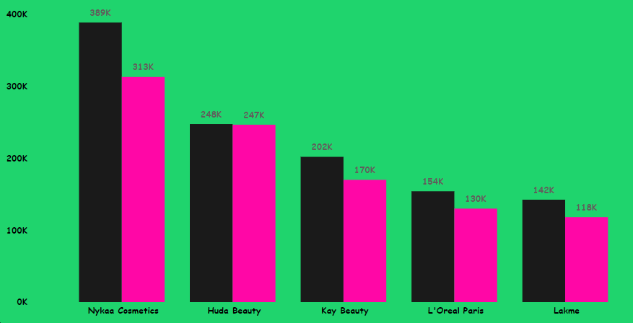
Type: Bar Chart
Data: The chart visualizes the comparison between the MRP (Maximum Retail Price) and the Actual Price for five cosmetic brands.
Key Observations:
Nykaa Cosmetics has the highest MRP at 389K (presumably 389 thousand units of currency).
Huda Beauty shows a significant difference between MRP (313K) and Actual Price (248K), indicating a substantial discount.
Kay Beauty also has a noticeable difference between MRP (247K) and Actual Price (202K).
L'Oreal Paris has an MRP of 170K and an Actual Price of 154K.
Lakme has the smallest difference between MRP (142K) and Actual Price (118K).
Interpretation:
The chart highlights the price differences between the MRP and the actual prices offered for the five brands. This information can be valuable for consumers to understand the extent of discounts available for each brand and make informed purchasing decisions.
MRP vs price

Slide 8

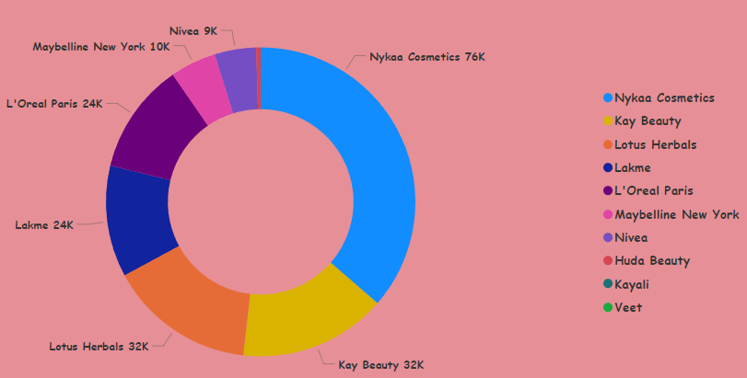
Type: Donald Chart (which is essentially a pie chart with a central hole)
Data: The chart visualizes the sum of discounts offered across various cosmetic brands. Each slice of the pie corresponds to a brand, and the size of the slice represents the total discount amount for that brand.
Key Observations:
Nykaa Cosmetics dominates with the largest slice, indicating it offers the highest sum of discounts at 76K (presumably 76 thousand units of currency).
Kay Beauty and Lotus Herbals tie for the second-largest slice with a sum of discounts at 32K each.
Lakme and L'Oreal Paris also tie, offering a sum of discounts at 24K each.
Maybelline New York offers a sum of discounts at 10K.
Nivea offers the smallest sum of discounts at 9K.
Note:
The exact units for the sum of discounts (e.g., rupees, dollars) are not specified in the chart.
Interpretation:
The chart clearly shows that Nykaa Cosmetics offers the highest total discounts, followed by a tie between Kay Beauty and Lotus Herbals. This information could be valuable for consumers looking for the best deals on cosmetic products.
Highest discount brands

Slide 9

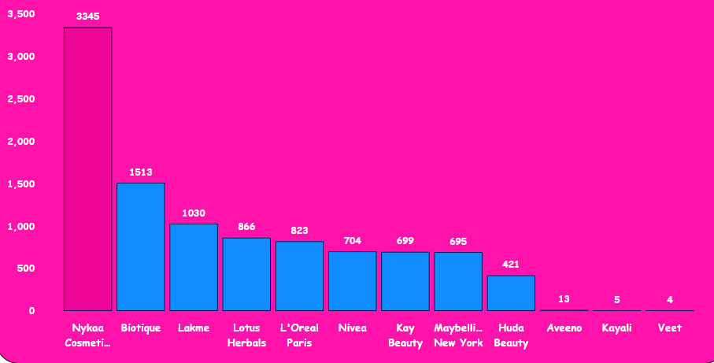
Type: Bar Chart
Data: The chart visualizes the sum of ratings received by different cosmetic brands. The x-axis represents the brand names, and the y-axis represents the sum of ratings.
Key Observations:
Nykaa Cosmetics holds the highest sum of ratings with a value of 3345.
Biotique comes in second with a sum of ratings at 1513.
Lakme has a sum of ratings at 1030.
Lotus Herbals has a sum of ratings at 866.
The remaining brands show a decreasing trend in the sum of ratings, with L'Oreal Paris at 823, Nivea at 704, Kay Beauty at 699, Maybelline New York at 695, Huda Beauty at 421, Aveeno at 13, Kayali at 5, and Veet at 4.
Interpretation:
The chart clearly shows that Nykaa Cosmetics has received the highest number of ratings, indicating a strong customer base and positive feedback. Biotique and Lakme follow with a significant number of ratings. The remaining brands have a lower number of ratings, suggesting a smaller customer base or less active user engagement.
Highest rating brands

Slide 10

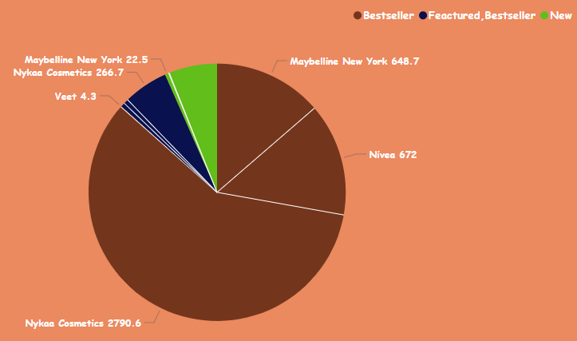
Type: Pie Chart
Data: The chart visualizes the sum of ratings for different cosmetic brands, categorized by their tags such as "Bestseller," "Featured," "Bestseller & Featured," and "New."
Key Observations:
Nykaa Cosmetics dominates the chart with a significant portion of the pie, indicating a high sum of ratings across various tags.
Nivea has the second-largest slice, suggesting a substantial sum of ratings, likely driven by the "Bestseller" tag.
Maybelline New York has two slices, one for "Featured, Bestseller" and another for "New," indicating a presence across different tag categories.
Veet has a small slice, indicating a lower sum of ratings.
Interpretation:
The chart provides insights into the distribution of ratings across different brands and their associated tags. It helps identify which brands are perceived as "Bestsellers," "Featured," or "New" by users, and how this perception influences their rating behavior.
Tags and brand name

Slide 11
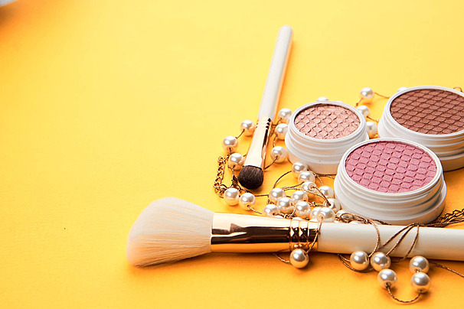

Thank You

